Slide 1
Computer Vision
Kevin T. Duraj
California Lutheran University
May, 2014

Slide 2
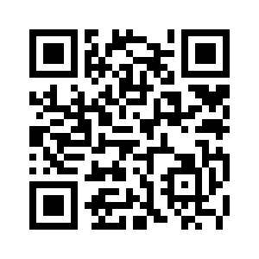
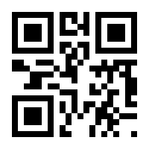
Detecting QR Code
Different size, density
And color shade

Slide 3
Otsu Thresholding
QR code consist of black and white features however when a picture is taken using with a camera, QR code image can be contain slightly different shade of black and white colors.
OTSU Thresholding will binarize image into black and white colors only for further processing.

Slide 4
Connected Components
Detect Connected Components

