Slide 1
Computer Vision
Kevin T. Duraj
California Lutheran University
May, 2014

Slide 2
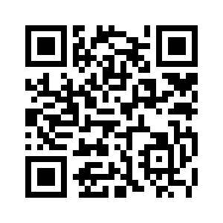
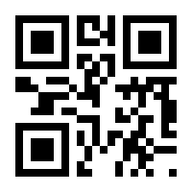
Detecting QR Code
Different size, density
And color shade

Slide 3
Otsu Thresholding
QR code consist of black and white features however when a picture is taken using with a camera, QR code image can be contain slightly different shade of black and white colors.
OTSU Thresholding will binarize image into black and white colors only for further processing.

Slide 4
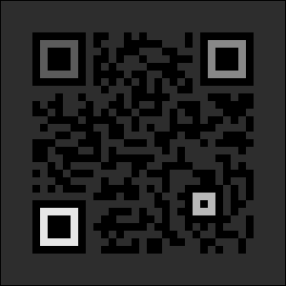
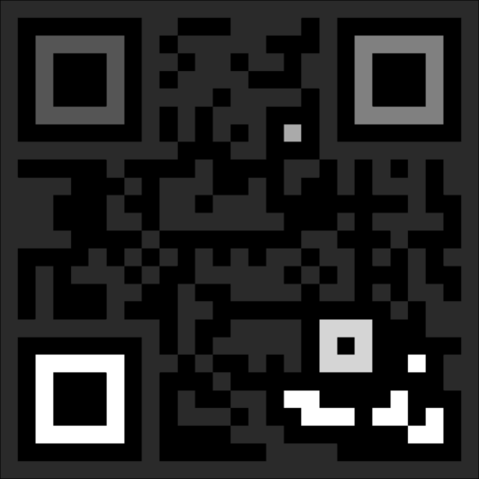
Connected Components
Detect Connected Components Regions

Slide 5
Hit-And-Miss Transform
The hit-and-miss transform (HMT) is a natural operation to select out pixels that have certain geometric properties such as corner points, isolated points, boundary points, etc. In addition, the HMT performs template matching, thinning, thickening, and centering.

Slide 6

Hit-And-Miss Transform Image 1

Slide 7

Hit-And-Miss Transform Image 2

Slide 8
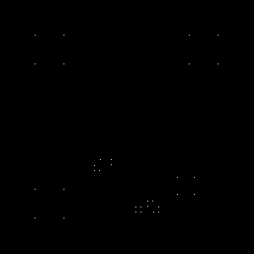
Hit-And-Miss Transform Image 3

Slide 9
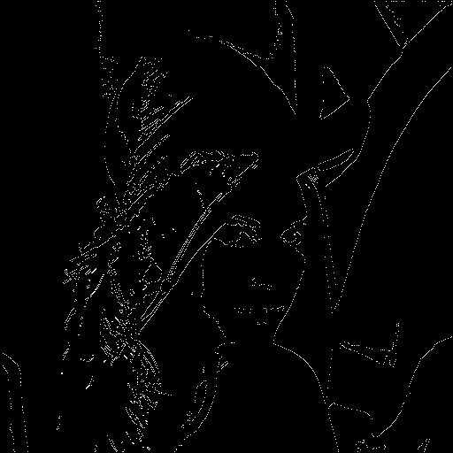
Lenna.png

Slide 10
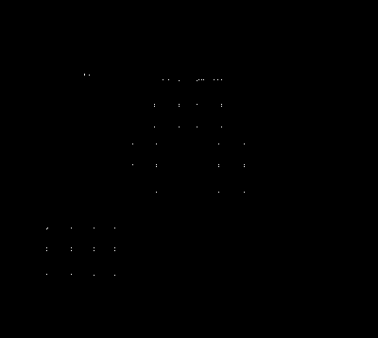
House.png

