Slide 1
PageRank
What is PageRank
Why PageRank
Related work and problems
Link Structure of the Web
Definition of PageRank
Dangling Links
Implementation

Slide 2

PageRank(cont.)
What is PageRank
In order to measure the relative importance of web pages, PageRank is proposed. It is a method for computing a ranking for every web page based on the graph of the web.

Slide 3

PageRank(cont.)
Why PageRank
__The World Wide Web is very large and
heterogeneous.
__Search engines on the Web must also contend
with inexperienced users and pages engineered
to manipulate search engine ranking functions.
Unlike “flat” document collections, the World
Wide Web is hypertext and provides considerable

Slide 4
PageRank(cont.)
auxiliary information on top of the text of the web pages, such as link structure and link text. We can take advantage of the link structure of the web to produce a PageRank of every web page. It helps search engines and users quickly make sense of the vast heterogeneity of the World Wide Web.

Slide 5
PageRank (Cont.)
Related work and problems
__Backlink counts
Problem: for example, if a web page has a link off the Yahoo home page, it may be just one link but it is very important one. This page should be ranked higher than many pages with more
backlinks but from obscure places.
__The ranks and numbers of backlinks
This covers both the case that when a page has many backlinks and when a page has a few highly ranked backlinks. Let u be a webpage,

Slide 6
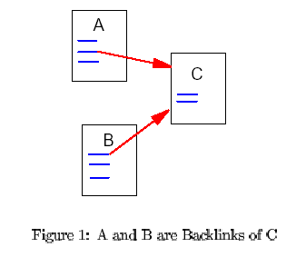
PageRank (Cont.)

Slide 7



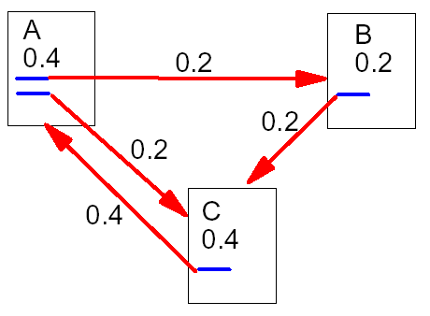
PageRank (Cont.)
be the set of pages that point to u. be the number of
links from u and let c be a factor used for normalization, then
a simplified version of PageRank:

Slide 8
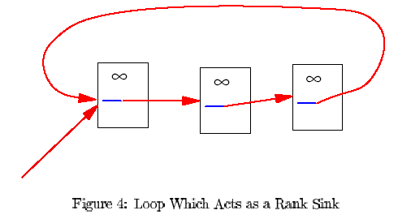
PageRank (Cont.)
Problem: may form a rank sink. Consider two web pages
that point to each other but to no other page. And if there is
some web page which points to one of them. Then, during
iteration, this loop will accumulate rank but never distribute
any rank. The loop forms a sort of trap called a rank sink.

Slide 9
PageRank (Cont.)
Link Structure of the Web
___Pages are as nodes
___Links are as edges (outedges and inedges)
Every page has some forward links (outedges) and
backlinks (inedges). We can never know whether we
have found all the backlinks of a particular page but if we
have downloaded it, we know all of its forward links at that
time. PageRank handles both cases and everything in
between by recursively propagating weights through the
link structure of the web.

Slide 10
PageRank(Cont.)
Definition of PageRank
We assume page A has pages T1,…,Tn, which
point to it. The parameter d is a damping factor
which can be set between 0 and 1(usually d is
set to 0.85). Also C(A) is defined as the number
of links going out of page A. The PageRank of
page A is given as follows:

Slide 11
T1
PR=0.5
3
A
4
2
T2
PR=0.3
T3
PR=0.1
5
PR(A)=(1-d) + d*(PR(T1)/C(T1) + PR(T2)/C(T2) + PR(T3)/C(T3))
=0.15+0.85*(0.5/3 + 0.3/4+ 0.1/5)

Slide 12








PageRank(Cont.)
Let A be a square matrix with the rows and column
corresponding to web pages. Let if
there is an edge from u to v and if not. If
we treat R as a vector over web pages, then we
have . Here E is a uniform vector.
Since , we can rewrite this as
. So R is an eigenvector of
with eigenvalue d.

Slide 13
PageRank(Cont.)
Dangling Links
Dangling links are simply links that point to any page with
no outgoing links. They affect the model because it is not
clear where their weights should be distributed, and there
are a large number of them. Because they do not affect
the ranking of any other page directly, we simply remove
them from the system until all the PageRanks are
calculated. After all the PageRanks are calculated, they
can be added back in, without affecting things significantly.

Slide 14
PageRank(Cont.)
Implementation
Sort the link structure by ParentID
Remove dangling links from the link database
Make an initial assignment of the ranks
Memory is allocated for the weights for every page
After the weights have converged, add the dangling links back in and recompute the rankings

