Slide 1
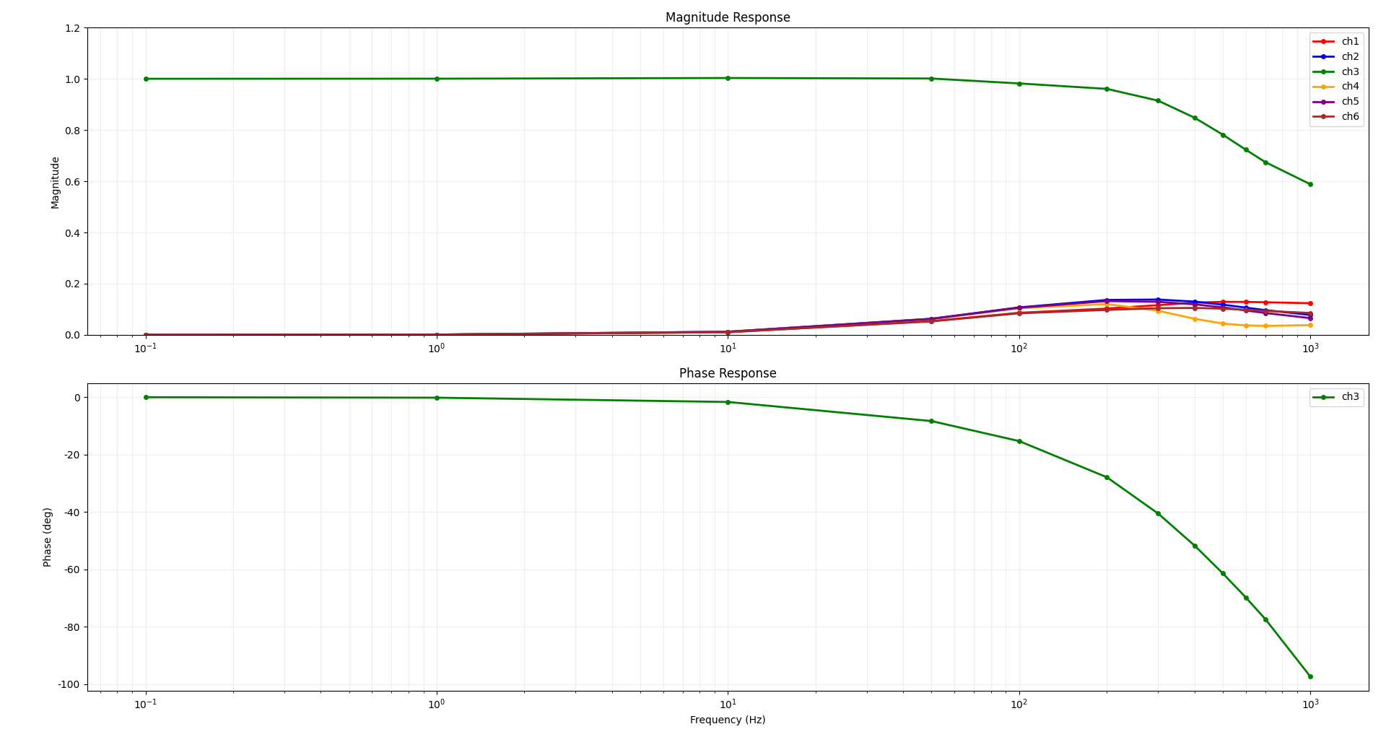
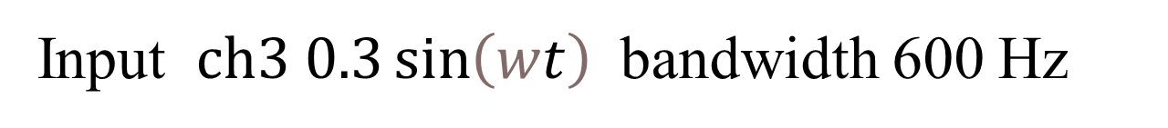
Input $ch3 0.3\sin\left(wt\right)$ bandwidth 600 Hz

Slide 2
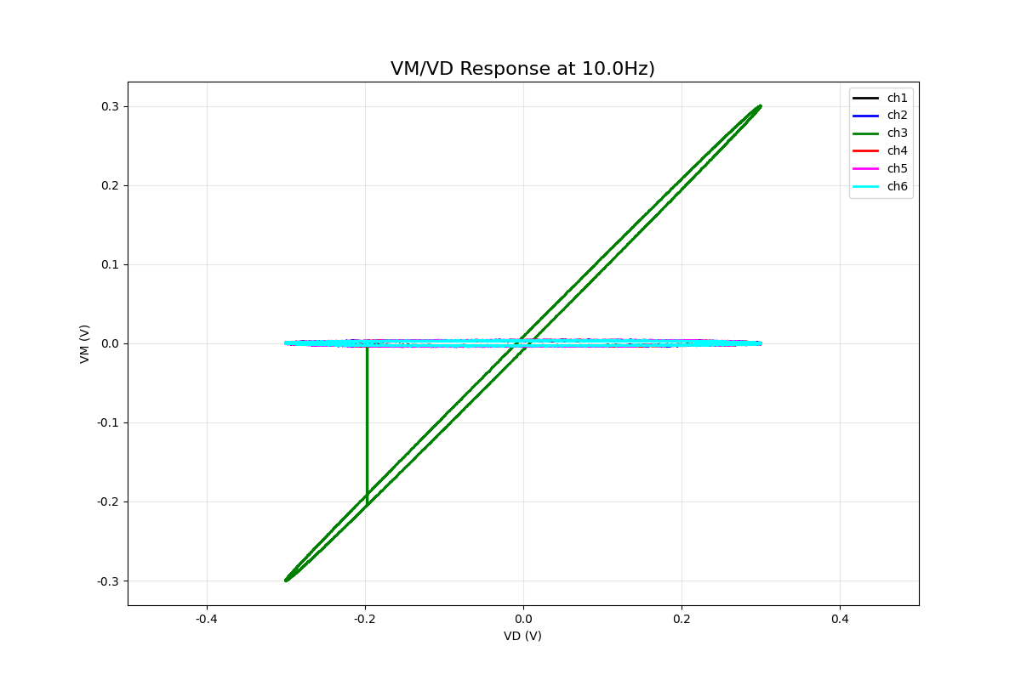

Slide 3
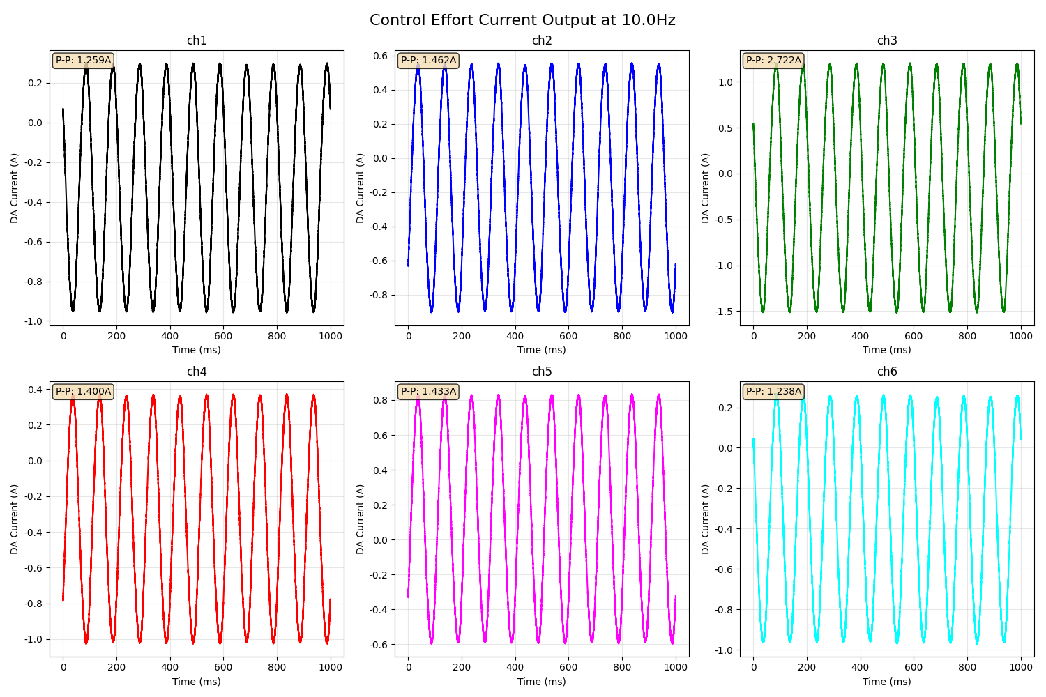

Slide 4
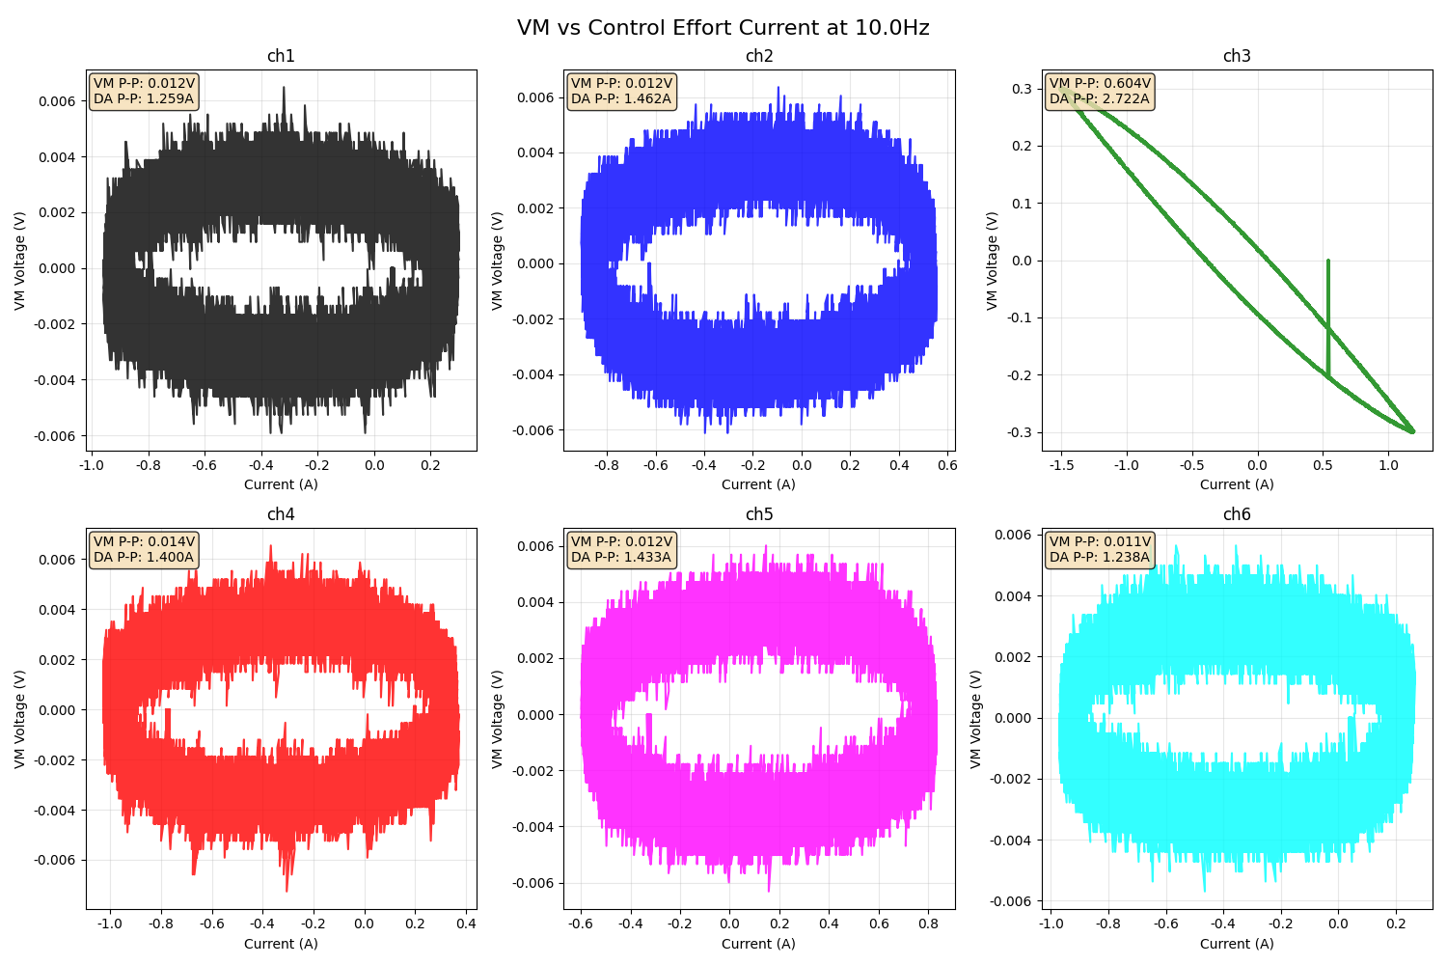

Slide 5
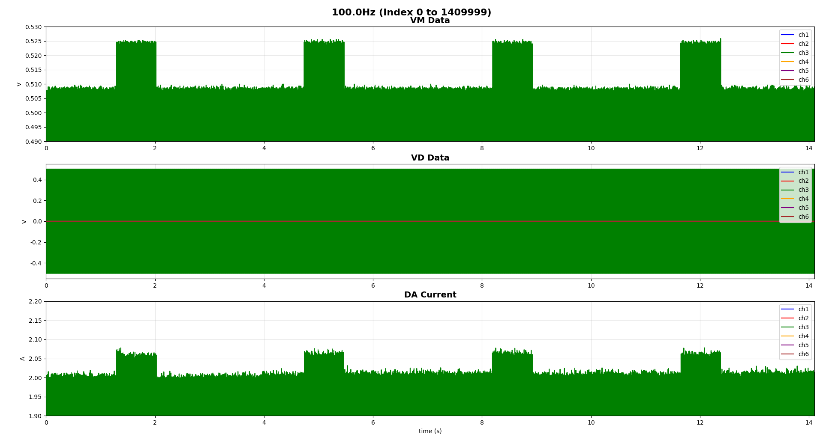
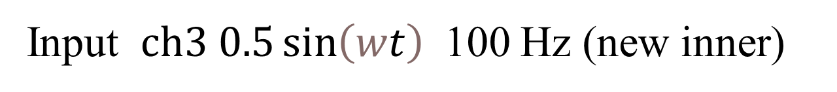
Input $ch3 0.5\sin\left(wt\right)$ 100 Hz (new inner)
HIGH: -0.525557 ~ 0.525259 V
LOW:-0.509617 ~ 0.509631 V
0.7s
2.6s

Slide 6
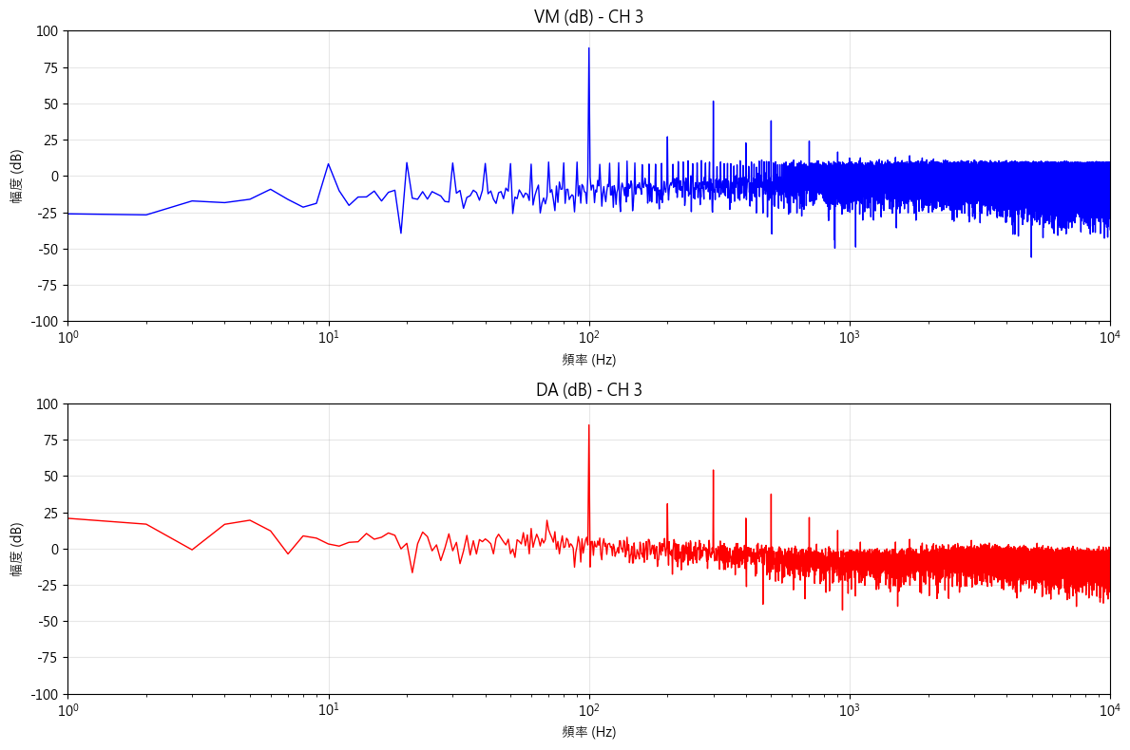
Input $ch3 0.5\sin\left(wt\right)$ 100 Hz (new inner) LOW
VM主要頻率成分
100.0 Hz 88.18 dB
300.0 Hz 51.54 dB
500.0 Hz 37.97 dB
DA主要頻率成分
100.0 Hz 85.13 dB
300.0 Hz 54.11 dB
500.0 Hz 37.50 dB

Slide 7
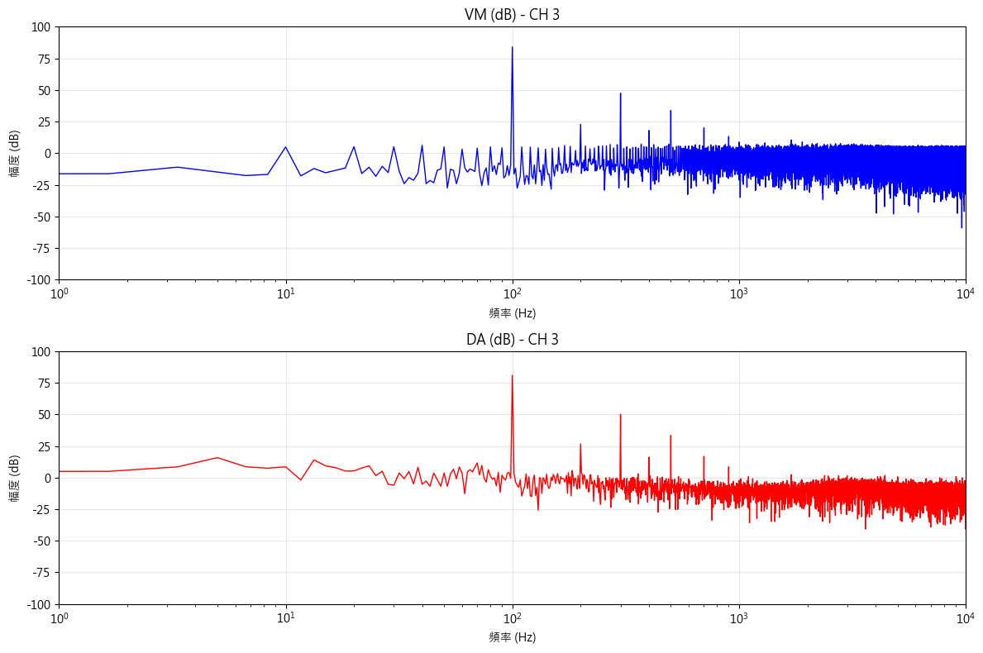
Input $ch3 0.5\sin\left(wt\right)$ 100 Hz (new inner) HIGH
VM主要頻率成分
100.0 Hz 88.18 dB
300.0 Hz 51.54 dB
500.0 Hz 37.97 dB
DA主要頻率成分
100.0 Hz 85.13 dB
300.0 Hz 54.11 dB
500.0 Hz 37.50 dB

Slide 8
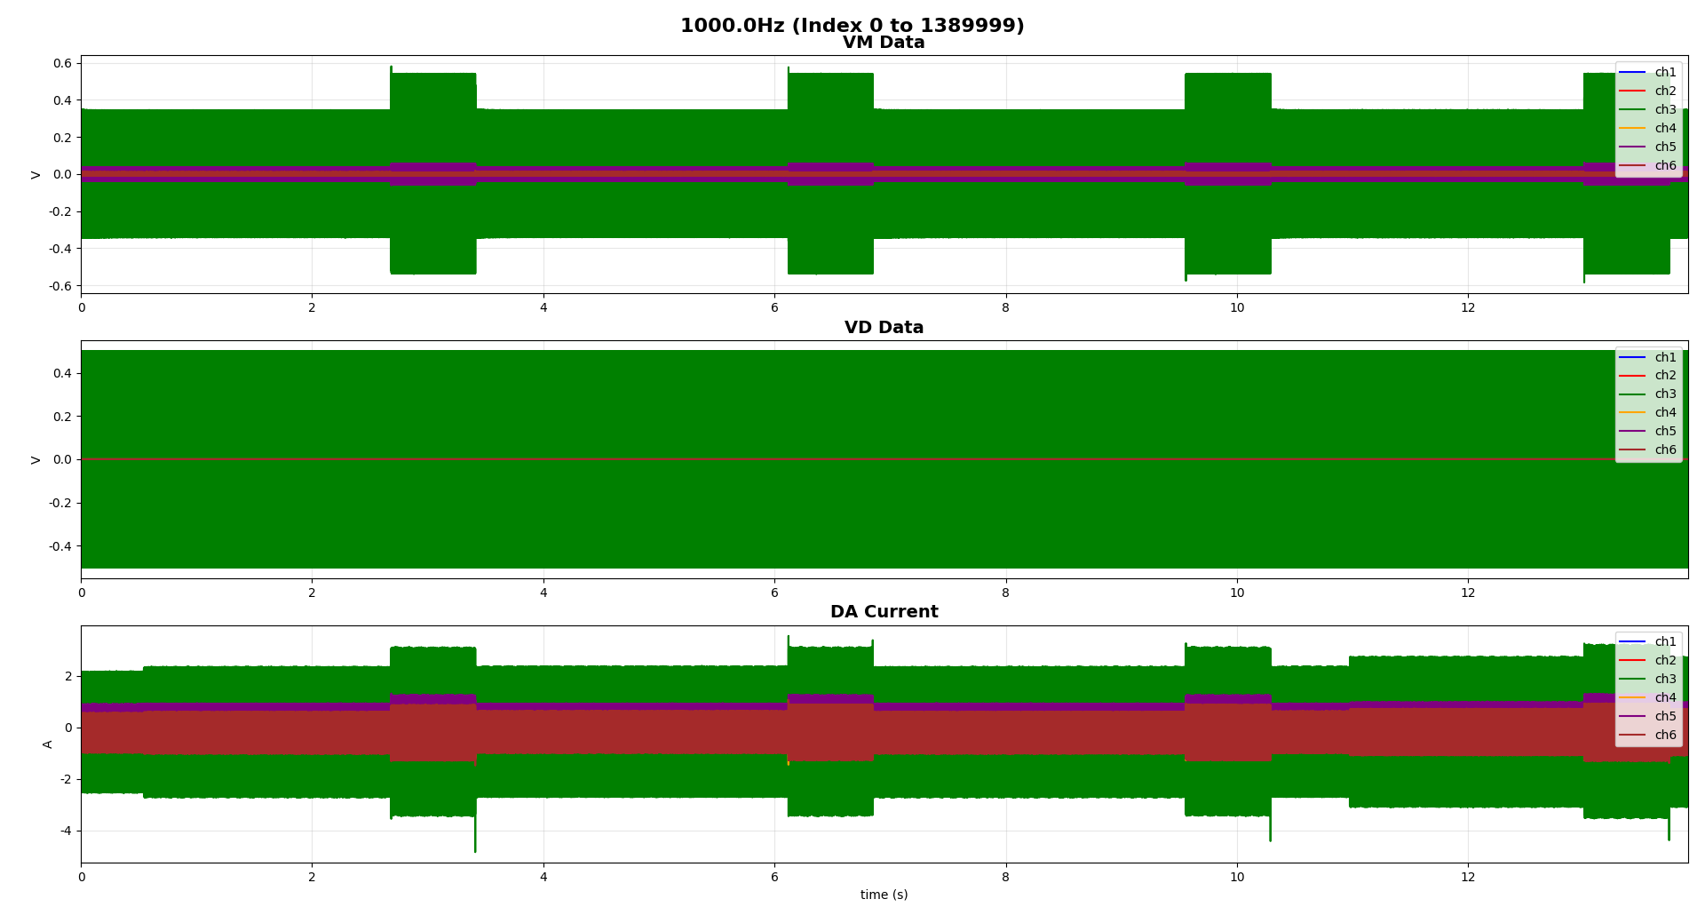

Input $ch3 0.5\sin\left(wt\right)$ 1000 Hz (new inner)
HIGH: -0.539934 ~ 0.542137 V LOW: -0.342712 ~ 0.345226 V
0.7s
2.6s

Slide 9
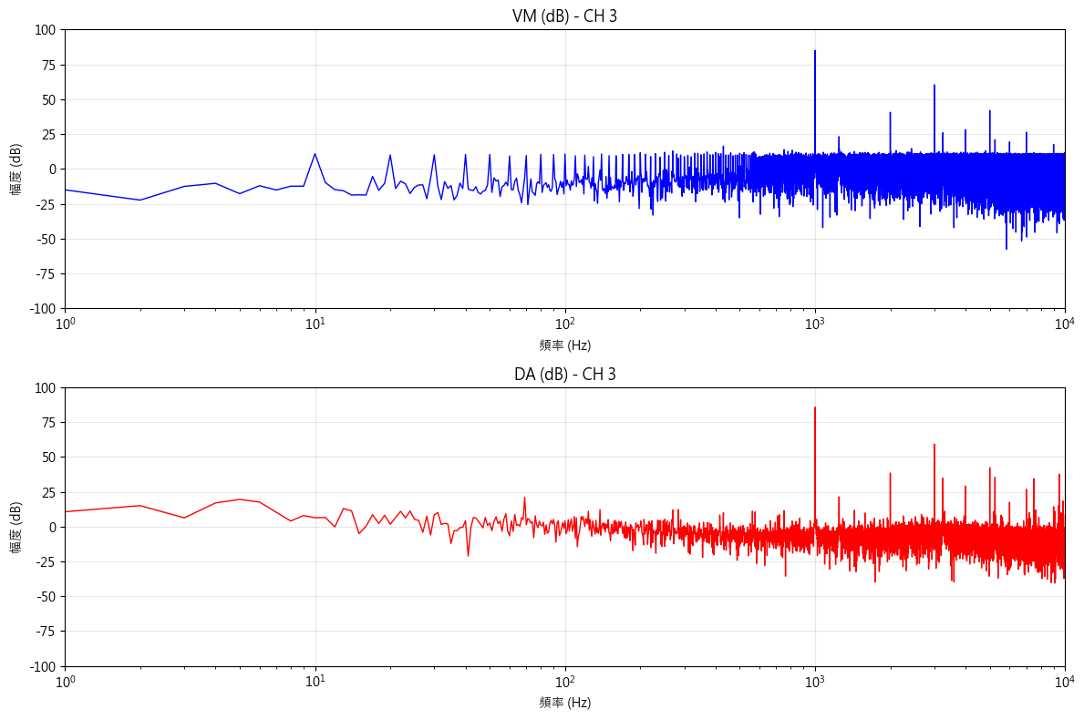
Input $ch3 0.5\sin\left(wt\right)$ 1000 Hz (new inner) LOW
VM主要頻率成分
1000.0 Hz 84.92 dB
3000.0 Hz 60.31 dB
5000.0 Hz 41.90 dB
DA主要頻率成分
1000.0 Hz 85.66 dB
3000.0 Hz 59.24 dB
30733.0 Hz 45.34 dB

Slide 10
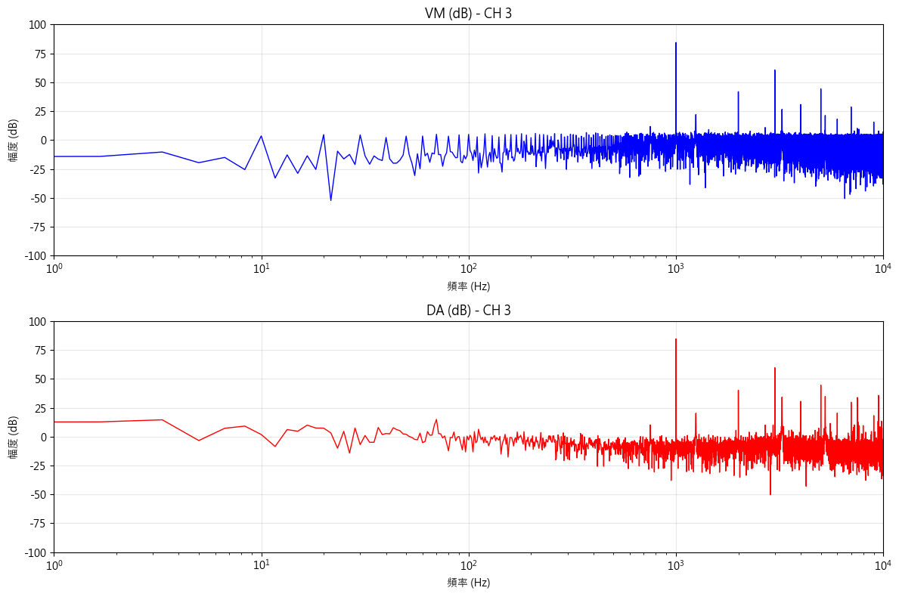
Input $ch3 0.5\sin\left(wt\right)$ 1000 Hz (new inner) HIGH
VM主要頻率成分
1000.0 Hz 84.35 dB
3000.0 Hz 60.57 dB
5000.0 Hz 44.27 dB
DA主要頻率成分
1000.0 Hz 84.55 dB
3000.0 Hz 59.61 dB
5000.0 Hz 44.57 dB

Slide 11
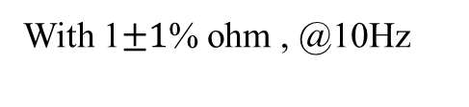
With 1$±1$% ohm , @10Hz

Slide 12
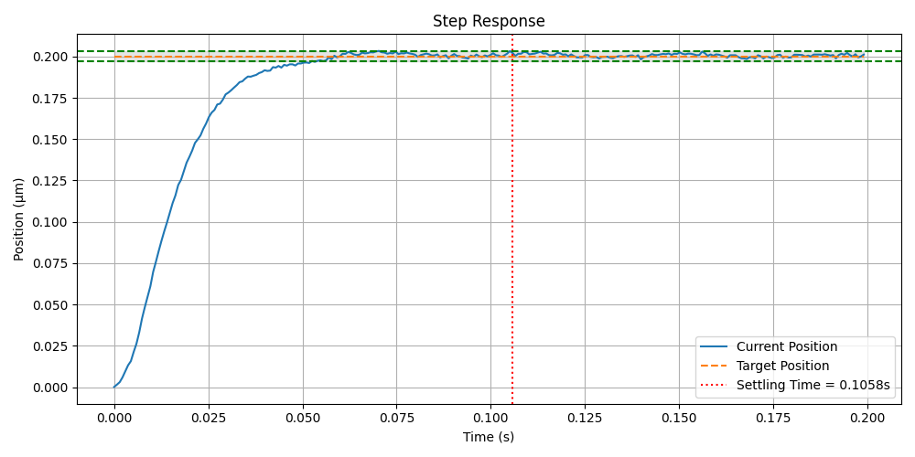
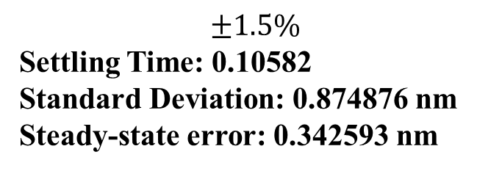
$$±1.5\%$$
Settling Time: 0.10582
Standard Deviation: 0.874876 nm
Steady-state error: 0.342593 nm

Slide 13
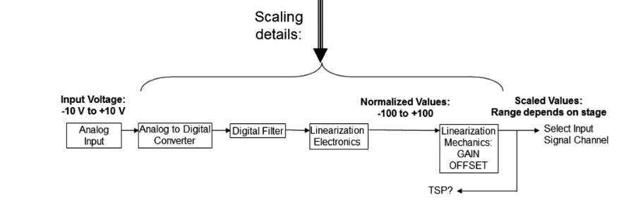
GAIN = (MaxScaledValue - MinScaledValue) / (MaxNormalizedValue - MinNormalizedValue)
OFFSET = MaxScaledValue - GAIN * MaxNormalizedValue

Slide 14
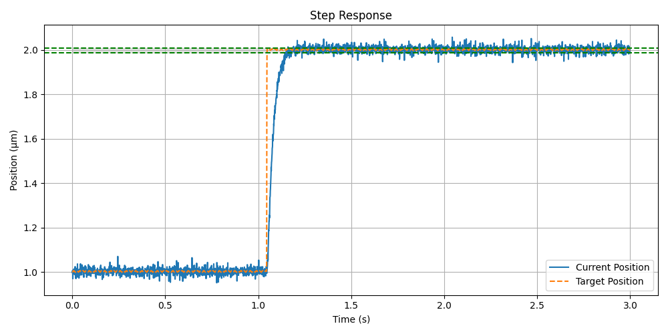
Settling Time (settling range5%): 未穩定
Standard Deviation: 12.212636 nm
Steady-state error: 0.337115 nm

Slide 15
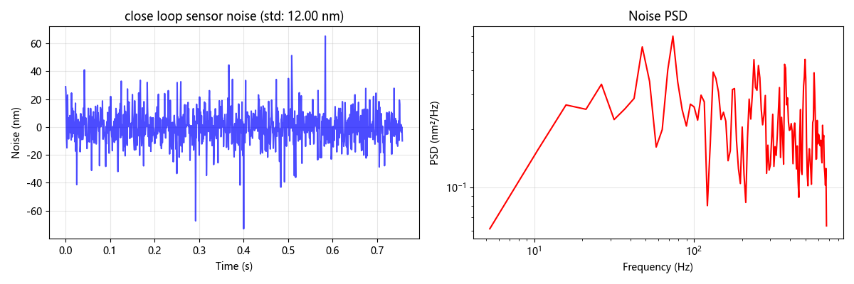
with IIR filter B.W. 600Hz & default PI gain
target position : 70000 nm
noise std: 12.005 nm
steady state error: 3.483 nm

Slide 16
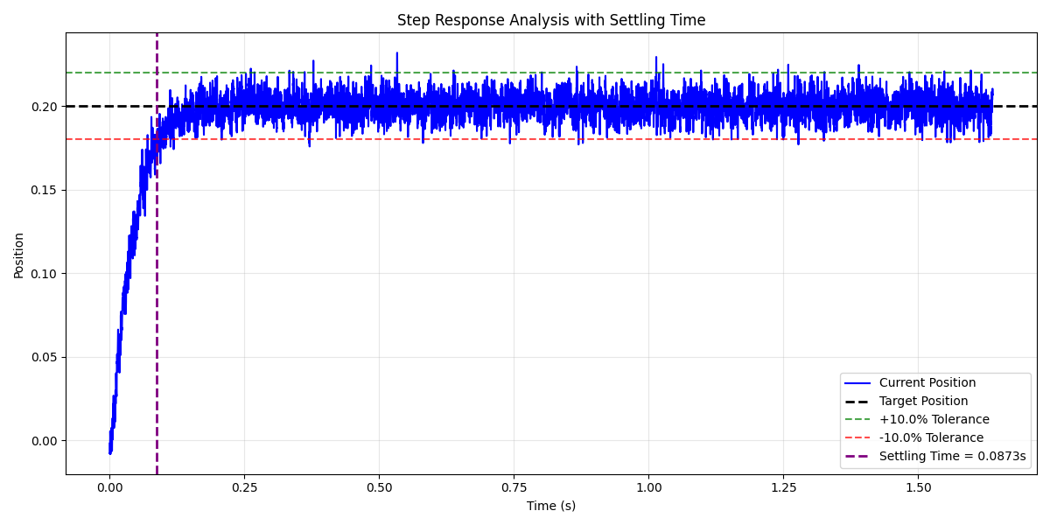
Last week testing step response
Standard Deviation: 7.082854 nm
Steady-state error: -0.111250 nm

Slide 17
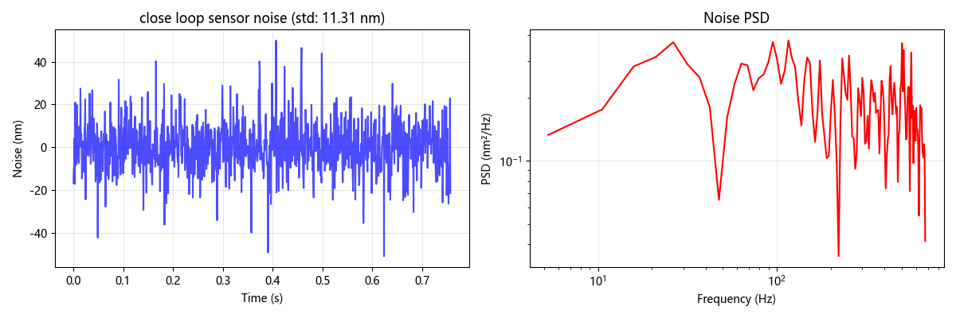
with IIR filter B.W. 600Hz & default PI gain
target position: 30000.0 nm
noise std: 11.309 nm
steady state error: -1.143 nm

Slide 18
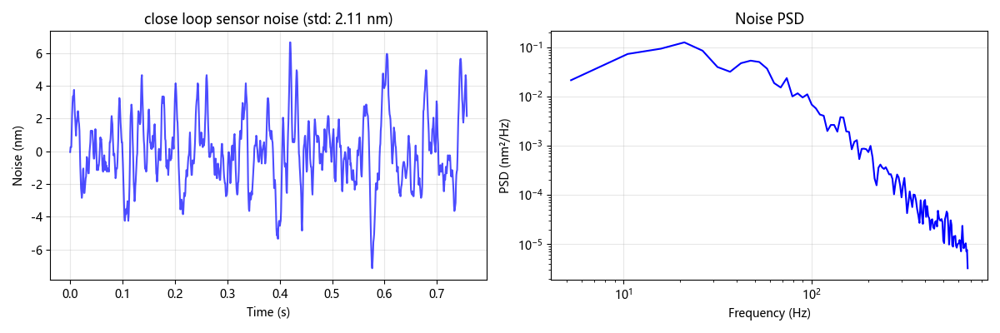
with IIR filter B.W. 50Hz & after tuning PI gain
target position: 20000.0 nm
noise std: 2.114 nm
steady state error: 0.653 nm

Slide 19
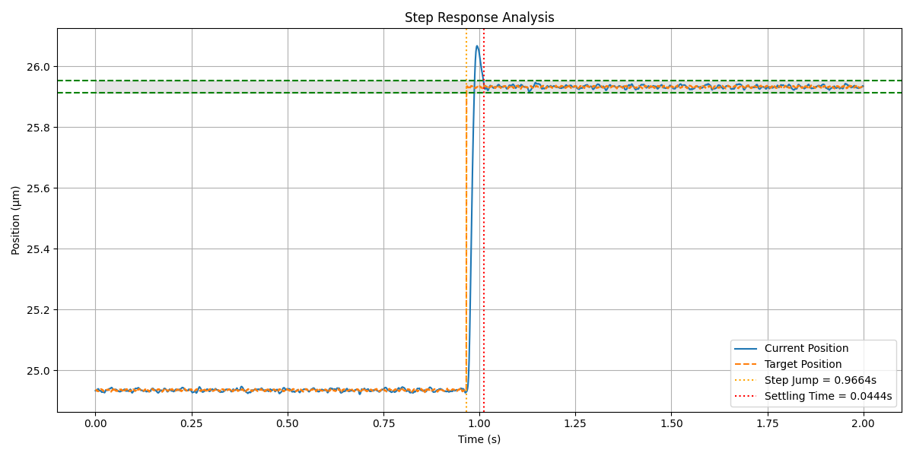
Settling Time (settling range 2%): 44.4 ms
Steady-state error: -0.218299 nm
=== Stable Region ===
Position - Mean: 25.932255 μm, STD: 4.788797 nm
Target - Mean: 25.932103 μm, STD: 2.303558 nm

Slide 20
Step repeatability: 2.3nm
Maximum step error: ±10nm for all 1μm move

Slide 21
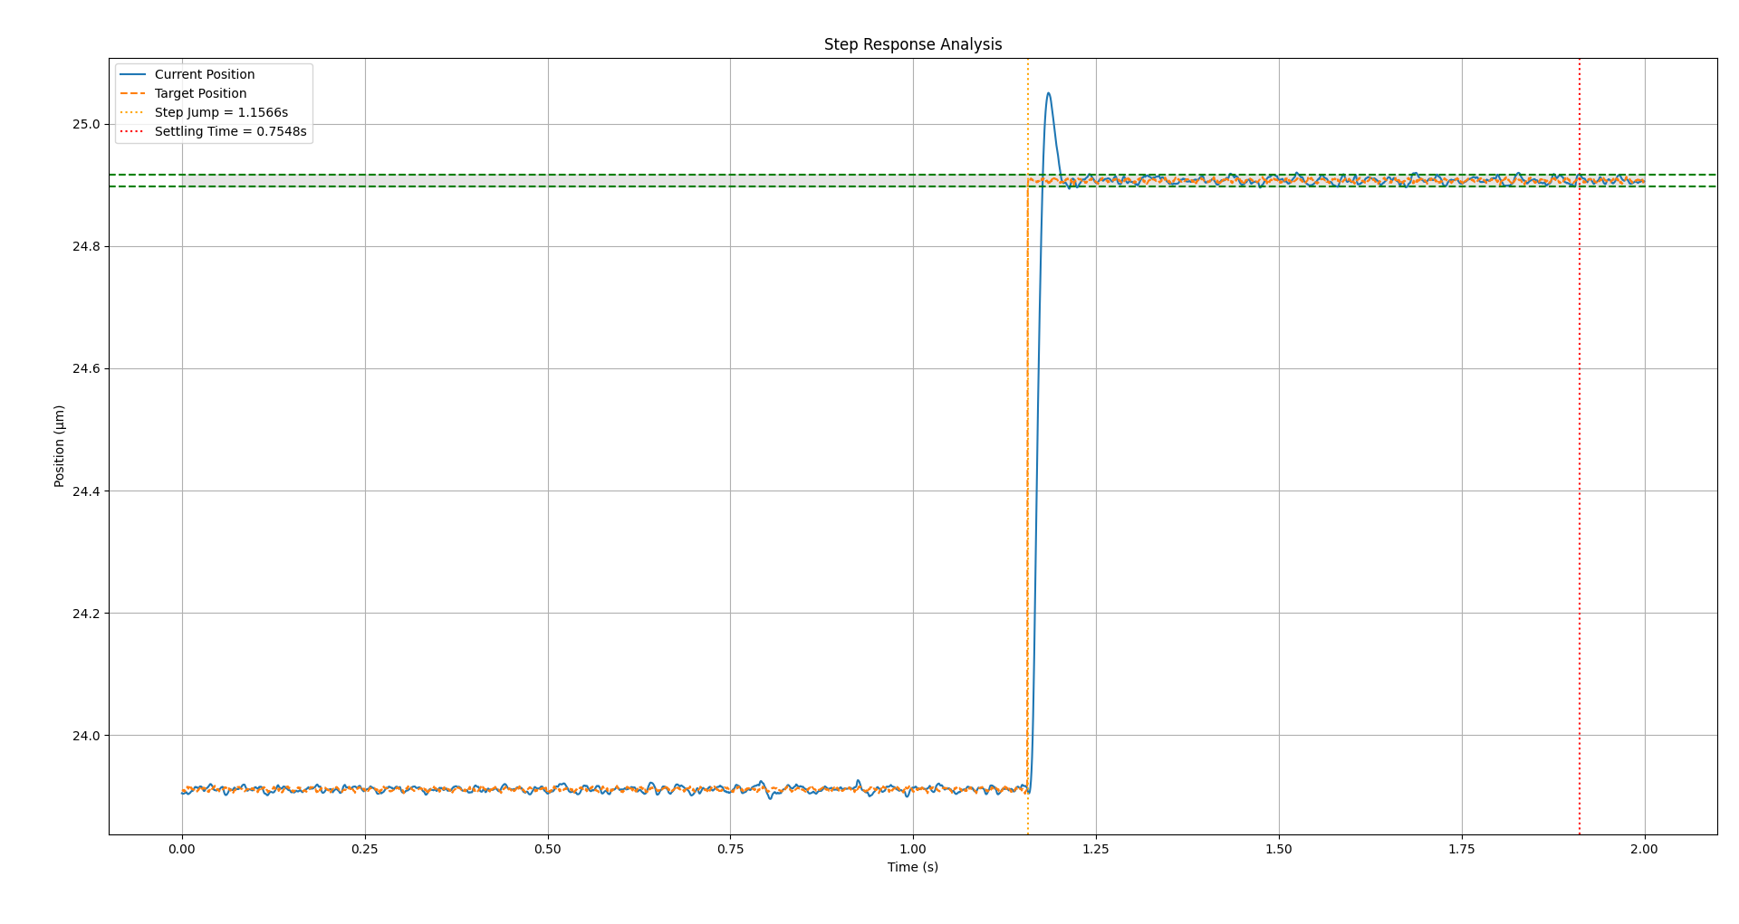
=== Step Response Analysis ===
Step Jump Time: 1.1566s
Settling Time (settling range 1%): 1.91142
Settling Time from Jump: 0.7548s
Standard Deviation: 5.686600 nm
Steady-state error: 0.231423 nm
=== Statistics Before Step Jump ===
Current - Mean: 23.911259 μm, STD: 4.410914 nm
Target - Mean: 23.911266 μm, STD: 2.345777 nm
=== Statistics After Settling (Stable Region) ===
Current - Mean: 24.907154 μm, STD: 3.749264 nm
Target - Mean: 24.907179 μm, STD: 2.350564 nm
New PI G

Slide 22
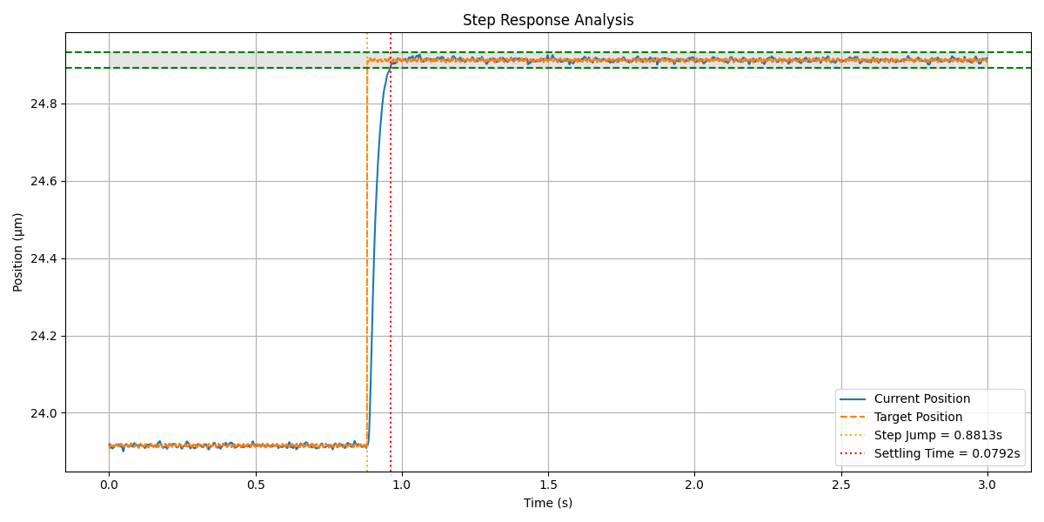
=== Step Response Analysis ===
Step Jump Time: 0.8813s
Settling Time (settling range 2%): 0.96052
Settling Time from Jump: 0.0792s
Standard Deviation: 4.465186 nm
Steady-state error: 0.220222 nm
=== Statistics Before Step Jump ===
Current - Mean: 23.915059 μm, STD: 3.970211 nm
Target - Mean: 23.915499 μm, STD: 2.433369 nm
=== Statistics After Settling (Stable Region) ===
Current - Mean: 24.911901 μm, STD: 4.162849 nm
Target - Mean: 24.911498 μm, STD: 2.389850 nm
default

Slide 23
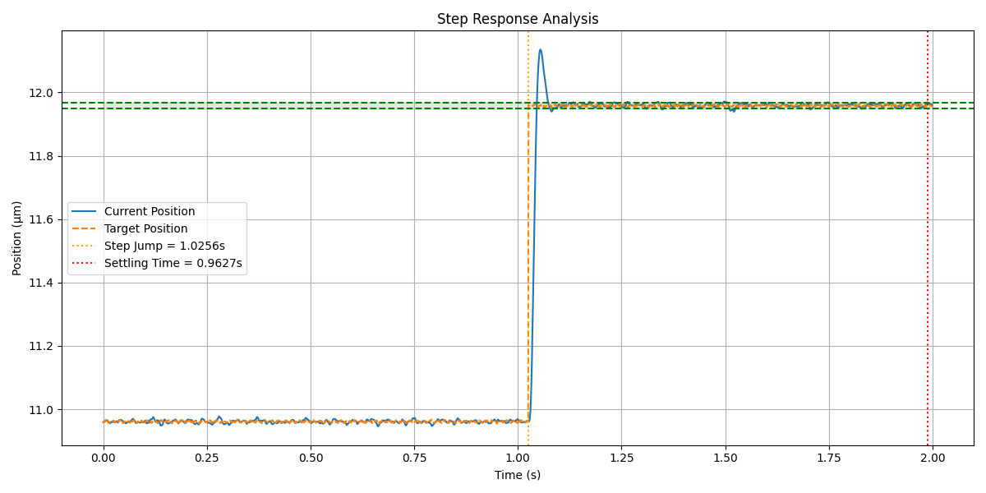
=== Step Response Analysis ===
Step Jump Time: 1.0256s
Settling Time (settling range 1%): 1.98838
Settling Time from Jump: 0.9627s
Standard Deviation: 5.029024 nm
Steady-state error: 0.630869 nm
=== Statistics Before Step Jump ===
Current - Mean: 10.961151 μm, STD: 4.739387 nm
Target - Mean: 10.961150 μm, STD: 2.363531 nm
=== Statistics After Settling (Stable Region) ===
Current - Mean: 11.963819 μm, STD: 2.478966 nm
Target - Mean: 11.958962 μm, STD: 1.934837 nm
New PI G

Slide 24
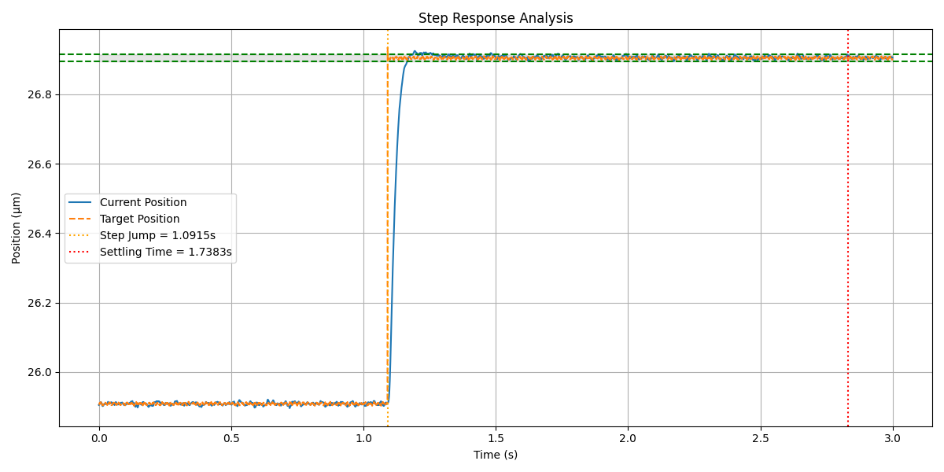
=== Step Response Analysis ===
Step Jump Time: 1.0915s
Settling Time (settling range 2%): 1.19584
Settling Time from Jump: 0.1043s
Standard Deviation: 4.696897 nm
Steady-state error: 0.948089 nm
=== Statistics Before Step Jump ===
Current - Mean: 25.908716 μm, STD: 3.988451 nm
Target - Mean: 25.908582 μm, STD: 2.399279 nm
=== Statistics After Settling (Stable Region) ===
Current - Mean: 26.906845 μm, STD: 4.676132 nm
Target - Mean: 26.904396 μm, STD: 2.415791 nm
Default

Slide 25
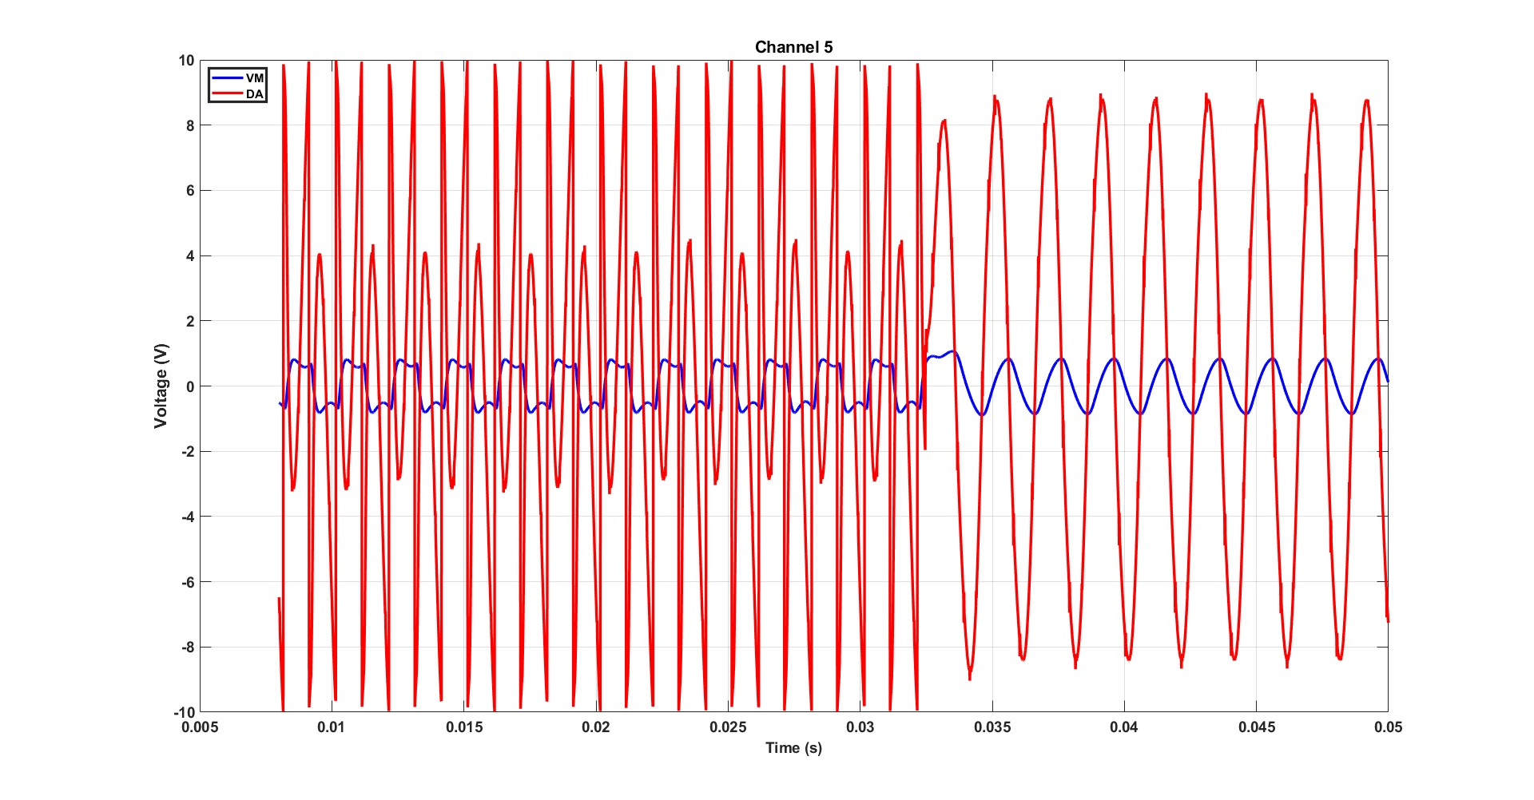

Slide 26
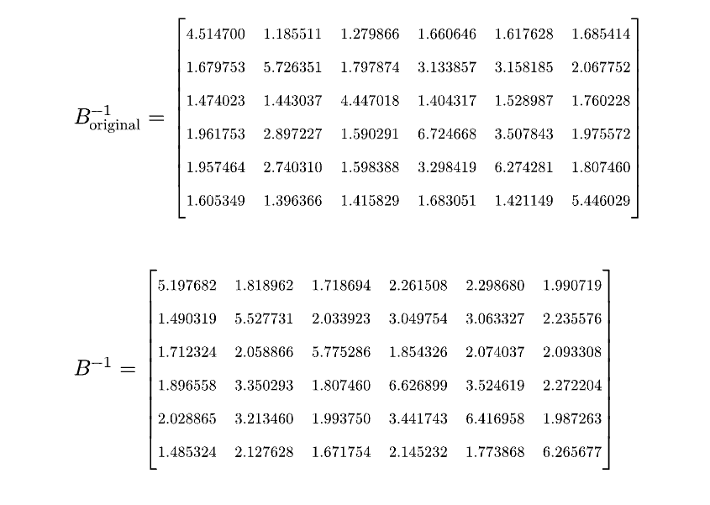

Slide 27
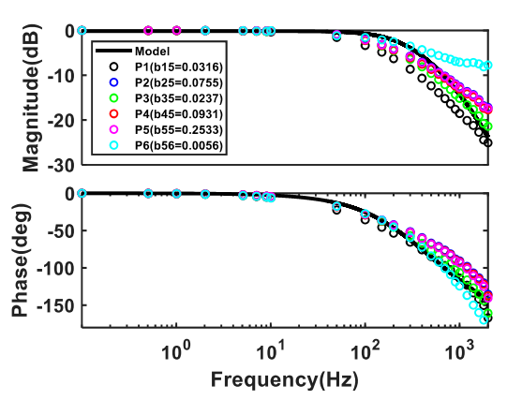
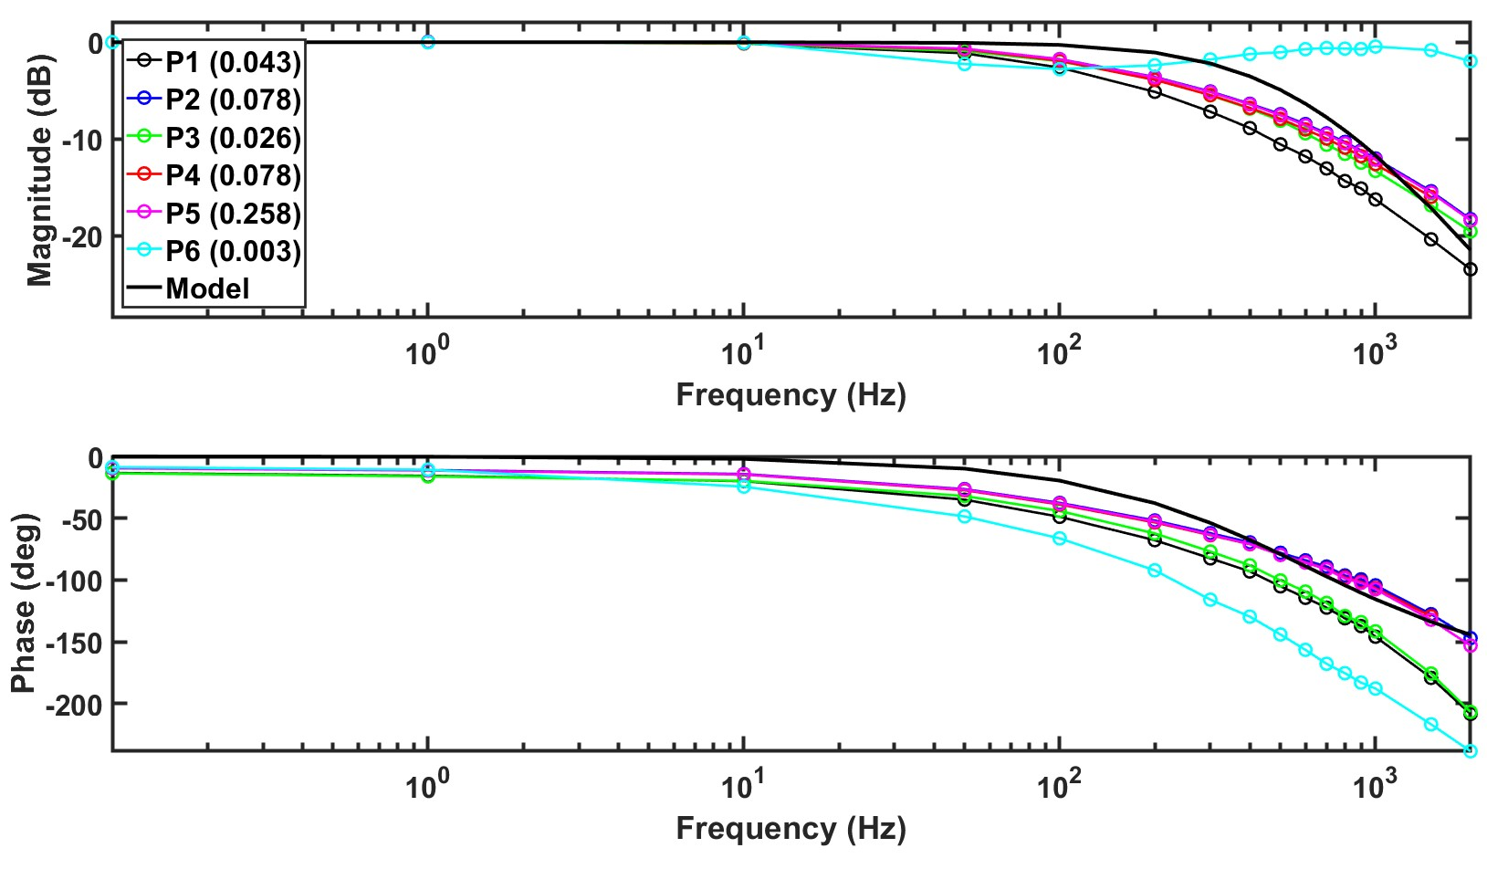

Slide 28
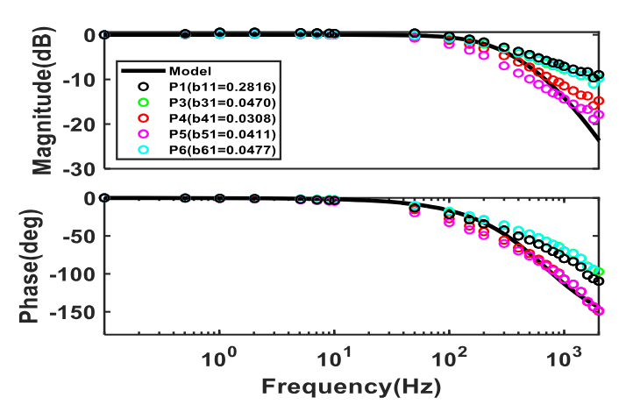
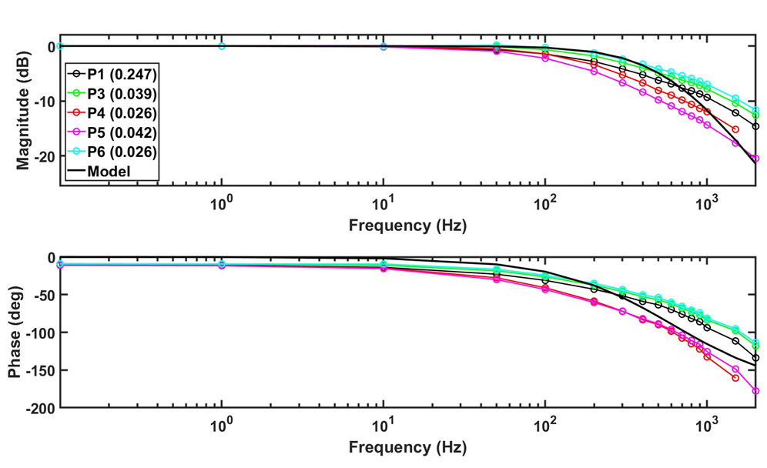

Slide 29
6x6 matrix
i_A1matrix_s_lambda[35:0]
i_L2_esti[35:0]
i_inv_B[35:0]
parameter
ilambda
iBeta_m
iAnew[0], iAnew[1]
iAnew[2] (L1)
iAnew[3] (L2)
iAnew[4] (a1_s_lamc)

