Slide 1
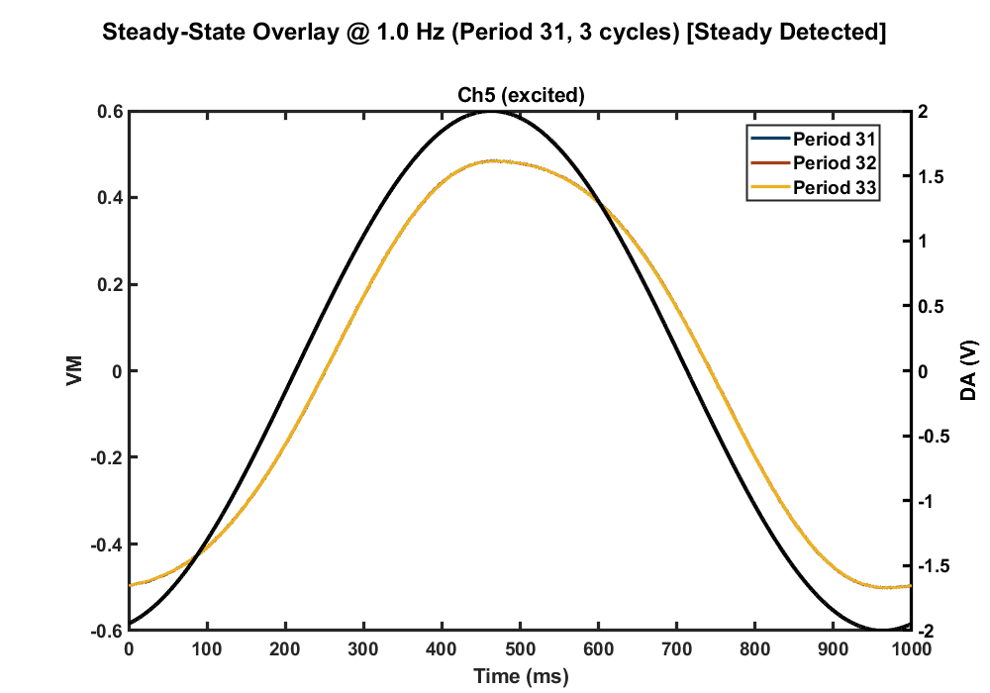
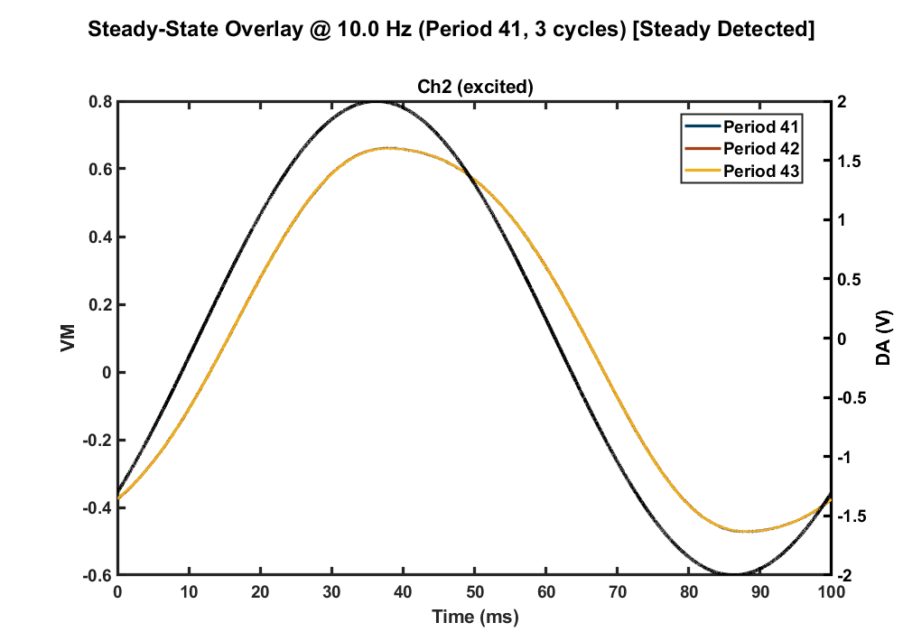
Time Domain Data
P5 Excitation P5 Response
P2 Excitation P2 Response

Slide 2
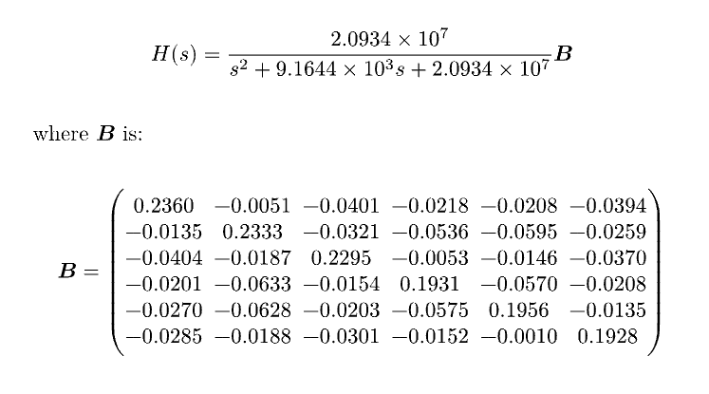
Fitting with Original Phase Data

Slide 3
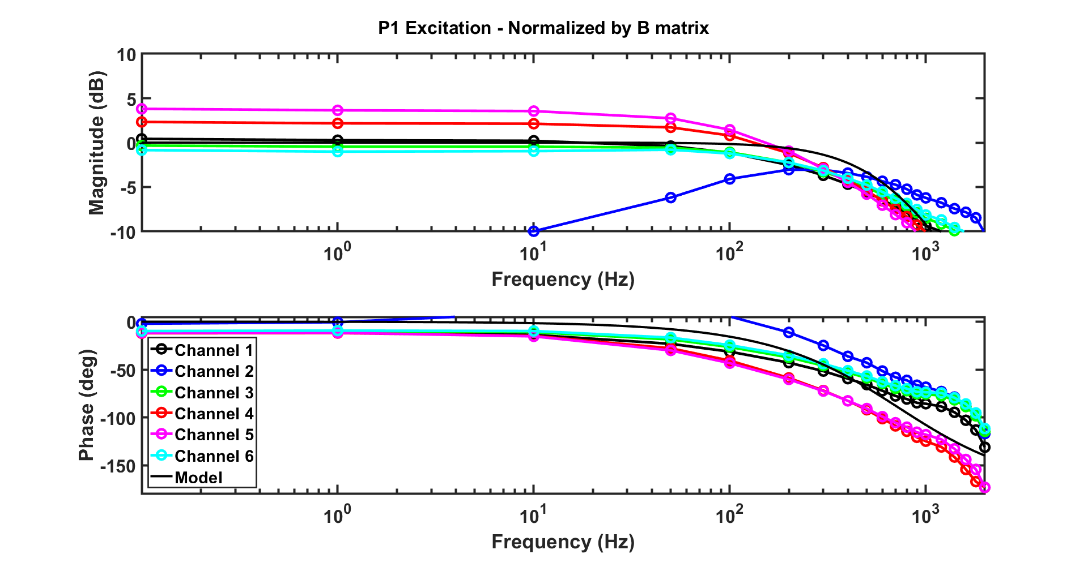
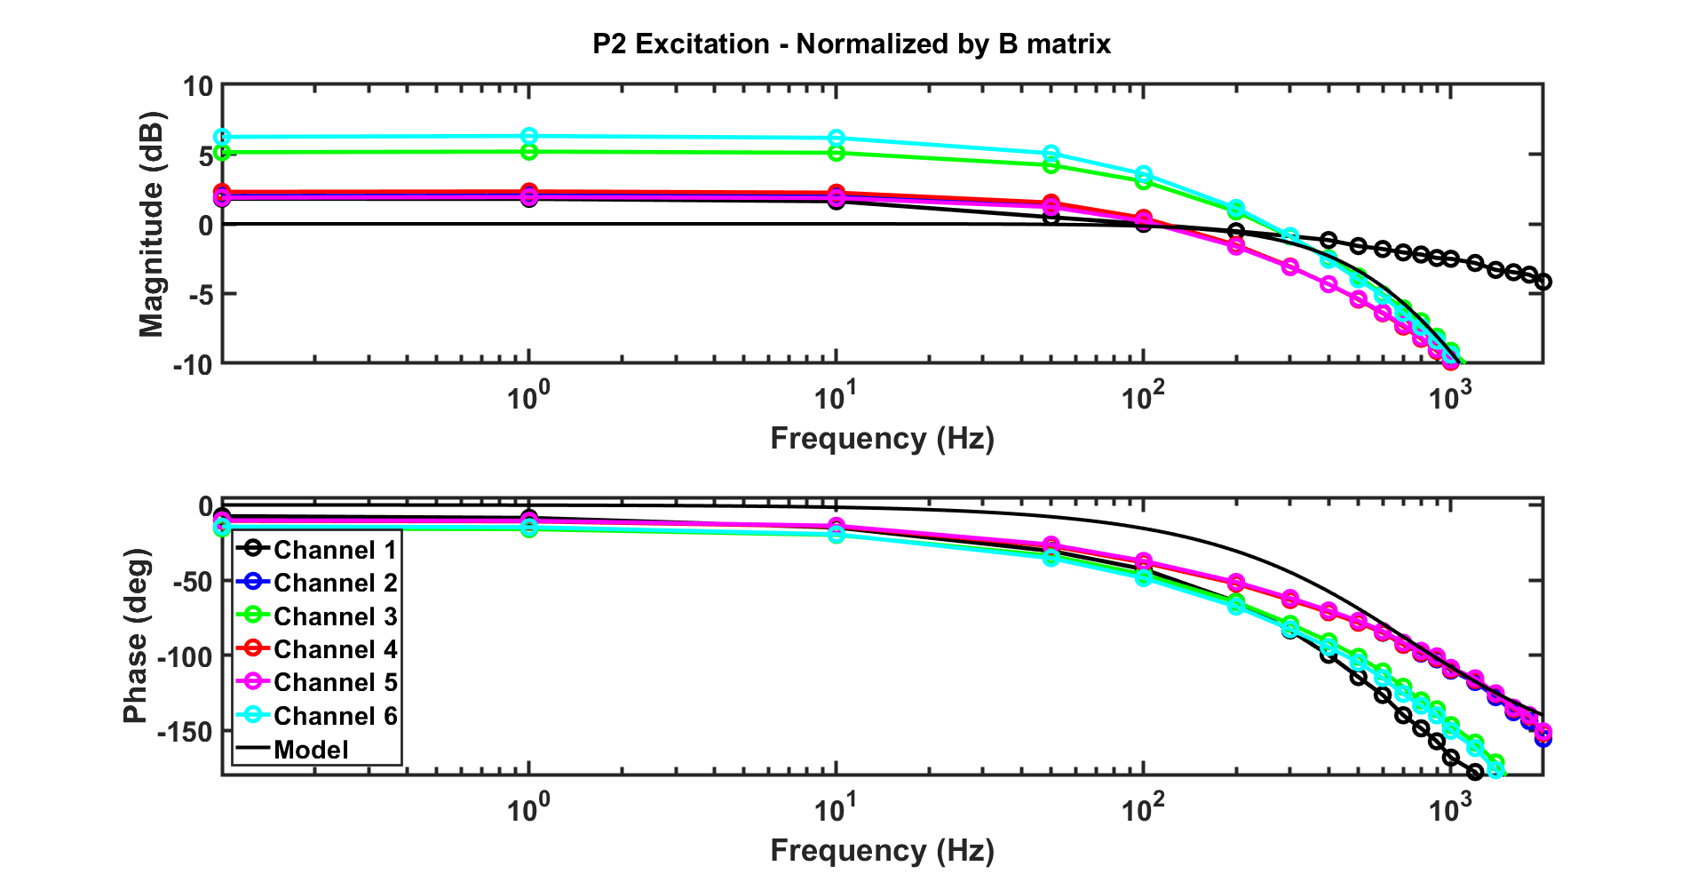
Fitting with Original Phase Data

Slide 4
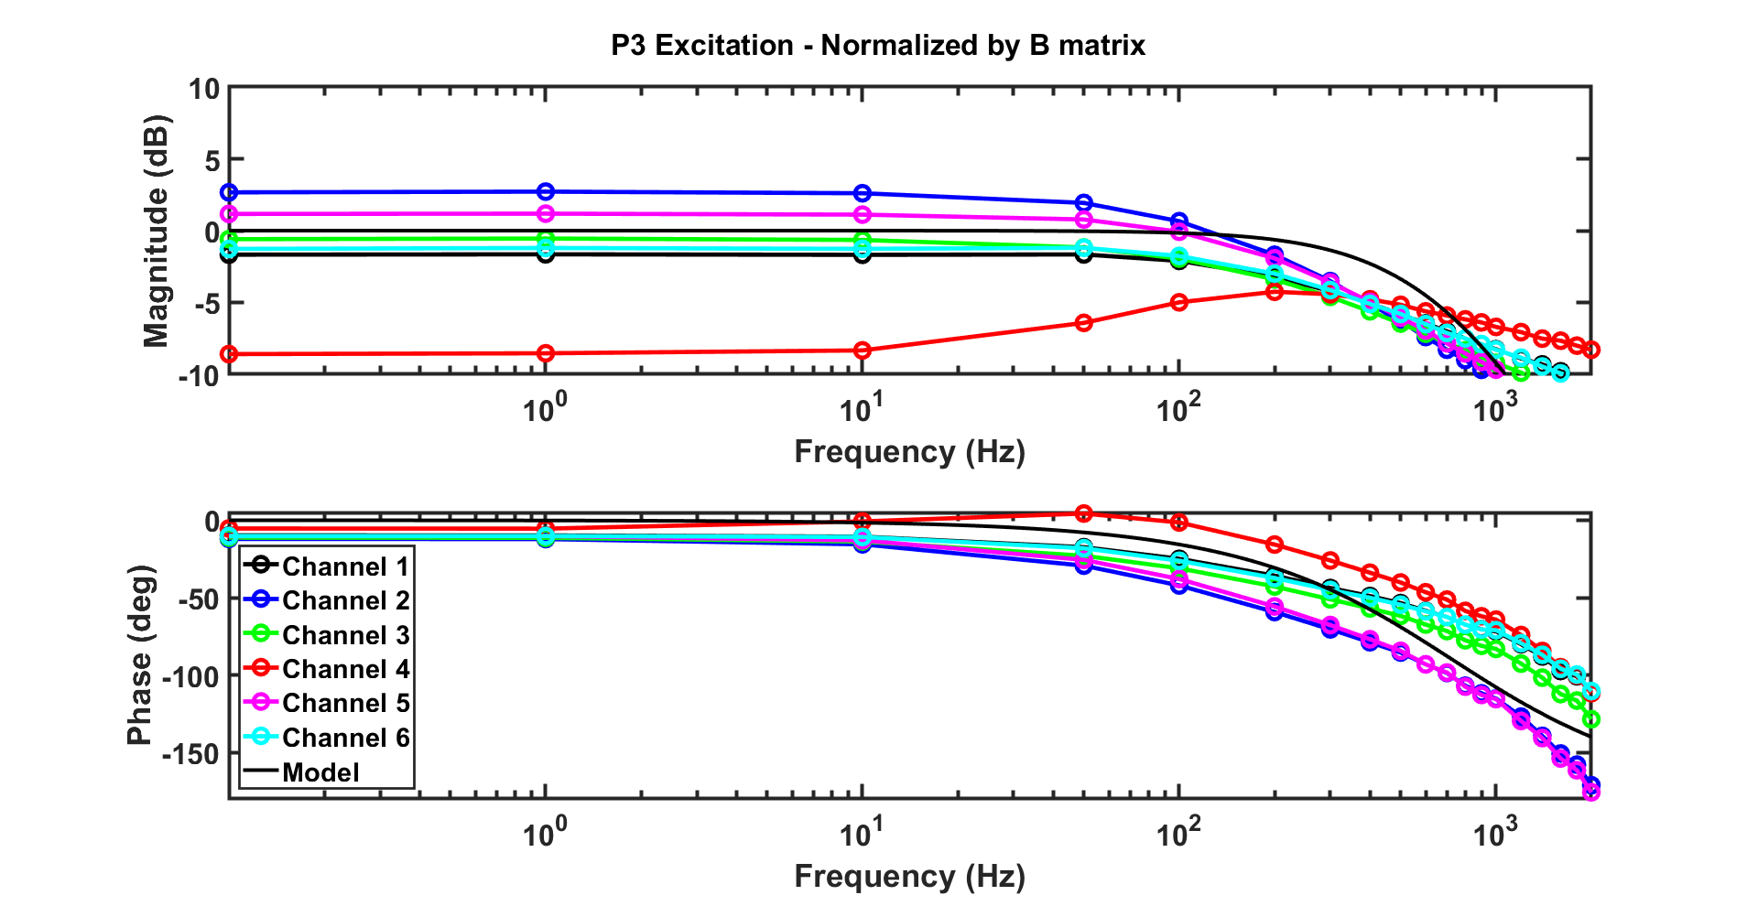
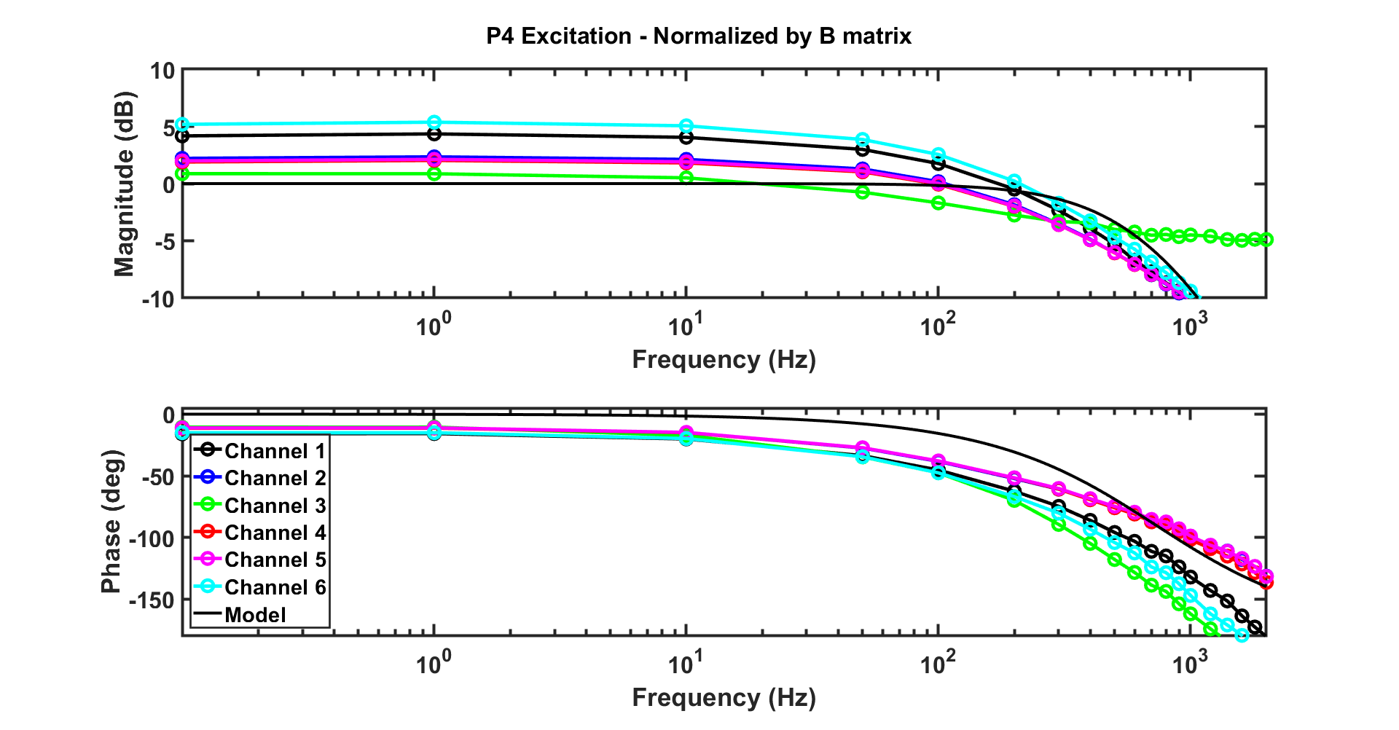
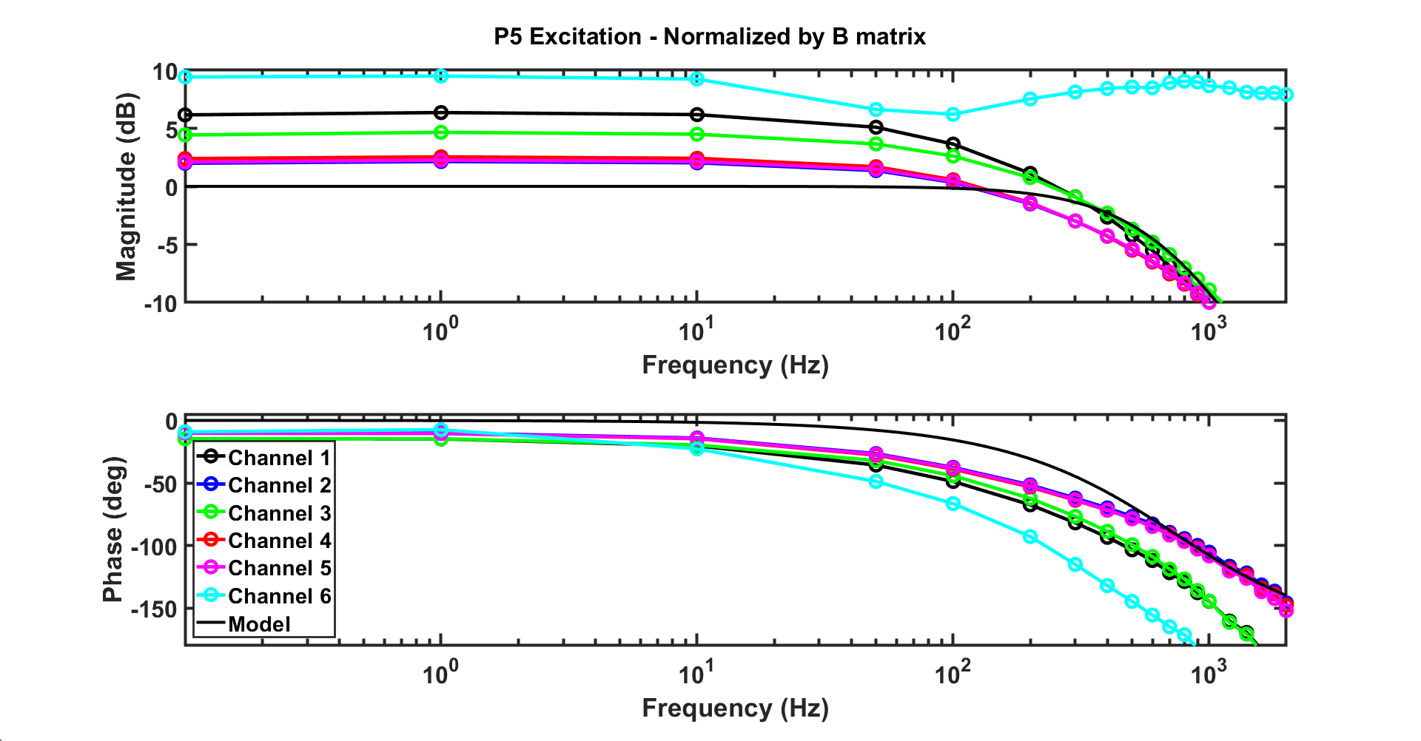
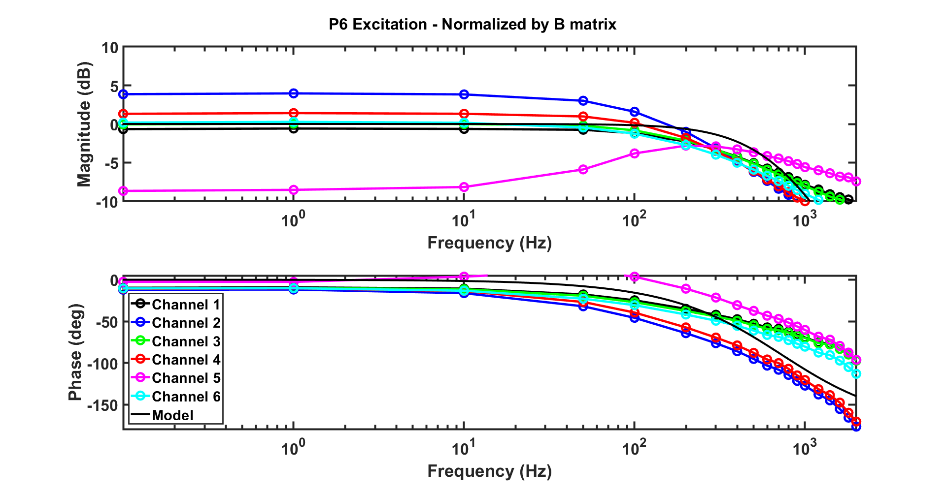

Slide 5
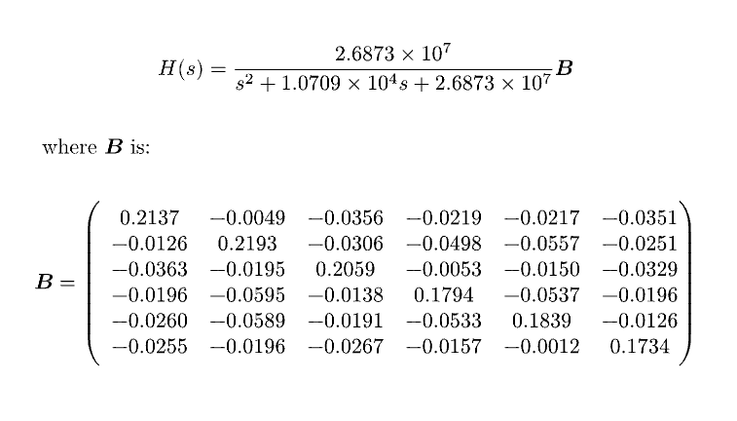
Fitting with Phase-Offset-Removed Data

Slide 6
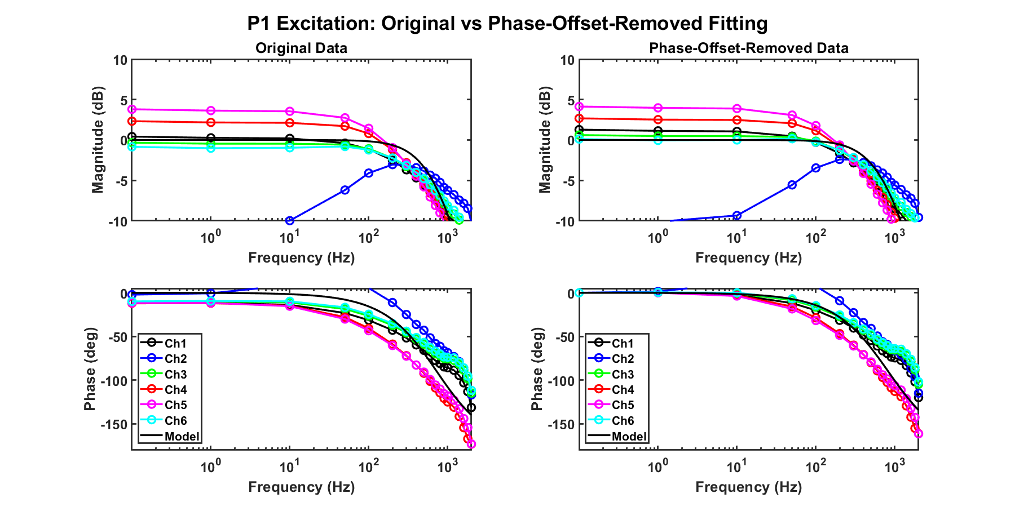
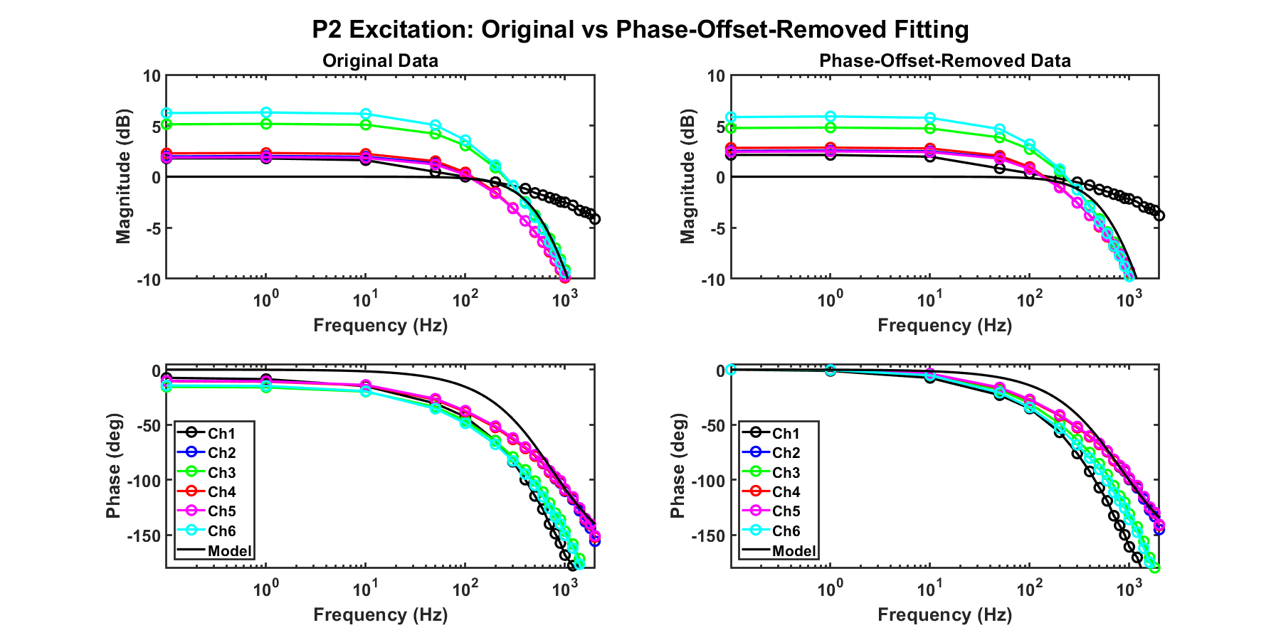
Comparison Results

Slide 7
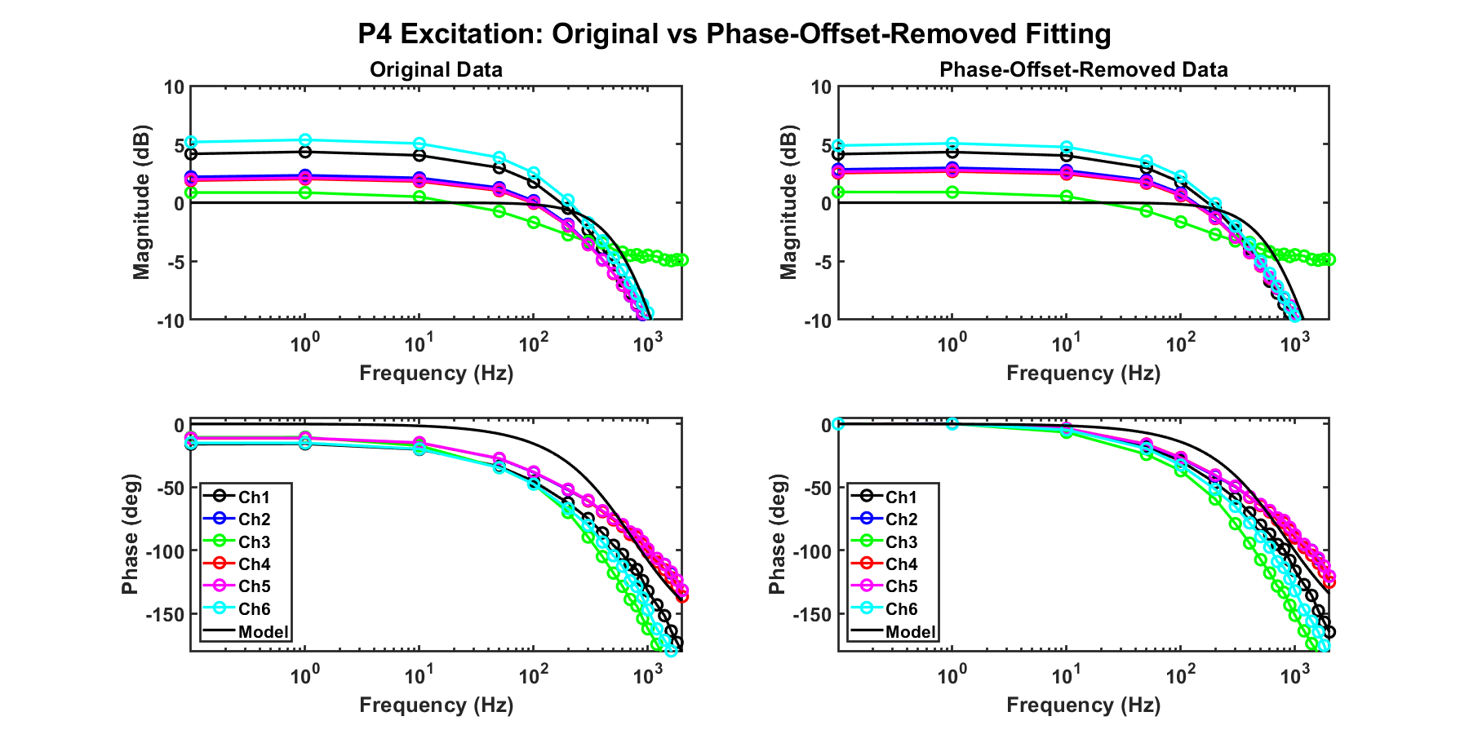
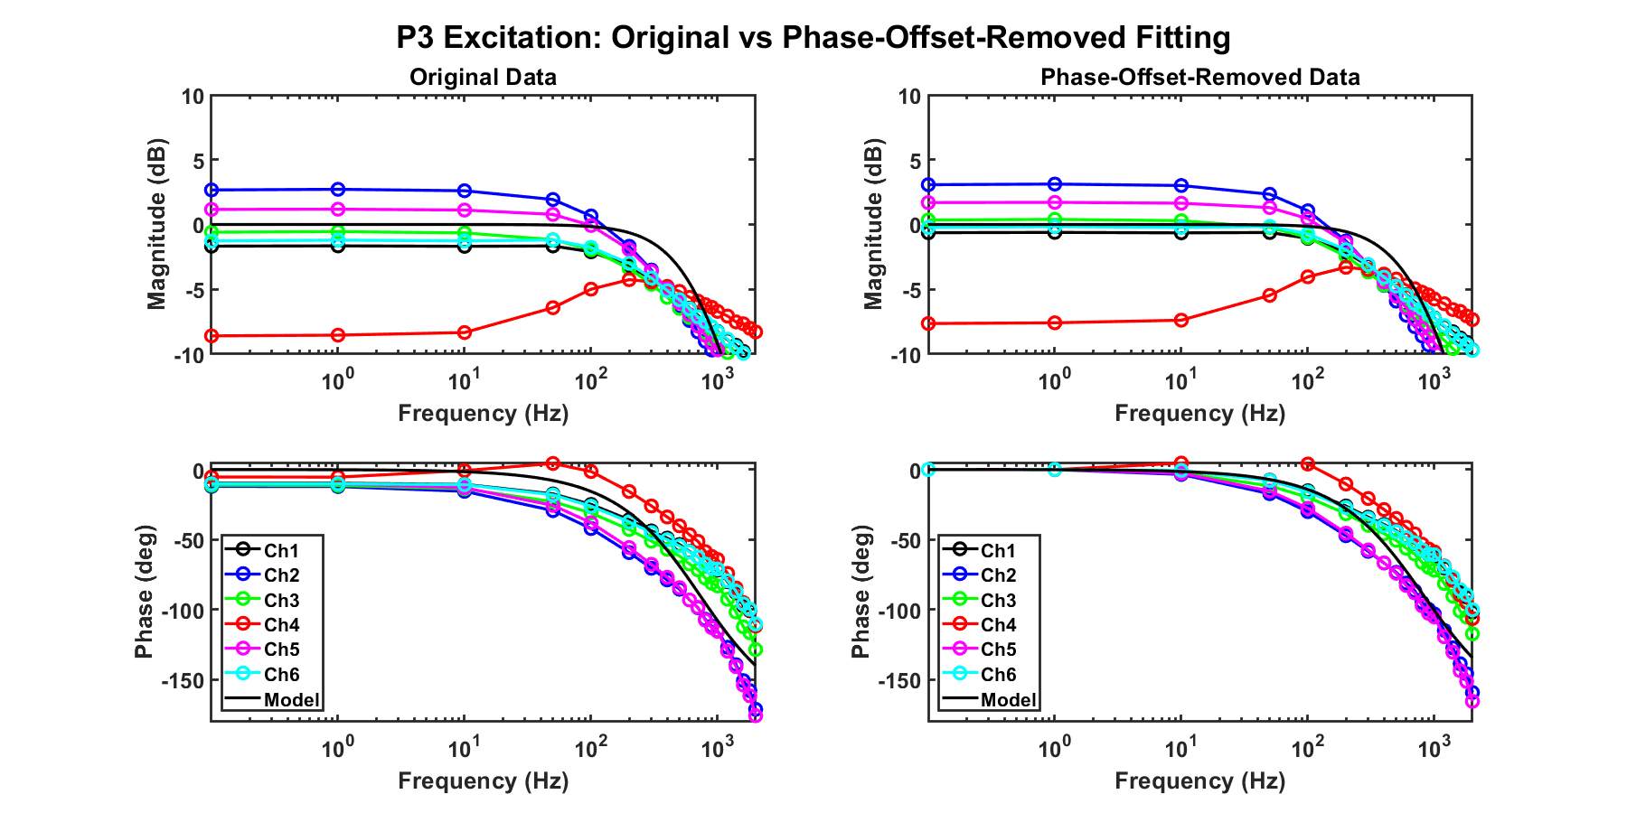
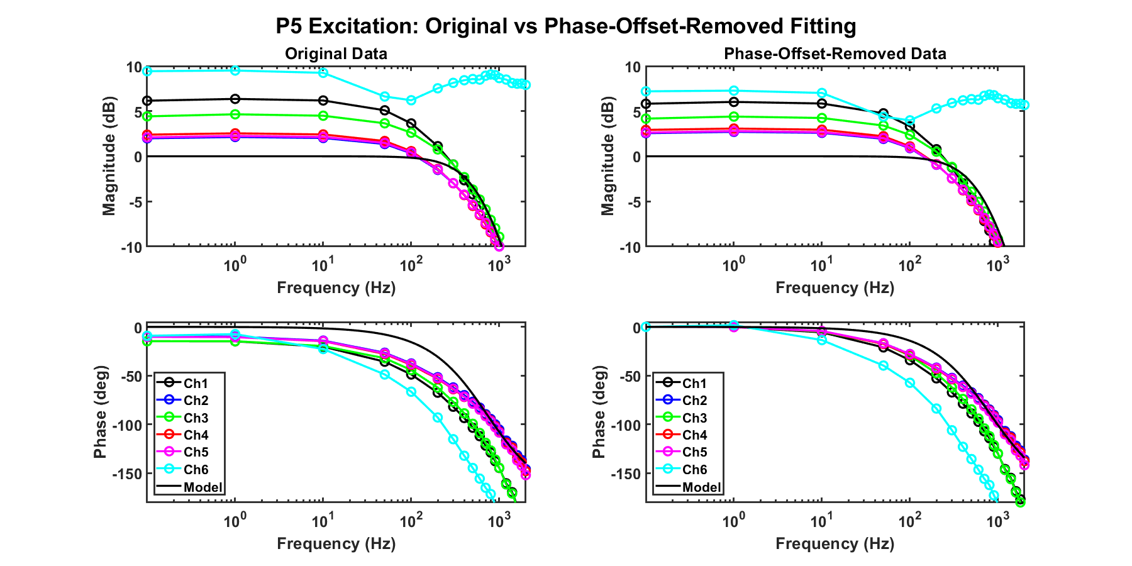
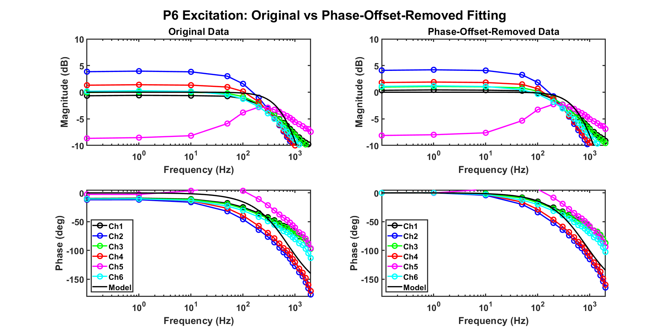

Slide 8
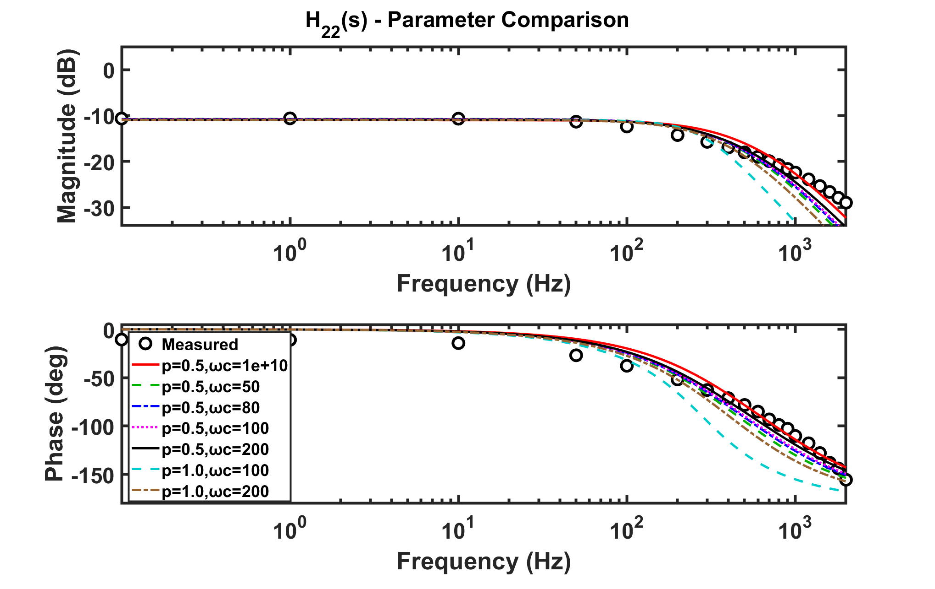


Slide 9
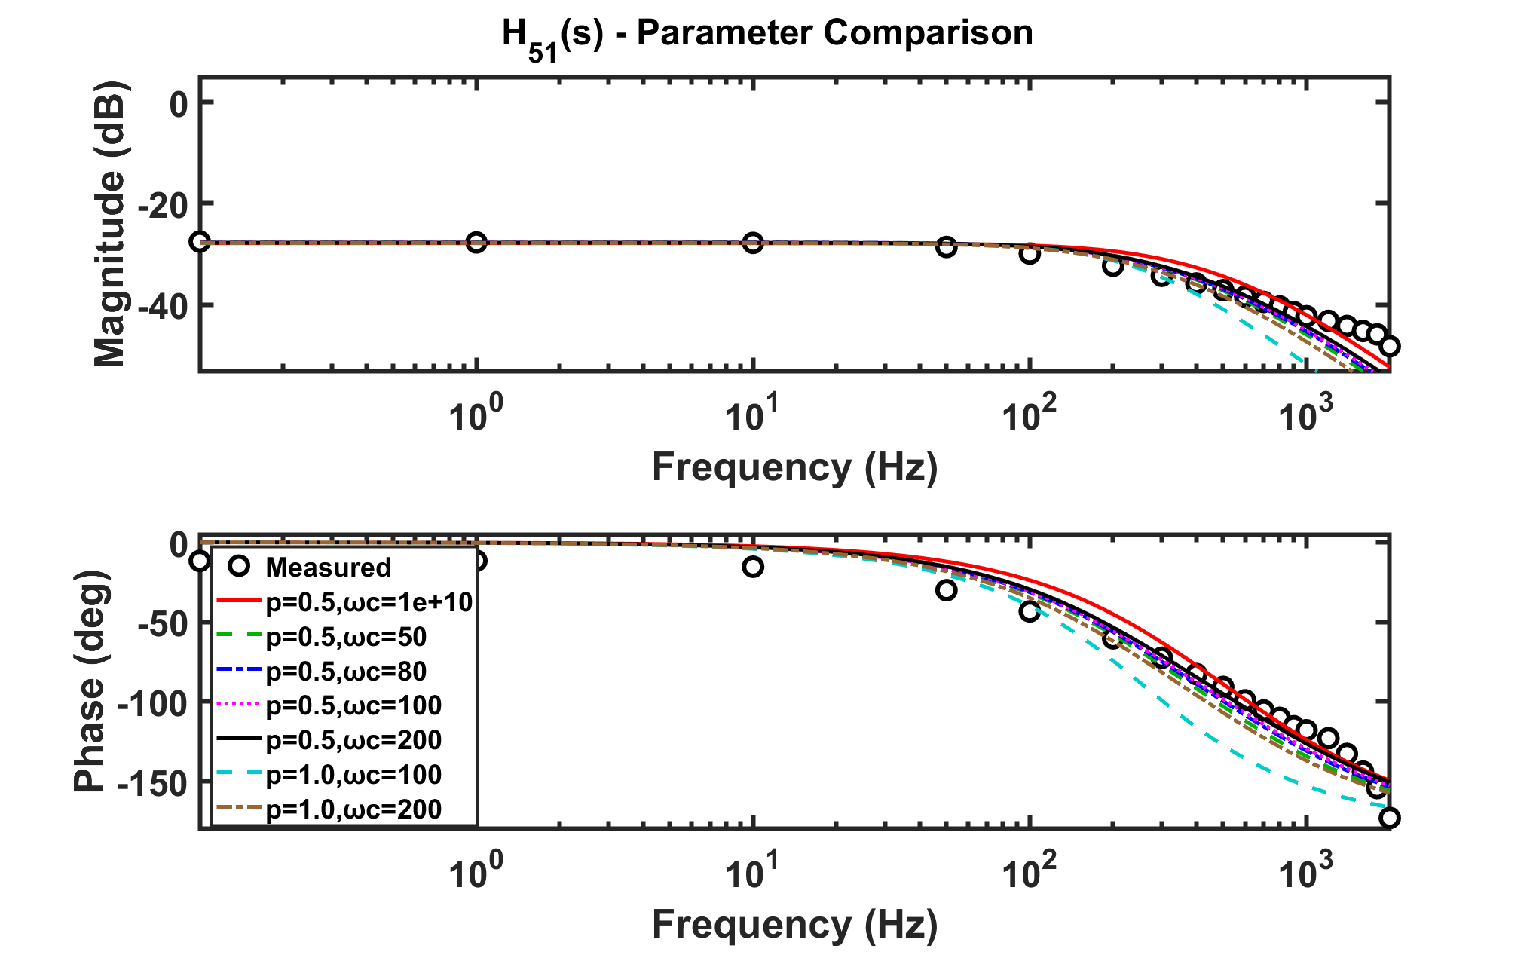
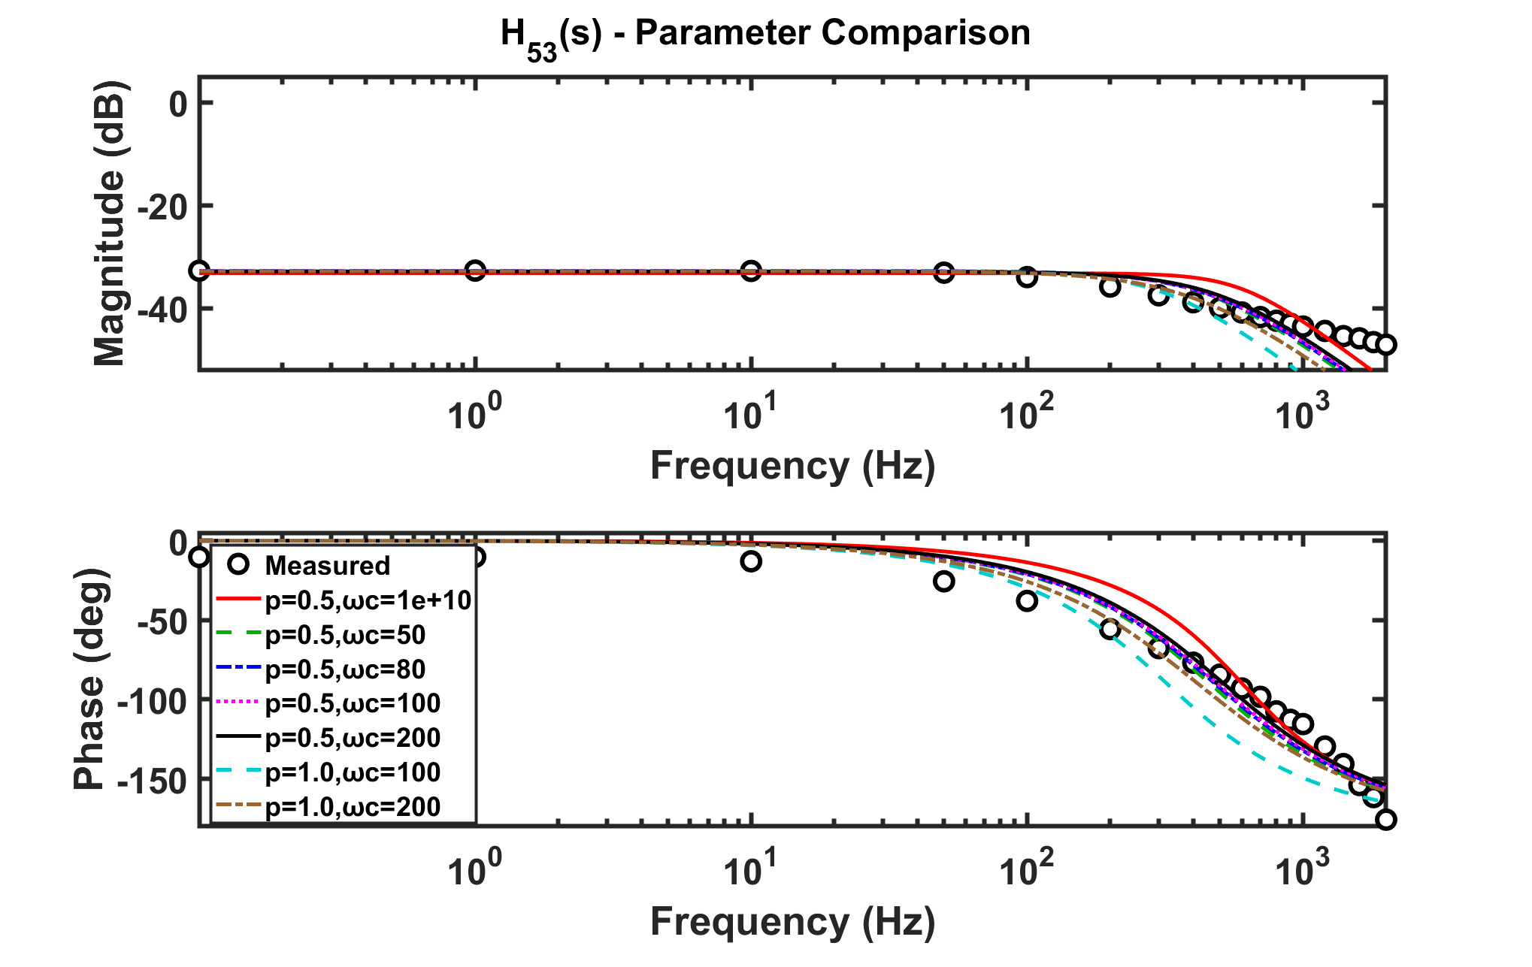

Slide 10



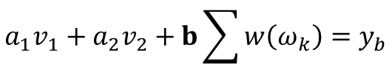

$$a_{11}a_{1}+v_{1}^{T}b=y_{1}$$
$$a_{22}a_{2}+v_{2}^{T}b=y_{2}$$
$$a_{1}v_{1}+a_{2}v_{2}+b\sum{w\left(ω_{k}\right)}=y_{b}$$
$$b=\frac{1}{\sum{w\left(ω_{k}\right)}}\left[y_{b}−a_{1}v_{1}−a_{2}v_{2}\right]$$
$$\left(a_{11}−\frac{1}{\sum{w\left(ω_{k}\right)}}v_{1}^{T}v_{1}\right)a_{1}−\left(\frac{1}{\sum{w\left(ω_{k}\right)}}v_{1}^{T}v_{2}\right)a_{2}=y_{1}−\frac{1}{\sum{w\left(ω_{k}\right)}}v_{1}^{T}y_{b}$$
$$−\left(\frac{1}{\sum{w\left(ω_{k}\right)}}v_{2}^{T}v_{1}\right)a_{1}+\left(a_{22}−\frac{1}{\sum{w\left(ω_{k}\right)}}v_{2}^{T}v_{2}\right)a_{2}=y_{2}−\frac{1}{\sum{w\left(ω_{k}\right)}}v_{2}^{T}y_{b}$$
$$b=\frac{1}{\sum{w\left(ω_{k}\right)}}\left[y_{b}−a_{1}v_{1}−a_{2}v_{2}\right]$$

Slide 11
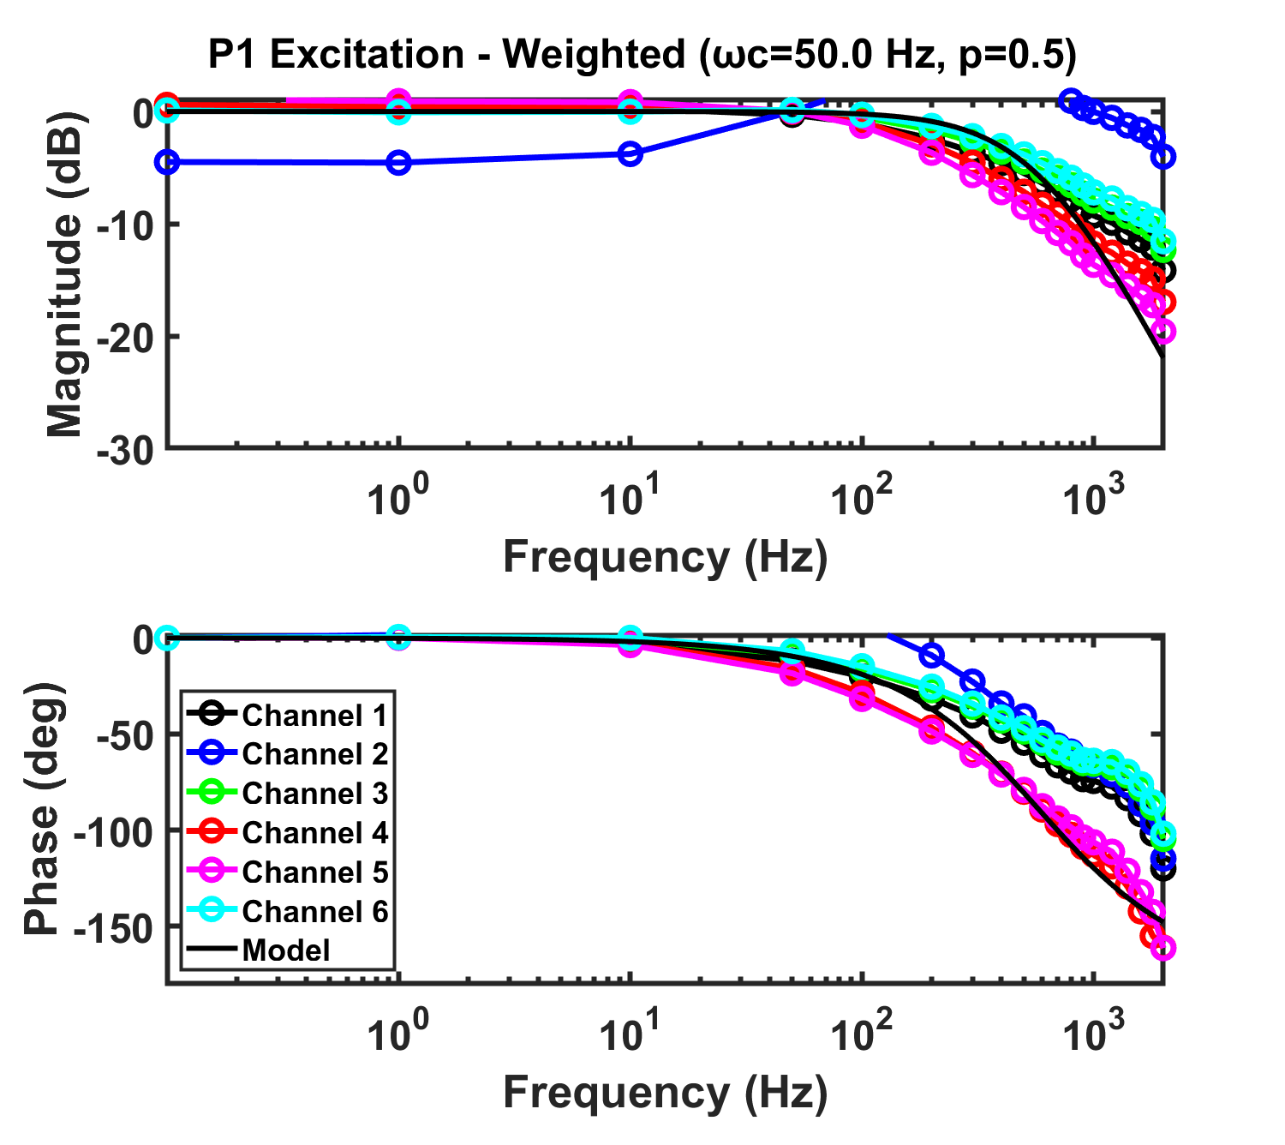
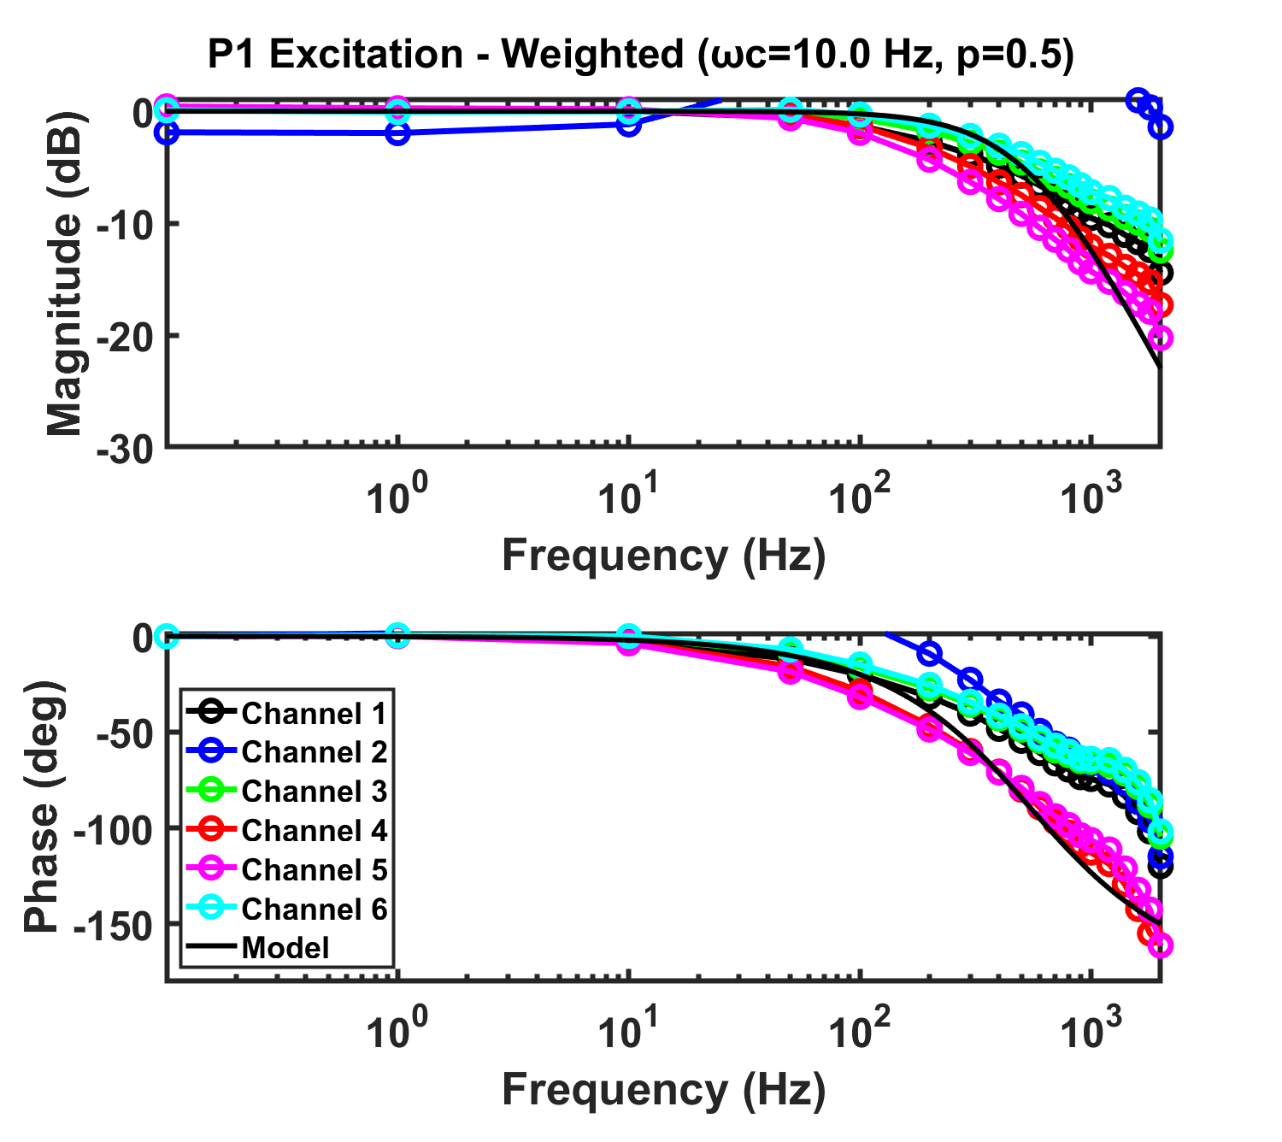

Slide 12
