Slide 1

OUTBREAK
Tanner Smith
Sean Marek
Kevin Fauver
Jeffrey Daniels
For iPhone Platform

Slide 2
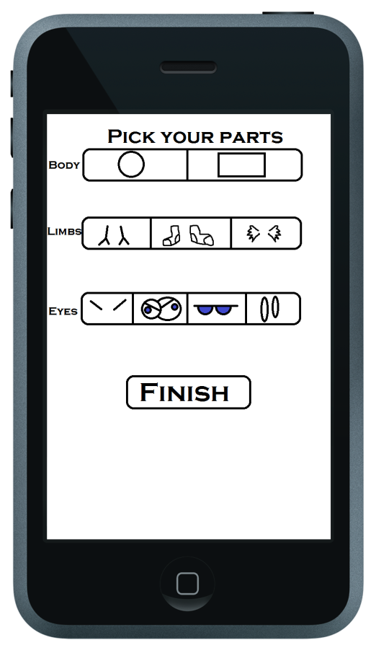
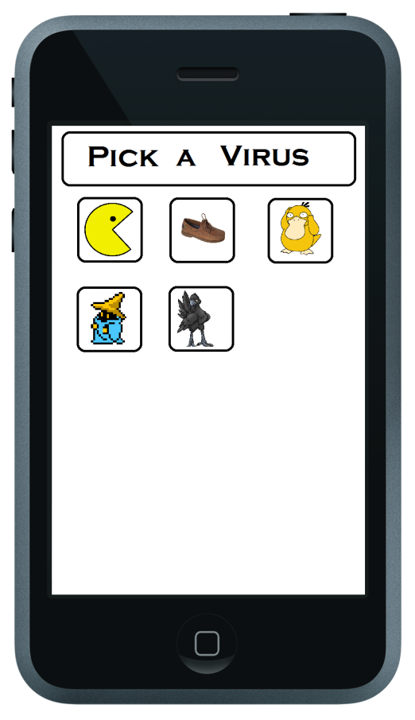
Creation

Slide 3
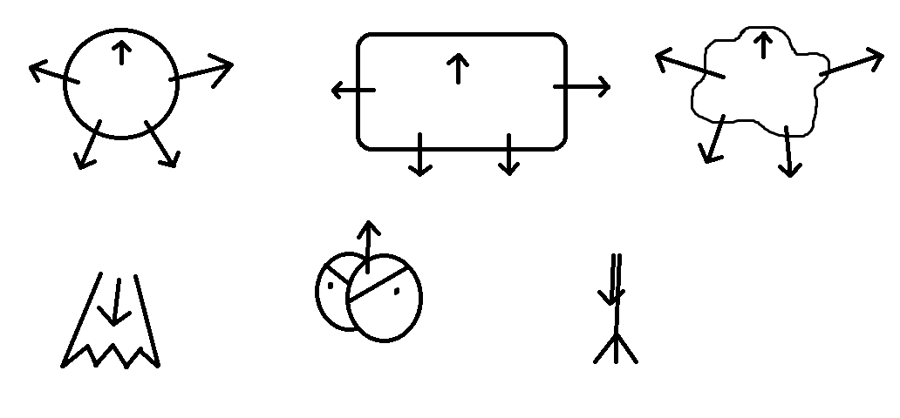
Virus Customization
Customization
Each Body Has Bind points for Eyes, Arms, Legs, Etc…
Each bind point has a vector associated
Each Limb/accessory also has a bind point and direction vector
Allows for modularity and easy addition to character parts library
Can be used for both avatar and virus customization

Slide 4
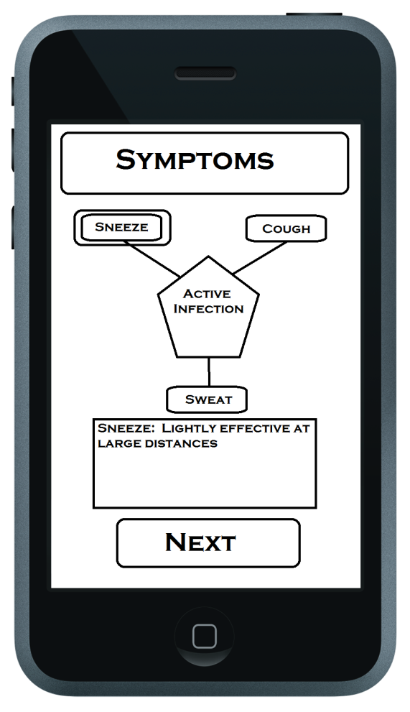
Symptoms
Choose one symptom from each category:
Active infection
Cough(M), Sneeze(L), Sweat(H)
Passive zone infection
Diarrhea(L), Vomiting(M), Bleeding(H)
Server connection for infected zones
Perks
Fever, Fluid in lungs, Brain Swelling
Causes unique effects
High/Medium/Low
H:High infection %, small infect zone
M: Medium infection %, medium infection zone
L: Low infection %, large infection zone

Slide 5
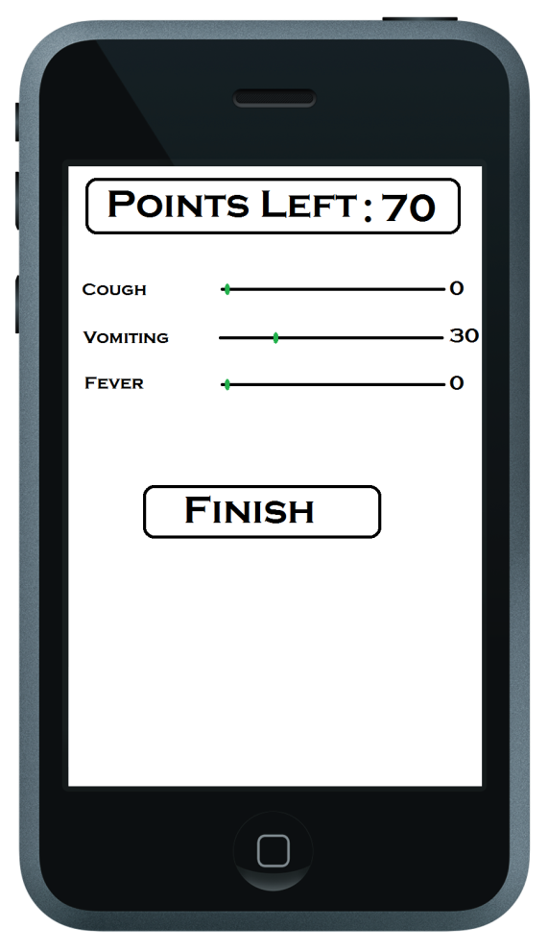
Point Allocation
100 points total
All must be used to continue
Max stat for one skill is 100

Slide 6
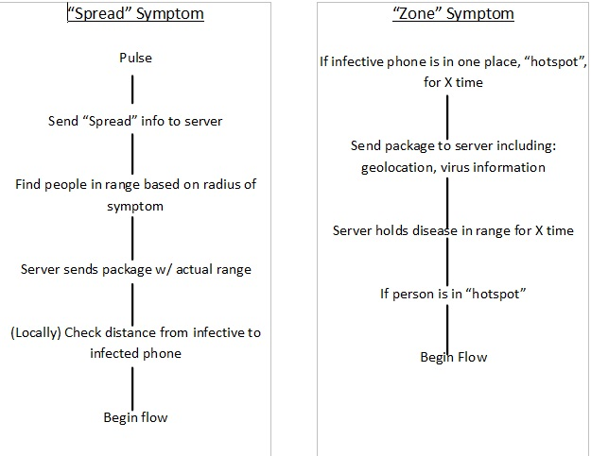

Slide 7
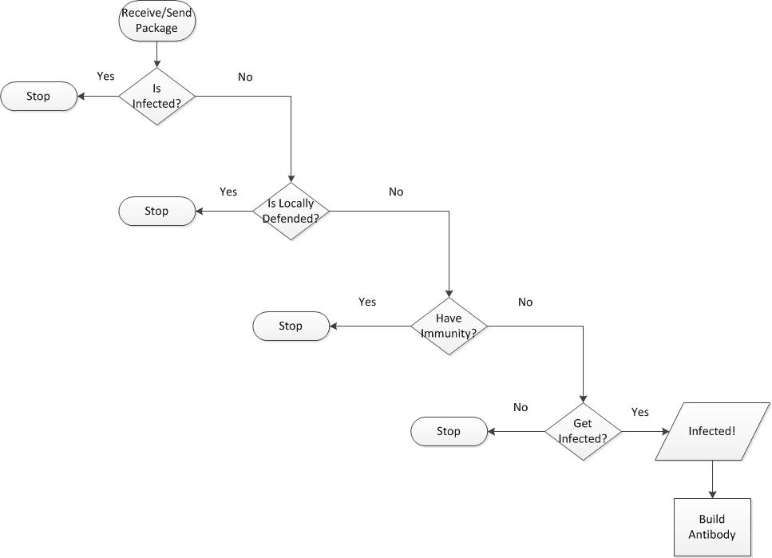

Slide 8


Defenses
Natural
External
Build Antibodies
Check against incoming viruses
Wear Flu mask
Check against spread type

Slide 9


Remedies
Time
Cures
Length of time given for Virus severity
Drugs, Chicken Soup, Sleep, doctor visit, Herbal remedies

Slide 10
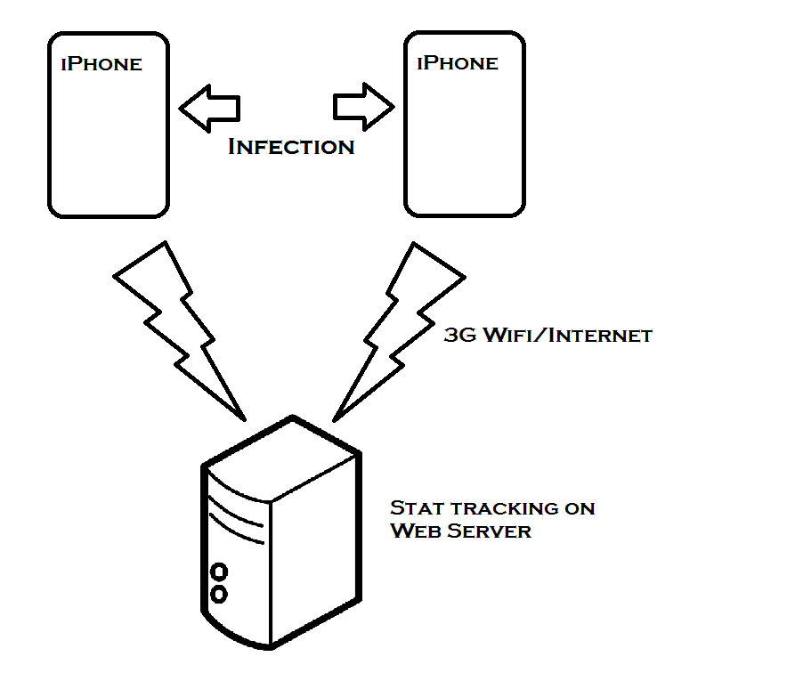
Communication
3G Wifi/Internet
Web Server
Stat tracking
Geo-Location tracking

Slide 11

Keep Track of Hot-Zone
Geo-Location of Players
Upload/Download Virus statistics
User’s Immunizations
Server DataBase

Slide 12

Cross Platform
Using geo-location
Offsite infection zone monitor
Bonjour
cross-platform

