Slide 1
CSC435: Web Programming Lecture 15: Walk the Dom tree
Bei Xiao
American University
March 8, Friday, 2019

Slide 2
Future lecture plan
Lectures | Content | homework
March 8 | Walk the DOM tree | Rectangle Exercise, Homework 4 out
March 19 | JS review | CP 3 Out
March 22 | Midterm exam | Homework 4 Due
March 26 | Ajax/JSON | CP3 Due
March 30 | Server side programming | Project 5 is out, CP4 out

Slide 3
Readings
What you need to know about JavaScript OOP:
http://eloquentjavascript.net/1st_edition/chapter8.html
http://javascriptissexy.com/oop-in-javascript-what-you-need-to-know/
JavaScript Timers:
https://www.w3schools.com/js/js_timing.asp

Slide 4
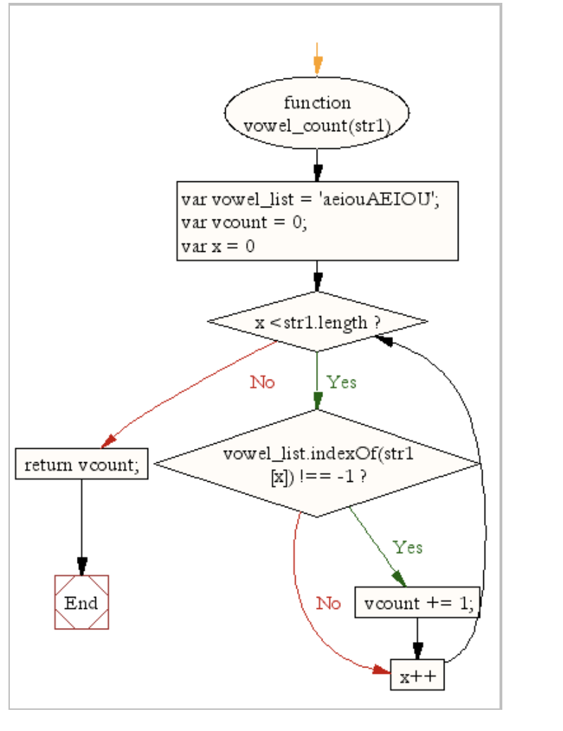
Warm-up exercise
Write a JS function that counts vowels in a sentence. You can consult with the following chart:

Slide 5
Timer Exercise : Bouncing Ball
Create a page which contains an animated bouncing all. You are given ball.html and ball.css and you will write ball.js.
The bounce area is 600px by 400px, and the ball takes up 40px by 40px of space.
Every frame of animation (every 20ms), apply a "gravity" ot the ball and increase its downward speed by 1.
If the ball hits the ground, make it "bounce" up to 3/4 the velocity it previously had.
Center the ball within the ball area and use that element's width/height as boundaries.
Optional: Make the code generic enough to work with any size ball and any size bounce area (ie., don't hard code these numbers)

Slide 6

How to annoy a web developer?
https://xkcd.com/1144/

Slide 7
The keyword this
this.fieldName // access field
this.fieldName = value; // modify field
this.functionName(parameters); // call method
All JavaScript code actually runs inside of an object
By default, code runs in the global window object (so this === window)
All global variables and functions you declare become part of window
The this keyword refers to the current object

Slide 8
Event Handler Binding
window.onload = function() {
document.getElementById("textbox").onmouseout = booyah;
};
function booyah() { // booyah knows what object it was called on
this.value = "booyah";
}
Event handlers attached unobtrusively are bound to the element
Inside the handler, that element becomes this

Slide 9
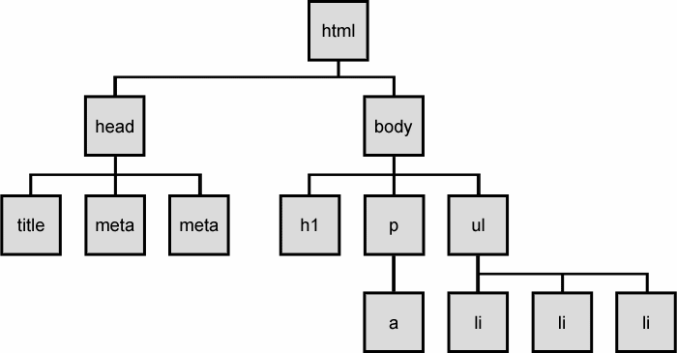
The DOM tree
The elements of a page are nested into a tree-like structure of objects the DOM has properties and methods for traversing this tree

Slide 10
DOM versus innerHTML hacking
Why not just code this way?
function slideClick() {
document.getElementById("main").innerHTML += "<p>A paragraph!</p>";
}
Imagine that the new node is more complex:
ugly: bad style on many levels (e.g. JS code embedded within HTML)
error-prone: must carefully distinguish " and '
can only add at beginning or end, not in middle of child list
function slideClick() {
document.getElementById("main").innerHTML += "<p style='color: red; " +
"margin-left: 50px;' " + "onclick='myOnClick();'>" +
"A paragraph!</p>";
}

Slide 11
Creating new node
name | description
document.createElement("tag") | creates and returns a new empty DOM node representing an element of that type
document.createTextNode("text") | creates and returns a text node containing given text
// create a new <h2> node
var newHeading = document.createElement("h2");
newHeading.innerHTML = "This is a heading";
newHeading.style.color = "green";
merely creating a element does not add it to the page
you must add the new element as a child of an existing element on the page...

Slide 12
Example: replace child
<ul id="myList"><li>Coffee</li><li>Tea</li><li>Milk</li></ul>
<script>
function myFunction() {
var textnode = document.createTextNode("Water");
var item = document.getElementById("myList").childNodes[0];
item.replaceChild(textnode, item.childNodes[0]);
}
</script>

Slide 13
Modifying the DOM tree
Every DOM element object has these methods:
name | description
appendChild(node) | places given node at end of this node's child list
insertBefore(new, old) | places the given new node in this node's child list just before old child
removeChild(node) | removes given node from this node's child list
replaceChild(new, old) | replaces given child with new node
let p = document.createElement("p");
p.innerHTML = "A paragraph!";
document.getElementById("main").appendChild(p);
A paragraph!

Slide 14
Complex DOM manipulation problems
How would we do each of the following in JavaScript code? Each involves modifying each one of a group of elements ...
When the Go button is clicked, reposition all the divs of class “puzzle” to random x/y locations.
When the user hovers over the maze boundary, turn all maze walls red.
Change every other item in the ul list with id of TAs to have a gray background.

Slide 15
Selecting groups of DOM object
methods in document and other DOM objects (* = HTML5):
name | description
getElementsByTagName | returns array of descendents with the given tag, such as "div"
getElementsByName | returns array of descendents with the given name attribute (mostly useful for accessing form controls)
querySelector * | returns the first element that would be matched by the given CSS selector string
querySelectorAll * | returns an array of all elements that would be matched by the given CSS selector string

Slide 16
Getting all elements of a certain type
Highlight all paragraphs in the document:
let allParas = document.querySelectorAll("p");
for (var i = 0; i < allParas.length; i++) {
allParas[i].style.backgroundColor = "yellow";
} JS
<body>
<p>This is the first paragraph</p>
<p>This is the second paragraph</p>
<p>You get the idea...</p>
</body> HTML

Slide 17
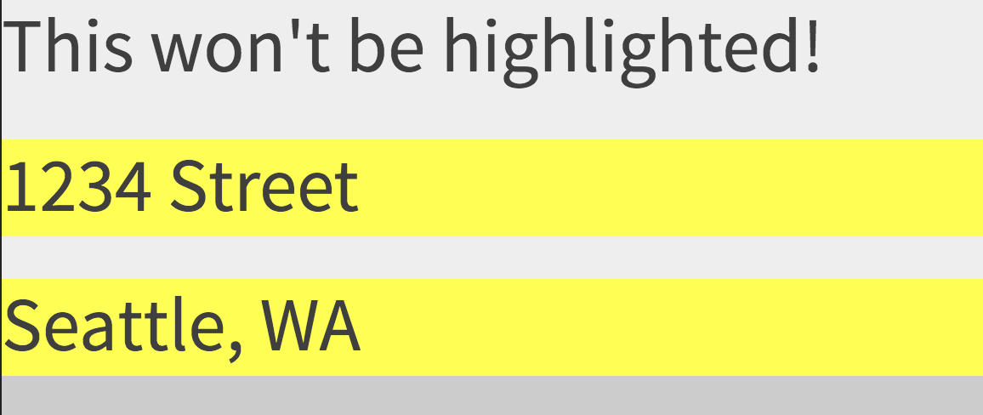
Complex Selectors
Highlight all paragraphs inside the section with ID “address”:
// document.getElementById("address").getElementsByTagName("p")
var addrParas = document.querySelectorAll("#address p");
for (var i = 0; i < addrParas.length; i++) {
addrParas[i].style.backgroundColor = "yellow";
}
<p>This won't be returned!</p>
<div id="address">
<p>1234 Street</p>
<p>Seattle, WA</p>
</div> HTML

Slide 18
Common querySlectorAll issues
Many students forget to write . or # in front of a class or id
// get all buttons with a class of "control"
var gameButtons = document.querySelectorAll("control");
var gameButtons = document.querySelectorAll(".control"); JS
querySelectorAll returns an array, not a single element; must loop over the results (document.querySelector returns just the first element that matches, if that's what you want)
// set all buttons with a class of "control" to have red text
document.querySelectorAll(".gamebutton").style.color = "red";
var gameButtons = document.querySelector(".gamebutton");
for (var i = 0; i < gameButtons.length; i++) {
gameButtons[i].style.color = "red";
}

Slide 19
Problems with Reading/Changing Styles
<button id="clickme" style="font-size:16pt;">Click Me</button>
HTML
window.onload = function() {
document.getElementById("clickme").onclick = biggerFont;
};
function biggerFont() {
let button = document.getElementById("clickme");
let size = parseInt(button.style.fontSize);
button.style.fontSize = (size + 4) + "pt";
}
JS
The style property lets you set any CSS style for an element
A catch: you can only use “this” to read styles set in the html or with the DOM .style. You cannot read css properties from “this”his.

Slide 20
Getting/Setting CSS Classes with classlist
function highlightField() {
// turn text yellow
let text = document.getElementById("text");
if (!text.classList.contains("invalid"))
{ text.classList.add("highlight");
}
}
classList collection has methods add, remove, contains, and toggle to manipulate CSS classes.
.
// div is an object reference to a <div> element with class="foo bar" div.classList.remove("foo");
div.classList.add("anotherclass");
// if visible is set remove it, otherwise add it div.classList.toggle("visible");
// add/remove visible, depending on test conditional, i less than 10 div.classList.toggle("visible", i < 10 );

Slide 21
Removing a Node from a page
function slideClick() {
let bullet = document.getElementById("removeme"); bullet.parentNode.removeChild(bullet);
}
Add odd idio: obj/parentNode. remove(obj)

Slide 22
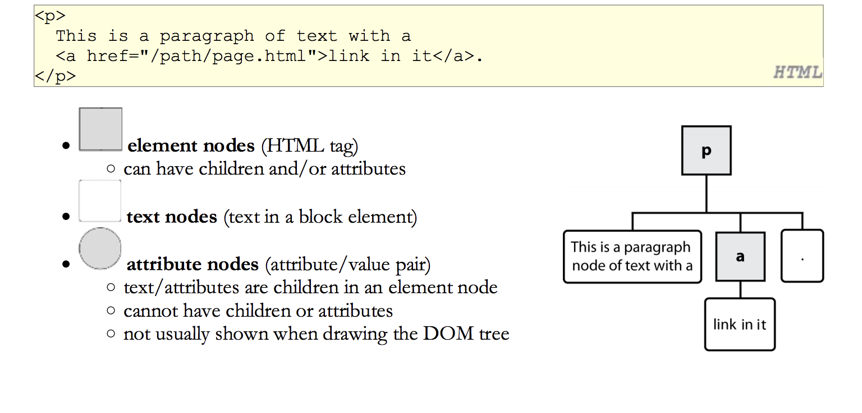
Types of DOM node

Slide 23
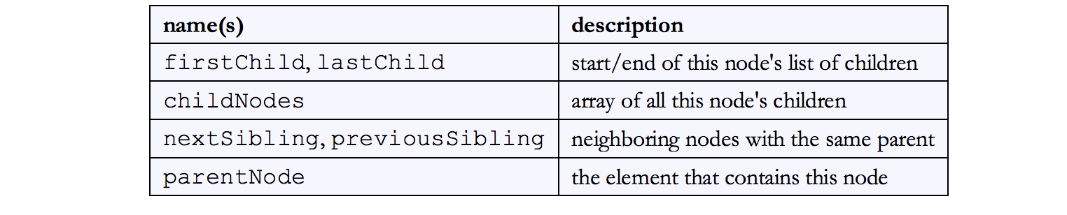
Traversing the DOM tree

Slide 24
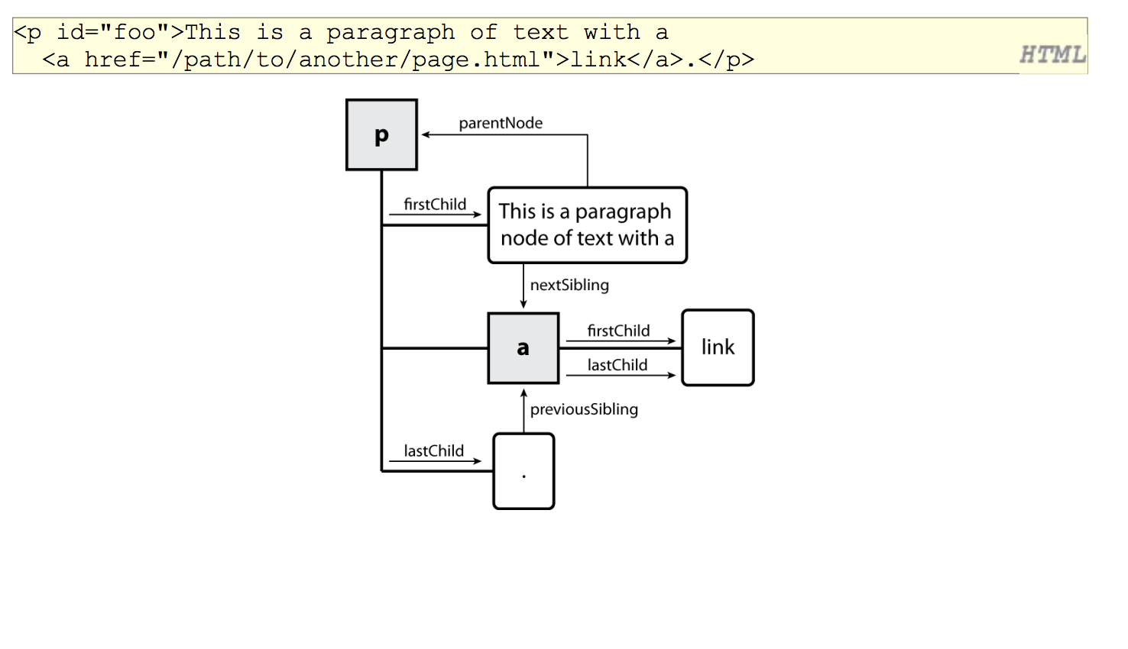
DOM tree transverse example

Slide 25
Example: replace child
<ul id="myList"><li>Coffee</li><li>Tea</li><li>Milk</li></ul>
<script>
function myFunction() {
var textnode = document.createTextNode("Water");
var item = document.getElementById("myList").childNodes[0];
item.replaceChild(textnode, item.childNodes[0]);
}
</script>

Slide 26
Example: remove child
<span>
Shotting
<img id= “fallenstar” src = “star_on.gif”>
</span>
var star = document.getElementById('fallenstar');
star.parentNode.removeChild(star);

Slide 27
Example: document.createTextNode
<span id = “math”
6*7 =
</span>
document.getElementByID(‘math’).appendChild(document.createTextNode(42));

Slide 28
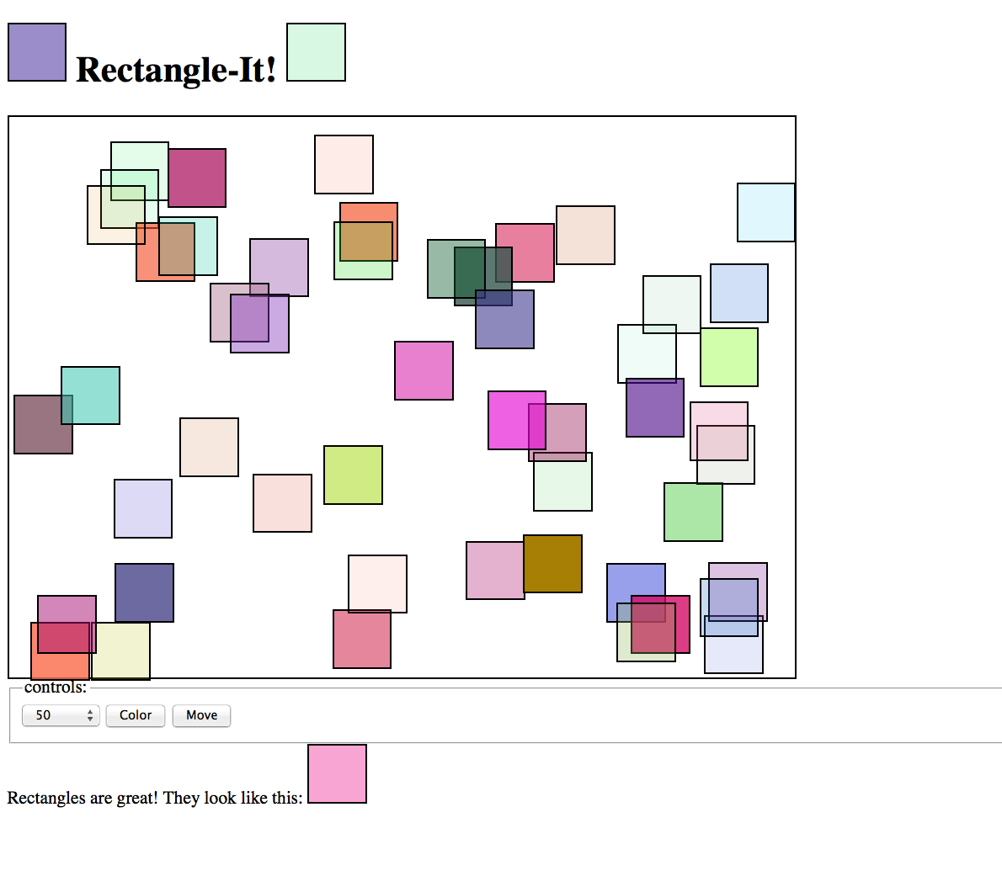
Take-home Exercise: color rectangles, Requires Turn-in

Slide 29
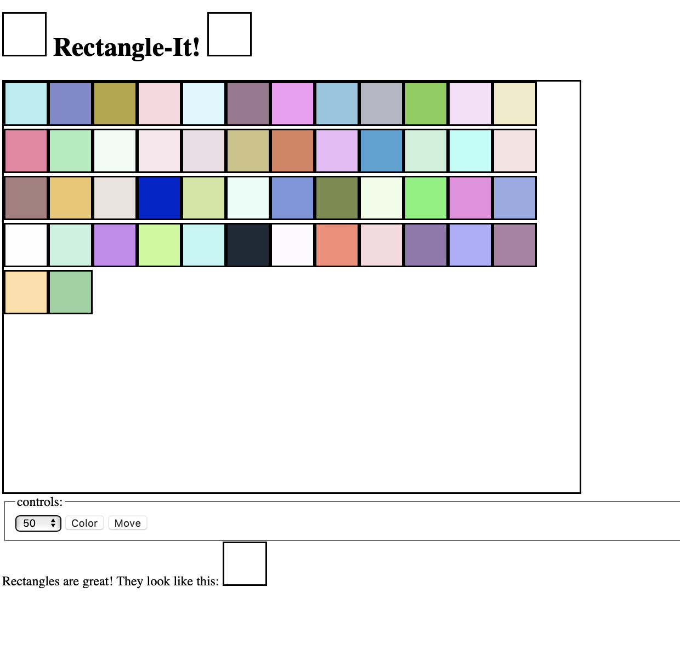

Slide 30
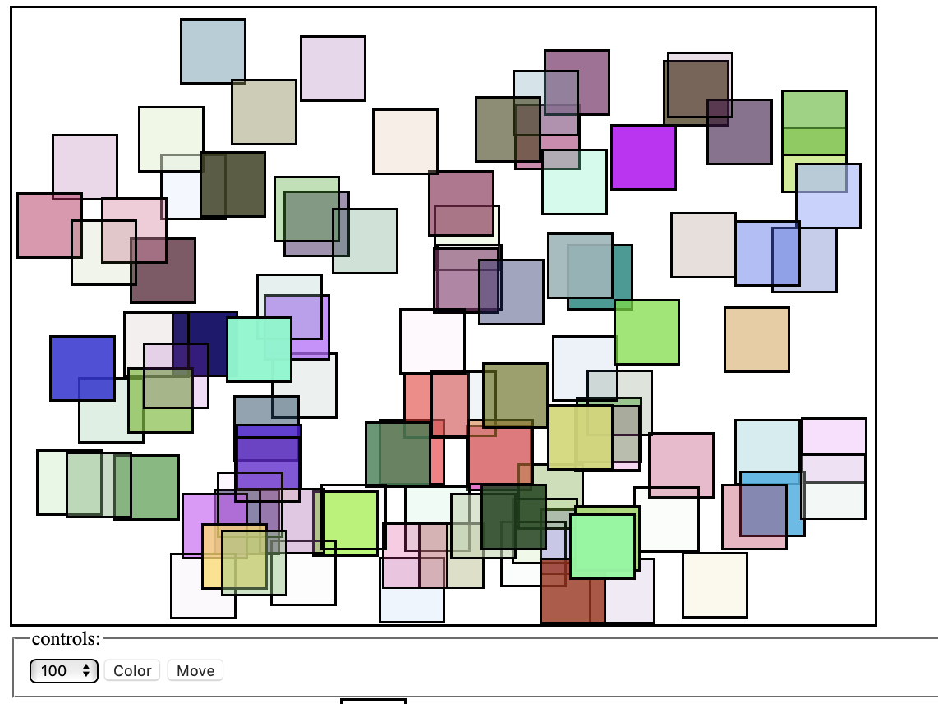

Slide 31
color rectangles, Instructions
You can create 1, 50, 100 rectangles with different colors by editing the rectangle.js script by using the drop-down menu. You can use the dropdown menu also to re-place the rectangles as a grid.
You can add colors to the rectangle by clicking “ Color”. Everytime you click “color”, it changes the color of the rectangles.
You can move the rectangles to random locations WITHIN the boarder by clicking “Move”.

Slide 32
Object: function construct with “this”
function Rabbit(adjective) {
this.adjective = adjective;
this.speak = function(line) {
print("The ", this.adjective, " rabbit says '", line, "'");
};
}
var killerRabbit = new Rabbit("killer");
killerRabbit.speak("GRAAAAAAAAAH!");
http://eloquentjavascript.net/1st_edition/chapter8.html
Notes:
Even though objects seem to share the properties of their prototype, this sharing is one-way. The properties of the prototype influence the object based on it, but the properties of this object never change the prototype.
¶
The precise rules are this: When looking up the value of a property, JavaScript first looks at the properties that the object itself has. If there is a property that has the name we are looking for, that is the value we get. If there is no such property, it continues searching the prototype of the object, and then the prototype of the prototype, and so on. If no property is found, the value undefined is given. On the other hand, when setting the value of a property, JavaScript never goes to the prototype, but always sets the property in the object itself.

Slide 33
Extending objects with prototype
Create an object:
Create an object:
The function person has a prototype property. We can add properties to the function:
function Person(name)
{
this.name = name;
}
// when we create a new object using:
var zack = new Person (“Zack”)
Person.prototpye.kind = ‘person’
//in the new object we have access to
Person.prototype.person.kind // person

Slide 34
Example: prototype (see Demo_Extending.html)
// constructor function that takes two properties, and one method showInfo
function Person(personName) {
this.name = personName;
this.info = “This person is called” + this.name;
this.showInfo = function(){
alert(this.info);
}
}
// create two objects
var person1 = new Person (“Adam”);
Var person2 = new Person (“Eve”);
// we can add a further method sayHello to the person object
Definition.
Person.prototype.sayHello = function(){
alert(this.name + “say hello”);
}
Person1.sayHello() //”Adam say hello”
Person2.showInfo()

Slide 35
Inheriting objects
Inheritance is the ability to create one object type from another, the new object type inherits the properties and the methods of the old, as well as optionally having further properties and the methods of its own.
object.prototype can be used to add new methods and properties, but it can also be utilized to add all of the methods and properties of an existing constructor function to your new object.

Slide 36
Demo: cat and dog
Create a function called Pet() that can have the property of “animal” and “name”
Create methods setAnimal and setName. Such as
var myCat = new Pet();
myCat.setAnimal("cat");
myCat.setName("Garfield");
Now create a function called Dog() that has an additional method called breed.
Let the Dog inherit all the properties from Pet()
var myDog = new Dog();
myDog.setAnimal("Dog");
myDog.setName("Odie");
myDog.setBreed("Greyhound");

Slide 37
Step 1: Pet()
function Pet(){
this.animal = "";
this.name = "";
this.setAnimal = function(newAnimal){
this.animal = newAnimal;
}
this.setName = function(newName){
this.name = newName;
}
}

Slide 38
Step 2: cat object
// A Pet object has properties that contain the type of animal and the name of the pet and methods to set these values.
var myCat = new Pet();
myCat.setAnimal("cat");
myCat.setName("Garfield");
alert(" " + myCat.animal + " is called " + myCat.name);

Slide 39
Step 3: create dog and make it breed
//Now we create a function for Dog. We want to add a property breed and a method setBreed.
function Dog(){
this.breed = "";
this.setBreed = function(newBreed){
this.breed = newBreed;
}
}
// we want the dog has the same property as Pet, to do so we simply inherit the properties and methods of Pet.
Dog.prototype = new Pet();

Slide 40
Step 4: Make dog inherit pet()
// we want the dog has the same property as Pet, to do so we simply inherit the properties and methods of Pet.
Dog.prototype = new Pet();
//Now, we can access to the properties and methods of Pet in addition to those of Dog.
var myDog = new Dog();
myDog.setAnimal("Dog");
myDog.setName("Odie");
myDog.setBreed("Greyhound");
alert(" My " + myDog.animal + " " + myDog.name+" is a " + myDog.breed);

Slide 41
Now, please do the take-home exercises of OOP. Will be used in the mid-term

Slide 42
Exercise 1: using prototype to extend existing JavaScript object
You can implement a String.prototype.backwards methods that returns a reversed version of any string you supply.
Here is your starter .js code:
<script type="text/javascript">
var inString = prompt("Enter your test string");
document.write(inString.backwards());
</script>

Slide 43
Exercise 2
Write a constructor function for a card object with properties suit (diamonds, hearts, spades, or clubs) and face (ace, 1, 2,…king).
Add methods to set the values of suit and face.
Hint: alert the suitName and the faceName into the screen when you set the new values of suit and face.
Inside the constructor:
this.setValues = function(suitName, faceName) {
}
var myCard1 = new Card(“space”, “ace”)
myCard.setValues (“Hearts”, “12”)

Slide 44
Exercise 3
Write a JavaScript program to get the volume of a Cylinder with four decimal places using object class.
Volume of a cylinder is V = pi r ^2 h
Hint: create a Cylinder class that takes height and radius and use prototype to add the Volume function.
//You shall create a new Cylinder object by:
var cyl = new Cylinder (7,4);
//And output:
Document.write(cyl.Volume)
num.toFixed(4)
http://www.w3schools.com/jsref/jsref_tofixed.asp

