Slide 1
CSC435: Web Programming Lecture 20: Server-side, Intro to PHP
Bei Xiao
American University
April 5 , Friday

Slide 2
Future lecture plan
Lectures | Content | homework
April 5 | Ajax Review, Chatroom Intro to PHP | Homework 5 (trivia pursuit) will be out this weekend
April 9 | More on PHP syntax, File I/O | CP 4 out
April 12 | Query Parameters, Form Regular Expressions | Homework 5 due
April 16 | Cookies and Sessions | Final Project (dating website)
April 19 | More Cookies and Sessions | Final Project, Final CP due May 3rd Grades due May 5
April 23 | SQL

Slide 3
Review: Course Outline
HTML: Webpage content
CSS: Webpage presentation
JavaScript: Webpage functionality (client-side)
AJAX: Fetching data from the internet
PHP: Server-side code
Regular expressions: validating input
SQL: Storing data (optional)
Putting things together: Final project

Slide 4
Today’s lecture
AJAX exercise
HTTP review
Server side programming
Install Ammps and run PHP script
Basic PHP

Slide 5
Install AMPS
http://www.ampps.com/LAMP
Create a symbolic link of your folder in the www:
ln -s /yourpath /Applications/AMPPS/www
Or put your code in the www folder
run hello.php in localhost
See here for reference:
https://manik.me/2016/02/29/sync-ampps-with-multiple-machines/

Slide 6
Fetch()
function checkStatus(response) { ... }
function callAjax(){
let url = ..... // put url string here
fetch(url, {chandleError(error){ //error: do something with error }redentials: 'include'}) // include credentials for cloud9 .then(checkStatus)
.then(handleResponse)
.catch(handleError);
}
function handleResponse(responseText){
//success: do something with the responseText }

Slide 7
Ajax quiz: Fetch a file!
To keep it simple, assume that the file that is typed in will be a simple file name ("hello.txt") and assume it is valud input.
that the file is stored in the same directory as your HTML and JS. You may assume (mostly) valid user input,
but you must handle the case where the file doesn’t exist. If the file doesn’t exist, place an error message of your choice inside p#error.

Slide 8
Ajax quiz: Fetch a file!
Given the following HTML (only the body is shown), write a JavaScript program that adds a click event handler to the ’Go Fetch’ button such that when clicked:
• Gets the current input from the text input box
• Uses AJAX to attempt to fetch the contents of the file name given in the input text box
• Uses DOM manipulation to put the contents of the fetchd file into the #file-contents paragraph
Run your .html in AMPPS through local host

Slide 9
Ajax exercise 1: Chat room
Download the HTML skeleton code and the chatit.php file from blackboard.
Write the necessary JavaScript code to make the page into a chat program. Read and submit chat messages by making Ajax requests to the provided (https://webster.cs.washington.edu/cse154/sections/9/chatit/chatit.php
) .
Reading: every 5 seconds, make an Ajax GET request to ask the PHP script for all messages. Optional parameters: reverse returns output in reverse-chronological order; limit returns only that many most recent posts
Submitting: When the 'Send!' button is clicked, make an Ajax POST request to the PHP script with the parameter msg to submit a message.

Slide 10
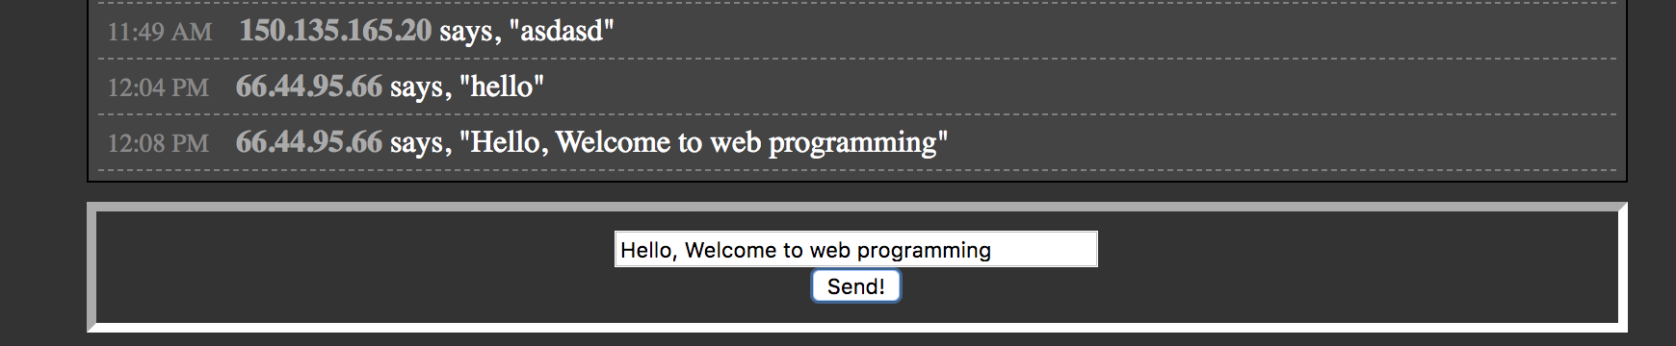
Ajax exercise 1: Chat room

Slide 11
URLs and Web Servers
https://server/path/file
Usually when you type a URL in your browser:
Your computer looks up the server's IP address using DNS
Your browser connects to that IP address and requests the given file
The web server software (e.g. Apache) grabs that file from the server's local file system and then send back its contents to you
Some URLs actually specify programs that the web server should run, and then send their output back to you as the result:
https://catalog.american.edu/content.php?catoid=6&navoid=1426
The above URL tells the server ameican.edu to run the program content.php (with some parameters) and send back its output

Slide 12
Request to a static site
HTTP Request: GET www.xkcd.com
xkcd
Client
Your Browser
HTTP Response: web content HTML file, client side code: HTML, CSS, JavaScript
Web server:
IP: 72.26.203.99

Slide 13
Request to a dynamic site
The server must respond dynamically if it needs to provide
Different client-side code depending on the situation
Date and time
Specifics of the user’s request
Database contents- forms and authentication
HTTP Request: GET www.facebook.com
Client
Your Browser
HTTP Response: web content HTML file, client side code: HTML, CSS, JavaScript (dynamically generated by server)
Web server:

Slide 14
Request to a dynamic site
The server must respond dynamically if it needs to provide
Different client-side code depending on the situation
Date and time
Specifics of the user’s request
Database contents- forms and authentication
Look up things that go on user’s profile, such as wall posts and friends, caches, database lookups
Generate client-side code containing these things
Send as HTTP response
HTTP Request: GET www.facebook.com
Client
Your Browser
HTTP Response: web content HTML file, client side code: HTML, CSS, JavaScript (dynamically generated by server)
Web server:

Slide 15
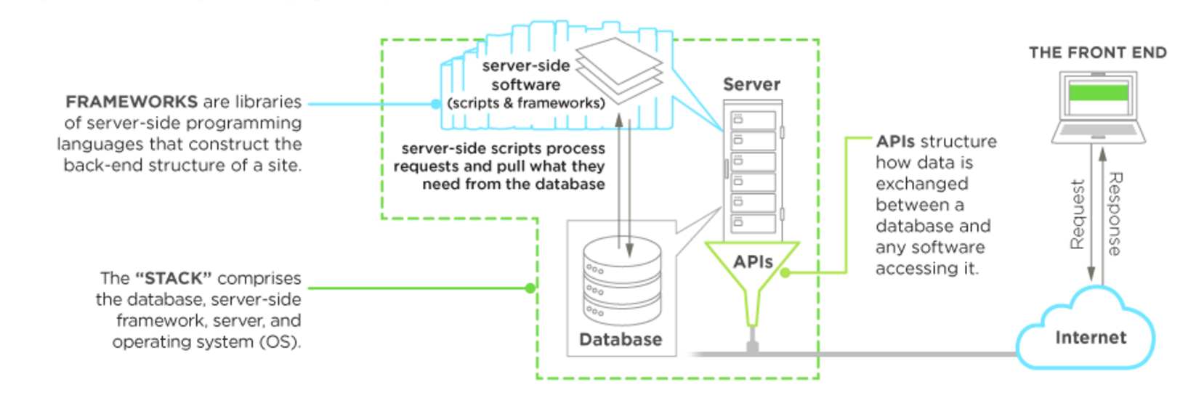
Back-end development
Notes:
API: application programming interface

Slide 16
http methods
Two HTTP request Methods
Get: Request data from a specified resource
Post: Submits data to be processed to a specified resource
Notes:
API: application programming interface

Slide 17
GET method
Is used to retrieve data from a server
Query string is sent in URL:
/test/demo_form.php?name=value1&name=value2
GET requests can be cached
GET requests remain in the browser history
GET requests can be bookmarked
GET requests should never be used when dealing with sensitive data
GET requests have length restrictions
GET requests should be used only to retrieve data
Notes:
API: application programming interface

Slide 18
POST method
Is used to send data to the server , customer information via HTML form
POST /test/demo_form.sap HTTP/1.1
Host: w3schools.com
name1=value1&name=value2
POST requests are never cached
POST requests do not remain in the browser history
POST requests cannot be bookmarked
POST requests have no restrictions on data length
Notes:
API: application programming interface

Slide 19
Server-side script basics
Runs on a server
Facilitates the transfer of data
Runs on-call, e.g. with Ajax.
Powers functions in a dynamic web applications.
Plays a big role in how a database is built from ground up and manages afterwards
Build application programming interfaces (APIs), which controls what data and software a site shares
Notes:
API: application programming interface

Slide 20
URLs and web servers
http://server/path/file
usually when you type a URL in your browser:
your computer looks up the server's IP address using DNS
your browser connects to that IP address and requests the given file
the web server software (e.g. Apache) grabs that file from the server's local file system, and sends back its contents to you
some URLs actually specify programs that the web server should run, and then send their output back to you as the result:
http://php.net/manual/en/features.commandline.webserver.php
Notes:
API: application programming interface

Slide 21




Server-side options
server-side pages are programs written using one of many web programming languages/frameworks
examples: PHP, Java/JSP, Ruby on Rails, ASP.NET, Python, Perl, NodeJS
the web server contains software that allows it to run those programs and send back their output
each language/framework has its pros and cons
Programming Language Popularity
we will use PHP for server-side programming
Notes:
API: application programming interface

Slide 22
Why PHP?
There are many other options for server-side languages: Ruby on Rails, JSP, ASP.NET, etc. Why choose PHP?
free and open source: anyone can run a PHP-enabled server free of charge
compatible: supported by most popular web servers
simple: lots of built-in functionality; familiar syntax
well-documented: type php.net/functionName in browser Address bar to get docs for any function
Notes:
API: application programming interface

Slide 23
What is PHP?
PHP = PHP: Hypertext Preprocessor
Server-side scripting language that maybe embedded into HTML
PHP is executed from the server
Ultimate goal is to get PHP files to generate client-side code
Must end up with HTML, CSS, JavaScript, other client-side code!
Notes:
API: application programming interface

Slide 24
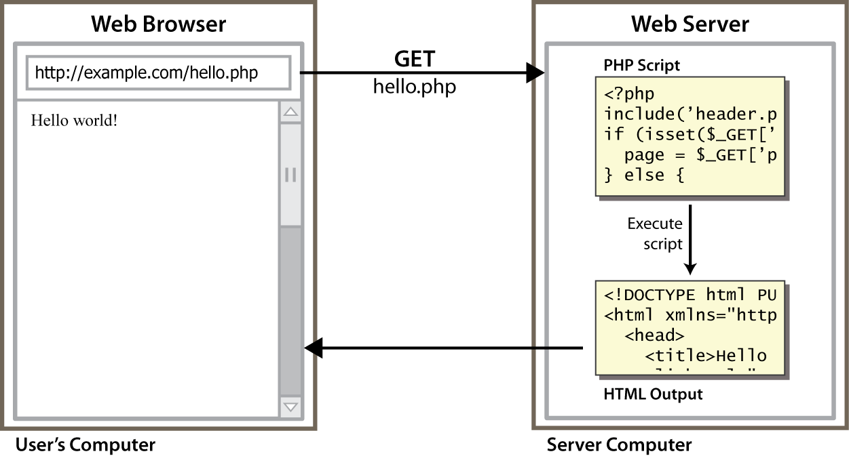
Life cycle of a PHP web request
browser requests a .html file (static content): server just sends that file
browser requests a .php file (dynamic content): server reads it, runs any script code inside it, then
Notes:
API: application programming interface

Slide 25
Life cycle of a PHP web request
browser requests a .html file (static content): server just sends that file
browser requests a .php file (dynamic content): server reads it, runs any script code inside it, then
Notes:
API: application programming interface

Slide 26
Side by side
PHP File: Output: resulting HTML
<html>
<head>
<title> PHP Introduction </title>
</head>
<body>
This is HTML! <br />
<?php
echo 'This is PHP! <br />';
?>
</body>
</html>
<html>
<head>
<title> PHP Introduction </title>
</head>
<body>
This is HTML! <br />
This is PHP! <br /></body>
</html>
Notes:
API: application programming interface

Slide 27
A closer look
<html>
<head>
<title> PHP Introduction </title>
</head>
<body>
This is HTML! <br />
<?php
echo 'This is PHP! <br />'; // prints to screen
/*
Here's a longer
comment
that spans multiple
lines.
*/
?>
</body>
</html>
PHP tag <?php and ?>
The echo command or print
Single line comment //
Multiple line comment /* and */
http://php.net/manual/en/tutorial.firstpage.php
Notes:
API: application programming interface

Slide 28
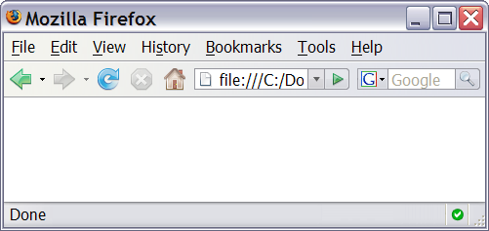
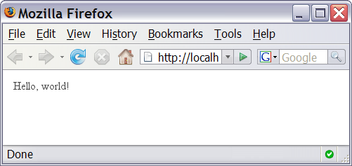
Viewing PHP output
you can't view your .php page on your local hard drive; you'll either see nothing or see the PHP source code
if you upload the file to a PHP-enabled web server, requesting the .php file will run the program and send you back its output
Notes:
API: application programming interface

Slide 29
Execute PHP script
Installing AMMPs (WAMP, MAMP, LAMP)
http://www.ampps.com/downloads
You can:
1. Put your.php files in subdirectory of webserver /var/www/ (not recommended)
2. Or configure your directory in configuration inside AMMPs. For example, create a symbolic link into the www directory:
ln -s /Users/bxiao/Desktop/CSC435 /Applications/AMPPS/www
https://ole.michelsen.dk/blog/setup-local-web-server-apache-php-macos-x-mavericks.html
Notes:
API: application programming interface

Slide 30
Arithmetic Operations
+ - * / % . ++ -- = += -= *= /= %= .=
many operators auto-convert types: 5 + "7" is 12

Slide 31
Variables
$name = expression; PHP
$user_name = "PinkHeartLuvr78";
$age = 16;
$drinking_age = $age + 5;
$this_class_rocks = TRUE; PHP
names are case sensitive; separate multiple words with _ (as in $user_name)
names always begin with $, on both declaration and usage
implicitly declared by assignment (type is not written; a "loosely typed" language)

Slide 32
Types
basic types: int, float, boolean, string, array, object, NULL
test what type a variable is with is_type functions, e.g. is_string
gettype function returns a variable's type as a string (not often needed)
PHP converts between types automatically in many cases:
string → int auto-conversion on + ("1" + 1 == 2)
int → float auto-conversion on / (3 / 2 == 1.5)
type-cast with (type):
$age = (int) "21";

Slide 33
String type
$favorite_food = "Ethiopian";
print $favorite_food[2];
0-based indexing using bracket notation
string concatenation operator is . (period), not +
5 + "2 turtle doves" produces 7
5 . "2 turtle doves" produces "52 turtle doves“
can be specified with "" or ' '

Slide 34
String functions
# index 0123456789012345
$name = “Austin Weale";
$length = strlen($name); # 16
$cmp = strcmp($name, “Linda Guo"); # > 0
$index = strpos($name, “s"); # 2
$first = substr($name, 7, 4); # “Weal"
$name = strtoupper($name); # “AUSTIN WEALE“ PHP
Name | Java Equivalent
strlen | length
strpos | indexOf
substr | substring
strtolower, strtoupper | toLowerCase, toUpperCase
trim | trim
explode, implode | split, join

Slide 35
Interpreted Strings
$age = 16;
print "You are " . $age . " years old.\n";
print "You are $age years old.\n"; # You are 16 years old.
Strings inside " " are interpreted
Variables that appear inside them will have their values inserted into the string
Strings inside ' ' are not interpreted:
print 'You are $age years old.\n'; # You are $age years old.
If necessary to avoid ambiguity, you can enclose the variable in {}:
print "Today is your {$age}th birthday.\n";

Slide 36
bool (Boolean) Type
$feels_like_summer = FALSE;
$php_is_rad = TRUE;
$student_count = 217;
$nonzero = (bool)
$student_count; # TRUE
The following values are considered to be FALSE (all others are TRUE):
0 and 0.0
"", "0", and NULL (includes unset variables)
arrays with 0 elements
Can cast to boolean using (bool)
FALSE prints as an empty string (no output); TRUE prints as a 1

Slide 37
For Loops
for (initialization; condition; update) { statements }
for ($i = 0; $i < 10; $i++) {
print "$i squared is " . $i * $i . "\n"; }

Slide 38
If/Else Statement
if (condition) {
statements;
} else if (condition) { statements;
} else {
statements;
}
Can also use elseif instead of else if

Slide 39
While Loop (same as Java)
while (condition) {
statements;
}
do {
statements;
} while (condition);

Slide 40
Arrays
$name = array();
# create $name = array(value0, value1, ..., valueN); $name[index] # get element value $name[index] = value; # set element value $name[] = value; # append PHP
$a = array(); # empty array (length 0)
$a[0] = 23; # stores 23 at index 0 (length 1)
$a2 = array("some", "strings", "in", "an", "array");
$a2[] = "Ooh!"; # add string to end (at index 5)
to append, use bracket notation without specifying an index
element type is not specified; can mix types

Slide 41
Array functions
function name(s) | description
count | number of elements in the array
print_r | print array's contents
array_pop, array_push, array_shift, array_unshift | using array as a stack/queue
in_array, array_search, array_reverse, sort, rsort, shuffle | searching and reordering
array_fill, array_merge, array_intersect, array_diff, array_slice, range | creating, filling, filtering
array_sum, array_product, array_unique, array_filter, array_reduce | processing elements

Slide 42
Functions
function name(parameterName, ..., parameterName) {
statements;
}
function bmi($weight, $height) {
$result = 703 * $weight / $height / $height;
return $result;
}

Slide 43
Calling Functions
name(expression, ..., expression);
$w = 163; # pounds
$h = 70; # inches
$my_bmi = bmi($w, $h);
if the wrong number of parameters are passed, it's an error

Slide 44
Embedded PHP

Slide 45
PHP syntax template
HTML content
<?php
PHP code
?>
HTML content
<?php
PHP code
?>
HTML content ... PHP
any contents of a .php file between <?php and ?> are executed as PHP code
all other contents are output as pure HTML

Slide 46
Quiz 1
Write a simple PHP script, set variables $a = ‘My name’, $firstname = ‘Harry’, $lastname = ‘Potter’, and print out ‘My name is Harry Potter.’ Also, print out the position of the string “Harry”.

Slide 47
Quiz 2
Create an array with weather conditions, rain, sunshine, showers, clouds, snow, sleet, and windy.
And write the following sentence to the browser:
“We have seen all kinds of weather, in the beginning of the moth, we had snow, then yesterday morning, we had showers, later it becomes cloudy, in the evening, it started to snow. Today, we finally had sunshine.”
Hint: use print or echo

Slide 48
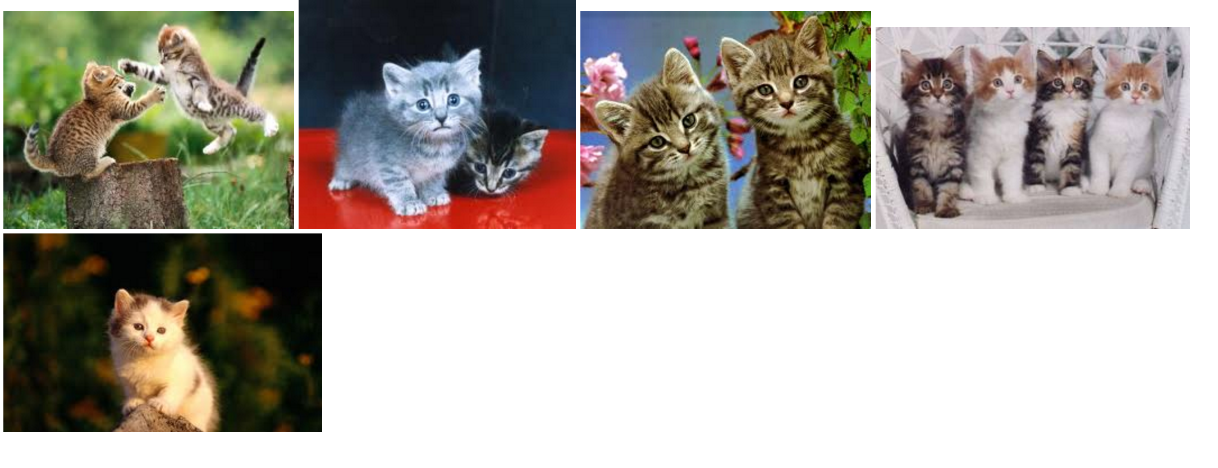
Quiz 3
Download kitten.html and kitten images
Write PHP code that display five kitten images.
Your code should replace the .html in the <div> Hint: how do you make
<img src = “”> into a loop.

Slide 49
Quiz 4
Create a simple form, asking user for their name and address
And create a safedata.php
to save the information as a .txt file.
Hint: Use $.Ajax() or Fect()

Slide 50
Take home read
HTTP tutorial
http://code.tutsplus.com/tutorials/http-the-protocol-every-web-developer-must-know-part-1--net-31177
Introduction to PHP, codeacademy, track 1-3
https://www.codecademy.com/ja/courses/web-beginner-en-StaFQ/0/1?curriculum_id=5124ef4c78d510dd89003eb8
PHP manual:
http://www.php.net/manual/en/language.references.php
Phiilp Guo (Univ. Rochester) has a nice video demos how to configure AMMPs, but he taught Python-CGI instead of PHP:
https://www.youtube.com/watch?v=b7l8zgVVvgE

