Slide 1
CSC435: Web Programming Lecture 21: Function, File I/O
Bei Xiao
American University
Friday, April 12, 2019

Slide 2
Today’s lecture
More on basic PHP
Query parameters
Web services
JSON/File processing
Exercises: music page

Slide 3
Take home tutorial !!
PHP tutorials for beginners (really great tutorials):
http://www.homeandlearn.co.uk/php/php.html
PHP, Ajax, JavaScript, JSON (important for homework!)
http://blog.teamtreehouse.com/beginners-guide-to-ajax-development-with-php
jQuery Ajax call and JSON return
https://jonsuh.com/blog/jquery-ajax-call-to-php-script-with-json-return/

Slide 4
More on fetch(): Get
fetch('http://example.com/movies.json’)
.then(function(response) { return response.json(); })
.then(function(myJson) { console.log(JSON.stringify(myJson));
});

Slide 5
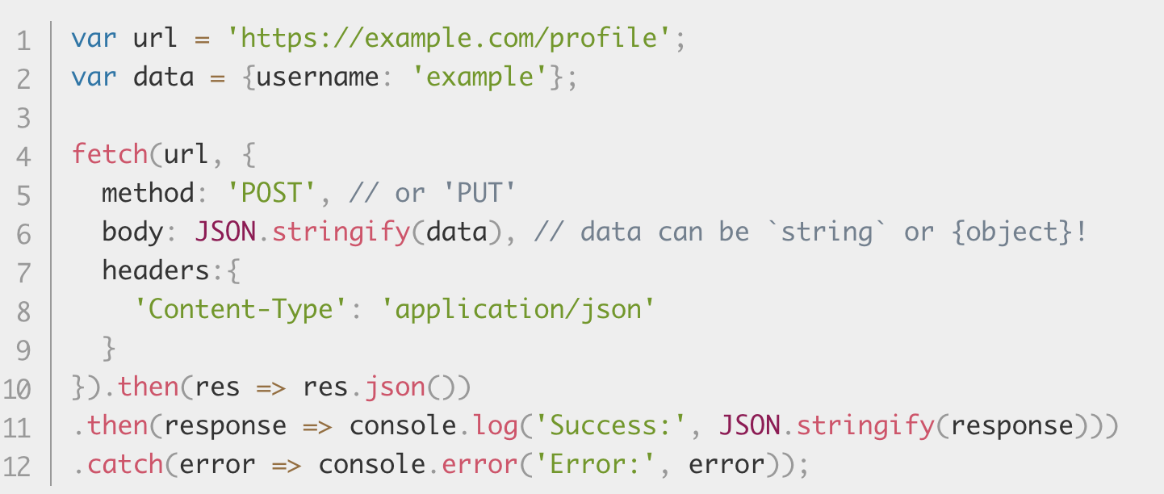
More on fetch(): using post to update JSOn
https://developer.mozilla.org/en-US/docs/Web/API/Fetch_API/Using_Fetch

Slide 6
PHP expression blocks
<?= expression ?> PHP
<h2> The answer is <?= 6 * 7 ?> </h2> PHP
The answer is 42 output
PHP expression block: evaluates and embeds an expression's value into HTML
<?= expr ?> is equivalent to <?php print expr; ?>

Slide 7
Warm-up exercise 1
Create an array with weather conditions, rain, sunshine, showers, clouds, snow, sleet, and windy.
And write the following sentence to the browser:
“We have seen all kinds of weather, in the beginning of the moth, we had snow, then yesterday morning, we had showers, later it becomes cloudy, in the evening, it started to snow. Today, we finally had sunshine.”
Hint: use print or echo

Slide 8
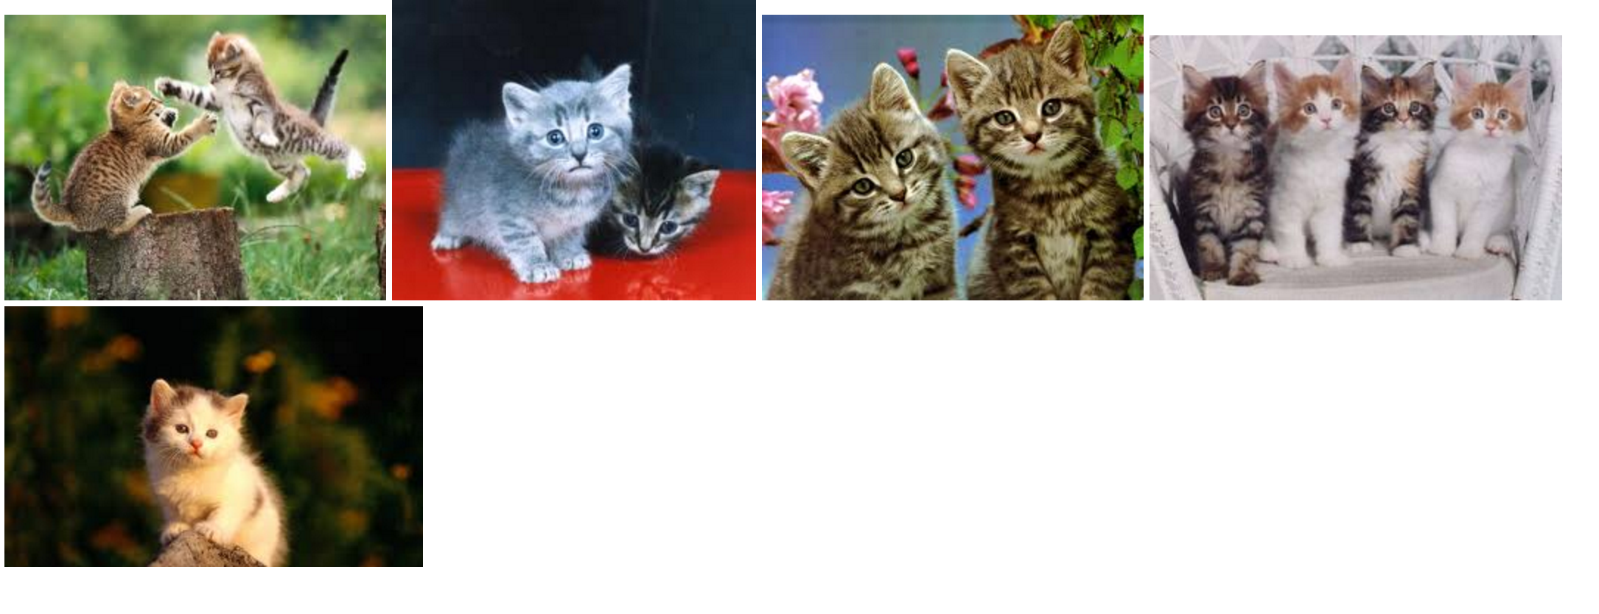
Warm-up 2
Download the kitten.html
Write PHP code that display five kitten images.
Your code should replace the .html in the <div> Hint: how do you make
<img src = “”> into a loop.

Slide 9
Common errors, unclosed braces
<body>
<p>Watch how high I can count:
<?php for ($i = 1; $i <= 10; $i++) {?>
<?= $i ?>
}
</p>
</body>
</html> PHP

Slide 10
Common errors, unclosed braces
<body>
<p>Watch how high I can count:
<?php for ($i = 1; $i <= 10; $i++) {?>
<?= $i ?>
<?php } ?>
</p>
</body>
</html> PHP
</body> and </html> above are inside the for loop, which is never closed
if you forget to close your braces, you'll see an error about 'unexpected $end‘
if you forget = in <?=, the expression does not produce any output

Slide 11
Complex expression blocks
<body>
<?php for ($i = 1; $i <= 3; $i++) { ?>
<h<?= $i ?>>This is a level <?= $i ?> heading.</h<?= $i ?>>
<?php } ?>
</body>

Slide 12
Complex expression blocks
<body>
<?php for ($i = 1; $i <= 3; $i++) { ?>
<h<?= $i ?>>This is a level <?= $i ?> heading.</h<?= $i ?>>
<?php } ?>
</body>
This is a level 1 heading.
This is a level 2 heading.
This is a level 3 heading.
expression blocks can even go inside HTML tags and attributes

Slide 13
The foreach loop
foreach ($array as $variableName) {
...
}
$stooges = array ("Larray", "Moe", "Curly", "Shemp");
foreach ($stooges as $stooge) {
print "Moe slaps $stooge\n"; # even himself
}
A convenient way to loop over each element of an array without indices.

Slide 14
Math operations
$a = 3;
$b = 2;
$c = sqrt(pow($a, 2) + pow($b, 2));
abs, ceil, cos, floor, log, log10, min, max, pow, rand, round, sin, sqrt, tan
The syntax for method calls, parameters, and returns is the same as in Java
The syntax for method calls, parameters, and returns is the same as in JAVA

Slide 15
Null
$name = "Pascal";
$name = NULL;
if (isset($name)) {
print "This line isn't going to be printed";
}
A variable is NULL if
It has not been set to any value (undefined)
It has been assigned the constant NULL
It has been deleted using the unset function
Can test if a variable is NULL using the isset function
NULL prints as an empty string (no output)

Slide 16
Functions
function name(parameterName, ..., parameterName) {
statements;
}
function bmi($weight, $height) {
$result = 703 * $weight / $height / $height;
return $result;
}

Slide 17
Calling Functions
name(expression, ..., expression);
$w = 163; # pounds
$h = 70; # inches
$my_bmi = bmi($w, $h);
if the wrong number of parameters are passed, it's an error

Slide 18
Variable scope: global and local vars
$school = ”AU"; # global
...
function downgrade() {
global $school;
$suffix = "(Washington)"; # local
$school = "$school $suffix";
print "$school\n";
} PHP
variables declared in a function are local to that function; others are global
if a function wants to use a global variable, it must have a global statement
but don't abuse this; mostly you should use parameters

Slide 19
Default Parameter Value
function name(parameterName = value, ..., parameterName = value) {
statements;
} PHP
function print_separated($str, $separator = ", ") {
if (strlen($str) > 0) {
print $str[0];
for ($i = 1; $i < strlen($str); $i++) {
print $separator . $str[$i];
}
}
}
print_separated("hello"); # h, e, l, l, o
print_separated("hello", "-"); # h-e-l-l-o PHP
if no value is passed, the default will be used (defaults must come last)

Slide 20
Query strings and parameters
URL?name=value&name=value...
http://www.google.com/search?q=Romney
http://example.com/student_login.php?username=obourn&id=1234567
query string: a set of parameters passed from a browser to a web server
often passed by placing name/value pairs at the end of a URL
above, parameter username has value obourn, and sid has value 1234567
PHP code on the server can examine and utilize the value of parameters
a way for PHP code to produce different output based on values passed by the user

Slide 21
Query parameters: $_GET, $_POST
$user_name = $_GET["username"];
$id_number = (int) $_GET["id"];
$eats_meat = FALSE;
if (isset($_GET["meat"])) {
$eats_meat = TRUE;
} PHP
$_GET["parameter name"] or $_POST["parameter name"] returns a GET/POST parameter's value as a string
parameters specified as http://....?name=value&name=value are GET parameters
test whether a given parameter was passed with isset
Notes:
http://www.tutorialspoint.com/php/php_get_post.htm

Slide 22
$_GET, $_POST used in form submission
<?php
if( $_GET["name"] || $_GET["age"] ) {
echo "Welcome ". $_GET['name']. "<br />";
echo "You are ". $_GET['age']. " years old.";
exit();
}
?>
<form action = "<?php $_PHP_SELF ?>" method = "GET">
Name: <input type = "text" name = "name" />
Age: <input type = "text" name = "age" />
<input type = "submit" />
</form>
Notes:
http://www.tutorialspoint.com/php/php_get_post.htm

Slide 23
Web services
Web service: software functionality that can be invoked through the internet using common protocols
Like a remote function(s) you can call by contacting a program on a web server
Many web services accept parameters and produce results
Can be written in PHP and contacted by the browser in HTML and/or AJAX code
Service's output might be HTML but could be text, XML, JSON, or other content
Notes:
http://www.tutorialspoint.com/php/php_get_post.htm

Slide 24
Setting Content Type with header
header("Content-type: type/subtype");
header("Content-type: type/plain");
print "This output will appear as plain text now !\n
By default, a PHP file's output is assumed to be HTML (text/html)
However, in this course we aren't using PHP to generate HTML, so we use the header function to specify non-HTML output
Must appear before any other output generated by the script
(doesn't have to be the first line of code, though)
l appear as plain text now!\n";
Notes:
http://www.tutorialspoint.com/php/php_get_post.htm

Slide 25
Example: Exponent Web Service
Write a web service that accepts a base and exponent and outputs base to the exponent power. For example, the following query should output 8:
http://example.com/exponent.php?base=2&exponent=3
Solution
<?php
header("Content-type: text/plain");
$base = (int) $_GET["base"];
$exp = (int) $_GET["exponent"];
$result = pow($base, $exp);
print $result;
?>
Notes:
http://www.tutorialspoint.com/php/php_get_post.htm

Slide 26
Embedded PHP Syntax Template
HTML content
<?php PHP code ?>
HTML content
<?php PHP code ?>
HTML content...
Any contents of a .php file between <?php and ?> are executed as PHP code
All other contents are output as pure HTMLML
Notes:
http://www.tutorialspoint.com/php/php_get_post.htm

Slide 27
Embedded PHP Syntax Template
<DOCTYPE html>
<html> <head><title>Embedded PHP</title></head>
<body>
<?php for ($i = 99; $i >= 1; $i--) { ?>
<p> <?= $i ?> bottles of beer on the wall, <br /> <?= $i ?> bottles of beer. <br /> Take one down, pass it around, <br /> <?= $i - 1 ?> bottles of beer on the wall. </p>
<?php } ?>
</body>
</html>
Note: This is messy! There are much better ways to do this, and you should not write any embedded PHP in this class. But you should be aware of it.
Notes:
http://www.tutorialspoint.com/php/php_get_post.htm

Slide 28
Returning JSON from PHP
We use the PHP function json_encode(array) to output JSON
json_encode takes PHP arrays (including nested arrays) and generates JSON strings that can be printed
NOTE: we can also use json_decode to convert json strings into PHP arrays.
Notes:
http://www.tutorialspoint.com/php/php_get_post.htm

Slide 29
Example PHP code
<?php
header("Content-Type: application/json"); $output = array();
$output["name"] = "Kyle"; $output["hobbies"] = array("reading", "frisbee");
print(json_encode($output));
?>
Produces:
{
“name”: “Kyle”,
“hobbies”: [“reading”,”frisbee”]
}
Notes:
http://www.tutorialspoint.com/php/php_get_post.htm

Slide 30
PHP file I/O functions
function name(s) | category
file, file_get_contents, file_put_contents | reading/writing entire files
basename, file_exists, filesize, fileperms, filemtime, is_dir, is_readable, is_writable, disk_free_space | asking for information
copy, rename, unlink, chmod, chgrp, chown, mkdir, rmdir | manipulating files and directories
glob, scandir | reading directories
Notes:
http://www.tutorialspoint.com/php/php_get_post.htm

Slide 31
The File() function
file function returns lines of a file as an array (\n at end of each)
<?php
print_r(file("test.txt"));
?>
Array
(
[0] => Hello World. Testing testing!
[1] => Another day, another line.
[2] => If the array picks up this line,
[3] => then is it a pickup line?
)
Notes:
http://www.tutorialspoint.com/php/php_get_post.htm

Slide 32
The File() function
# display lines of file as a bulleted list
$lines = file("todolist.txt");
foreach ($lines as $line) {
print $line;
} PHP
file returns the lines of a file as an array of strings
each ends with \n ; to strip it, use an optional second parameter:
$lines = file("todolist.txt", FILE_IGNORE_NEW_LINES);
common idiom: foreach or for loop over lines of file
Notes:
http://www.tutorialspoint.com/php/php_get_post.htm

Slide 33
Reading/Writing files
contents of foo.txt | file("foo.txt") | file_get_contents("foo.txt")
Hello how r u? I'm fine | array( "Hello\n", # 0 "how r u?\n", # 1 "\n", # 2 "I'm fine\n" # 3 ) | "Hello\n how r u?\n # a single \n # string I'm fine\n"
file function returns lines of a file as an array (\n at end of each)
file_get_contents returns entire contents of a file as a single string
file_put_contents writes a string into a file
Notes:
http://www.tutorialspoint.com/php/php_get_post.htm

Slide 34
Splitting/Joining strings
$array = explode(delimiter, string);
$string = implode(delimiter, array); PHP
$s = ”CSC 435 S";
$a = explode(" ", $s); # ("CSC", ”435", ”S")
$s2 = implode("...", $a); # ”CSC...435...S“ PHP
explode and implode convert between strings and arrays
for more complex string splitting, you can use regular expressions (later)
http://php.net/explode
Notes:
http://www.tutorialspoint.com/php/php_get_post.htm

Slide 35
Example with explode
Martin D Stepp
Jessica K Miller
Victoria R Kirst contents of input file names.txt
<?php foreach (file("names.txt") as $name) {
$tokens = explode(" ", $name); #separated by space
?>
<p> author: <?= $tokens[2] ?>, <?= $tokens[0] ?> </p>
<?php
}
author: Stepp, Marty
author: Miller, Jessica
author: Kirst, Victoria output
http://php.net/explode
Notes:
http://www.tutorialspoint.com/php/php_get_post.htm

Slide 36
Glob example
# reverse all poems in the poetry directory
$poems = glob("poetry/poem*.dat");
foreach ($poems as $poemfile) {
$text = file_get_contents($poemfile); # read entire file
file_put_contents($poemfile, strrev($text));
print "I just reversed " . basename($poemfile) . "\n";
} PHP
glob can match a "wildcard" path with the * character
glob("foo/bar/*.doc") returns all .doc files in the foo/bar subdirectory
glob("food*") returns all files whose names begin with "food"
the basename function strips any leading directory from a file path
basename("foo/bar/baz.txt") returns "baz.txt"
Notes:
http://php.net/file_get_contents
str_rev : reverse string

Slide 37
scandir example
<ul>
<?php foreach (scandir("taxes/old") as $filename) { ?>
<li>I found a file: <?= $filename ?></li>
<?php } ?>
</ul> PHP
.
..
2007_w2.pdf
2006_1099.doc output
scandir includes current directory (".") and parent ("..") in the array
don't need basename with scandir; returns file names only without directory
Notes:
http://php.net/file_get_contents

Slide 38
Reading directories
function | description
glob | returns an array of all file names that match a given pattern (returns a file path and name, such as "foo/bar/myfile.txt")
scandir | returns an array of all file names in a given directory (returns just the file names, such as "myfile.txt")
glob can accept a general path with the * wildcard character
(more powerful)
Notes:
http://www.tutorialspoint.com/php/php_get_post.htm

Slide 39
Exercise 1: JSON
Write a save.php to create a .JSON and save the file on your disk.
It can contain anything. E.g. {‘Eric’:{“grades”:”A”}…..}
File_put_contents(‘myfile.json’,$jason_data)
Write a read.php to read the JSON from your disk.
And echo the content back to the browser.

Slide 40
Exercise 2: Fibonacci
Modify fibonacci.html to print the first 20 Fibonacci numbers in an ordered list
Using PHP.
Recall that in the fabonacci sequence, each number is the sum of the two previous numbers, with the first and second numbers being 0 and 1.
Hint: a simple for loop will do
Don’t forget to use <? $variablename ?>
<?= $first ?>
Put the results in a <li> element
<li><?= $first ?></li>

Slide 41
Exercise 3: Largest cities
Create an array of largest cities in the world:
New York, Tokyo, Mesico City, Shanghai, Paris, London
Print these values to the browser separated by commas, using a loop to iterate over the array.
Sort the array, print the values to the browser in an unordered list.
Add the following cities to the array: Los Angeles, Chicago, Beijing, Cairo.
Sort the array again and print as an unordered list.
Hint: use sort ($variable)
And array_push($cities)
And foreach loop

Slide 42
Exercise 4: 99 beers on the wall
Write PHP code that print the lyrics of the song 99 bottles of beer on the wall.
https://en.wikipedia.org/wiki/99_Bottles_of_Beer

Slide 43
Lab: music list
Brian has written a page named music.php to display his MP3s. He has already written the basic HTML and CSS code. But the HTML is redundant, and he must manually edit it every time he adds songs to his collection.
In this lab, you will turn this page into dynamic PHP program that removes redundancy and dynamically lists the MP3 on the computer.
Download the music.php and viewer. css

Slide 44
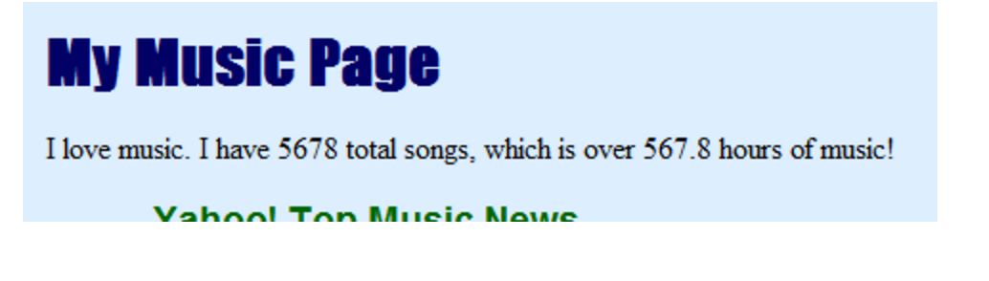
Exercise: Variable for Song Count
Brian has 1234 songs (123 hours of music). Turn this into a PHP variable you can change.
Download music.php and open it with your text editor.
Add a variable for the number of songs, and use it in HTMP/PHP code. Change its value to something other than
1234, say, 5678
Express the number of hours of music items of your variable. Assume that 10 songs can be played per hour.
Execute Music.php in your browser and see the change.

Slide 45
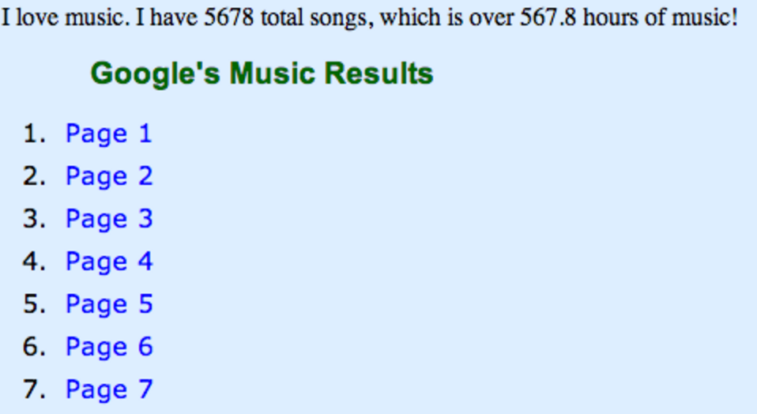
Exercise: Loops for link
The five Google music result links at the top of the page are redundant, so express them using for loop.
You should be able to change your loop bound to get more/fewer page links. Try that Also, the links should still work when you click on them.

Slide 46
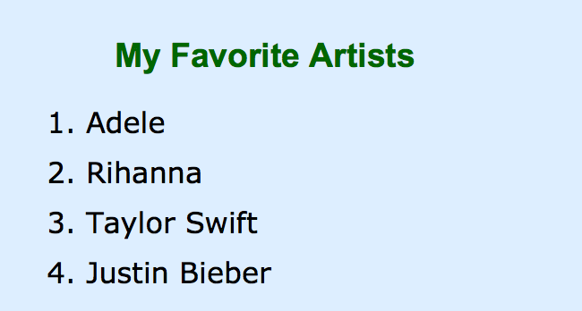
Exercise: Array of Favorite Artists
The page lists Brian’s favorite artists as bulleted list:
Create an array containing the favorite artists’ names and use the array to generate the bullets in the list.
Test that it is working by adding at least one more favorite artist (e.g. Lady Gaga)

Slide 47
Exercise: File of Favorite Artists
Instead of writing your own array of fav artists, read them from a file, favorite.txt.
Download this file to your machine and upload to your localhost folder. Read the artists from it, one per line.
For added challenge, make each artists name a link.
Check PHP’s string functions.
Example: Justin Bieber links to https://www.vevo.com/artist/justin-bieber

Slide 48
Exercise: list Mp3 files
The page hard-codes the list of MP3 file names. Change it to read file names from the server.
Put a few your favorite .mp3 files in a folder called “yourfolder/songs”.
Comment out the existing list of MP3/playlist file names on the page
Write PHP code that loks for the names of all .mp3 files in the folder using the glob function.
Print each file names as an li list item with the class mp3item.

Slide 49
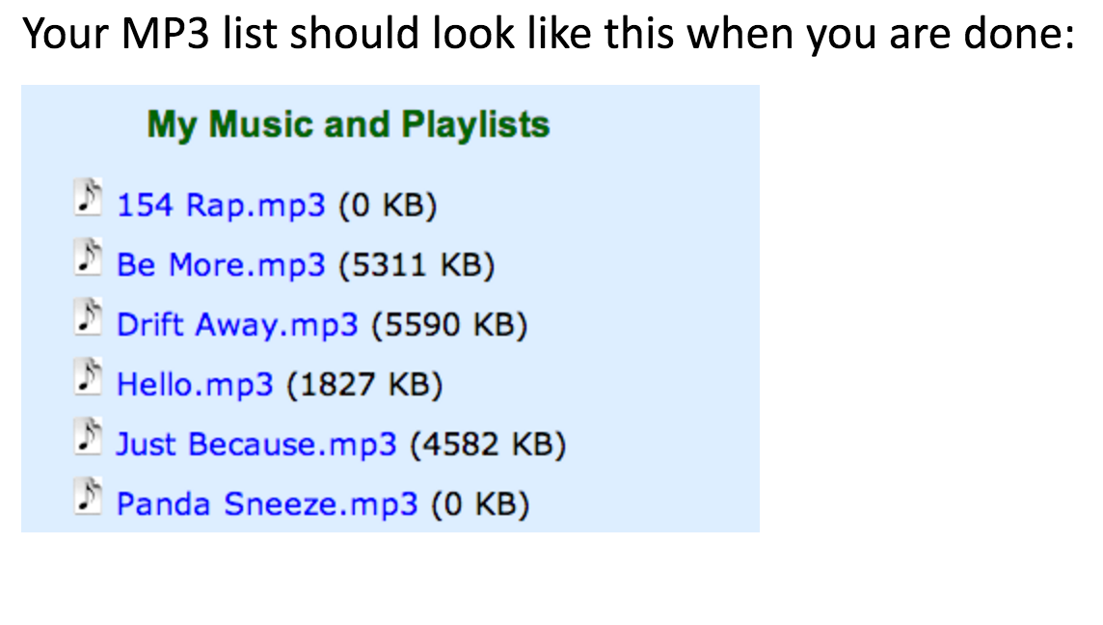
Exercise: output

Slide 50
Take home read
PHP tutorials for beginners (really great tutorials):
http://www.homeandlearn.co.uk/php/php.html
PHP, Ajax, JavaScript
http://blog.teamtreehouse.com/beginners-guide-to-ajax-development-with-php

