Slide 1
CSC435: Web Programming Lecture 23: Regular Expression, Cookies
Bei Xiao
American University
Tuesday, April 23, 2019

Slide 2
Final weeks plan
Lectures | Forms | homework
April 23(Tuesday) | Form Validation Regular expressions, | Homework 6 due CP 4 due
April 26 (Friday) | Cookies, Sessions | Exercise: Form validation with regular expression
May 3 | Final Presentation | Final project (team) due

Slide 3
Today’s lecture
File I/O summary
Form validation
Regular Expressions
Exercises + Quiz

Slide 4
PHPI/O Function recap
function name(s) | category
file, file_get_contents, file_put_contents | reading/writing entire files
basename, file_exists, filesize, fileperms, filemtime,is_dir, is_readable, is_writable, disk_free_space | asking for information
copy, rename, unlink, chmod, chgrp, chown, mkdir, rmdir | manipulating files and directories
glob, scandir | reading directories

Slide 5
Example with explode
Marty D
Stepp Jessica KMiller
Victoria R Kirst contents of name. txt
foreach (file("names.txt") as $name)
{ $tokens = explode(" ", $name);
print "author";
} php
author: Stepp, Marty
author: Miller, Jessica
author: Kirst, Victoria

Slide 6
Reading directories
function | description
glob | returns an array of all file names that match a given pattern (returns a file path and name, such as "foo/bar/myfile.txt")
scandir | returns an array of all file names in a given directory (returns just the file names, such as "myfile.txt")
glob can accept a general path with the * wildcard character
(more powerful)
Notes:
http://www.tutorialspoint.com/php/php_get_post.htm

Slide 7
Returning JSON
We use the PHP function json_encode(array) to output JSON
json_encode takes PHP arrays (including nested arrays) and generates JSON strings that can be printed
NOTE: we can also use json_decode to convert json strings into PHP arrays.
Notes:
http://www.tutorialspoint.com/php/php_get_post.htm

Slide 8
Example PHP code
<?php
header("Content-Type: application/json");
$output = array();
$output["name"] = "Kyle";
$output["hobbies"] = array("reading", "frisbee"); print(json_encode($output));
?>
Produces:
{ "name":"Kyle", "hobbies":["reading","frisbee"]
}
Notes:
http://www.tutorialspoint.com/php/php_get_post.htm

Slide 9
What is form validation?
validation: ensuring that form's values are correct
some types of validation:
preventing blank values (email address)
ensuring the type of values
integer, real number, currency, phone number, Social Security number, postal address, email address, date, credit card number, ...
ensuring the format and range of values (ZIP code must be a 5-digit integer)
ensuring that values fit together (user types email twice, and the two must match)

Slide 10
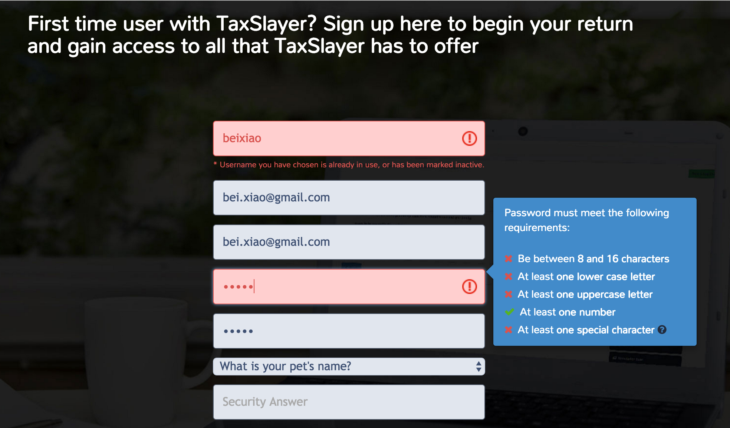
A real form that uses validation

Slide 11
Client vs. server-side validation
Validation can be performed:
client-side (before the form is submitted)
can lead to a better user experience, but not secure (why not?, think about ways to get into the server by-pass JS?)
server-side (in PHP code, after the form is submitted)
needed for truly secure validation, but slower
both
best mix of convenience and security, but requires most effort to program

Slide 12
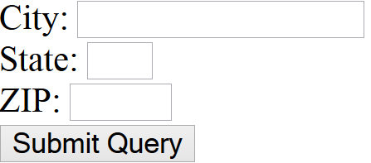
An example form to be validated
<form action="http://foo.com/foo.php" method="get">
<div>
City: <input name="city" /> <br />
State: <input name="state" size="2" maxlength="2" /> <br />
ZIP: <input name="zip" size="5" maxlength="5" /> <br />
<input type="submit" />
</div>
</form> HTML
output
Let's validate this form's data on the server...

Slide 13
Basic server-side validation
$city = $_POST["city"];
$state = $_POST["state"];
$zip = $_POST["zip"];
if (!$city || strlen($state) != 2 || strlen($zip) != 5) {
print "Error, invalid city/state/zip submitted.";
} PHP
basic idea: examine parameter values, and if they are bad, show an error message and abort. But:
How do you test for integers vs. real numbers vs. strings?
How do you test for a valid credit card number?
How do you test that a person's name has a middle initial?
(How do you test whether a given string matches a particular complex format?)

Slide 14
Regular expression
/^[a-zA-Z_\-]+@(([a-zA-Z_\-])+\.)+[a-zA-Z]{2,4}$/
regular expression ("regex"): a description of a pattern of text
can test whether a string matches the expression's pattern
can use a regex to search/replace characters in a string
regular expressions are extremely powerful but tough to read (the above regular expression matches email addresses)
regular expressions occur in many places:
Java: Scanner, String's split method (sentence generator)
supported by PHP, JavaScript, and other languages
many text editors (TextPad) allow regexes in search/replace
The site Rubular is useful for testing a regex.
http://www.sitepoint.com/regular-expressions-php/

Slide 15
Basic regular expression
/abc/
in PHP, regexes are strings that begin and end with /
the simplest regexes simply match a particular substring
the above regular expression matches any string containing "abc":
YES: "abc", "abcdef", "defabc", ".=.abc.=.", ...
NO: "fedcba", "ab c", "PHP", ...

Slide 16
Wildcards: .
A dot . matches any character except a \n line break
/.oo.y/ matches "Doocy", "goofy", "LooNy", ...
A trailing i at the end of a regex (after the closing /) signifies a case-insensitive match
/all/i matches “Allison Obourn", “small", “JANE GOODALL", ...

Slide 17
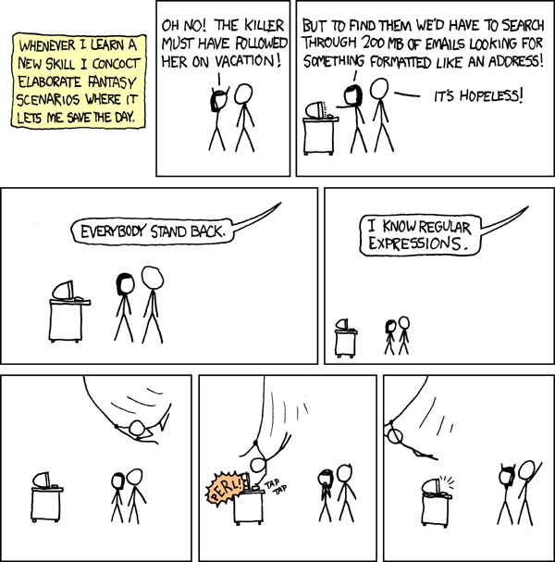
Regular Expressions
Perl is also the most acknowledged language when it comes to the performance while evaluating regular expressions.

Slide 18
Special characters: |,(),\
| means OR
/abc|def|g/ matches "abc", "def", or "g"
There's no AND symbol. Why not?
() are for grouping
/(Homer|Marge) Simpson/ matches "Homer Simpson" or "Marge Simpson"
\ starts an escape sequence
many characters must be escaped to match them literally: / \ $ . [ ] ( ) ^ * + ?
<br \//>/ matches lines containing <br /> tags

Slide 19
Quantifiers: *, +,?
* means 0 or more occurrences
/abc*/ matches "ab", "abc", "abcc", "abccc", ...
/a(bc)*/ matches "a", "abc", "abcbc", "abcbcbc", ...
/a.*a/ matches "aa", "aba", "a8qa", "a!?xyz__9a", ...
+ means 1 or more occurrences
/Hi!+ there/ matches "Hi! there", "Hi!!! there", ...
/a(bc)+/ matches "abc", "abcbc", "abcbcbc", ...
? means 0 or 1 occurrences
/a(bc)?/ matches "a" or "abc"

Slide 20
More quantifiers: {min,max}
{min,max} means between min and max occurrences (inclusive)
/a(bc){2,4}/ matches "abcbc", "abcbcbc", or "abcbcbcbc"
min or max may be omitted to specify any number
{2,} means 2 or more
{,6} means up to 6
{3} means exactly 3

Slide 21
Practice exercise
When you search Google, it shows the number of pages of results as "o"s in the word "Google". What regex matches strings like "Google", "Gooogle", "Goooogle", ...? (try it)
Notes:
Answer: /Goo+gle/ (or /Go{2,}gle/)

Slide 22
Practice exercise
When you search Google, it shows the number of pages of results as "o"s in the word "Google". What regex matches strings like "Google", "Gooogle", "Goooogle", ...? (try it)
Answer: /Goo+gle/ (or /Go{2,}gle/)
Notes:
Answer: /Goo+gle/ (or /Go{2,}gle/)

Slide 23
Anchors: ^ and $
^ represents the beginning of the string or line; $ represents the end
/Jess/ matches all strings that contain Jess; /^Jess/ matches all strings that start with Jess; /Jess$/ matches all strings that end with Jess; /^Jess$/ matches the exact string "Jess" only
/^Bei.*Xiao$/ matches “Bei Xiao”, “Bei Bei Xiao”, “BeiXiao”, ... but NOT “Bei Xiao stinks" or "I H8 Bei Xiao"
(on the other slides, when we say, /PATTERN/ matches "text", we really mean that it matches any string that contains that text)
Notes:
Answer: /Goo+gle/ (or /Go{2,}gle/)

Slide 24
Character sets: []
[] group characters into a character set; will match any single character from the set
/[bcd]art/ matches strings containing "bart", "cart", and "dart"
equivalent to /(b|c|d)art/ but shorter
inside [], many of the modifier keys act as normal characters
/what[!*?]*/ matches "what", "what!", "what?**!", "what??!", ...
What regular expression matches DNA (strings of A, C, G, or T)?
/[ACGT]+/

Slide 25
Character ranges: [start-end]
inside a character set, specify a range of characters with -
/[a-z]/ matches any lowercase letter
/[a-zA-Z0-9]/ matches any lower- or uppercase letter or digit
an initial ^ inside a character set negates it
/[^abcd]/ matches any character other than a, b, c, or d
inside a character set, - must be escaped to be matched
/[+\-]?[0-9]+/ matches an optional + or -, followed by at least one digit
Notes:
Answer: /Goo+gle/ (or /Go{2,}gle/)

Slide 26
Practice Exercise
Write a regular expression for the following:
Match can
Match man
Match fan
Skip dan
Skip ran
Skip pan
Notes:
[^drp]an

Slide 27
Practice Exercise
Write a regular expression for the following:
Match Ana
Match Bob
Match Cpc
Skip aax
Skip bby
Skip ccz
Notes:
[A-C][n-p][a-c]

Slide 28
Practice Exercise
What regular expression matches letter grades:
A+, A, A-, B, B+, B-, C, C+, C- D, F Try it)
What regular expression matches AU student email address?
e.g. ar4305a@american.edu
What regular expression would match a sequence of only consonants, assuming that the string consists only of lowercase letters?
What regular expression would match a zip code?
Notes:
[A-C][+-]?|D|F
Zip code has 5 digits:
^d{7}

Slide 29
Escape sequences
special escape sequence character sets:
\d matches any digit (same as [0-9]); \D any non-digit ([^0-9])
\w matches any word character (same as [a-zA-Z_0-9]); \W any non-word char
\s matches any whitespace character ( , \t, \n, etc.); \S any non-whitespace
What regular expression matches names in a "Last, First M." format with any number of spaces?
Notes:
[A-C][+-]?|D|F

Slide 30
Escape sequences
special escape sequence character sets:
\d matches any digit (same as [0-9]); \D any non-digit ([^0-9])
\w matches any word character (same as [a-zA-Z_0-9]); \W any non-word char
\s matches any whitespace character ( , \t, \n, etc.); \S any non-whitespace
What regular expression matches names in a "Last, First M." format with any number of spaces?
/\w+,\s+\w+\s+\w\./
Notes:
[A-C][+-]?|D|F

Slide 31
PHP form validation w/regexes
$state = $_POST["state"];
if (!preg_match("/^[A-Z]{2}$/", $state)) {
print "Error, invalid state submitted.";
} PHP
preg_match and regexes help you to validate parameters
sites often don't want to give a descriptive error message here (why?)
Notes:
[A-C][+-]?|D|F

Slide 32
Regular expressions in PHP
regex syntax: strings that begin and end with /, such as "/[AEIOU]+/"
function | description
preg_match(regex, string) | returns TRUE if string matches regex
preg_replace(regex, replacement, string) | returns a new string with all substrings that match regex replaced by replacement
preg_split(regex, string) | returns an array of strings from given string broken apart using given regex as delimiter (like explode but more powerful)
Notes:
[A-C][+-]?|D|F

Slide 33
PHP form validation w/regexes
$state = $_POST["state"];
if (!preg_match("/^[A-Z]{2}$/", $state)) {
print "Error, invalid state submitted.";
} PHP
preg_match and regexes help you to validate parameters
sites often don't want to give a descriptive error message here (why?)
Notes:
[A-C][+-]?|D|F

Slide 34
The die function
die("error message text"); PHP
PHP's die function prints a message and then completely stops code execution
it is sometimes useful to have your page "die" on invalid input
problem: poor user experience (a partial, invalid page is sent back)
Notes:
[A-C][+-]?|D|F

Slide 35
Including files: include
include("filename"); PHP
include("header.html");
include("shared-code.php"); PHP
inserts the entire contents of the given file into the PHP script's output page
encourages modularity
useful for defining reused functions needed by multiple pages
Notes:
[A-C][+-]?|D|F

Slide 36
Including a common HTML file
<!DOCTYPE html>
<!-- this is top.html -->
<html><head><title>This is some common code</title>
... HTML
include("top.html"); # this PHP file re-uses top.html's HTML content
Including a .html file injects that HTML output into your PHP page at that point
useful if you have shared regions of pure HTML tags that don't contain any PHP content
Notes:
[A-C][+-]?|D|F

Slide 37
Exercise 1: Regex hybrid
In this exercise, you will use regex with PHP to display photos of... animals. You can find the starter files and images in the hybrid.zip folder.
Slides with more details are provided below.

Slide 38
Exercise 1: Reg hybrid
In this exercise, you will use regex with PHP to display photos of... animals. You can find the starter files and images in the hybrid.zip folder.
Slides with more details are provided below.

Slide 39
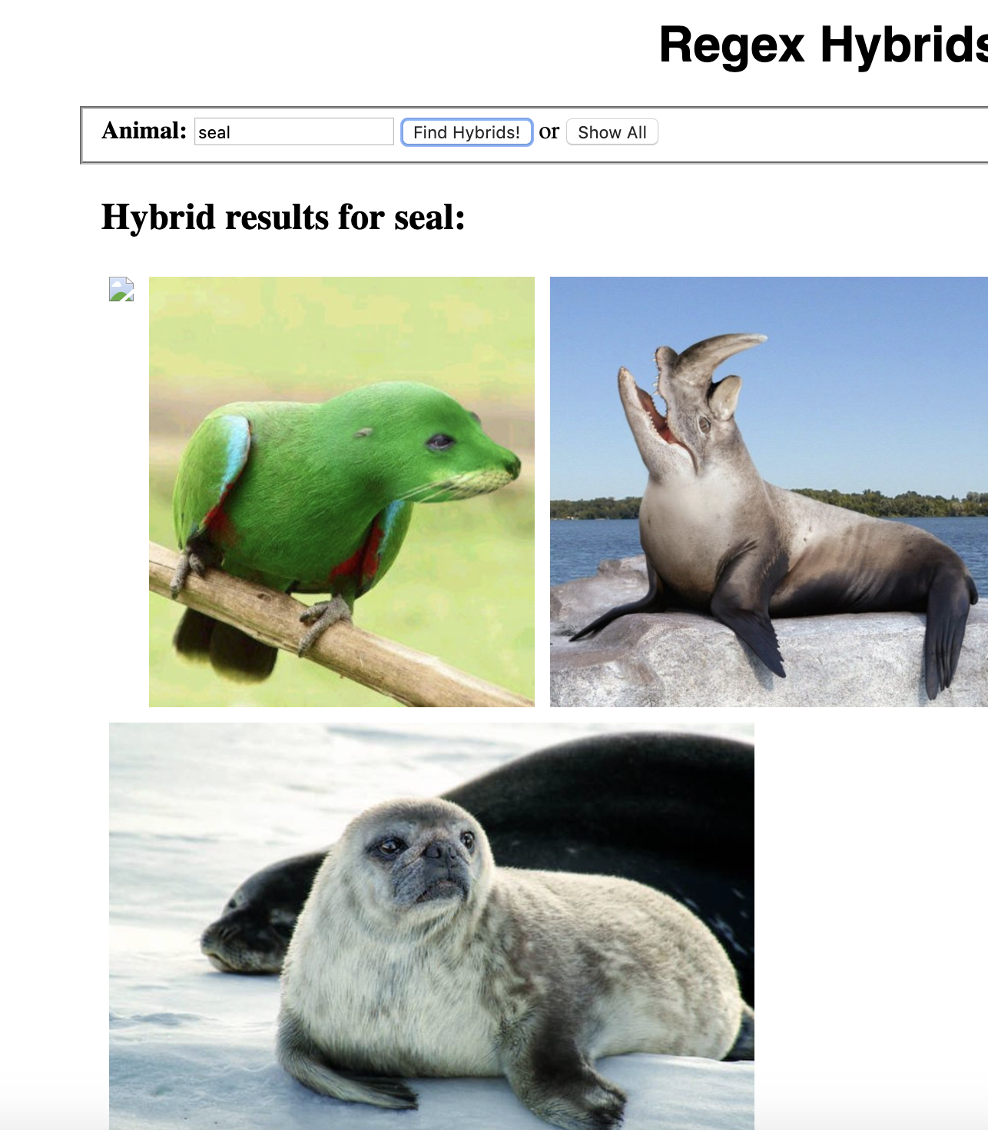
Exercise 1: example outcome:

Slide 40
Exercise 1: example outcome:
The hybrids.html page uses hybrids.js (completed for you) to make GET requests to regexhybrids.php and display images on the page using the plain text results. When #submit-one button is clicked, a request will be made to regexhybrids.php with a query parameter of animal and a value of whatever the user input into the #animal text input box.
If the user clicks on #submit-all instead, a request will be made passing animal=all as the query parameter. The response will then be used to populate the #results area with the resulting images.

Slide 41
Exercise 1: example outcome:
Modify regexhybrids.php to use regular expressions so that it will return a plain text result of all images matching the GET parameter (each on their own line) if given any animal query parameter (other than "all"). If passed animal=all, it should instead return a plain text result of all images in the images/ folder. Recall you can use preg_match to match image names against a given regular expression.

Slide 42
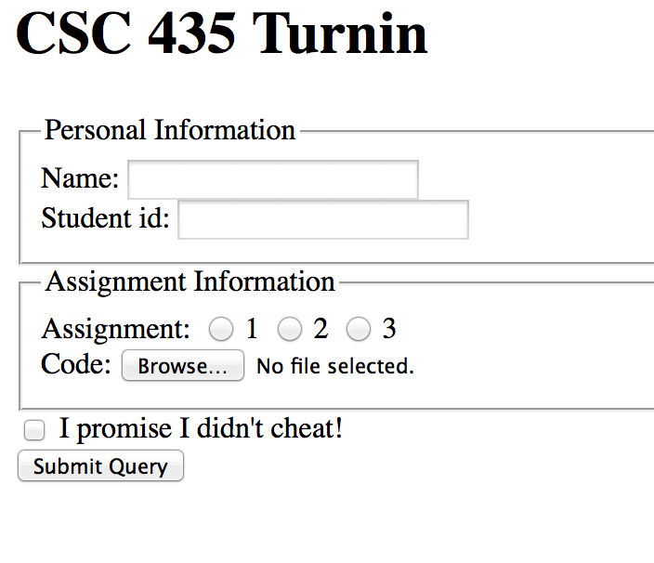
Quiz : turn in form
Download turnin.html of the following turn-in form and save it as .php,

Slide 43
Quiz: turn in form
Download turnin.html of the following turn-in form
Use regular expressions to add validation the turn-in form
The student name must not be blank and must contain a first and last name (two words).
The student ID must be a seven-digit integer.
The assignment file name must be a string such as "hw1" or "hw6".
The email address must follow a valid general format such as user@example.com.
Check “ I didn’t cheat” was checked. Otherwise, ask the user whether they cheated.
Hint: You can grab the data using $_Post[“name”] etc.

Slide 44
Take home read
PHP regular expressions:
http://www.tutorialspoint.com/php/php_regular_expression.htm
http://regexone.com/references/php

Slide 45
Next class
Cookie and Sessions
User log in

Slide 46
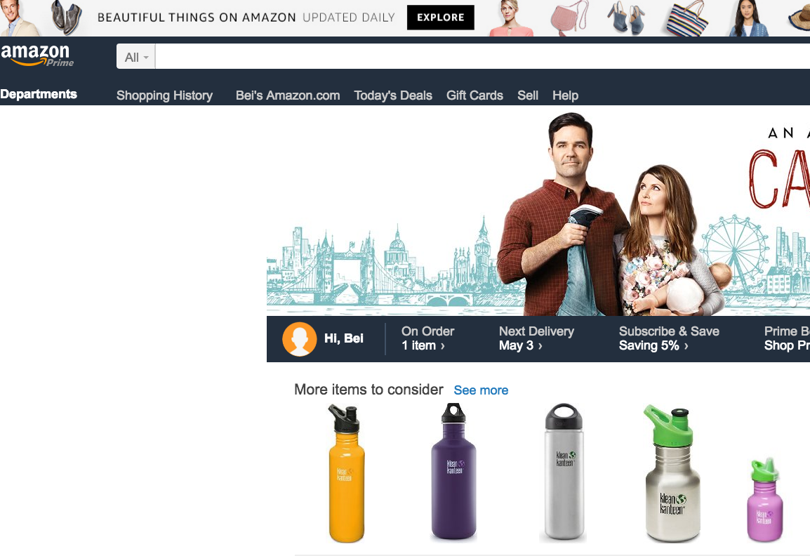
Stateful client/server interaction
Sites like amazon.com seem to "know who I am." How do they do this? How does a client uniquely identify itself to a server, and how does the server provide specific content to each client?
HTTP is a stateless protocol; it simply allows a browser to request a single document from a web server
We'll learn about pieces of data called cookies used to work around this problem, which are used as the basis of higher-level sessions between clients and servers
Notes:
[A-C][+-]?|D|F

Slide 47

What is a cookie?
cookie: a small amount of information sent by a server to a browser, and then sent back by the browser on future page requests
cookies have many uses:
authentication
user tracking
maintaining user preferences, shopping carts, etc.
a cookie's data consists of a single name/value pair, sent in the header of the client's HTTP GET or POST request
Notes:
[A-C][+-]?|D|F

Slide 48
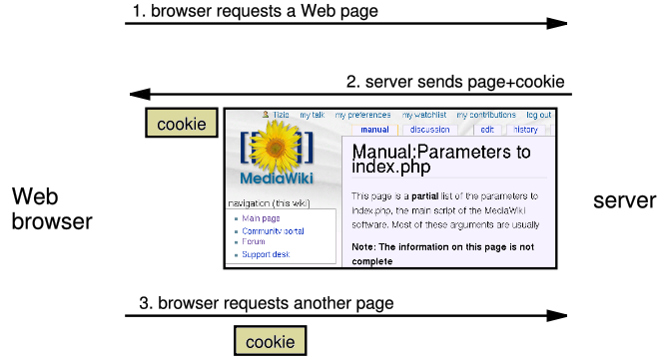
How cookies are sent
http://www.allaboutcookies.org/cookies/
Notes:
[A-C][+-]?|D|F

Slide 49

Where are the cookies?
Chrome:
C:\Users\username\AppData\Local\Google\Chrome\User Data\Default
Firefox: HomeDirectory\.mozilla\firefox\???.default\cookies.txt
view cookies in Firefox preferences: Privacy, Show Cookies...
http://www.allaboutcookies.org/cookies/
Notes:
[A-C][+-]?|D|F

