Slide 1
CSC435: Web Programming Lecture 13: Oop in JavaScript
Bei Xiao
American University
March 1, Friday, 2018

Slide 2
Mid-term Exam
Mid-term exam date modified: March 22.
In-class, coding questions, required to turned in blackboard within 75 mins
Covering up to the lecture before the exam. HTML, CSS, JavaScript.

Slide 3
Take-home reading&exercises
OOP tutorial (you can skip chapter 2) with excellent exercises:
https://javascript.info/object-basics
JavaScript with objects:
https://developer.mozilla.org/en-US/docs/Web/JavaScript/Guide/Working_with_Objects

Slide 4
JS Warm-up exercise 1
With the Chrome or Firefox console open, write a function named crazyCaps that accepts a string as a parameter and returns a new string with its capitalization altered such that the characters at even index are in lower-case and odd indexes are in the uppercase.
For example:
crazyCaps('Hey There!!')
"hEy tHeRe!!”
Hint: s.toLowerCase()

Slide 5
JavaScript Events and Timers

Slide 6
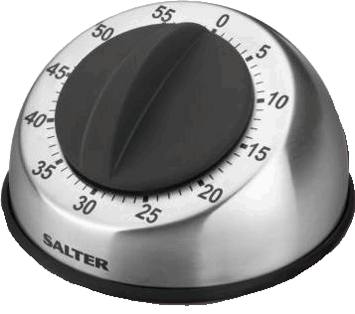
Setting a timer
method | description
setTimeout(function, delayMS); | arranges to call given function after given delay in ms
setInterval(function, delayMS); | arranges to call function repeatedly every delayMS ms
clearTimeout(timerID); clearInterval(timerID); | stops the given timer
both setTimeout and setInterval return an ID representing the timer
this ID can be passed to clearTimeout/Interval later to stop the timer

Slide 7

setTimeout Example
<button id="clickme">Click me!</button>
<span id="output"></span> HTML
window.onload = function() {
document.getElementById("clickme").onclick = delayedMessage;
};
function delayedMessage() {
document.getElementById("output").innerHTML = "Wait for it...";
setTimeout(sayBooyah, 5000);
}
function sayBooyah() { // called when the timer goes off
document.getElementById("output").innerHTML = "BOOYAH!";
} JS
output

Slide 8
setInterval Example
var timer = null; // stores ID of interval timer
function delayMsg2() {
if (timer === null) {
timer = setInterval(rudy, 1000);
} else {
clearInterval(timer); //clear the timer
timer = null;
}
}
function rudy() { // called each time the timer goes off
document.getElementById("output").innerHTML += " Rudy!";
} JS
output

Slide 9
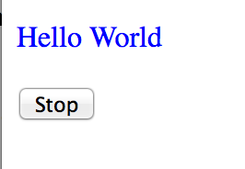
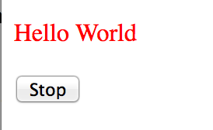
Exercise 1: use setInterval to flash text
Your html code:
<body onload="changeColor();">
<div id="my_box">
<p>Hello World</p>
</div>
<button onclick="stopTextColor();">Stop</button>
</body>

Slide 10
Anonymous function
An example of a named function:
An example of a named function:
An example of an anonymous function:
function flyToTheMoon()
{
alert (“Zoom! Zoom! Zoom1”);
}
flyToTheMoon();
var flyToTheMoon = function()
{
alert(“Zoom! Zoom! Zoom!”)
}
flyToTheMoon();

Slide 11

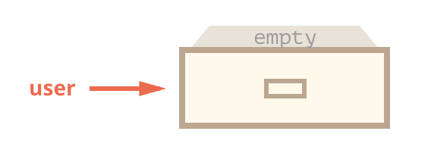
OOP
let user = new Object(); // "object constructor" syntax
let user = {}; // "object literal" syntax

Slide 12
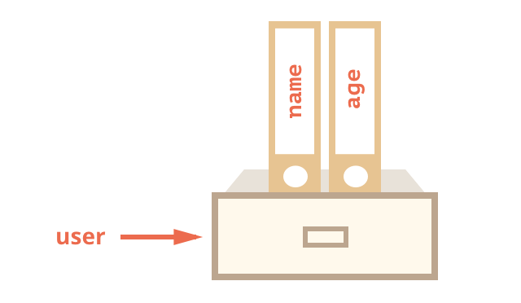
OOP
let user = new Object(); // "object constructor" syntax
let user = {}; // "object literal" syntax
let user = { // an object
name: "John", // by key "name" store value "John"
age: 30 // by key "age" store value 30
};

Slide 13
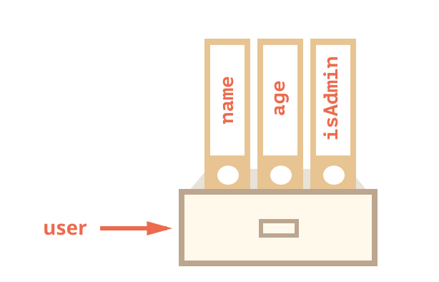
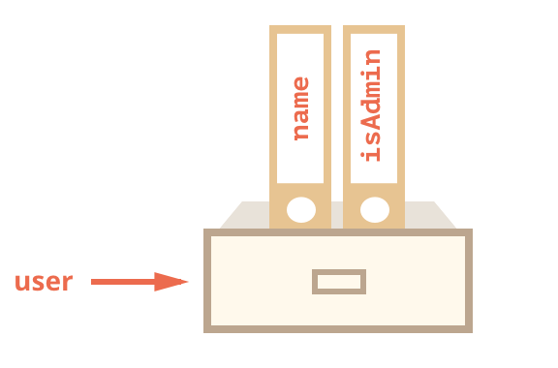
OOP
user.isAdmin = true;
delete user.age;

Slide 14
Accessing object properties
Object.Property notation
let user = {
name: John,
age: 30, //
}
// get fields of the object:
alert( user.name ); // John
alert( user.age ); // 30
Square bracket notation
let user = {};
// set
user["likes birds"] = true;
// get
alert(user["likes birds"]); // true
// delete
delete user["likes birds"];

Slide 15
Adding values to objects
Object.Property notation
var cat = {};
cat.name = ‘roxy’;
cat.color = “gray”;
Square bracket notation
var cat = {};
cat[“legs”] = 3;
cat[“name”] = “harry”;
cat[“color”] = “orange”;

Slide 16
Existence check
See if a property is undefined:
let user = {};
alert( user.noSuchProperty === undefined ); // true means "no such property”
Check particular property’s existence
let user = { name: "John", age: 30 };
alert( "age" in user ); // true, user.age exists
alert( "blabla" in user ); // false, user.blabla doesn't exist

Slide 17
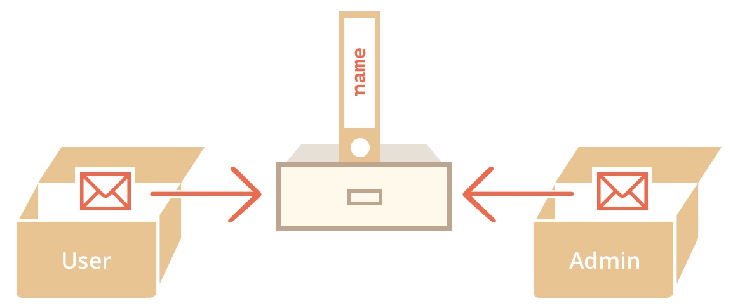
Copying by reference
Primitive values: strings, numbers, Booleans- are assigned/copied “as a whole value” :
let message = "Hello!";
let phrase = message; // now phrase and message are independent variables. Both storing “hello”.
When the object variable is copied- the reference is copied, the object is not duplicated.
let user = { name: "John" };
let admin = user; // copy the reference
admin.name = 'Pete'; // changed by the "admin" reference
alert(user.name); // 'Pete', changes are seen from the "user" reference

Slide 18
Object: methods (using object to do things)
_{let user = {}
_{name: "John",}
_{age: 30}
};
_{user.sayHi = function() {}
_{alert("Hello!");}
};
_{user.sayHi(); // Hello!}
A function that is the property of an object is called its method.
https://javascript.info/object-methods

Slide 19
Object: methods (shorthand)
// these objects do the same
let user = {
sayHi: function() {
alert("Hello");
}
};
// method shorthand looks better, right?
// we can omit ”function” and just write sayHi()
let user = {
sayHi() { // same as "sayHi: function()"
alert("Hello");
}
};
https://javascript.info/object-methods

Slide 20
Object: function construct with “this”
_{function} person(firstname,lastname,age,eyecolor)
{
_{this.firstname=firstname;}
_{this.lastname=lastname;}
_{this.age=age;}
_{this.eyecolor=eyecolor;}
}
_{// new instance}
myFather=new person("John","Doe",50,"blue");
https://developer.mozilla.org/en-US/docs/Web/JavaScript/Reference/Operators/this

Slide 21
Object: adding method
_{myFather.name = function () {}
return this.firstName + " " + this.lastName;
};
Notes:
See blackboard CreateObject.html

Slide 22
Create object using constructor function
Constructor function to build an object. “this” refers to the function’s parent object.
“
T
This
function Pet(name, species, hello) {
this.name = name;
this.species = species;
this.hello = hello;
this.sayHello = function()
{
alert(this.hello);
}
}
//create a new object
var rufus = new Pet(“Rufus”, “cat”,”miaow”);
rufus.sayHello()

Slide 23
Return from constructor
Usually, constructors do not have a return statement. Their task is to write all necessary stuff into this, and it automatically becomes the result.
But if there is a return statement, then the rule is simple:
If return is called with object, then it is returned instead of this.
If return is called with a primitive, it’s ignored.
function BigUser() {
this.name = "John";
return { name: "Godzilla" }; // <-- returns an object
}
alert( new BigUser().name ); // Godzilla, got that object

Slide 24
Object: “this” in method
objectName.methodname = function_name;
var myObj = {
myMethod: function(params) {
// ...do something
}
// OR THIS WORKS TOO
myOtherMethod(params) {
// ...do something else
}
};
https://developer.mozilla.org/en-US/docs/Web/JavaScript/Guide/Working_with_Objects

Slide 25
Object: “this” in method
function User(name) {
this.name = name;
this.sayHi = function() {
alert( "My name is: " + this.name );
};
}
// common to name a constructor function with Capital letter.
let john = new User("John");
john.sayHi(); // My name is: John
/*
john = {
name: "John",
sayHi: function() { ... }
}
*/
https://developer.mozilla.org/en-US/docs/Web/JavaScript/Guide/Working_with_Objects

Slide 26
Syntax check
What is the result of the code?
let user = {
name: "John",
go: function() { alert(this.name) }
}
(user.go)()

Slide 27
Syntax check
What is the result of the code?
let luke = {
name: "John",
go: function() { alert(this.name) }
}; // here misisng a semicolon
(luke.go)()

Slide 28
Example: using this for object reference
<form name="myForm">
<p><label>Form name:<input type="text" name="text1" value="Beluga"></label>
<p><input name="button1" type="button" value="Show Form Name"
onclick="this.form.text1.value = this.form.name">
</p>
</form>
The button's onclick event handler uses this.form to refer to the parent form, myForm.

Slide 29
Enumeration of object
for (var key in object ) {
print(object[key]);
}
var obj = {first: “prop1”, second: “propr2”, 3: “proper3”}
for (var key in obj) {
s += key + “:” + obj[key] + “ “;
}
document.write(s);
Notes:
See blackboard CreateObject.html

Slide 30
Exercise 1: sum object properties
We have an object storing salaries of our team
let salaries = {
John: 100,
Ann: 160,
Pete: 130
}
Write the code to sum all salaries and store in the variable sum. Should be 390 in the example above.
You can use alert(sum);
If salaries is empty, then the result must be 0.

Slide 31
Exercise 2: create a calculator
Create a constructor function Calculator that creates objects with 3 methods:
read() asks for two values using prompt and remembers them in object properties.
sum() returns the sum of these properties.
mul() returns the multiplication product of these properties.
For instance:
let calculator = new Calculator();
calculator.read();
alert( "Sum=" + calculator.sum() );
alert( "Mul=" + calculator.mul() );

Slide 32
Extending objects with prototype
A major advantage of using object is the ability to reuse already written code in a new context.
JavaScript provides a mean to modify objects to include new methods and properties or even create brand new objects based on the one that already exists.
These techniques are known, respectively as extending and inheriting objects using prototypes.

Slide 33
Class-based versus Prototype based languages
A prototype-based language has the notion of a prototypical object, an object used as a template from which to get the initial properties for a new object. Any object can specify its own properties, either when you create it or at run time.
This is different from Java and C++ which are class-based language. A class is an abstract thing, rather than any particular member of the set of objects it describes.

Slide 34
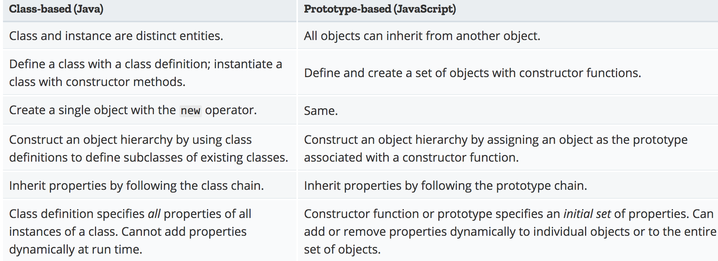
Class-based versus Prototype based languages

Slide 35
Extending objects with prototype
Create an object:
Create an object:
The function person has a prototype property. We can add properties to the function:
function Person(name)
{
this.name = name;
}
// when we create a new object using:
var zack = new Person (“Zack”)
Person.prototpye.kind = ‘person’
//in the new objecdt we have access to
Person.prototype.person.kind // person

Slide 36
Example: prototype
// constructor function that takes two properties, and one method showInfo
function Person(personName) {
this.name = personName;
this.info = “This person is called” + this.name;
this.showInfo = function(){
alert(this.info);
}
}
// create two objects
var person1 = new Person (“Adam”);
Var person2 = new Person (“Eve”);
// we can add a further method sayHello to the person object
Definition.
Person.prototype.sayHello = function(){
alert(this.name + “say hello”);
}
Person1.sayHello() //”Adam say hello”
Person2.showInfo()

Slide 37
Inheriting objects
Inheritance is the ability to create one object type from another, the new object type inherits the properties and the methods of the old, as well as optionally having further properties and the methods of its own.
object.prototype can be used to add new methods and properties, but it can also be utilized to add all of the methods and properties of an existing constructor function to your new object.

Slide 38
Demo: cat and dog
Create a function called Pet() that can have the property of “animal” and “name”
Create methods setAnimal and setName. Such as
var myCat = new Pet();
myCat.setAnimal("cat");
myCat.setName("Garfield");
Now create a function called Dog() that has an additional method called breed.
Let the Dog inherit all the properties from Pet()
var myDog = new Dog();
myDog.setAnimal("Dog");
myDog.setName("Odie");
myDog.setBreed("Greyhound");

Slide 39
Encapsulation
Encapsulation is the name given to OOP(object oriented programming)’s capability to hide data and instructions inside an object.
function Box(width, length, height) {
function volume (a,b,c) {
return a * b* c;
}
this.boxVolume = volume(width, length, height);
}
var crate = newBox(5,4,3);
alert(crate.boxVolume); // what is the output?
alert(volume (5,4,3)); // what is the output?

Slide 40
Quiz
Deriving new objects by using the design of currently existing objects is known as:
A. Encapsulation
B. Inheritance
S. Instantiation

Slide 41
Using feature detection
typeOf operator in JavaSript allows you to probe the data type of its operand, such as weather a variable is string, number, object, function, boolean, etc.
var myvar=5
alert(typeof myvar) //alerts "number”
if (typeof x=="undefined")
alert("Variable x doesn't exist)
else
// continue with script

Slide 42
Quiz: type of
What are the outputs of the following commands:
typeof {a:1}
typeof 4E-3;
typeof true;
typeof “”;
typeof “hello world”
typeof Math.tan
typeof abc
typeof (“4” + 7);

Slide 43
Object: exercise 3
Write a JavaScript program to list the property of the following sample object:
let student = {
Name: “Jenny Klein”
Class: “ Senior”
AUID: “ 31635”
Hobby: “writing code”
};
Sample output: name, Class, AU ID, Hobby
Hint: write a function to output the list of property. E.G. you can use string.push() to append to an empty array and then print out the array.

Slide 44
Object: exercise 4
Write a JavaScript program to display the reading status (i.e. display book name, author name, and reading status) of the following books.
let library = [
{
title: 'Bill Gates',
author: 'The Road Ahead',
readingStatus: true
},
{
title: 'Steve Jobs',
author: 'Walter Isaacson',
readingStatus: true
},
{
title: 'Mockingjay: The Final Book of The Hunger Games',
author: 'Suzanne Collins',
readingStatus: false
}];

Slide 45
Exercise 4: using prototype to extend existing JavaScript object
You can implement a String.prototype.backwards methods that returns a reversed version of any string you supply.
Here is your starter .js code:
<script type="text/javascript">
var inString = prompt("Enter your test string");
document.write(inString.backwards());
</script>

Slide 46
Exercise 5
Write a constructor function for a card object with properties suit (diamonds, hearts, spades, or clubs) and face (ace, 1, 2,…king).
Add methods to set the values of suit and face.
Hint: alert the suitName and the faceName into the screen when you set the new values of suit and face.
Inside the constructor:
this.setValues = function(suitName, faceName) {
}
var myCard1 = new Card(“space”, “ace”)
myCard.setValues (“Hearts”, “12”)

Slide 47
Exercise 5
Write a JavaScript program to get the volume of a Cylinder with four decimal places using object class.
Volume of a cylinder is V = pi r ^2 h
Hint: create a Cylinder class that takes height and radius and use prototype to add the Volume function.
//You shall create a new Cylinder object by:
var cyl = new Cylinder (7,4);
//And output:
Document.write(cyl.Volume)
num.toFixed(4)
http://www.w3schools.com/jsref/jsref_tofixed.asp

Slide 48
Take-home Reading (very important for exams)
Introduction to Object Oriented Programming
https://developer.mozilla.org/en-US/docs/Web/JavaScript/Introduction_to_Object-Oriented_JavaScript
“This” keyword:
https://github.com/getify/You-Dont-Know-JS/blob/master/this%20&%20object%20prototypes/ch1.md
Object. Prototype:
https://developer.mozilla.org/en-US/docs/Web/JavaScript/Reference/Global_Objects/Object/prototype

