Slide 1
CSC435: Web Programming Lecture 19: Ajax JSON Exercises
Bei Xiao
American University
April 2, Tuesday, 2019

Slide 2
Future lecture plan
Lectures | Content | homework
April 10 | JSON, basic jQuery, review.
April 13 | Intro to server side, PHP
April 17 | More PHP | CP3 due Homework 5 out
April 20 | Query Parameters, file I/O
April 24 | Cookies and Sessions | Final Project out
April 27 | Intro to SQL

Slide 3
Ajax
using JS to download data (or other stuff) from the server in the background
allows dynamically updating a page without making the user wait
JSON is now more common than XML, but they are both just ways to store data
not a programming language; a particular way of using JavaScript
avoids the "click-wait-refresh" pattern
examples: Practice-It; Amazon product pages, most auto-complete search features

Slide 4
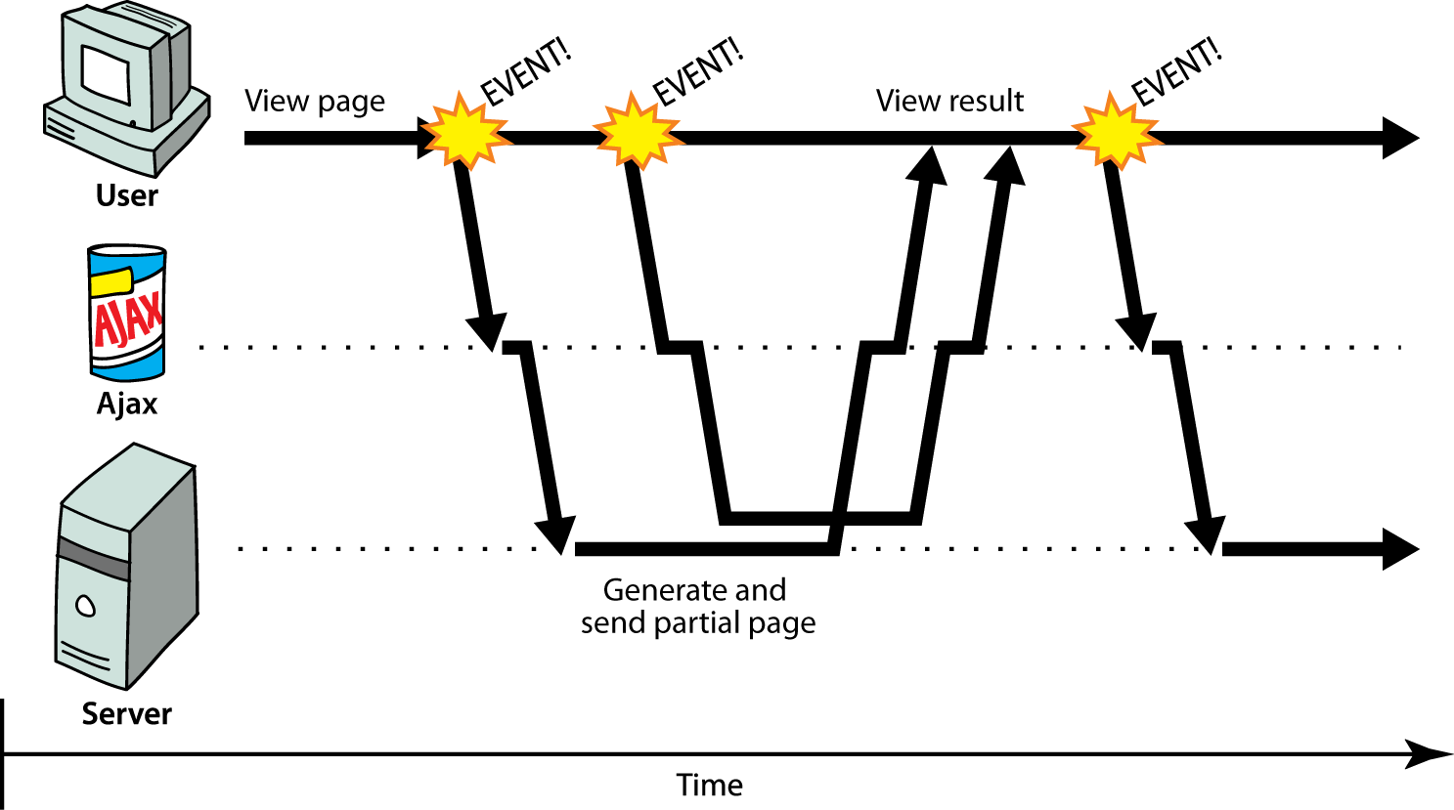
Ajax

Slide 5
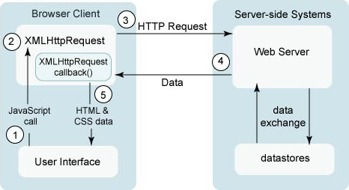
XML HTTP request
https://developers.google.com/web/updates/2015/03/introduction-to-fetch

Slide 6
XML HTTP request
function reqListener() { var data = JSON.parse(this.responseText); console.log(data); } function reqError(err) { console.log('Fetch Error :-S', err); } var oReq = new XMLHttpRequest(); oReq.onload = reqListener; oReq.onerror = reqError; oReq.open('get', './api/some.json', true); oReq.send();
https://developers.google.com/web/updates/2015/03/introduction-to-fetch

Slide 7
Fetch request
fetch('./api/some.json'). // or url to a php .then( function(response) { if (response.status !== 200) { console.log('Looks like there was a problem. Status Code: ' + response.status); return; } // Examine the text in the response response.json().then(function(data) { console.log(data); }); } ) .catch(function(err) { console.log('Fetch Error :-S', err); });
https://developers.google.com/web/updates/2015/03/introduction-to-fetch

Slide 8
promise
A JS object that executes some code that has an uncertain outcomePromises have three states:
Pending
Fulfilled
Rejected
let promise = new Promise( function( resolve, reject ) {
// do something uncertain (like make an ajax call)
if ( success ) {
resolve(); // Fulfilled
} else {
reject(); // Rejected
}
});
Read more: https://www.stephanboyer.com/post/107/fun-with-promises-in-javascript
Notes:
https://www.stephanboyer.com/post/107/fun-with-promises-in-javascript

Slide 9
Promises examples: using a promise
let promise = // some Promise....; promise.
then( function( params... ) {
// Promise resolved -- handle success } );
catch( function( params... ) {
// Promise rejected -- handle failure } );
let promise = new Promise( function( resolve, reject ) {
// do something uncertain (like make an ajax call)
if ( success ) {
resolve(); // Fulfilled
} else {
reject(); // Rejected
}
});

Slide 10
Why are they useful?
To help deal with uncertainty in your code. You never know exactly what will happen or when it will happen when you make an Ajax call, so wrapping the call in a Promise is a nice way to deal with the uncertainty.
You also define what happens after the Promise fulfills with the then function, and what happens when it rejects in the catch function.
Notes:
We will be using promises to fetch information from a server, which is an uncertain task
Our Promise has been wrapped in a fetch call that has much the same structure
We give you "boilerplate" starting code because you will use this frequently

Slide 11
Ajax Code Skeleton
//include this code: based on https://developers.google.com/web/updates/2015/03/introduction-to-fetch
function checkStatus(response) {
if (response.status >= 200 && response.status < 300) {
return response.text(); }
else {
return Promise.reject(new Error(response.status+": "+response.statusText)); }
}
function callAjax(){
let url = ..... // put url string here
fetch(url, {credentials: 'include'})
// include credentials for cloud9 .then(checkStatus)
.then(function(responseText) {
//success: do something with the responseText })
.catch(function(error) {
//error: do something with error })
;}

Slide 12
Ajax Code Skeleton (slight variation)
function checkStatus(response) { ... }
function callAjax(){
let url = ..... // put url string here fetch(url, {credentials: 'include'}) // include credentials for cloud9 .then(checkStatus)
.then(handleResponse)
.catch(handleError);
}
function handleResponse(responseText){
//success: do something with the responseText }
function handleError(error){ //error: do something with error }

Slide 13
jQuery
jQuery is a fast and concise JavaScript Library
How to install? Download jquery-2.1.3.min.js file in a dir of your computer
Include in your <scririp></script> in HTML
<script type = "text/javascript" src = "/jquery/jquery-2.1.3.min.js">
</script>
Learn jQuery: https://learn.jquery.com/using-jquery-core/document-ready/

Slide 14
Calling jQuery function
<script type = "text/javascript" language = "javascript">
$(document).ready(function() { $("div").click(function()
{alert("Hello, world!");
});
});
</script>

Slide 15
You can save jQery code as .js and link in HTML just as other .js
/* Filename: custom.js */
$(document).ready(function() {
$("div").click(function() {
alert("Hello, world!");
});
});

Slide 16
jQery selectors. $()
$(document).ready(function() {
$("p").css("background-color", "yellow");
});
Name, #ID, .Class. E.g.#(”li:first”)

Slide 17
jQuery.ajax()
$(document).ready(function(){
$("button").click(function(){
$.ajax({url: "demo_test.txt", success: function(result){ $("#div1").html(result);
}});
});});
<body>
<div id="div1"><h2>Let jQuery AJAX Change This Text</h2>
</div>
<button>Get External Content</button>
</body>
http://api.jquery.com/jquery.ajax/

Slide 18
Ajax, jQuery, JSON
$(function() {
subject = prompt("Please enter your initials"); let bn = getQueryVariable("blocknumber"); blocknumber = bn ? bn : 1;
let base = "conditions/block", filetype = '.json';
let conditionfile = base.concat(blocknumber, filetype);
$.ajax({ url: conditionfile,
async: false,
dataType: 'json',
success: function(json){ for (var i = 0, len = json.length; i < len; i++) { my_json_new.push(json[i]); }
}
});
});

Slide 19
JSON
JavaScript Object Notation
A data format that represents data as a set of JavaScript objects invented by JS guru Douglas Crockford of Yahoo! natively supported by all modern browsers (and libraries to support it in old ones)

Slide 20
Examples of JS objects:
let person = {
name: "Philip J. Fry", // string
age: 23, //
number "weight": 172.5, // number friends: ["Farnsworth", "Hermes", "Zoidberg"], // array
getBeloved: function() { return this.name + " loves Leela"; } };
alert(person["age"]); // 23 alert(person.weight); // 172.5 alert(person.friends[2])); // Zoidberg alert(person.getBeloved()); // Philip J. Fry loves Leela
An object can have methods (function properties) that refer to itself as this can refer to the fields with .fieldName or ["fieldName"] syntax field names can optionally be put in quotes (e.g. weight above)

Slide 21
Examples of JS objects:
DOM elements
Documnt, window
XMLHttpRequest
Promise
http://api.jquery.com/jquery.ajax/

Slide 22
JavaScript Objects and JSON
JSON is a way of saving or storing javascript objects. (The technical term is "serializing" which is just a fancy word for turning an object into a savable string of characters)
Browser JSON methods:
JSON.parse( /* JSON string */ ) -- converts JSON string into Javascript object
JSON.stringify( /* Javascript Object */ ) -- converts a Javascript object into JSON text
http://api.jquery.com/jquery.ajax/

Slide 23
What is JSON used for?
JSON data comes from many sources on the web:
web services use JSON to communicate
web servers store data as JSON files
databases sometimes use JSON to store, query, and return data
JSON is the de facto universal format for exchange of data
http://api.jquery.com/jquery.ajax/

Slide 24
JSON Rules
JSON has a few rules that differ from regular JS:
Strings must be double-quoted
All property/field names must be quoted
Values can be:
Number (23)
String ("string has to be quoted, like this" , 'or like this')
Boolean (true, false)
Array ( [ "value1", 24, true, 'hallo' ] )
Object ( { "nested" : "object", "which" : { "can" : "have more nested objects" } } )
null
JSON validator: https://jsonlint.com/

Slide 25
JSON limitations
JSON can't handle certain data types, so these things just fall out of the object if you try to make JSON strings out of them:
Function
Date
RegExp
Error
To get Date objects or RegExp objects into your JSON, you could extract them as strings, and then rebuild them from strings.
However, since JSON is ideal for communicating across different types of systems, you can't put Javascript functions in JSON. Other languages wouldn't be able to read JSON effectively if it had Javascript code in it.
(This is also why Dates and RegExps can't go into the JSON object– other languages wouldn’t know how to interpret them for what they are.

Slide 26
Valid JSON
{ // no variable assignment "first_name": 'Bart', // strings and properties must be quoted
'last_name': "Simpson", // single or double quotes both work
"age" : 13, // numbers can be here without quotes
"cowabunga": true // booleans can be here without quotes } // no semicolon at the end
http://api.jquery.com/jquery.ajax/

Slide 27
JSON exercise:
Given the JSON data at right, what expressions would produce. Assume the JSON data is stored in a string variable called json.
The window's title?
The image's third coordinate?
The number of messages?
The y-offset of the last message?
{ "window": {
"title": "Sample Widget",
"width": 500,
"height": 500 },
"image": { "src": "images/logo.png",
"coords": [250, 150, 350, 400],
"alignment": "center" },
"messages": [
{"text": "Save", "offset": [10, 20]},
{"text": "Help", "offset": [ 0, 50]}, {"text": "Quit", "offset": [30, 15]} ],
"debug": "true"
}

Slide 28
Answers:
let data = JSON.parse(json);
let title = data.window.title;
let coord = data.image.coords[2];
let len = data.messages.length;
let y = data.messages[len - 1].offset[1];
{ "window": {
"title": "Sample Widget",
"width": 500,
"height": 500 },
"image": { "src": "images/logo.png",
"coords": [250, 150, 350, 400],
"alignment": "center" },
"messages": [
{"text": "Save", "offset": [10, 20]},
{"text": "Help", "offset": [ 0, 50]}, {"text": "Quit", "offset": [30, 15]} ],
"debug": "true"
}

Slide 29
Ajax code for JSON
function checkStatus(response) {
if (response.status >= 200 && response.status < 300) { return response.text(); }
else {
return Promise.reject(new Error(response.status+": "+response.statusText));
}
}
function callAjax(){
let url = ..... // put url string here
fetch(url, {credentials: 'include'}) .then(checkStatus) .then(function(responseJSON) { //success: do something with the responseJSON }) .catch(function(error) { //error: do something with error }); }

Slide 30
Ajax quiz: Fetch a file!
To keep it simple, assume that the file that is typed in will be a simple file name ("hello.txt") and assume
that the file is stored in the same directory as your HTML and JS. You may assume (mostly) valid user input,
but you must handle the case where the file doesn’t exist. If the file doesn’t exist, place an error message of your choice inside p#error.

Slide 31
Ajax quiz: Fetch a file!
Given the following HTML (only the body is shown), write a JavaScript program that adds a click event handler to the ’Go Fetch’ button such that when clicked:
• Gets the current input from the text input box
• Uses AJAX to attempt to fetch the contents of the file name given in the input text box
• Uses DOM manipulation to put the contents of the fetchd file into the #file-contents paragraph

Slide 32
Ajax exercise 1: Chat room
Download the HTML skeleton code and the chatit.php file from blackboard.
Write the necessary JavaScript code to make the page into a chat program. Read and submit chat messages by making Ajax requests to the provided (https://webster.cs.washington.edu/cse154/sections/9/chatit/chatit.php
) .
Reading: every 5 seconds, make an Ajax GET request to ask the PHP script for all messages. Optional parameters: reverse returns output in reverse-chronological order; limit returns only that many most recent posts
Submitting: When the 'Send!' button is clicked, make an Ajax POST request to the PHP script with the parameter msg to submit a message.

Slide 33
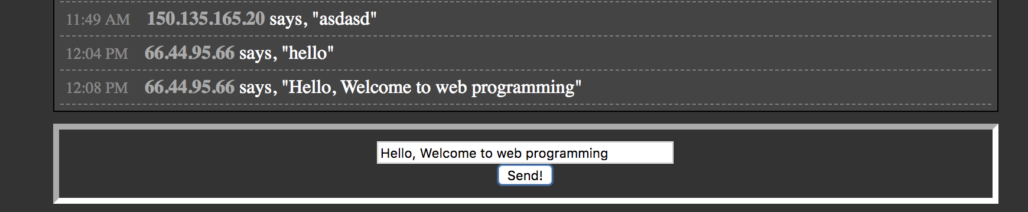
Ajax exercise 1: Chat room

Slide 34
Take-home quiz: Trivia!
Create a JSON file with a bunch of trivia questions.
E.g. Who discovered DNA Double Helix Structure?
E.g. Who invented toilet tissue paper?
Start with the HTML skeleton provided.
Show a user a question and difficulty (1,2,3)
Tell them if they are right or wrong.

Slide 35
Take-home quiz: Trivia!
Fetch the JSON and store it in a module-global variable. Sue DevTools or console.log to make sure this works.

Slide 36
Take-home quiz: Trivia!
Fill the #q-output div with a random question from the JSON result when "New Question" is pressed.
Choose a random element from a list like so:
function randomChoice(choices) { let index = Math.floor(Math.random() * choices.length); return choices[index]; }Note that the buttons on the page are initially disabed. You should enable them when the JSON data from Part I is successfully stored.

Slide 37
Take-home exercise 2: Trivia!
Now, let’s fill in the corresponding answer when "Show Answer" is pressed.
You may want to think about storing the just-shown question in a module-global variable.

Slide 38
Make an alarm clock
Step 1: set a global variable timer and evoke the timer by pressing a button.
var timer = null;
// attaches handler functions to buttons
window.onload = function() {
document.getElementById("go").onclick = go;
};

Slide 39
Make an alarm clock
Step 2: write a function set the timer off.
function go() {
// stops the timer from restarting if it is already running
if(!timer) {
timer = setInterval(tick, 100);
}
}

Slide 40
Make an alarm clock
Step 3: write a function to update the display of timer values onto the browser. How do you display into the form fields?
function tick() {
# your code
}

Slide 41
Take home read
Ajax getting started:
https://developer.mozilla.org/en-US/docs/AJAX/Getting_Started
Ajax tutorial:
http://www.w3schools.com/ajax/
XMLHTTP request
https://developer.mozilla.org/en-US/docs/Web/API/XMLHttpRequest

