Slide 1
CSC435: Web Programming Lecture 17: JavaScript Events
Bei Xiao
American University
April 3, Tuesday, 2018

Slide 2
Future lecture plan
Lectures | Content | homework
March 26 | JavaScript Events | CP3 out
March 29 | JSON, basic jQuery, review.
April 2 | Intro to server side, PHP | CP3 due, Homework 5 out
April 6 | More PHP

Slide 3
Take-home reading
Evets reference and lists:
https://developer.mozilla.org/en-US/docs/Web/Events
Handling events:
https://eloquentjavascript.net/15_event.html
A fantastic drag and drop tutorial and have good exercises at the end. You might want to go through it.
https://javascript.info/mouse-drag-and-drop

Slide 4
JavaScript event
abort | blur | change | click | dblclick | error | focus
keydown | keypress | keyup | load | mousedown | mousemove | mouseout
mouseover | mouseup | reset | resize | select | submit | unload
the click event (onclick) is just one of many events that
can be handled

Slide 5
The event object
function name(event) {
// an event handler function ...
} JS
Event handlers can accept an optional parameter to represent the event that is occurring. Event objects have the following properties / methods:
property name | description
type | what kind of event, such as "click" or "mousedown"
target | the element on which the event occurred
timeStamp | when the event occurred

Slide 6
Mouse events
click | user presses/releases mouse button on the element
dblclick | user presses/releases mouse button twice on the element
mousedown | user presses down mouse button on the element
mouseup | user releases mouse button on the element
clicking
mouseover | mouse cursor enters the element's box
mouseout | mouse cursor exits the element's box
mousemove | mouse cursor moves around within the element's box
movement

Slide 7
Mouse events
The event passed to a mouse handler has these properties:
property/method | description
clientX clientY | coordinates in browser window
screenX screenY | coordinates in screen
offsetX offsetY | coordinates in element (non-standard)
button | integer representing which button was pressed (0=Left, 1=Middle, 2=Right)

Slide 8
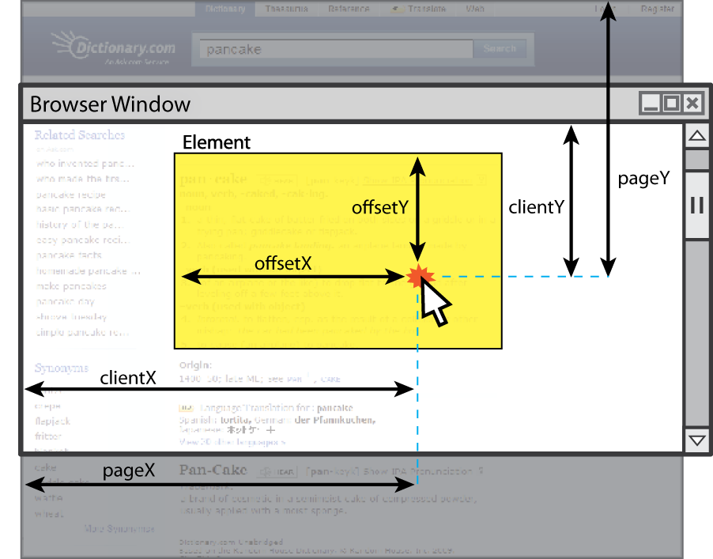
Mouse events

Slide 9
Mouse over
https://developer.mozilla.org/en-US/docs/Web/API/MouseEvent/clientX
Event.CLientX
Event.ClientY
Shows the current mouse position
function mouseDown(event) {
this.style.zIndex = 10;
this.dragging = true;
this.prevX = event.clientX;
this.prevY = event.clientY;
}

Slide 10
Mouse event example
<pre id="target">Move the mouse over me!</pre>
window.onload = function() {
var target = document.getElementById("target");
target.onmousemove = target.onmousedown = showCoords;
};
function showCoords(event) {
document.getElementById("target").innerHTML =
"screen : (" + event.screenX + ", " + event.screenY + ")\n"
+ "client : (" + event.clientX + ", " + event.clientY + ")\n"
+ "button : " + event.button;
}
screen : (333, 782)
client : (222, 460)
button : 0

Slide 11
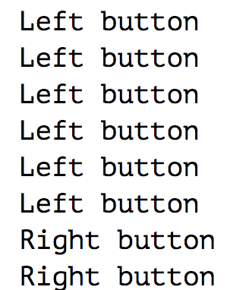
Event Handlers
<button>Click me any way you want</button>
<script>
let button = document.querySelector("button"); button.addEventListener("mousedown", event => {
if (event.button == 0) {
console.log("Left button"); }
else if (event.button == 1) { console.log("Middle button"); }
else if (event.button == 2) {
console.log("Right button"); } });
</script>

Slide 12
EventTarget.addEventListener()
The EventTarget method addEventListener() sets up a function that will be called whenever the specified event is delivered to the target. Common targets are Element, Document, and Window, but the target may be any object that supports events (such as XMLHttpRequest).
document.getElementById("myBtn").addEventListener("click", function(){
document.getElementById("demo").innerHTML = "Hello World";
});
What is better? addEventLIstener or onClick?
https://stackoverflow.com/questions/6348494/addeventlistener-vs-onclick
In Short, addEventListener allows register for unlimited event handlers.

Slide 13
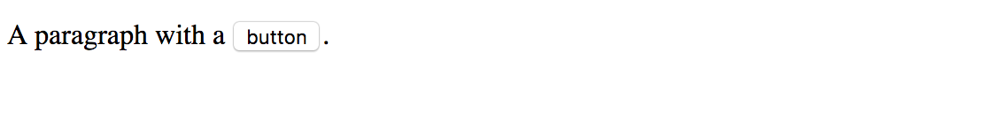
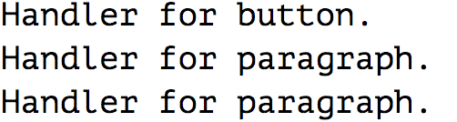
Event object: stopPropogation
<p> A paragraph with a <button> button</button>.</p>
<script>
let para = document.querySelector("p");
let button = document.querySelector("button"); para.addEventListener("mousedown", () => { console.log("Handler for paragraph."); });
button.addEventListener("mousedown", event => { console.log("Handler for button.");
if (event.button == 2)
event.stopPropagation();
});
</script>
If you click on the button, it will say “button” instead of ” paragraph”, though button is inside the paragraph. This is called “Propagation”. If both the paragraph and the button have a handler, the more specific handler—the one on the button—gets to go first.
Notes:
The addEventListener() method attaches an event handler to the specified element.

Slide 14
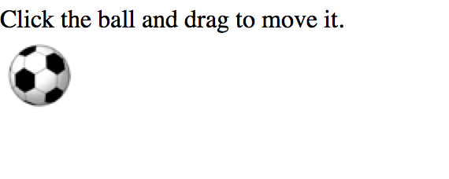
Exercise Drag and Drop exercise
Hint: use onmousedown onmouseup
var ball = document.getElementById("ball");
ball.onmousedown = mouseMove;
https://eloquentjavascript.net/15_event.html

Slide 15
Exercise Drag and Drop exercise
1. Catch mousedown on a draggable element.
2. Prepare the element to moving (maybe create a copy of it or whatever).
3. Then on mousemove move it by changing left/top and position:absolute.
4. On mouseup (button release) – perform all actions related to a finished Drag’n’Drop.
This exercises is explained very well here. But don’t read it before you try it out yourself.
https://javascript.info/mouse-drag-and-drop

Slide 16
Keyboard and text events
name | description
focus | this element gains keyboard focus (attention of user's keyboard)
blur | this element loses keyboard focus
keydown | user presses a key while this element has keyboard focus
keyup | user releases a key while this element has keyboard focus
keypress | user presses and releases a key while this element has keyboard focus
select | this element's text is selected or deselected

Slide 17
Key event objects
property name | description
keyCode | ASCII integer value of key that was pressed (convert to char with String.fromCharCode)
altKey, ctrlKey, shiftKey | true if Alt/Ctrl/Shift key is being held
issue: if the event you attach your listener to doesn't have the focus, you won't hear the event
possible solution: attach key listener to entire page body, document, an outer element, etc.

Slide 18
Key event example
document.getElementById("textbox").onkeydown = textKeyDown;
...
function textKeyDown(event) {
var key = String.fromCharCode(event.keyCode);
if (key == 's' && event.altKey) {
alert("Save the document!");
this.value = this.value.split("").join("-");
}
} JS
each time you push down any key, even a modifier such as Alt or Ctrl, the keydown event fires
if you hold down the key, the keydown event fires repeatedly
keypress event is a bit flakier and inconsistent across browsers

Slide 19
Useful Keycodes
Keyboard Key | Event Keycode
Backspace | 8
Tab | 9
Enter | 13
Escape | 27
Page Up, Page Down, End, Home | 33, 34, 35, 36
Left, Up, Right, Down | 37, 38, 39, 40
Insert, Delete | 45, 46
Window/Command | 91
F1-F12 | 112-123

Slide 20
Page/Window Events
Name | Description
contextmenu | the user right-clicks to pop up a context menu
error | an error occurs when loading a document or an image
load | the browser loads the page
resize | the browser window is resized
scroll | the user scrolls the viewable part of the page up/down/left/right
unload | the browser exits/leaves the page

Slide 21
Stopping an event
event method name | description
preventDefault | stops the browser from doing its normal action on an event; for example, stops the browser from following a link when <a> tag is clicked, or stops browser from submitting a form when submit button is clicked
stopPropagation | stops the browser from showing this event to any other objects that may be listening for it

Slide 22
Stopping an event
<form id="exampleform" action="http://foo.com/foo.php">...</form>
window.onload = function() {
var form = document.getElementById("exampleform");
form.onsubmit = checkData;
};
function checkData(event) {
if (document.getElementById("state").length != 2) {
alert("Error, invalid city/state."); // show error message
event.preventDefault();
return false; // stop form submission
}
}

Slide 23
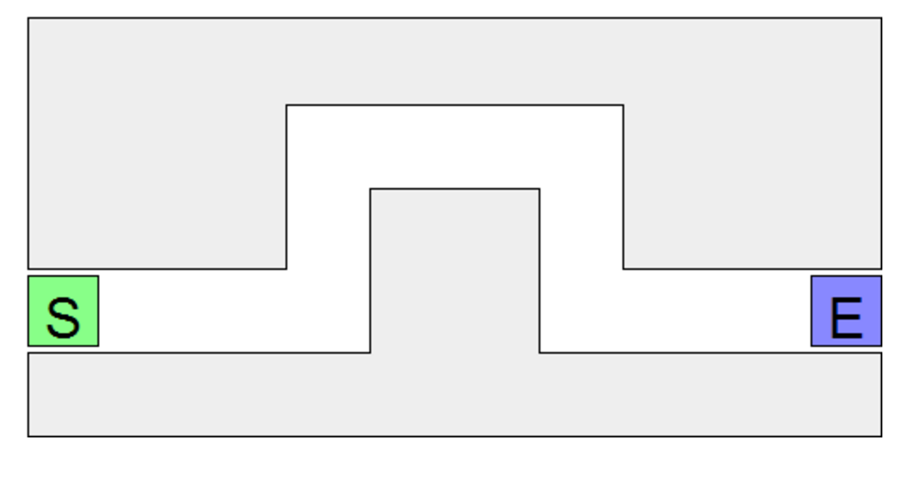
In-class exercise: Maze
This in-class lab practices unobtrusive JavaScirpt events and DOM.
We will write a page with a “maze” to navigate with the mouse.
You have to write the maze.js

Slide 24
Info about the maze
Download maze.html
The difficulty is in having the dexterity to move the mouse through without touchig any walls. When the mouse curcor touches a wall, all walls turns red and “you lose” messages shows.
Touch the start button with the mouse removes the red coloring from the wall.
The maze walls are 5 div elements. See the provided .CSS

Slide 25
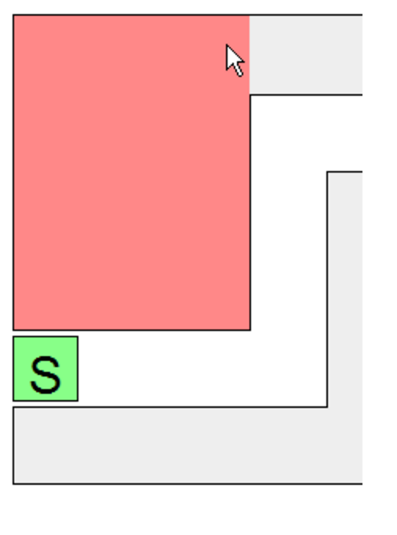
Step 1: Single boundary turns red (~15mins)
Write code so that when the user moves the mouse onto a single one of the maze’s walls (onmouseover), that wall will turn red.
Use the top-left wall; it is easier because it has an id of boundary1.
Write your JS code unobtrusively, without modifying maze.html
Write a window.onload handler that sets up an event handler.
Handle the event on the wall by making it turn red.
Turn the wall red by setting it to have provided CSS class youlose,
Use the classList property.
boundary.classList.add("youlose")

Slide 26
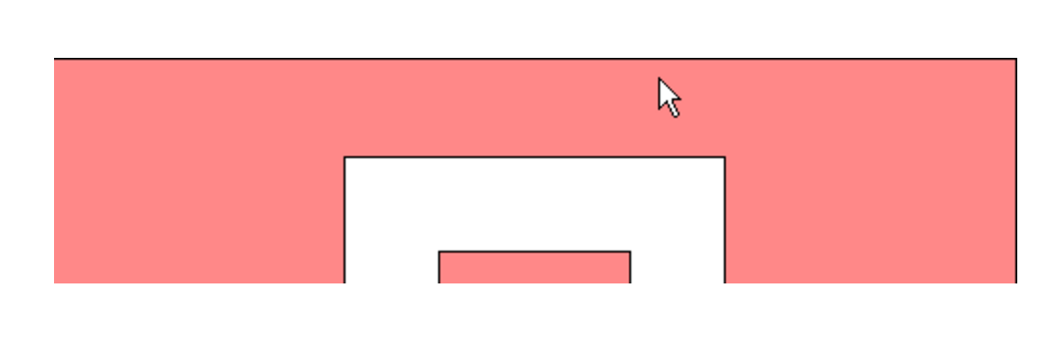
Step 2: all boundaries glow red on hover (10 min)
Make it so that all maze walls turn red when the mouse enters any one of them.
You will need to attach an event handler to each div that represents a wall of the maze.
It is harder to select all of these divs, since they do not have id attributes.
But they do have a class of boundary.
Use document.quereySelectorAll function to access them all.

Slide 27
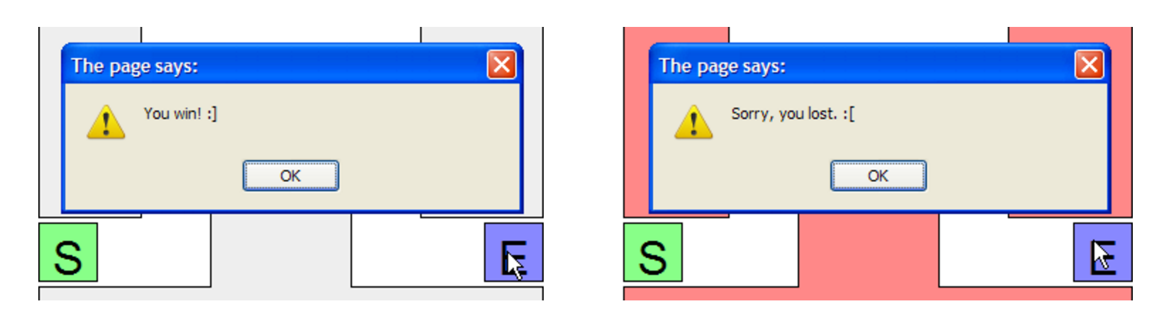
Step 3: Alert on completion of maze
When user complete the maze, alert “you win”
The end of the maze is a div with an id of end.
If they touch any wall, they lose.

Slide 28
Step 3: Reset the maze status
Make it so that when the user clicks the mouse on the Start div,
The maze state will reset. That is, if the maze boundary walls are red, they will all return to their normal color, so that the user can try to get through the maze again.
Hint: document.querySelectorAll

Slide 29
Step 3: Reset the maze status
Make it so that when the user clicks the mouse on the Start div,
The maze state will reset. That is, if the maze boundary walls are red, they will all return to their normal color, so that the user can try to get through the maze again.
Hint: document.querySelectorAll

Slide 30
Step 4: Disallow Cheating
It is too easy to cheat: Just move your mouse around the outside the maze:
Fix this by making it so that if the user moves the mouse anywhere outside the maze after clicking the Start area, the walls will light up red and the player will lose.
To do this, you need to listen to other kinds of mouse events.

Slide 31
Extra features:
Add a timer to the page so that once you start playing the maze, it starts the timer, and stops it when you complete the maze.
Timer is displayed on the page, and updates every second.
Implement a “lives” system, start out the user 5 lives, and decrement each time they lose.

Slide 32
Exercise: mouse over
https://developer.mozilla.org/en-US/docs/Web/API/MouseEvent/clientX
Event.CLientX
Event.ClientY
Shows the current mouse position
function mouseDown(event) {
this.style.zIndex = 10;
this.dragging = true;
this.prevX = event.clientX;
this.prevY = event.clientY;
}

Slide 33
Take home read
JavaScript Events:
http://101.lv/learn/JSweek/ch5.htm
http://javascript.info/tutorial/introduction-browser-events#assigning-event-handle
Drag and drop:
http://blog.teamtreehouse.com/implementing-native-drag-and-drop
Notice most of these tutorials don’t write JS in unobtrusive way. You must keep this in mind and write your own code in unobtrusive way.

Slide 34

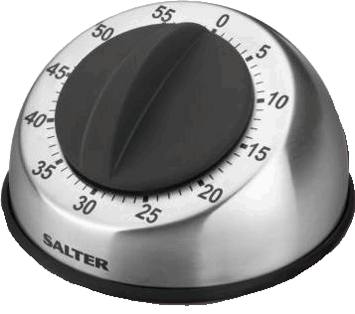
Setting a timer
method | description
setTimeout(function, delayMS); | arranges to call given function after given delay in ms
setInterval(function, delayMS); | arranges to call function repeatedly every delayMS ms
clearTimeout(timerID); clearInterval(timerID); | stops the given timer
both setTimeout and setInterval return an ID representing the timer
this ID can be passed to clearTimeout/Interval later to stop the timer

Slide 35
Setting a timer
method | description
setTimeout(function, delayMS); | arranges to call given function after given delay in ms
setInterval(function, delayMS); | arranges to call function repeatedly every delayMS ms
clearTimeout(timerID); clearInterval(timerID); | stops the given timer
both setTimeout and setInterval return an ID representing the timer
this ID can be passed to clearTimeout/Interval later to stop the timer

Slide 36

setInterval
var timer = null; // stores ID of interval timer
function delayMsg2() {
if (timer === null) {
timer = setInterval(rudy, 1000);
} else {
clearInterval(timer);
timer = null;
}
}
function rudy() { // called each time the timer goes off
document.getElementById("output").innerHTML += " Rudy!";
} JS
output

