Slide 1
Analysis of “A Linear Programming Methodology for the Optimization of Electric Power-Generation Schemes”
Group 2: Rukshar Abdul Bhisti, Kevin George, Nicole Hill
Notes:
Rukshar

Slide 2
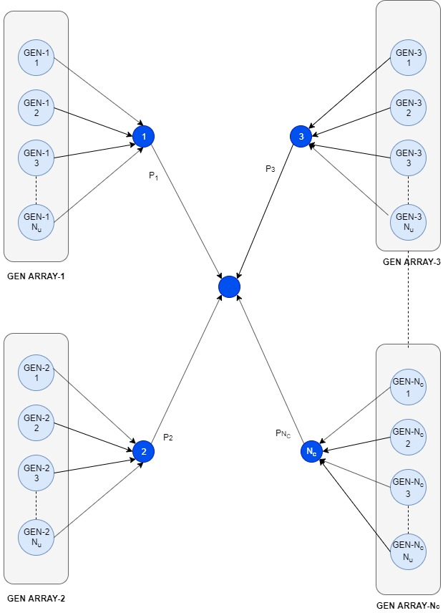
Utility of independent power generation schemes
Independent power sources ensure continuous, reliable power for industries that need continuous operation
Choosing a generator array can be time consuming and potentially costly if not properly selected
Linear/integer programming can highlight viable options that fulfill needs while still minimizing costs to the company
Notes:
Kevin

Slide 3
Model Formulation
The model covers the following four main cost groups:
Investment costs
Fuel costs
Operation and maintenance costs
Unavailability costs
The constraints on the model are:
Power generated must equal the average load demand
Power generated cannot exceed capacity of the generators
The generating array must have a capacity that exceeds the maximum load demand
Only one type of generator model can be chosen
Notes:
Kevin

Slide 4
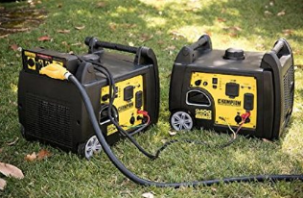
Model Formulation: Decision Variables and Sets
Paper:
Sets
TYPE: generator model, Nc
NUMBER: total number of generation units, Nu
Decision Variables
X_{i}: binary variable associated with installing an array of generator model i
X_{ij}: binary variable associated with installing a unit j of generator type i
P_{ij}: power associated with one generator unit j of type I
USP_{i}: variable associated with the average unserved power for array of generator model i
Our formulation:
Sets
GEN: generator model
Decision Variables
x_{i}: integer variable associated with the number of generator model i to install
y_{i}: binary variable associated with installing an array of generator model i
P_{i}: variable associated with the total power generator by generator array of model type i
USP_{i}: variable associated with the average unserved power for array of generator model i
Picture courtesy of: Champion Parallel Kit for 2800+ Inverter Generators. https://generatorpowersource.com/paralleling-generators-running-generators-in-parallel/
Notes:
Kevin

Slide 5
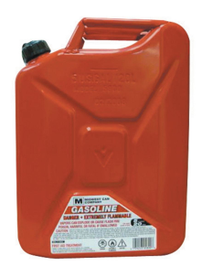
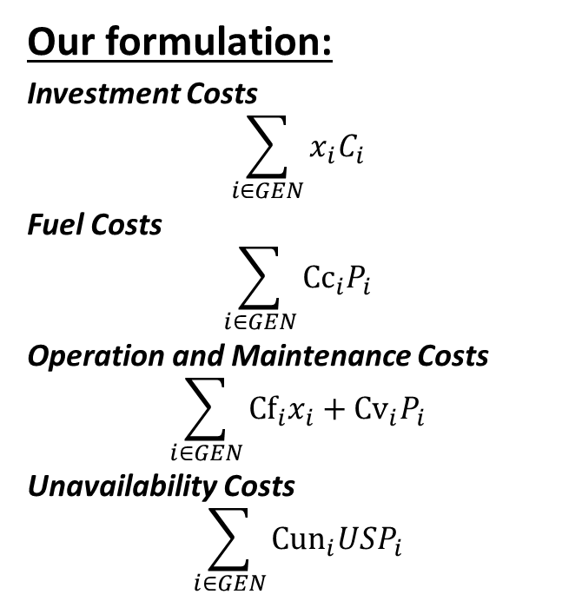
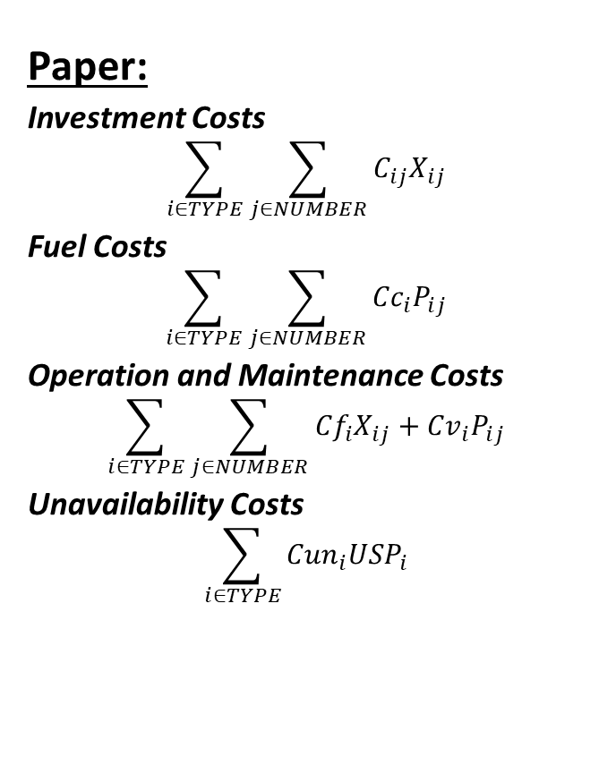
Model Formulation: Objective Function
Minimize cost=(Investment Costs + Fuel Costs + Operation and Maintenance Costs + Unavailability Costs)
Paper:
Investment Costs
$$\sum_{i∈TYPE}{\sum_{j∈NUMBER}{C_{ij}X_{ij}}}$$
Fuel Costs
$$\sum_{i∈TYPE}{\sum_{j∈NUMBER}{{Cc}_{i}P_{ij}}}$$
Operation and Maintenance Costs
$$\sum_{i∈TYPE}{\sum_{j∈NUMBER}{{Cf}_{i}X_{ij}+{Cv}_{i}P_{ij}}}$$
Unavailability Costs
$$\sum_{i∈TYPE}{{Cun}_{i}{USP}_{i}}$$
Our formulation:
Investment Costs
$$\sum_{i∈GEN}{x_{i}C_{i}}$$
Fuel Costs
$$\sum_{i∈GEN}{{Cc}_{i}P_{i}}$$
Operation and Maintenance Costs
$$\sum_{i∈GEN}{{Cf}_{i}x_{i}+{Cv}_{i}P_{i}}$$
Unavailability Costs
$$\sum_{i∈GEN}{{Cun}_{i}{USP}_{i}}$$
Pictures courtesy of: Champion Parallel Kit for 2800+ Inverter Generators. https://generatorpowersource.com/paralleling-generators-running-generators-in-parallel/, 5 Gallon Jerry Gas Can. https://www.harborfreight.com/automotive/automotive-accessories/fuel-cans-funnels/5-gallon-jerry-can-99551.html
Notes:
Nicole

Slide 6

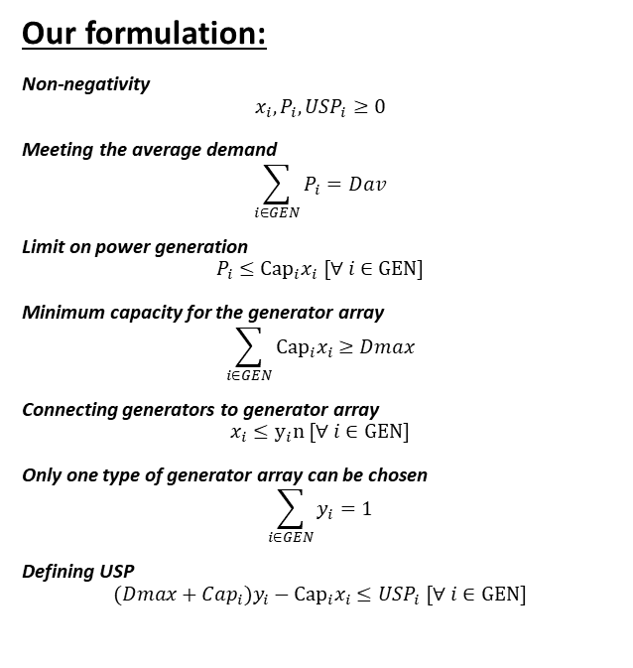
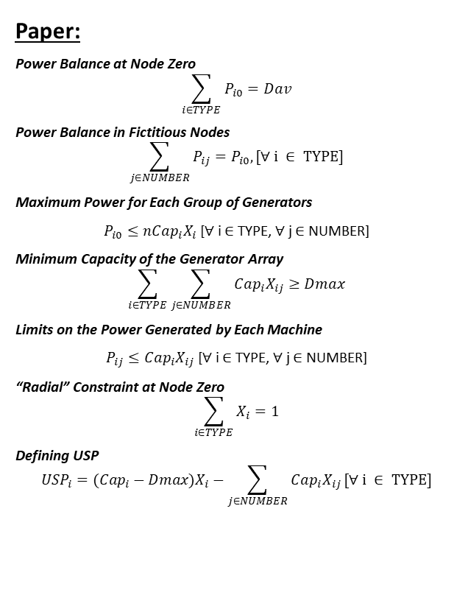
Model Formulation: Constraints
Paper:
Power Balance at Node Zero
$$\sum_{i∈TYPE}{P_{i0}}=Dav$$
Power Balance in Fictitious Nodes
$$\sum_{j∈NUMBER}{P_{ij}=P_{i0},[∀ i ∈ TYPE]}$$
Maximum Power for Each Group of Generators
$P_{i0}≤{nCap}_{i}X_{i}$ [$∀$ i $∈$ TYPE, $∀$ j $∈$ NUMBER]
Minimum Capacity of the Generator Array
$$\sum_{i∈TYPE}{\sum_{j∈NUMBER}{{Cap}_{i}X_{ij}≥Dmax}}$$
Limits on the Power Generated by Each Machine
$P_{ij}≤{Cap}_{i}X_{ij}$ [$∀$ i $∈$ TYPE, $∀$ j $∈$ NUMBER]
“Radial” Constraint at Node Zero
$$\sum_{i∈TYPE}{X_{i}}=1$$
Defining USP
$${{USP}_{i}=(Cap}_{i}−Dmax)X_{i}−\sum_{j∈NUMBER}{{Cap}_{i}X_{ij}}[∀ i ∈ TYPE]$$
Our formulation:
Non-negativity
$$x_{i},P_{i},{USP}_{i}≥0$$
Meeting the average demand
$$\sum_{i∈GEN}{P_{i}}=Dav$$
Limit on power generation
$$P_{i}≤{Cap}_{i}x_{i} [∀ i∈GEN]$$
Minimum capacity for the generator array
$$\sum_{i∈GEN}{{Cap}_{i}x_{i}}≥Dmax$$
Connecting generators to generator array
$$x_{i}≤y_{i}n [∀ i∈GEN]$$
Only one type of generator array can be chosen
$$\sum_{i∈GEN}{y_{i}}=1$$
Defining USP
$${(Dmax+Cap}_{i})y_{i}−{Cap}_{i}x_{i}≤{USP}_{i} [∀ i∈GEN]$$
Pictures courtesy of: M. Perry, Grumpy Llama. 2016. https://www.spectator.co.uk/2016/05/how-a-grumpy-llama-became-the-third-person-in-our-relationship/
Notes:
Nicole

Slide 7
Scalability
The paper model decision variables scale linearly with:
Number of generator models
Number of generator units
Our model scales linearly with:
Number of generator models
We increased the number of models ten fold and noticed no significant change in run time
Notes:
Nicole

Slide 8
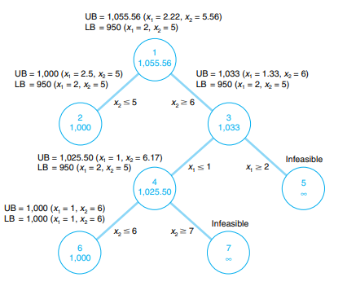
Paper Scheme: Branch and Bound
Starts with a relaxed LP solution
Gradually finds best feasible solution with integer values
Diagram courtesy of: B. W. Taylor, Module C. Integer Programming: The Branch and Bound Method, 10th ed., 2006.
Notes:
Nicole

Slide 9

Validity of the model
In general, we found a few issues with the validity with the solution:
The paper showed two different situations to test the model
Test Case 1
Test Case 2
Additional Comments
Paper Model:
An array with 2 PG5371 generators
Confirmed with another, older reference with a more extensive evaluation of alternatives
Predicted generator array fulfills all requirements
Our Model:
An array with 2 PG5371 generators
Predicted generator array fulfills all requirements
Paper Model:
An array with 3 PGT10 generators
No validation with another source
Predicted generator array fulfills all requirements
Our Model:
An array with 2 PGT10 generators
Predicted generator array fulfills all requirements
This model only observes the first year time period for costs, but does not take into account future years
The paper does not make clear several different aspect of the model, making a complete comparison difficult
The units presented in the paper don’t logically follow the results given, making a fair comparison difficult
Image courtesy of: Thumbs Up Emoji. https://emojiterra.com/thumbs-up/
Notes:
Nicole

Slide 10
Improvements
An improvement to the model would be allowing it to factor in future years, building a cumulative cost comparison for all generator models and creating a more logically sound argument for the best generator choice
The level of clarity in the paper was low, making it difficult to understand. We tried to improve the model by modifying some of the model characteristics to create what we felt was a more logical approach to this problem.
5 years
5 years
Cumulative Cost
1 year
1 year
Options
Notes:
Nicole

Slide 11
References
Paper:
H. M. Khodr, J. F. Gomez, L. Barnique, J. H. Vivas, P. Paiva, J. M. Yusta, and A. J. Urdaneta, "A linear programming methodology for the optimization of electric power-generation schemes," IEEE Transactions on Power Systems, vol. 17, pp. 864-869, 2002. https://ieeexplore.ieee.org/abstract/document/1033737
Information on Branch and Bound Method:
B. W. Taylor, Module C. Integer Programming: The Branch and Bound Method, 10th ed., 2006.
http://web.tecnico.ulisboa.pt/mcasquilho/compute/_linpro/TaylorB_module_c.pdf
US DOE Cost Estimates for Utility Scale Electricity Generating Plants:
Capital Cost Estimates for Utility Scale Electricity Generating Plants. US Department of Energy, 2016. https://www.eia.gov/analysis/studies/powerplants/capitalcost/pdf/capcost_assumption.pdf
Pictures:
Champion Parallel Kit for 2800+ Inverter Generators. https://generatorpowersource.com/paralleling-generators-running-generators-in-parallel/
5 Gallon Jerry Gas Can. https://www.harborfreight.com/automotive/automotive-accessories/fuel-cans-funnels/5-gallon-jerry-can-99551.html
M. Perry, Grumpy Llama. 2016. https://www.spectator.co.uk/2016/05/how-a-grumpy-llama-became-the-third-person-in-our-relationship/
Thumbs Up Emoji. https://emojiterra.com/thumbs-up/
J. Mumm, Break Out Dancing GIF. https://giphy.com/gifs/julesm-funny-dance-3ohBVc6Xt0T89cSfXa

Slide 12

Questions?
gif courtesy of: J. Mumm, Break Out Dancing GIF. https://giphy.com/gifs/julesm-funny-dance-3ohBVc6Xt0T89cSfXa

