Slide 1
What is Pyramid
(and where is it with respect to Django)
By: Kevin Gill
For: Python Ireland
Date: May 11 2011
https://github.com/kevingill1966/pyramid-talk-may11

Slide 2
Learning Objectives
Orientation to learn Pyramid
Why should you use Pyramid (versus Django)
How should you use Pyramid

Slide 3
Tutorial
Go through tutorial code:
https://github.com/kevingill1966/pyramid-talk-may11

Slide 4
Not covered in tutorial
Testing
Security
Authentication
Session Management
ZODB /Traversal
Deployment
Buildout etc

Slide 5
Versus Django: Landscape
Reuse
* Flask
* Pyramid
* Pylons
* Django
* Werkzeug
* Zope
Functionality / Stack Size
Notes:
Based on the concept that freameworks provide
Distpacher
Templating
Database
Are they available / build or reused
Opinionated Versus Non-opinionated
Reused versus built

Slide 6
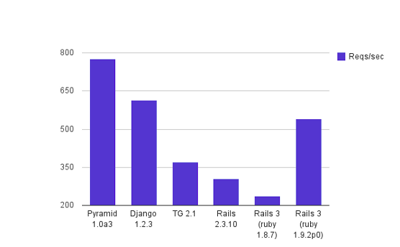
Versus Django: Performance
http://blog.curiasolutions.com/2010/11/the-great-web-technology-shootout-%E2%80%93-round-4-pyramid-vs-django-vs-tg-vs-rails-2-3/

Slide 7
Versus Django : Docs
Core very good for both
Pyramid – lacks third party, e.g. Blogs and cheatsheets

Slide 8
Versus Django : Stability
Pyramid unfinished – energy in framework
Django finished – energy in community

Slide 9
Versus Django : Community
Community Size / Support
Django huge
Pyramid politically clever
  Merged with Pylons – community seems happy

Slide 10
Versus Django : Vertical
Django Pinax
(zope plone), Pyramid ...

Slide 11
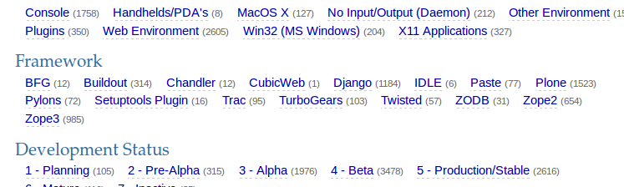
Versus Django: Apps
Search for 'pyramid' in PyPi gives 54 results

Slide 12
Versus Django : Reuse
Reuse complicated by different development patterns and choices in different projects
Serious reuse would require a layer on top of Pyramid e.g. CMS / Pinax
Pyramid provides mechanisms and advice for reuse, i.e. how to write configuration, store resources
http://docs.pylonsproject.org/projects/pyramid/1.0/narr/extending.html

Slide 13
Versus Django : IDE Support
IDE support for Django
  PyDev
  PyCharm
  django-komodo-kit
  http://code.djangoproject.com/wiki/UsingVimWithDjango
Nothing specific for pyramid

Slide 14

Https://convore.com/pylons
Http://docs.pylonsproject.org/docs/pyramid.html
Https://github.com/Pylons
Http://pylonsproject.org

