Slide 1


Creative
June 1st, 2016

Slide 2

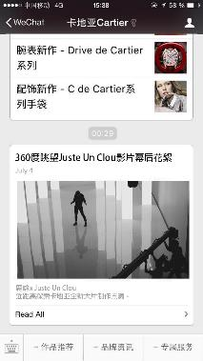
WECHAT PUSH ARTICLE
ON JULY 4TH WE WILL SEND A WECHAT PUSH WITH EXCLUSIVE CONTENT OF THE MAKING OFF OF THE JUC CARTIER FILM.

Slide 3
GA js.
<script>
(function(i,s,o,g,r,a,m){i['GoogleAnalyticsObject']=r;i[r]=i[r]||function(){
(i[r].q=i[r].q||[]).push(arguments)},i[r].l=1*new Date();a=s.createElement(o),
m=s.getElementsByTagName(o)[0];a.async=1;a.src=g;m.parentNode.insertBefore(a,m)
})(window,document,'script','https://www.google-analytics.com/analytics.js','ga');
ga('create', 'UA-25338682-37', 'auto');
ga('send', 'pageview');
</script>

Slide 4

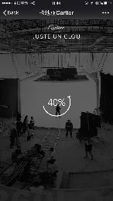

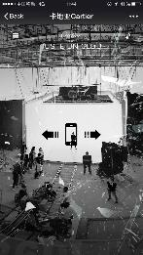

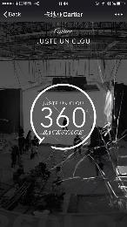
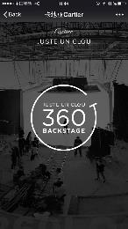
1
LOADING PAGE
THE LOADING MOTION IS IN THE SHAPE OF THE JUC BRACELET.
WHEN IT REACHES 100%, WE SEE DISPLAYED THE “JUST UN CLOU 360 BACKSTAGE” (SEE NEXT SLIDE).
THE LOADING TIME IS OVER.
NOW, THE BRACELET SHAPE TURNS ARROUND THE “JUSTE UN CLOU 360 BACKSTAGE” WRITING IN SLOW MOTION.
TO ACCESS THE 360 BACKSTAGE EXPERIENCE, THE USER WILL HAVE TO TAP THE SCREEN WHICH TRIGGERS THE GLASS BREAKING.
THE PHONE ICON WITH THE ARROWS (ANIMATED MOTION TOWARDS THE SIDES) GUIDES THE USER TO MOVE HIS PHONE TO EITHER SIDES, TO DISCOVER MORE CONTENT.
PHONE + ARROWS MOTION SHOULD DISAPPEAR WHEN THE GLASS IS FULLY FADED
# | Event Category | Event Name
1 | 360 | Experience

Slide 5
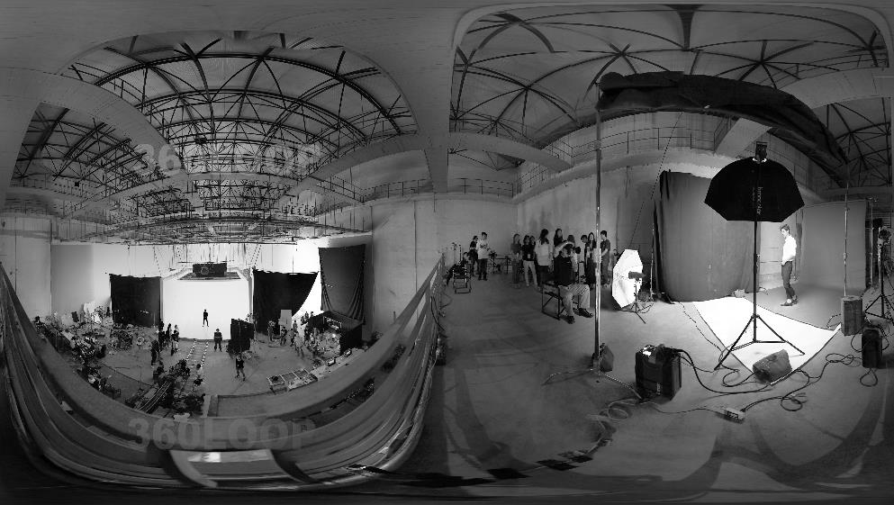



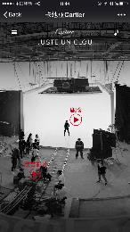
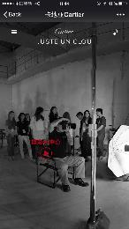
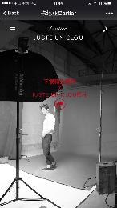
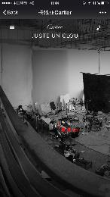
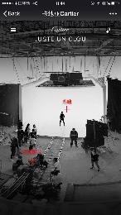
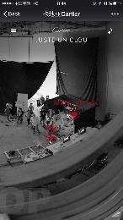
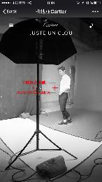
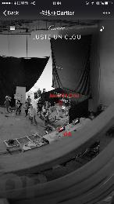
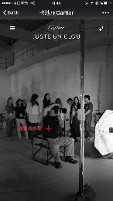
2
4
7
1
5
6
3
# | Event Category | Event Name
1 | 360 | Video-Lisa
2 | 360 | Video-Luhan
3 | 360 | Video-Film
4 | 360 | Video-Juste
5 | 360 | Video-Film-NG
6 | 360 | Video-Liqi
7 | 360 | Video-Photo

Slide 6


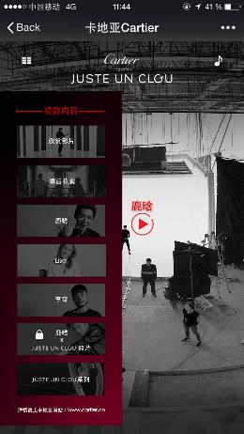
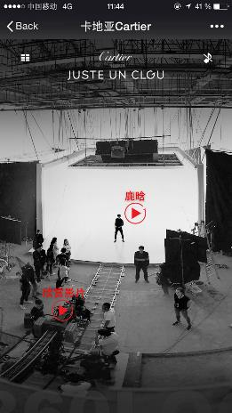
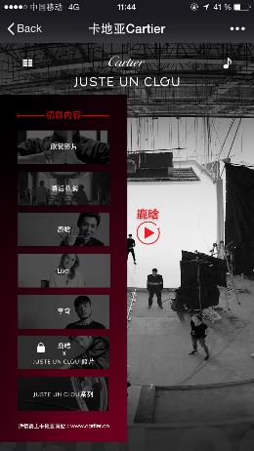

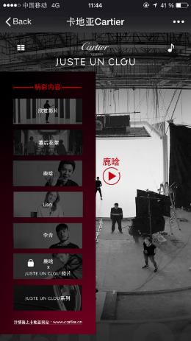

1
9
2
# | Event Category | Event Name
1 | 360 | Menu
2 | 360 | Menu-Film
3 | 360 | Menu-Film-NG
4 | 360 | Menu-Luhan
5 | 360 | Menu-Lisa
6 | 360 | Menu-Liqi
7 | 360 | Menu-Photo
8 | 360 | Menu-Juste
9 | 360 | Menu-Music
3
4
5
6
7
8

Slide 7

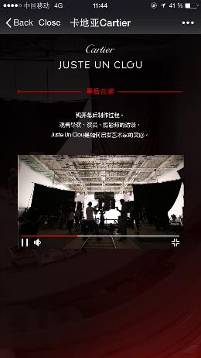
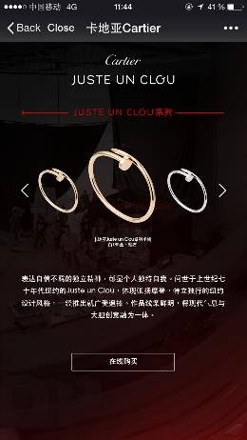
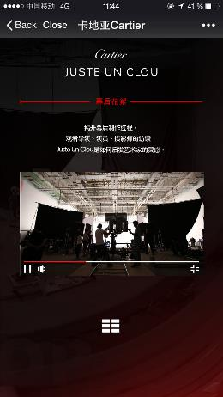
1
# | Event Category | Event Name
1 | 360 | Online-Purchase

Slide 8
MERCI 谢谢

