Slide 1

Basics and Related Work
Computer Vision UE Project, 2021W
Seng Tak Goh - Konstantina Kyriakouli
Bola Khalil - Mina Anis Ibrahim Shehata

Slide 2
Objectives
Goal: locate moving people in the forest
Problem: strong occlusion due to trees
Data: multiple temporal image sequences where each sequence
contains multiple RGB images recorded using a camera array (+
homography)
Task: your unsupervised localization algorithm
Evaluation: average precision (AP) of detection on additional test dataset
Adapted from Indrajit Kurmi's slides.

Slide 3
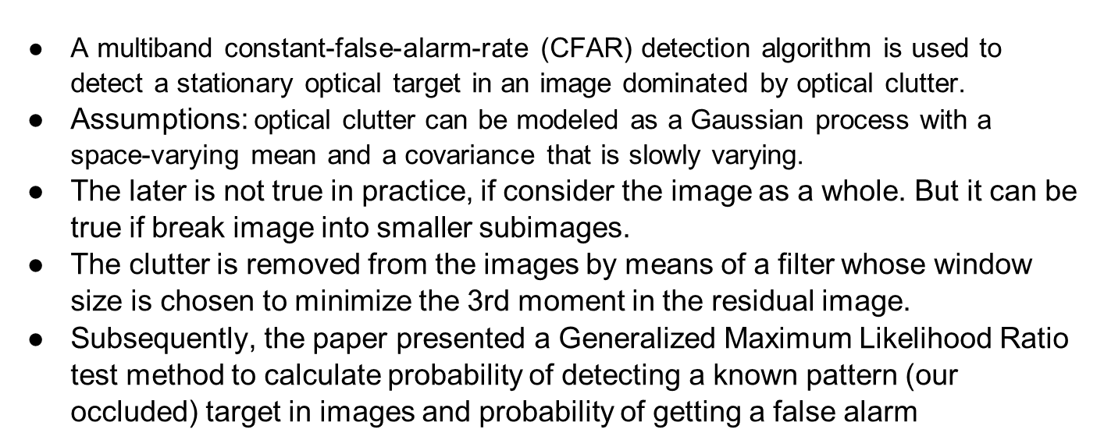
Adaptive Multiband CFAR Detection in Optical Images (1.1)
Notes:
Summarized by Seng Tak

Slide 4
Unsupervised object discovery and localization in the wild (2.1)
Fully unsupervised approach to object discovery, without: >image-level annotations >assumption of a single dominant class >known number of object classes
Part-based region matching approach combined with a foreground localization scheme
PHM (probabilistic Hough matching) based on a probabilistic Hough transform: an efficient matching algorithm considering both appearance and geometrical consistency. It is introduced for efficient region matching.
Outperforms state-of-the-art in very weakly supervised mode - Benchmarks: Object Discovery and PASCAL VOC 2007
Cho et al., 2015
Notes:
Summarized by

Slide 5
Unsupervised object discovery and localization in the wild (2.2)
Part-based region matching: Probabilistic Hough Matching
    Hough space score + Hough match confidence
    Their formulation can be seen as a combination of bottom-up and top-down processes
    Results in robust match confidences, matches can be one-to-one, one-to-many
Foreground localization: standout score
    Separate foreground objects from background unsupervised
    To this end, they leverage perceptual contrast, defining a “standout score”
Algorithm for object detection: iterations of blocks of: 1. Neighbor image retrieval (k = 10) 2. Part-based region matching 3. Foreground localization
    Based on the idea: better localization makes better retrieval & matching, and vice versa
    5 iters sufficient for convergence
    parallelizable
Cho et al., 2015
Notes:
Probabilistic Hough matching: The match of a region (assuming a common object appears) between two images is decomposed in a Bayesian manner, appearance likelihood and geometry likelihood are separated, a Hough space score is introduced in place of unknown geometry prior, as well as Hough match confidence.
Standout score: The score reflects the principle that we perceive lower contrast betw. parts of foreground than that betw. background and foreground.
Algo: retrieve k neighbors for each image, part-based region matching only for neighbors. 5 potential object regions for each image considered for which top 20 region proposals considered. Regions + neighbors updated over iterations. Final localization: selecting the most standout region in the end.

Slide 6
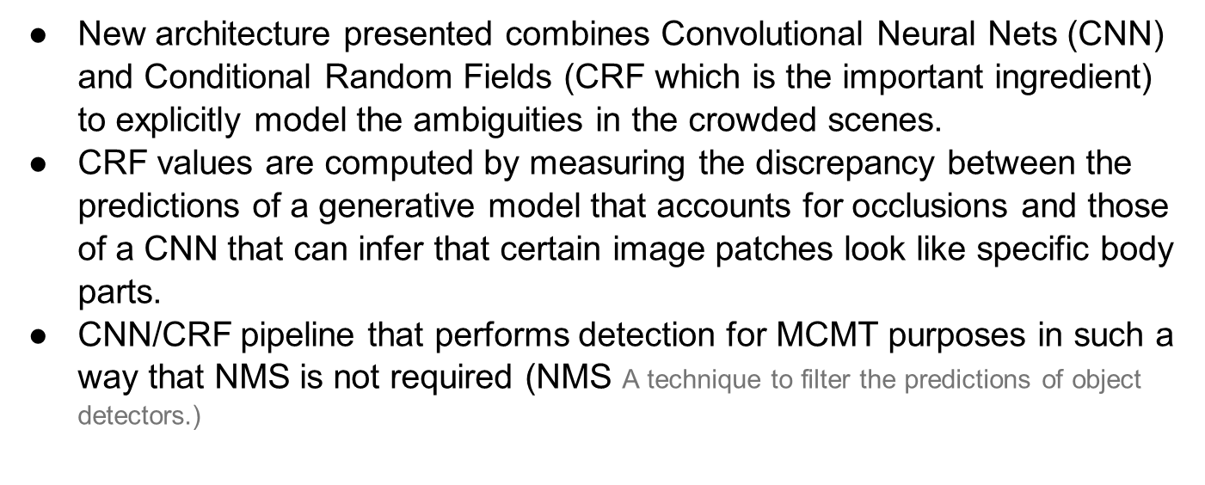
Deep occlusion reasoning for multi-camera multi-target (MCMT) detection (3.1)
Notes:
Summarized by Bola Khalil

Slide 7
Deep occlusion reasoning for multi-camera multi-target (MCMT) detection (3.2)
Training the CRFs is difficult because many interesting models yield intractable inference problems
The proposed model can be trained in a supervised and an unsupervised manner.

Slide 8
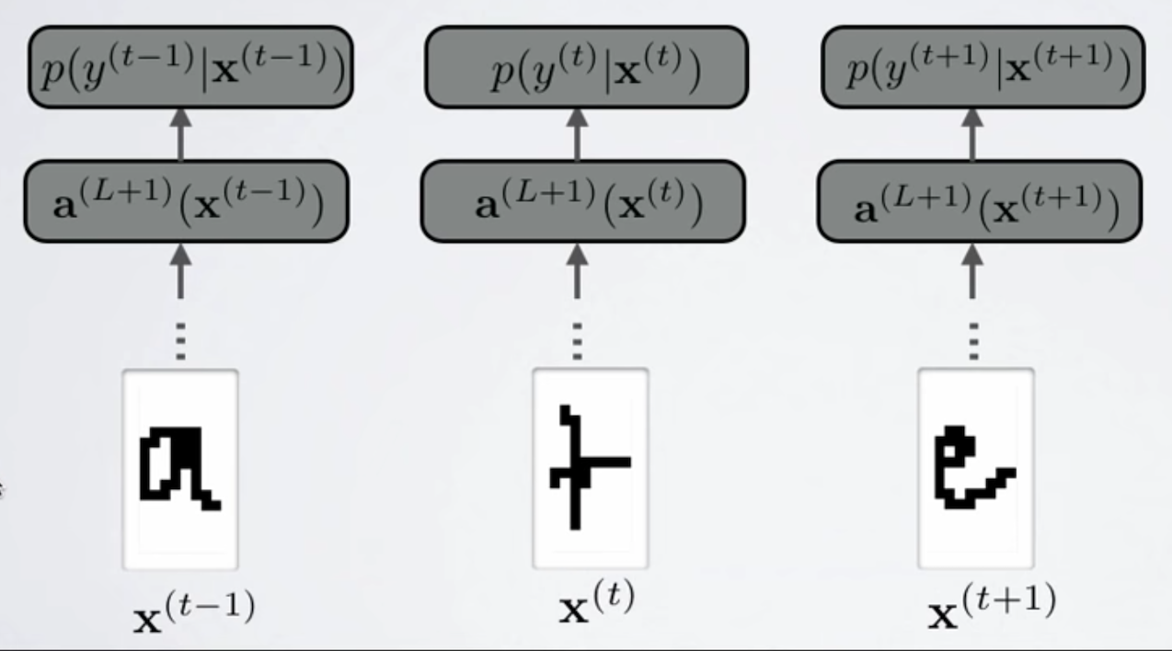
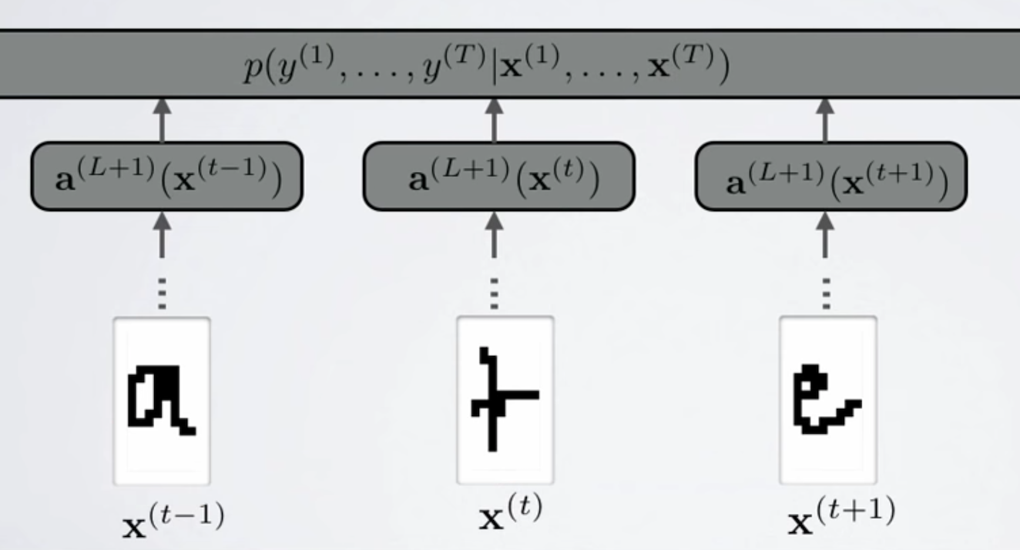
Deep occlusion reasoning for multi-camera multi-target (MCMT) detection (3.3)
CNN
CNN/CRF

Slide 9
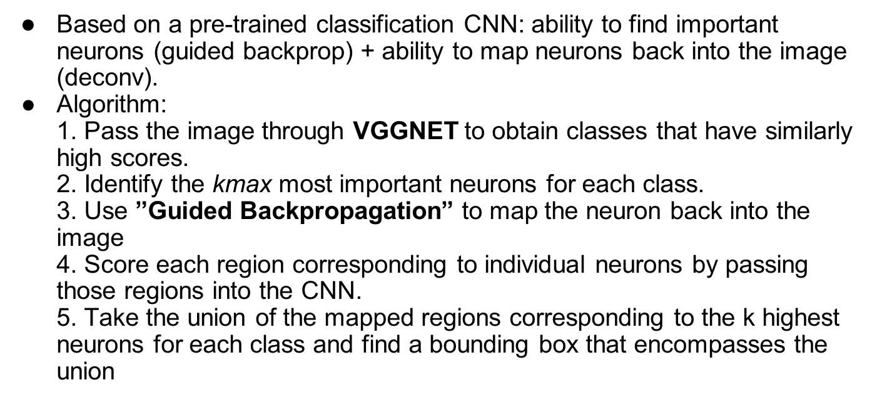

Fast Unsupervised Object Localization
Fast Unsupervised Object Localization; Dwaraknath,A. , Menghani,D. , Mongia, M, 2016, http://cs231n.stanford.edu/reports/2016/pdfs/285_Report.pdf
Notes:
BOLA K

Slide 10
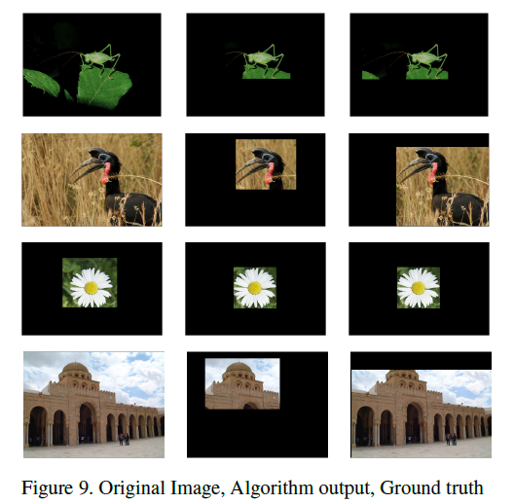
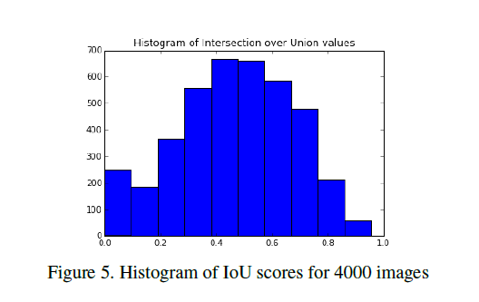
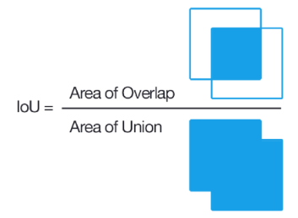
Fast Unsupervised Object Localization
The mean IoU score was found to be 0.4679
Fast Unsupervised Object Localization; Dwaraknath,A. , Menghani,D. , Mongia, M, 2016, http://cs231n.stanford.edu/reports/2016/pdfs/285_Report.pdf
Notes:
https://github.com/deepakrox/FastObjectLocalization

