Slide 1
Cloud Solution Provider
Integration
Isaiah Williams – Partner Technology Strategist (MSP)

Slide 2
Partner Center

Slide 3
API Usage
Microsoft API | Platform | Billing | Licensing | Provisioning | Support
Office 365 Service Communications API | Office 365 |  |  |  | Office 365 service health
Microsoft Graph | Office 365 |  | Assign licenses to users | Contacts Groups Users
Partner Center API/SDK | Partner Center | Azure rate card Azure usage records CSP invoice details | Assign licenses to users | Assign users to directory roles Groups Indirect Model (2-tier) Subscriptions Tenants Users | Service incidents (Azure/Office health) Service request management
Azure Insights REST API | Azure |  |  |  | Azure service health
Azure Resource Management API | Azure |  |  | Azure ARM resources
Notes:
This slide provides a quick reference for which Microsoft APIs should be utilize to accomplish specific tasks

Slide 4





Model Definition
Indirect Provider
Direct Partner
Sales Agent, Billing Admin, Support
Sales Agent, Billing Admin, Support
Indirect Reseller
Indirect Reseller
Customers
Notes:
Direct partners in the past have been referred to as 1-tier CSP partners. These partners have a direct relationship with Microsoft, and they are responsible for providing tier 1 and 2 support, for the CSP services they resell, to their customers.
Indirect providers in the past they have been referenced in numerous different manners. They provide the ability for indirect resellers to sell Azure, Dynamics, Office, and Windows through CSP. The indirect provider is responsible for providing support and escalating issues to Microsoft when it is appropriate.
Indirect resellers in the past have typically been referred to as 2-tier CSP partners. These partners have a relationship with an Indirect Provider, and through that relationship they resell Azure, Dynamics, Office, and Windows through CSP.

Slide 5
Key Scenarios for the Partner Center API
Customers
Create a customer
Get a customer given an Azure AD identity (tenant ID)
Get all of a customer's orders
Get all of a customer's billing profiles
Get all of a customer's subscriptions
Get a list of customers (with criteria)
Search for a customer with name / domain
Update customer's billing profile
Client Address field input validation
Find an existing customer by name
City, State, Zip validation
Delete a customer account from the integration sandbox
Verify domain availability
Orders / Subscriptions
Create an order
Update the nickname for a customer's subscription
Get a subscription by identifier
Get an order by identifier
Increase or decrease quantities of subscriptions
Order add-on subscriptions
Reactivate a suspended subscription
Suspend a subscription
Get a list of offers (customer)
Get a list of add-ons for a subscription
Cancel a subscription (not disable)
Rated Usage: Subscription Resource Usage
Rated Usage: Getting listing of subscriptions and their rated usage
Rated Usage: Customer level Rated usage
Transition a subscription
Indirect Provider
Verify a MPN ID
Return partner name for a MPN ID
Subscriptions by MPN ID for a customer
Partner Profile
Get / Update billing profile
Get / Update organization profile
Get / Update Partner Profile
Support
Create Service Request
Update Service Request
Get Service Request
Get Service Request Support Topics
Return services and AOBO Links for customer
Multi-channel / partner
Request Reseller relationship
Invoices
Get current invoices
Get historical invoices
Get Account Balance
Get recon files
Notes:
These are key scenarios that can be performed using the Partner Center API. Most partners who are developing their own integration will utilize most if not all of these scenarios.

Slide 6
Technical Actors Involved
Azure Active Directory
Source for application and user authentication
Credential and profile repository for applications and users
Partner and customer tenant assignment
Partner’s integration sandbox
Partner’s user roles (Admin Agent, Sales Agent, Helpdesk Agent)
Customer license assignment
Partner Center
Partner Center API/SDK

Slide 7
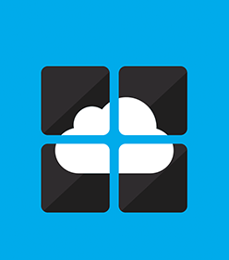
Integration Sandbox (TIP)
Provided so a partner can test their code and its integration with the Partner Center API before it is deployed broadly. Changes and transactions made within the integration sandbox account will not appear on a partner’s invoice. Limitations
75 customers, 5 subscriptions per customer, and 5 seats per subscriptions
Each Azure subscription can spend up to $200 per month
Customers can be deleted to avoid hitting the 75 customer limitation
Reseller relationships cannot be processed
Notes:
Partners should not utilize the integration sandbox for proof of concepts with customers. This environment is provided to allow the partner test their integration before it is deployed broadly. It is important to note that if an Azure CSP subscription, in the integration sandbox, exceeds the $200 limit it will be disabled for the remainder of the billing cycle. The subscription cannot be re-enabled through any means, other than waiting for the billing cycle to reset.

Slide 8
Partner Center API
Official REST API endpoint for CSP partners
Endpoint https://api.partnercenter.microsoft.com
Functionality in sync with Partner Center portal
Any partner still utilizing the CREST API will need to transition to the Partner Center API.
Access to the CREST API will be shutdown on October 1, 2017.
https://apidocs.microsoft.com/services/partnercenter
Notes:
CREST was the first API that was made available to CSP partners. This API has been replaced by the Partner Center API and all partners should be migrating a way from CREST as soon as possible.
New features will be made available through the API first.

Slide 9
Partner Center SDK
Makes available key complex scenarios with Object Model to expedite integration and shorten development cycles
Native .NET SDK benefits
Abstraction to the REST API
Strongly typed objects and collections
Simplifies authentication and token management
.NET - https://www.nuget.org/packages/Microsoft.Store.PartnerCenter
Java - https://github.com/PartnerCenterSamples/Partner-Center-Java-SDK

Slide 10
Limitations
Activity log only contains records for the past 90 days
Can only perform operations in the region where the reseller is authorized
Indirect Resellers cannot utilize the Partner Center API
Maximum number of Azure Usage records returned in a single call is 1000
Maximum number of customers returned in a single call is 50

Slide 11
Authentication
Partner Center uses Azure AD for authentication, and to use the API an application in Azure AD must be configured correctly.
App Only
Needs a web Azure AD application identifier and secret
No active user present
Useful for background process or customer facing portals
App + User
Requires the credentials of a partner user (admin agent, sales admin, or helpdesk agent)
Useful for auditing action performed
https://msdn.microsoft.com/en-us/library/partnercenter/mt634709.aspx

Slide 12
Consent
The Azure AD consent framework presents two primary problems for partners
Getting all customers to consent to an application can prove to be a difficult task.
There might be a need to perform an operation against a newly provisioned customer before access will be granted to the customer.
A partner can configure an Azure AD application for pre-consent. This enables an
application to take advantage of the delegated admin privileges the partner has been
granted and bypass the consent framework.
https://github.com/Microsoft/Partner-Center-Explorer/blob/master/docs/Preconsent.md

Slide 13







App Only Authentication via Admin Agents
Legend
CSP Reseller AAD Tenant
Customer B AAD Tenant
Customer A AAD Tenant
Is a member of
Tenant
Admin Role
Admin
Agents Group
Tenant
Admin Role
Is a partner of
Can manage
Users
MyApp
Sub1 | Tenant1
Sub2 | Tenant2
Owner
Role
Contributor
Role
Reader Role
Owner
Role
Contributor
Role
Reader Role
Customer A Subscription
Customer B Subscription

Slide 14



App + User Authentication
Legend
CSP Reseller AAD Tenant
Customer B AAD Tenant
Customer A AAD Tenant
Is a member of
Tenant
Admin Role
Admin
Agents Group
Tenant
Admin Role
Is a partner of
Can manage
Suzy User
John User
MyApp
Users via AAD Auth
Joe
Admin
Sub1 | Tenant1
Sub2 | Tenant2
Owner
Role
Contributor
Role
Reader Role
Owner
Role
Contributor
Role
Reader Role
Customer A Subscription
Customer B Subscription

Slide 15
Azure Resource Manager

Slide 16
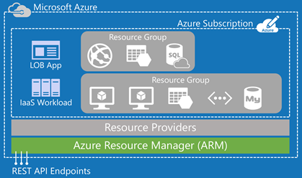
Why is this important to a CSP partner?
Performing operations within Azure is not supported by the Partner Center API
Through the use of the ARM API, and templates, a partner can automate resource deployment and management

Slide 17
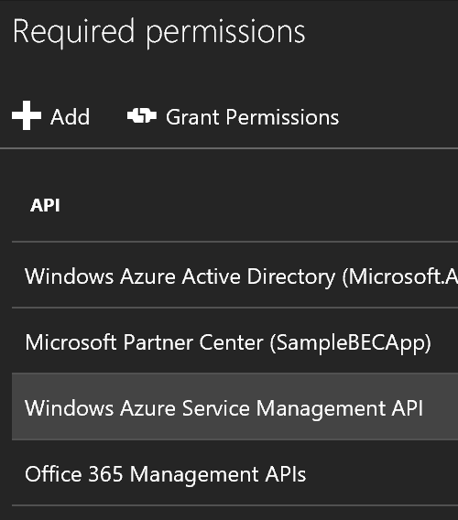
How does a partner access the ARM API on behalf of a customer?
Partner will create a multi-tenant Azure AD application in their reseller tenant
Recommended that the application be configured for pre-consent
The application needs to be configured to allow the Windows Azure Service Management APIs

Slide 18
How does a partner access the ARM API on behalf of a customer?
When the partner requests a token they must use the customer identifier in order for the requests to be scoped correctly.
POST https://login.microsoftonline.com/5eba1add-a810-414c-9371-37377764e7cc/oauth2/token HTTP/1.1
Content-Type: application/x-www-form-urlencoded
resource=https://management.azure.com/
&client_id=ceeb8a28-dd2d-46af-a6d8-b828c14afd3f
&client_secret=BYyVnAt56JpLwUcyo47XODd….
&grant_type=urn:ietf:params:oauth:grant-type:jwt-bearer
&assertion=eyJ0eXAiOiJKV1QiLCJhbGciOiJSUzI1NiIsImtpZCI6InowMz….
&requested_token_use=on_behalf_of
&scope=openid
orange text = identifier for the customer
blue text = identifier for the application in the partner’s tenant

Slide 19
Microsoft Graph

Slide 20
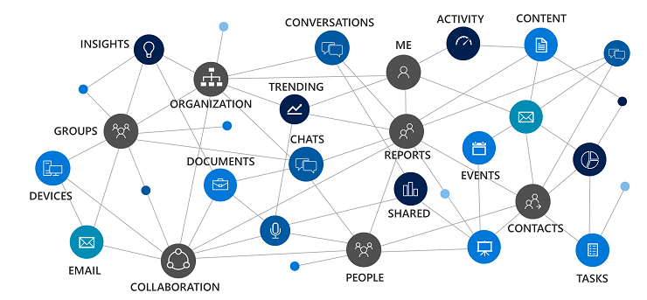
Why is this important to a CSP partner?
Provides single endpoint to interface with numerous resources (e.g. Exchange, OneDrive, SharePoint, etc...)
Various operations, such as adding vanity domains, are not supported by the Partner Center API

Slide 21
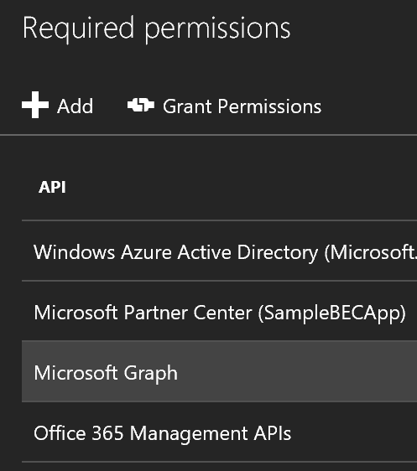
How does a partner access Microsoft Graph on behalf of a customer?
Partner will create a multi-tenant Azure AD application in their reseller tenant
Recommended that the application be configured for pre-consent
The application needs to be configured to allow Microsoft Graph

Slide 22
How does a partner access the ARM API on behalf of a customer?
When the partner requests a token they must use the customer identifier in order for the requests to be scoped correctly.
POST https://login.microsoftonline.com/5eba1add-a810-414c-9371-37377764e7cc/oauth2/token HTTP/1.1
Content-Type: application/x-www-form-urlencoded
resource=https://graph.microsoft.com/
&client_id=ceeb8a28-dd2d-46af-a6d8-b828c14afd3f
&client_secret=BYyVnAt56JpLwUcyo47XODd….
&grant_type=client_credentials
orange text = identifier for the customer
blue text = identifier for the application in the partner’s tenant
https://developer.microsoft.com/en-us/graph/docs/concepts/auth_cloudsolutionprovider

Slide 23
Challenges

Slide 24
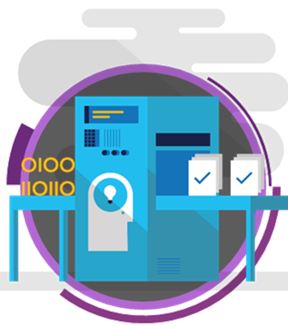
Provisioning
Some of the most successful partners have developed their own portals. While not everyone will design their own provisioning engine, custom development is often required in order to streamline the deliver of solutions.

Slide 25
Billing Systems
Custom development is required to integrate
Invoice information is available through the API, but new information is only made available once a month
Real time billing information can but provided, but you will need to use the following to calculate it
Activity Log (Delta API)
Rate Card (Azure)
Utilization Records (Azure)

Slide 26

Identity Management
A partner cannot redirect a Microsoft online cloud customer either for federation or synchronization to the partner’s multi-tenant identity management infrastructure.

Slide 27
Showcase – Coretek Services

Slide 28
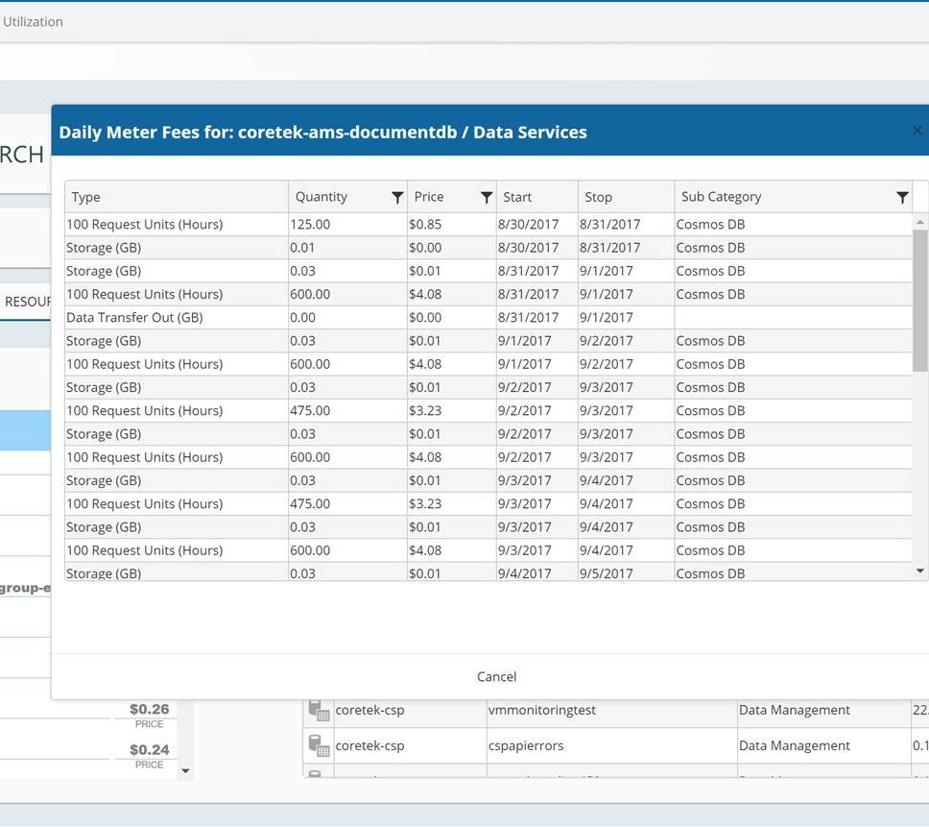
Daily Usage
One of the great aspects of Azure is that you only pay for what is used. Customers typically want to focus on how their services are performing and rely on the partner to provide them a dollarized view of the services they consumed daily.

Slide 29
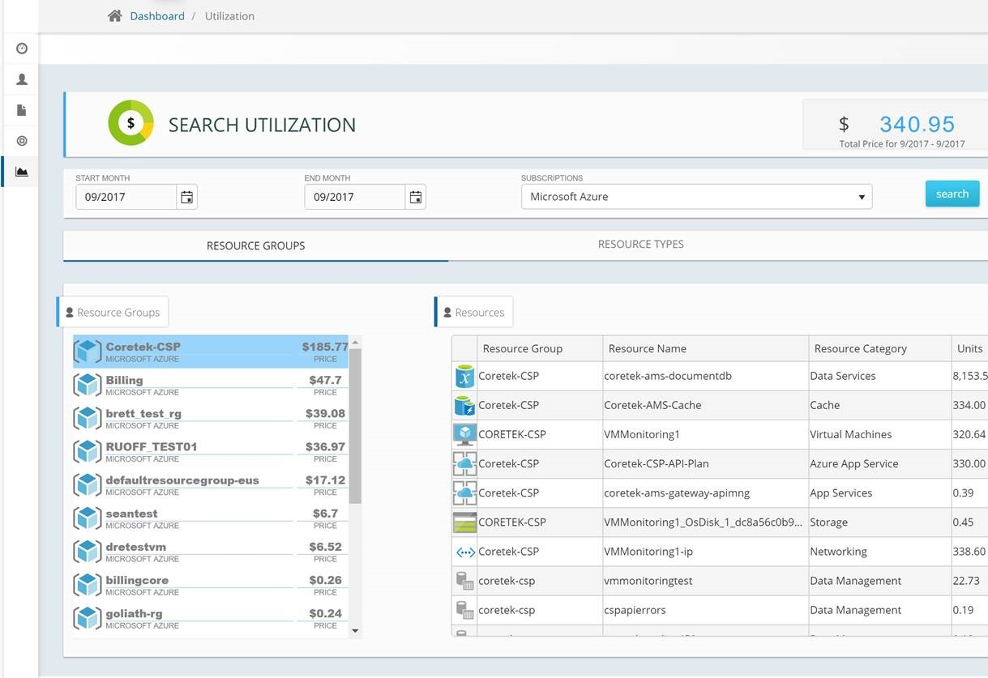
Resource Groups
Each customer has unique invoicing requirements. As an example there might be a customer that needs to perform charge back for distinct business units. While this can be accomplished in a number of different ways, one of the simplest is to leverage Resource Groups.

Slide 30
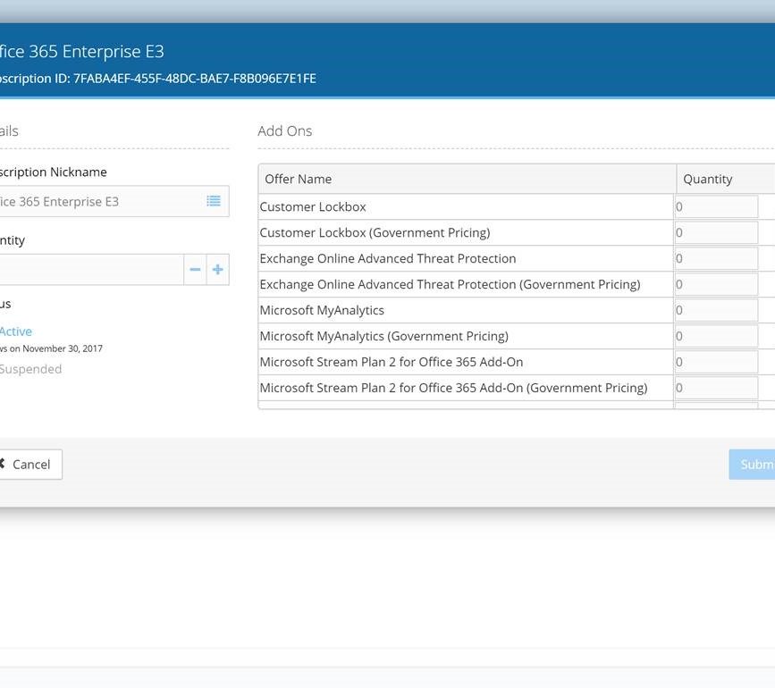
Self Service
When it comes to accelerating growth with Office 365 self service is one of the key factors. Provide the customer with the ability to increase, or decrease, seat counts and purchase new add ons will make the customer more efficient. Which means the partner will have more time to focus building new service offers, instead of handling support tickets.

Slide 31
Q & A

Slide 32
Appendix A: Resources
Azure REST APIs | Azure Resource Manager REST APIs are the heart of interacting with Azure, and form the connecting glue between your applications and Azure. They are described by specifications conforming to the OpenAPI Specification (formally known as Swagger 2.0). The OpenAPI specification provides a standard, language-agnostic interface to REST APIs. Additional information - https://azure.github.io/projects/apis/
Cloud Solution Provider Developers | This course is for Microsoft partners who are in the Cloud Solution Provider (CSP) program and who are interested in the Partner Center SDK and the Partner Center REST API. This includes partners who have been using the previous CREST API. The course consists of multiple video lessons and demos that are 10-60 minutes in duration. It also includes a self-paced hands-on-labs for course participants which is located at http://aka.ms/pcsdkhol. Additional information - https://channel9.msdn.com/Series/cspdev
Microsoft Graph | Microsoft Graph (previously called Office 365 unified API) exposes multiple APIs from Microsoft cloud services through a single REST API endpoint (https://graph.microsoft.com). Using the Microsoft Graph, you can turn formerly difficult or complex queries into simple navigations. Additional information - https://graph.microsoft.io/en-us/docs
Partner Center API Reference | The Partner Center managed API helps Cloud Solution Provider partners integrate their existing CRM or billing software with the Microsoft systems that manage customer accounts, place orders, manage subscriptions, and handle support requests in Partner Center. The Managed API also includes token management (so that you don’t have to refresh your Azure AD tokens and authentication each hour) and a simple interface library for network calls with retries. Additional information - https://msdn.microsoft.com/en-us/library/partnercenter/mt635943.aspx
Partner Center Explorer | Sample project developed to demonstrate how to utilize the Azure AD Graph API, Azure Resource Management API, and Partner Center SDK to retrieve data for a given CSP partner and the respective customers. Additional information - https://github.com/Microsoft/Partner-Center-Explorer/
Isaiah’s Blog | Isaiah Williams is a Cloud Technology Strategist that works on the US OCP MSP team. His blog contains several great resources that will help partners with developing their integration. https://blogs.msdn.microsoft.com/iwilliams/

