Slide 1
Secure Document Sharing
Protecting documents from unauthorized disclosure and detecting sensitive data in cloud apps.

Slide 2
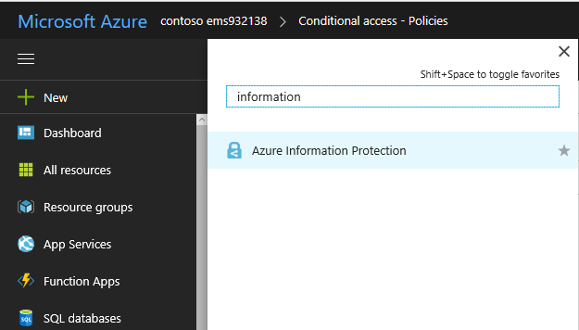
Data Classification

Slide 3
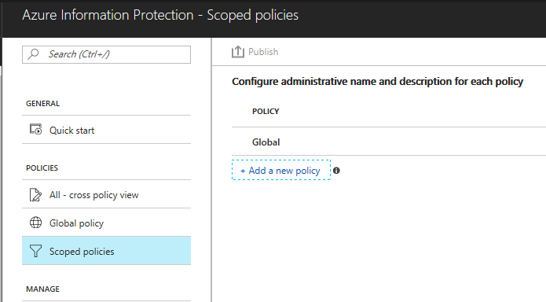
Data Classification

Slide 4
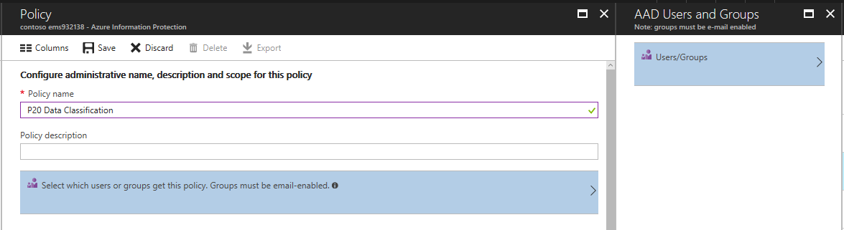
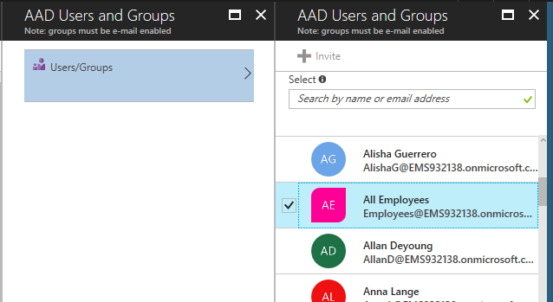
Data Classification

Slide 5
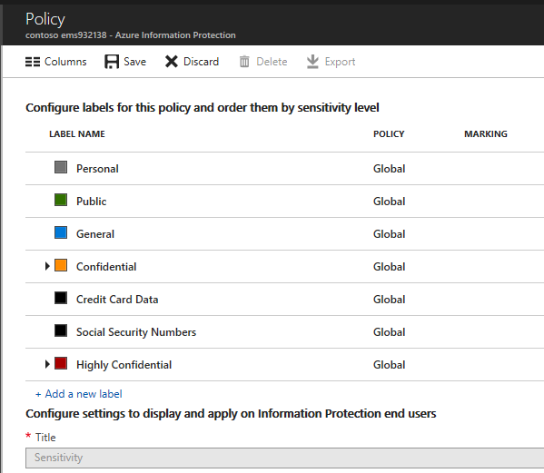
Data Classification

Slide 6
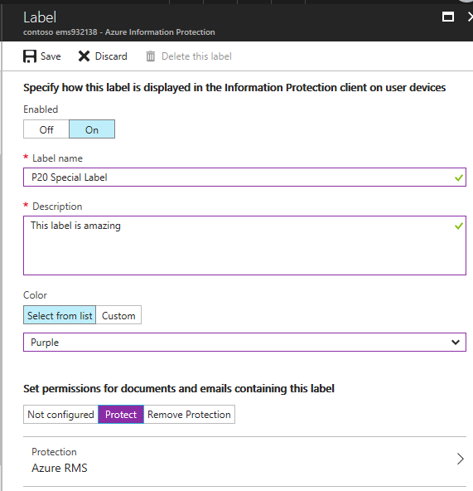
Data Classification
Note: Enabling protection means that the document will be encrypted. Without enabling protection the document will be labeled but not encrypted. Remove protection option allows to decrypt previously encrypted documents. (For example – in cases where after a period of time data becomes unclassified.)

Slide 7
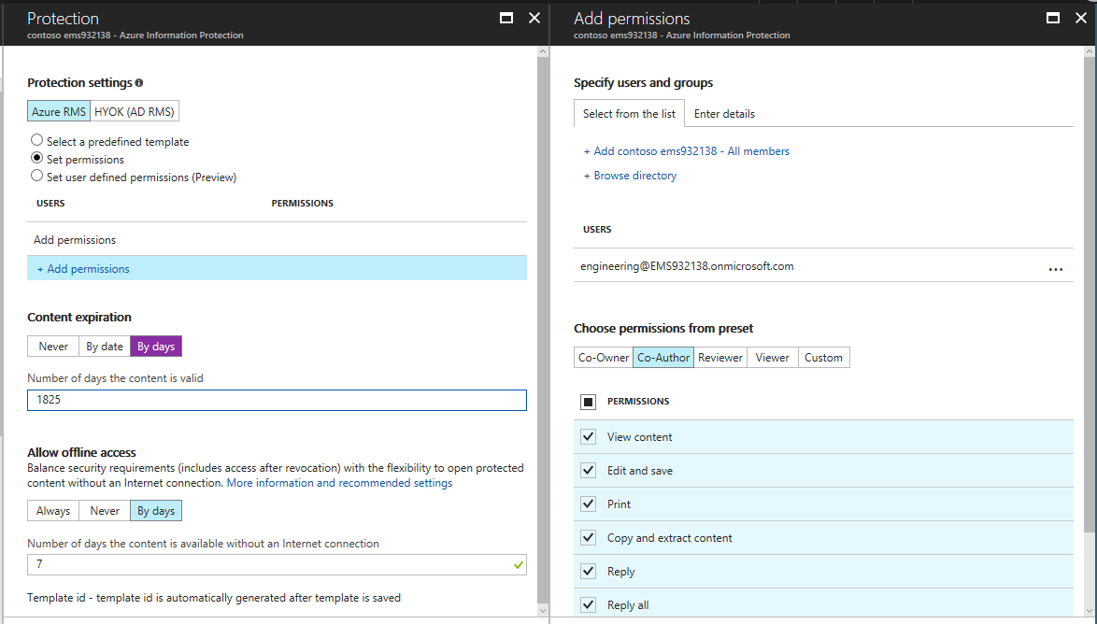
Data Classification

Slide 8
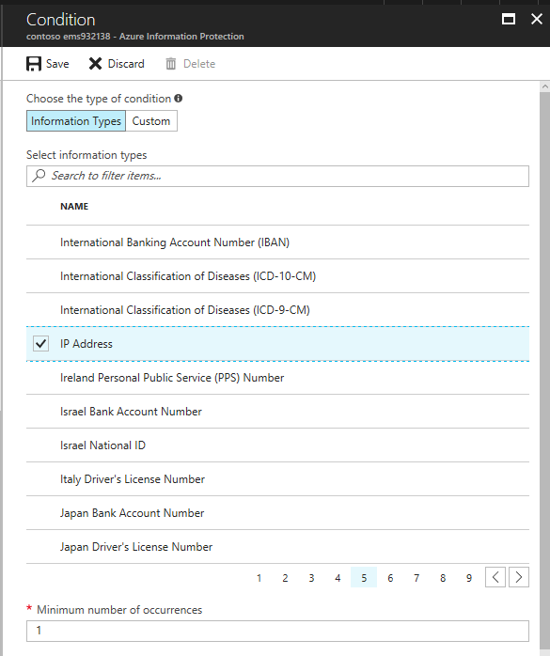
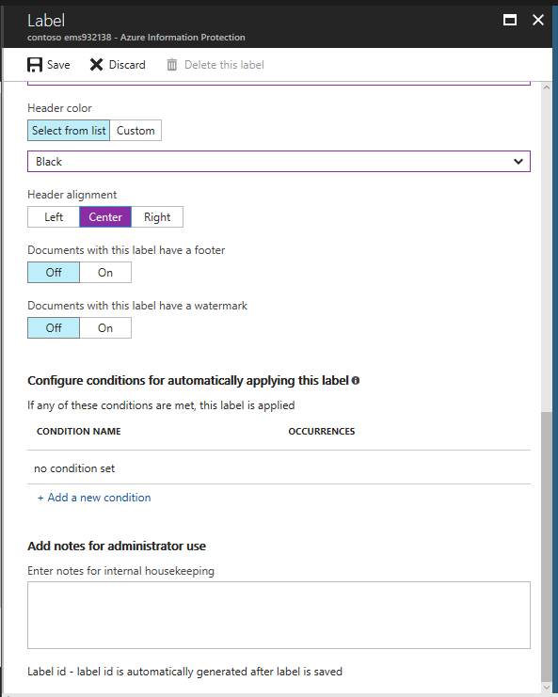
Data Classification

Slide 9
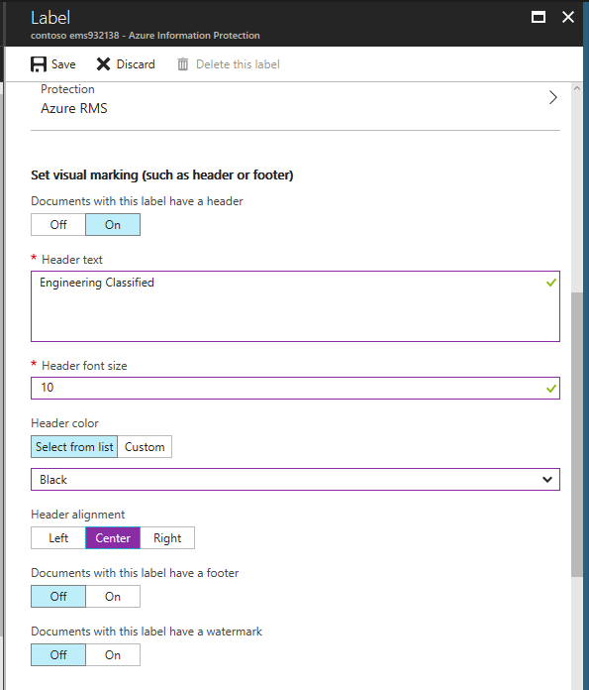
Data Classification
Back in the label configuration screen

Slide 10
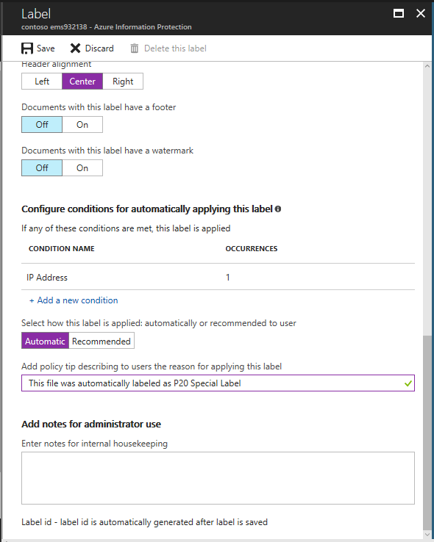
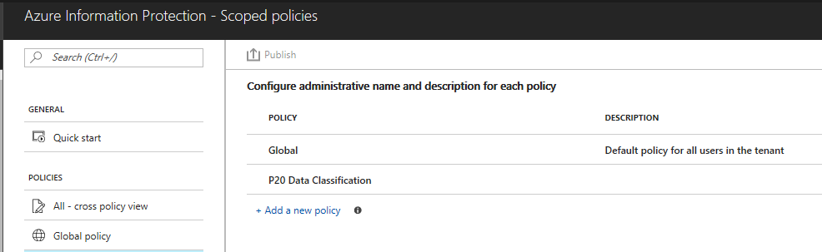
Data Classification

Slide 11
Detecting classified data in cloud apps
It will take about 15 minutes for the P20 label to show up in Cloud App Security since you’ve just created it. You can take a coffee break and come back or proceed and use one of the other labels that have been created earlier.

Slide 12
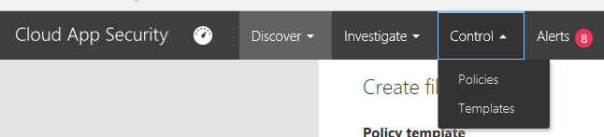
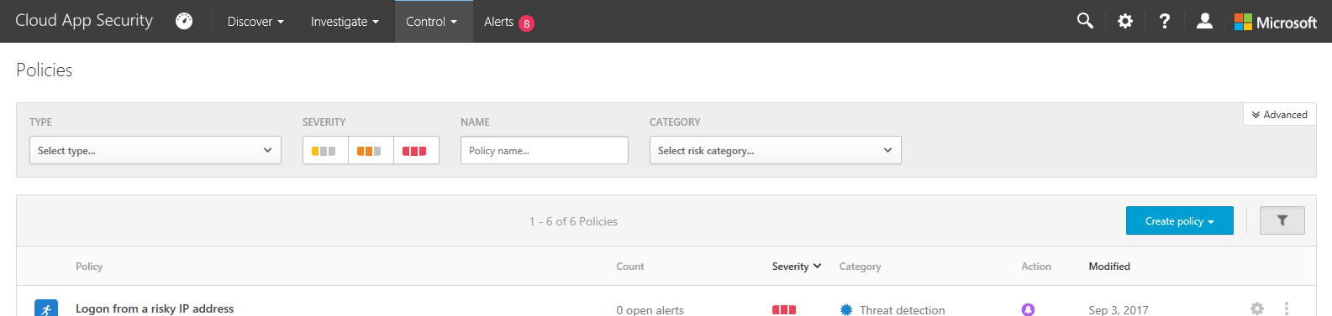
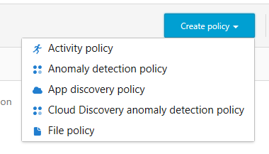
Data Classification
Go to portal.cloudappsecurity.com

Slide 13
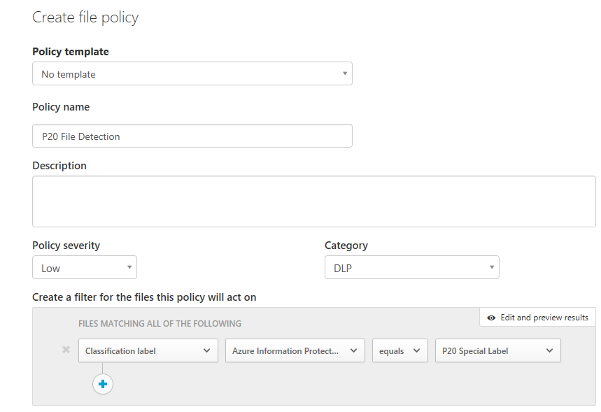
Data Classification
Note: P20 Special Label is the classification label you created earlier in this exercise. If you do not see it there – you either need to wait a bit more for it to show up (takes around 15 min), or you did something wrong earlier!

