Slide 1
Endpoint Security and Conditional Access

Slide 2
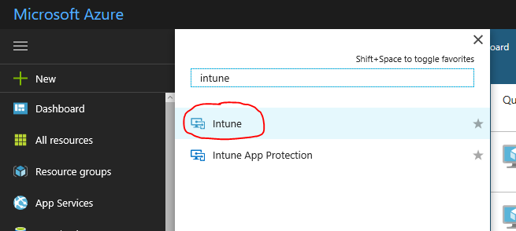
In this section we will configure a device configuration and compliance policy. While we focus on only one platform – I encourage you to explore the capabilities available.
Intune has come a long way in the last couple of years and now with addition of Mac OS management capabilities – it is growing faster than any other MDM solution in the market.
Open Intune in Azure Portal

Slide 3
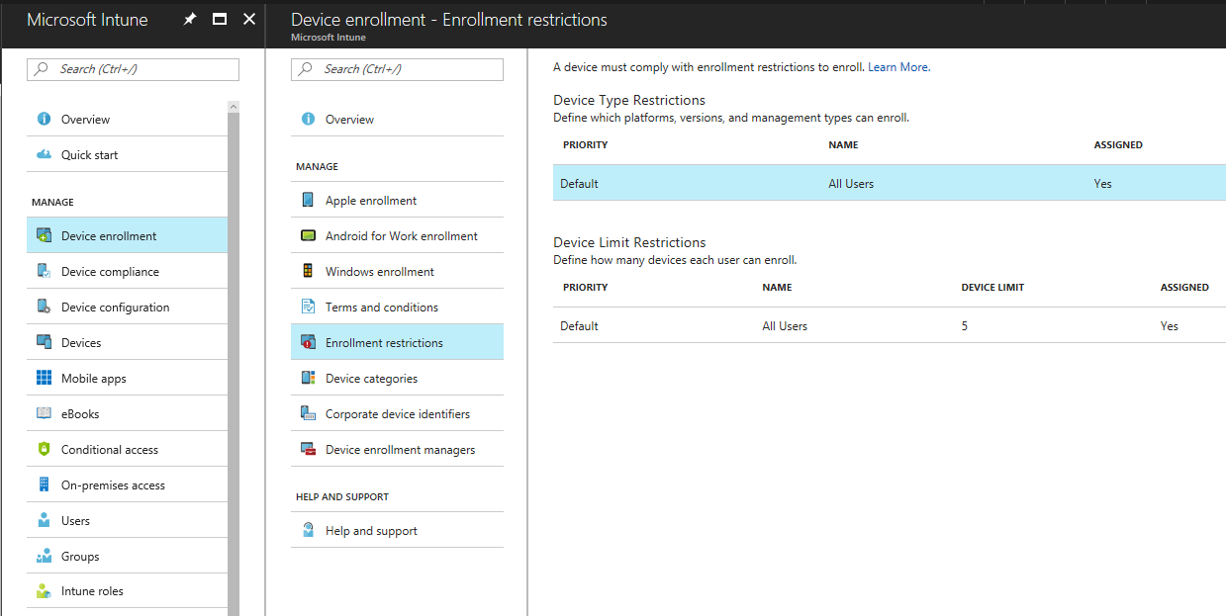
Device Enrollment
3
1
2

Slide 4
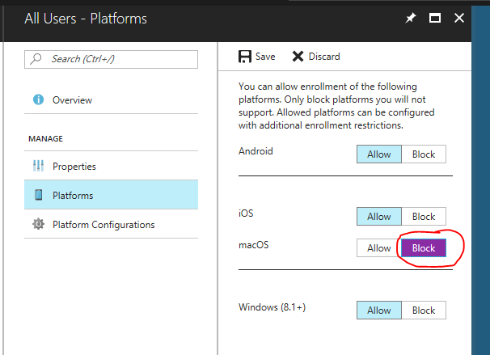
Device Enrollment – restrict a platform

Slide 5
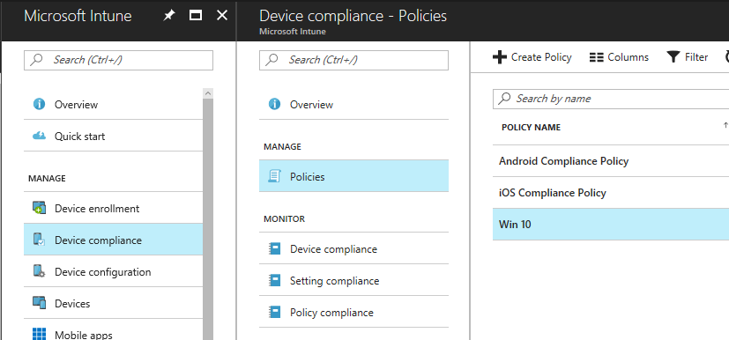
Device Compliance – Create Policy

Slide 6
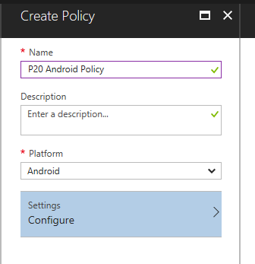
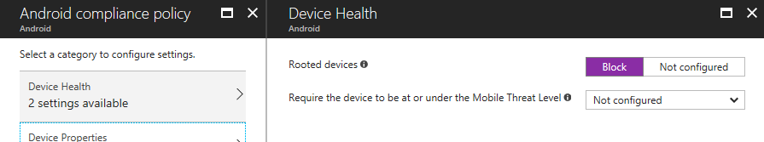
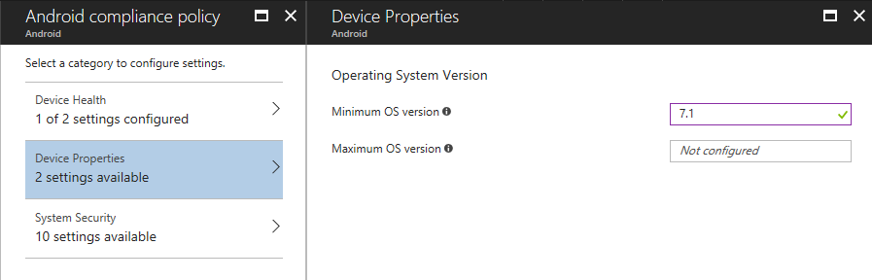
Device Compliance – Create Android Policy
1
2
3

Slide 7
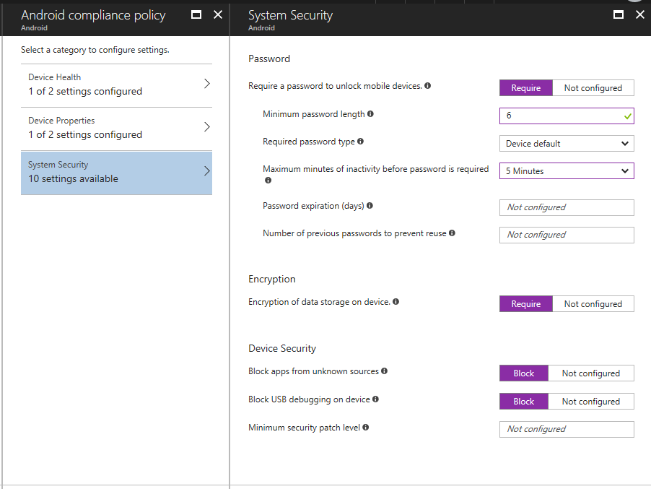
Device Compliance – Create Android Policy

Slide 8
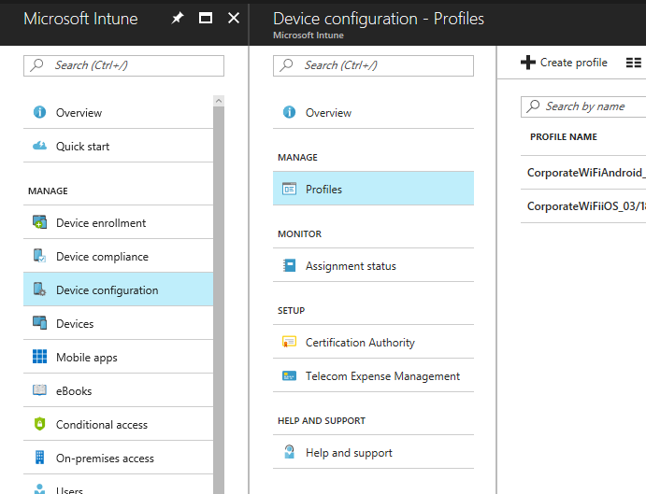
Device Configuration – Android Restrictions

Slide 9
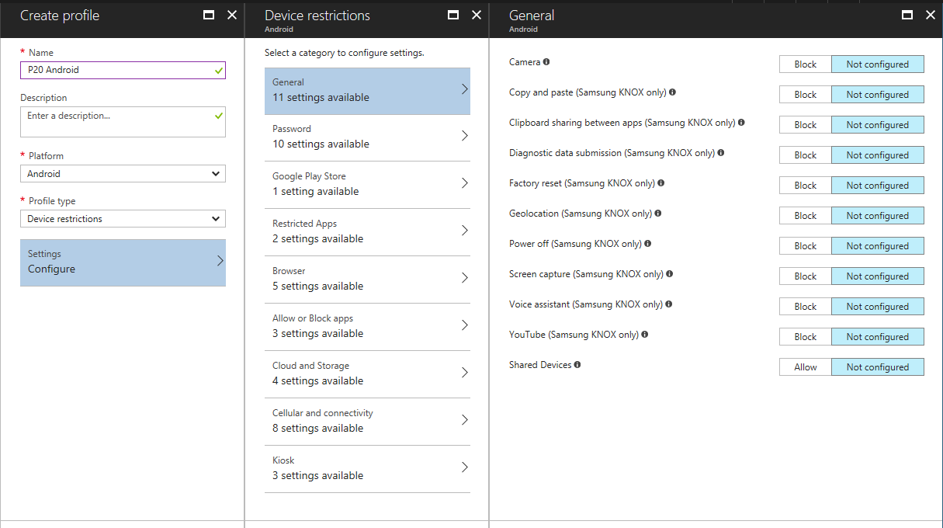
Explore available restriction/configuration options for Android and other platforms.

Slide 10
Conditional Access
Using Device Compliance for setting conditional access policies in Azure AD is one of the many ways our security products integrate with each other to give us a strong competitive advantage in the market.

Slide 11
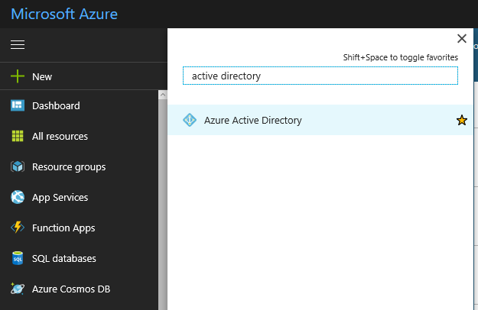
Conditional Access

Slide 12
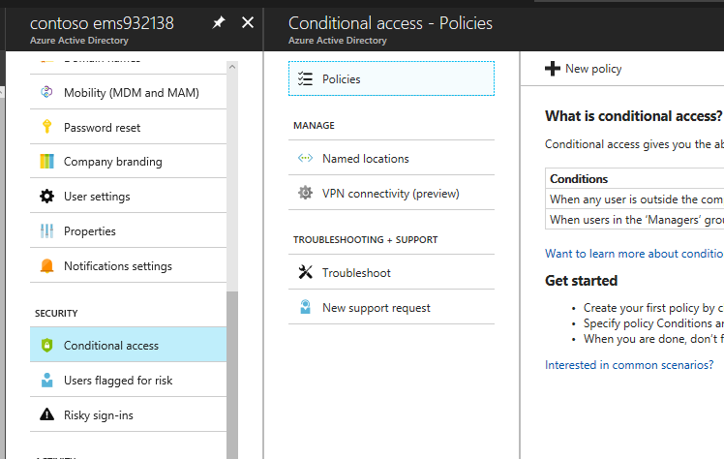
Conditional Access

Slide 13
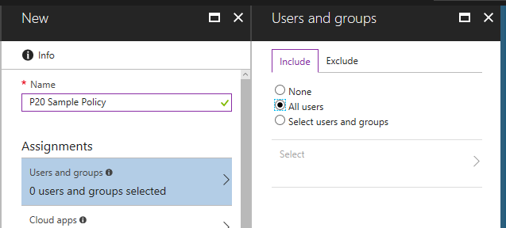
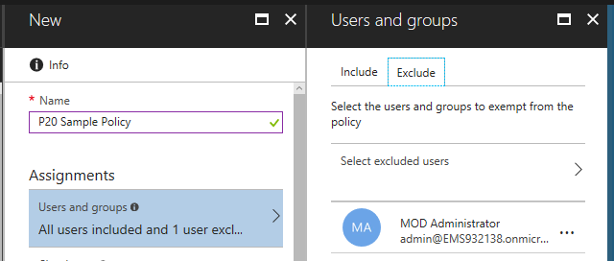
Conditional Access
Note: It is possible to completely lock yourself out of your Azure AD controlled environment, including all admin functions – if conditional access policy includes all users and all applications. We are setting an exclusion here to be sure you retain access.

Slide 14
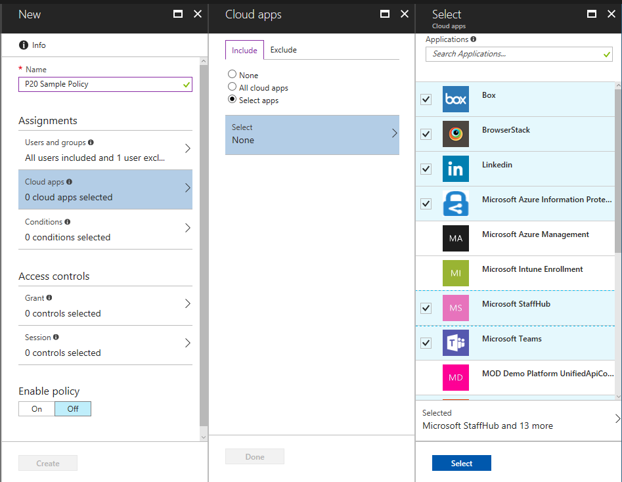
Conditional Access

Slide 15
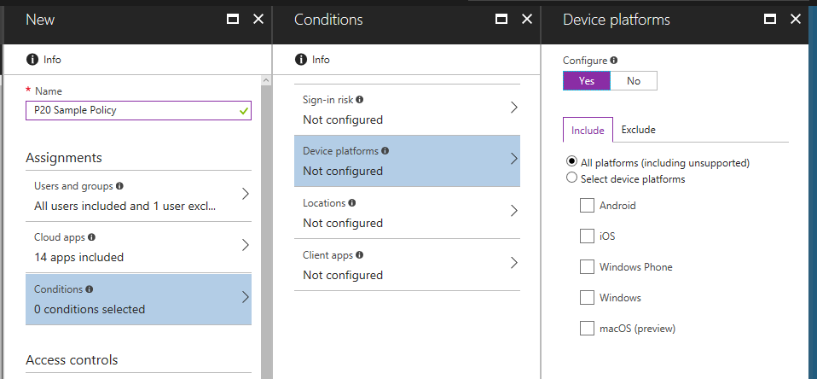
Conditional Access

Slide 16
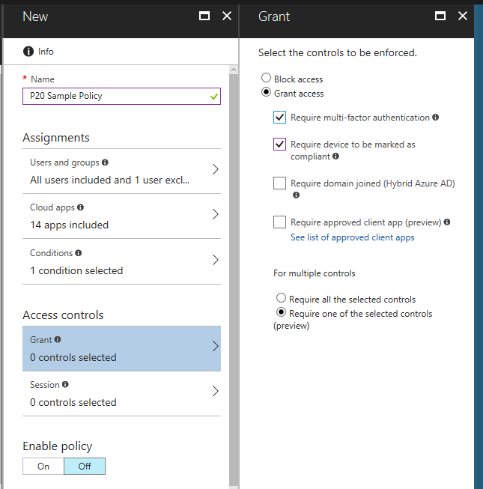
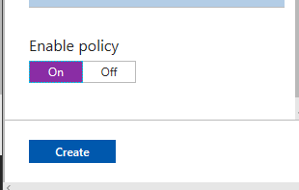
Conditional Access

