Slide 1
WorkingLife Balance
An example ISV scenario

Slide 2
WorkingLife is an ISV specializing Workforce Automation software.

Slide 3
WorkingLife’s Balance
Automates management of vacation and sick time for mid-sided organizations.
Current only support a deep integration with Google’s G Suite.
Majority of their existing customers are in the Google ecosystem.
Seeing a notable increase of interest in O365 from both existing customers and incoming leads.
Interested in replicating the scenarios they enable with Google in Office 365.
CEO believes O365 integration will be vital for both customer retention and acquisition going forward.

Slide 4
WorkingLife Engineering Team
Very little experience with Office 365 or Office extensibility
1
All have local Windows 7 and Windows 10 VMs for testing purposes
Internally WorkingLife uses Google
Majority of products are web apps built on Node.js & TypeScript
3
Heavily invested in micro-services architecture and REST APIs
They have no bias towards one or the other
Roughly 60% of the team carry a Mac, remaining carry Windows 10 machines
2
Mix of Azure and AWS in production
4

Slide 5
Core Requirments
User Experience must feel "native" to O365 users.
1
All users have a WorkingLife user name and password and they use OAUTH for authenticating users.
2
Front-end apps should be lightweight and rely on REST APIs to handle all heavy lifting.
3
Note: They also support a single-sign-on AD integration that some of their larger customers use
They feel this native feel has been integral to their success in the Google ecosystem
Solution must support Office across platforms, including iOS and Android devices.
4

Slide 6
Key Scenarios
Managers receive time off requests via email.
Rejection Appeal Form
Convert Existing Event
Manager Accept/Reject
When a request is rejected, an email is sent back to the employee.
When a request is accepted, they would like to automatically add a calendar entry to both the employee's and the manager's calendar.
This email may also contain a link to the Rejection Appeal Form within Balance
Appeal Form should be available from within Outlook wherever possible.
Managers should be able to accept/reject requests from within Outlook.
If the employee has "converted" a calendar event, it should update this event to show that it was accepted.
Employees generally use WorkLife's application to request time off but they would also like to enable "converting" an existing event on the user's calendar into a time off request.
Update Calendar

Slide 7
Scenario: Manager Response
A direct report of the Manager has created a new Time Off Request
01
Manager receives email notification of a Time Off Request from Balance
02
Manager decides to either Accept or Reject the Time Off Request
03

Slide 8
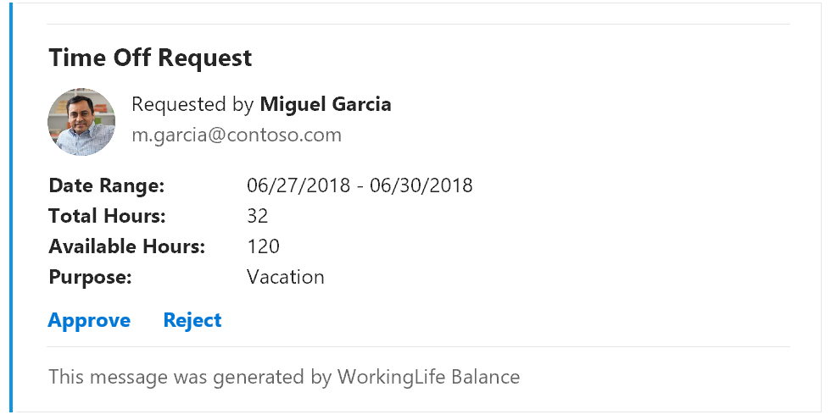
Solution: Manager Response
Leverage Outlook Actionable Messages to implement an interactive “Time Off Request” card.
Responses are immediately sent back to Balance over HTTP POST.
Unsupported email clients will automatically fallback to a text email with an outbound link to Balance

Slide 9
Scenario: Convert Calendar Item
Employee has an personal appointment on their calendar and would like to create a Time-Off Request for this appointment.
01
Employee opens the appointment and generates a Time-Off Request using the existing date/time parameters.
02
After confirming the details of the Time-Off Request, it is submitted to Balance.
03
At any time, the Employee can re-open the Appointment and check on the status of their Time-Off Request
04

Slide 10
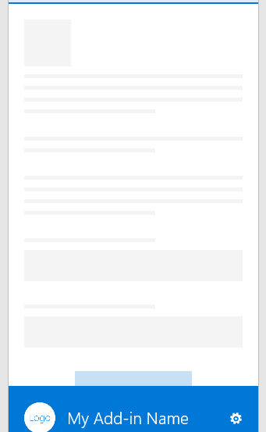
Solution Convert Calendar Item
Build an Outlook Add-in targeting the Appointment Compose form.
Surface Time Off Request form within the task pane
Pull default values for the Time Off Request from the Appointment form
When submitted, attach custom properties to the Appoint with Request ID from Balance.
After submission, take pane shows the current status of the request from Balance

Slide 11
Scenario: Add Time Off to Calendar
Manager approves the Employee’s Time Off Request
01
An Appointment is added to the Employee’s calendar (shown as “Out of Office”)
02
An appointment is added to the Manager’s calendar (shown as “Free”).
03

Slide 12
Solution Add Time Off to Calendar
POST https://graph.microsoft.com/v1.0/me/events
Content-type: application/json
Content-length: 600
{
"subject": “Time Off",
"body": {
"contentType": "HTML",
"content": “Time Off Request Approved"
},
"start": {
"dateTime": "2018-06-27T12:00:00",
"timeZone": "Pacific Standard Time"
},
"end": {
"dateTime": "2018-06-30T24:00:00",
"timeZone": "Pacific Standard Time"
},
"location":{
"displayName":“Vacation"
},
“showAs”: “Oof”
}
Use Microsoft Graph API to add events to their calendars.
Register an AppId for Balance
Request Application Permission scope Calendars.ReadWrite
POST event to /1.0/{userPrincipalName}/events

Slide 13
Resources
Office Add-ins
Office Dev Center https://dev.office.com/
GitHub Repo: GitHub Repo https://github.com/microsoftgraph
Script Lab https://store.office.com/en-us/app.aspx?assetid=WA104380862
Card Playground https://messagecardplayground.azurewebsites.net/
Microsoft Graph API
Documentation https://graph.microsoft.io
GitHub Repo https://github.com/microsoftgraph
Graph Explorer https://developer.microsoft.com/en-us/graph/graph-explorer
Office UI Fabric https://dev.office.com/docs/add-ins/design/office-ui-fabric.htm

