Slide 1
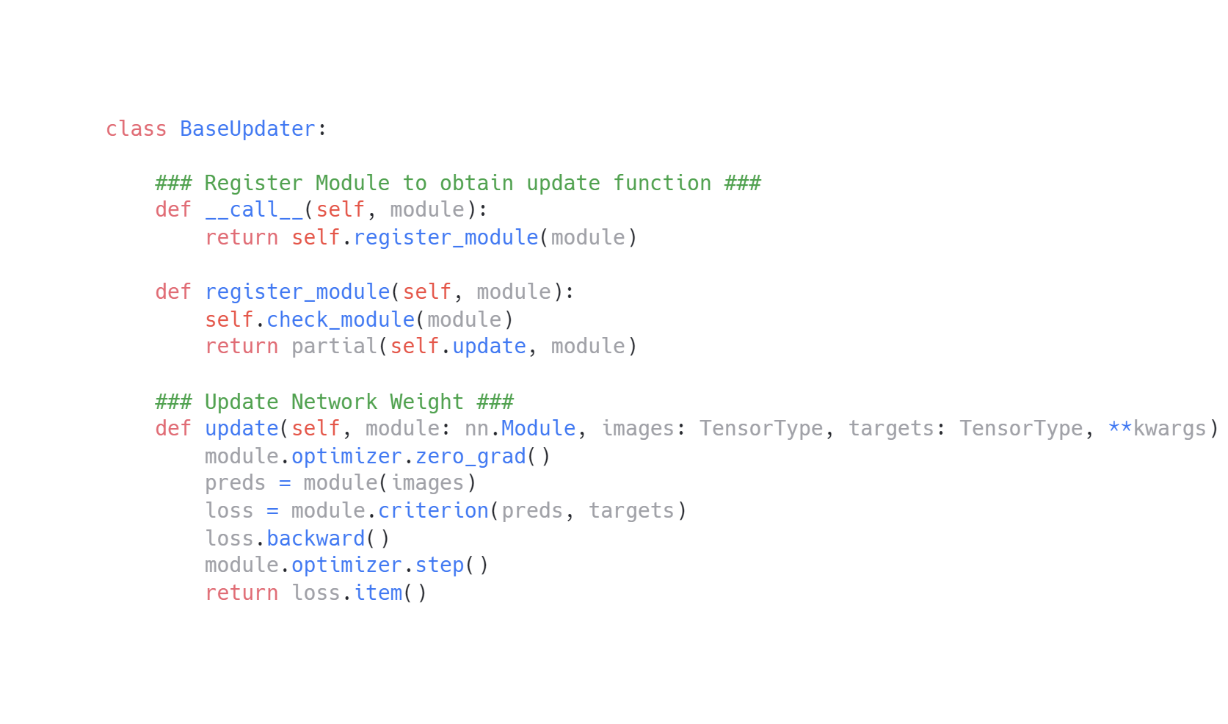
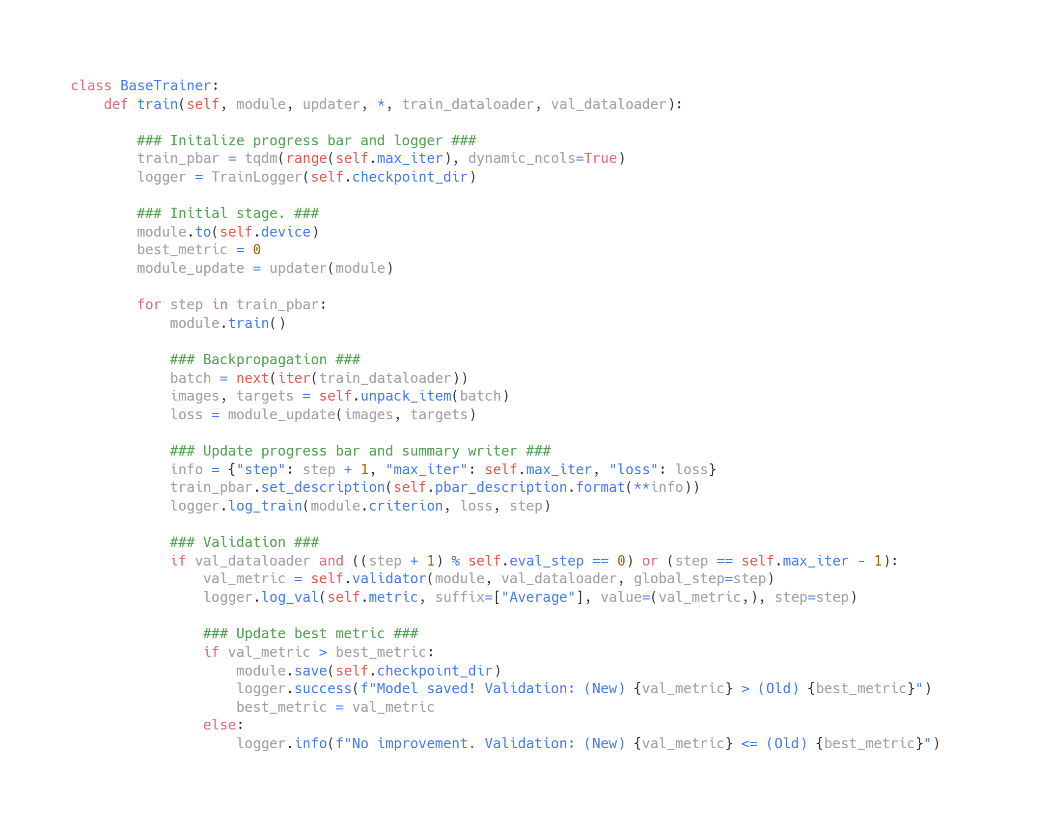
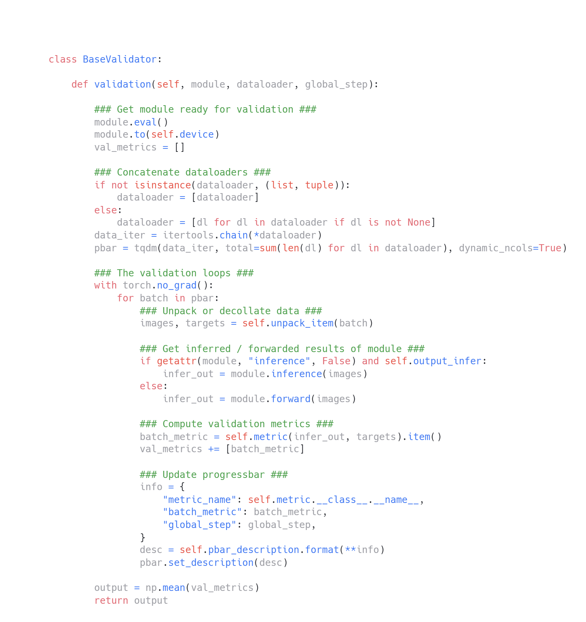
Updater
Trainer registers module in the updater
Trainer
Validator
Updater updates the weights of networks
Trainer calls the validator to
evaluate network performance

