Slide 1
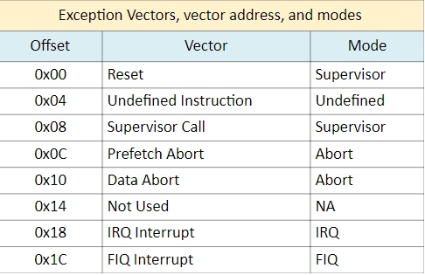
2.1 IRQ的編號
/* Private Peripheral Interrupts (PPI) */
#define XPS_GLOBAL_TMR_INT_ID 27U/* SCU Global Timer interrupt */
#define XPS_FIQ_INT_ID 28U/* FIQ from FPGA fabric */
#define XPS_SCU_TMR_INT_ID2 9U/* SCU Private Timer interrupt */
#define XPS_SCU_WDT_INT_ID 30U/* SCU Private WDT interrupt */
#define XPS_IRQ_INT_ID 31U/* IRQ from FPGA fabric */
Notes:
https://www.realdigital.org/doc/fb6974fbe87554b433bc0c6df2f14d69

Slide 2
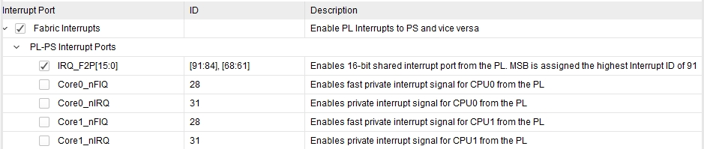
2.2 GIC的mask暫存器
中斷編號站存器
#define XSCUGIC_INTR_PRIO_MASK 0x000000F8U
/* Definitions for Fabric interrupts connected to ps7_scugic_0 */
#define XPAR_FABRIC_AXI_GPIO_1_IP2INTC_IRPT_INTR 61U
/* Definitions for peripheral PS7_SCUGIC_0 */
#define XPAR_PS7_SCUGIC_0_DEVICE_ID 0U
#define XPAR_PS7_SCUGIC_0_BASEADDR 0xF8F00100U
#define XPAR_PS7_SCUGIC_0_HIGHADDR 0xF8F001FFU
#define XPAR_PS7_SCUGIC_0_DIST_BASEADDR 0xF8F01000U
pending暫存器的addresses
#define XSCUGIC_PENDING_SET_OFFSET 0x00000200U /**< Pending Set Register */
#define XSCUGIC_PENDING_CLR_OFFSET 0x00000280U /**< Pending Clear Register */

Slide 3
2.2IP資暫存器的addresses
/* Canonical definitions for peripheral AXI_GPIO_0 */
#define XPAR_GPIO_0_BASEADDR 0x41200000
#define XPAR_GPIO_0_HIGHADDR 0x4120FFFF
#define XPAR_GPIO_0_DEVICE_ID XPAR_AXI_GPIO_0_DEVICE_ID
#define XPAR_GPIO_0_INTERRUPT_PRESENT 0
#define XPAR_GPIO_0_IS_DUAL 0
/* Canonical definitions for peripheral AXI_GPIO_1 */
#define XPAR_GPIO_1_BASEADDR 0x41210000
#define XPAR_GPIO_1_HIGHADDR 0x4121FFFF
#define XPAR_GPIO_1_DEVICE_ID XPAR_AXI_GPIO_1_DEVICE_ID
#define XPAR_GPIO_1_INTERRUPT_PRESENT 1
#define XPAR_GPIO_1_IS_DUAL 0

Slide 4
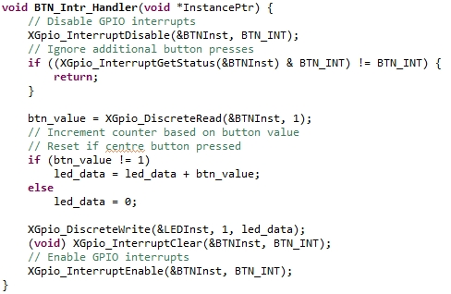
3. ISR(interrupt service routine)做什麼事情

