Slide 1
0304 progress
U11216002 資科三 黃瑞麟

Slide 2
Table of Contents
Test Neuropeptide limit
Stacking
Generate sequence peptide

Slide 3
1. Test Neuropeptide limit
For loop run 20 times
Complete run 3 times
Combine 3 result with best score + (origin result)

Slide 4
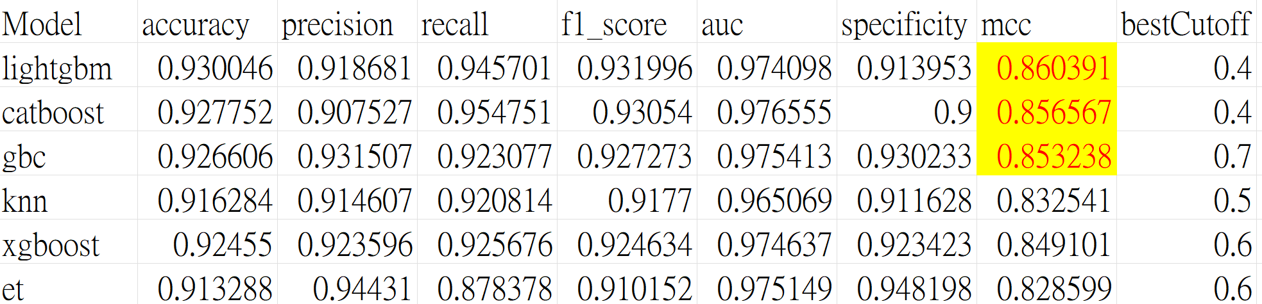
Combine 3 result
Top 6 table

Slide 5
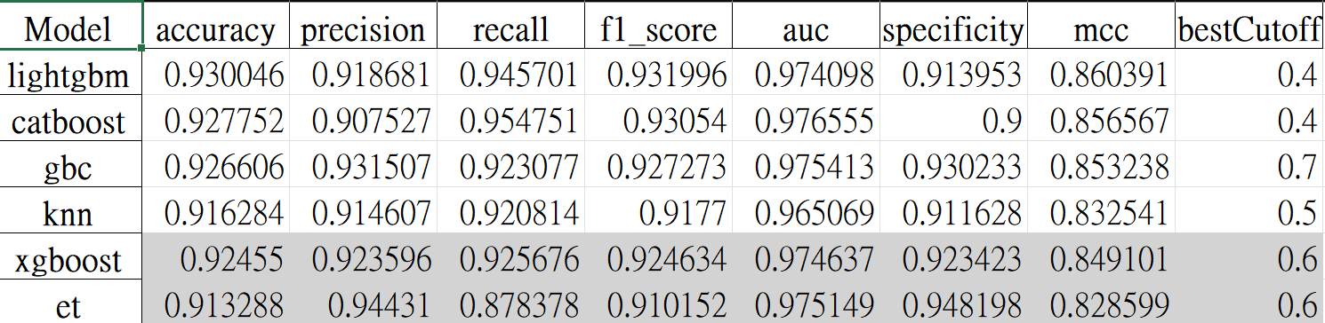
Combine 3 result
Top 6 cover table

Slide 6
2. Stacking
complete
Fasta特徵提取 -> 產生總表 (OK)(train, test. csv)feature_encode.py
總表拆分 -> (OK)(每個feature type一個檔案, 並分成train, test) feature_split.py 共56 * 2 csv
56 feature types * 17 modes -> 952機率表 (OK) meta_feature_gent.py
4. Filter mcc lower 0.4 (need?)
5. Boruta feature selection boruta_selection.py 50, 300 , 20
Except process

Slide 7
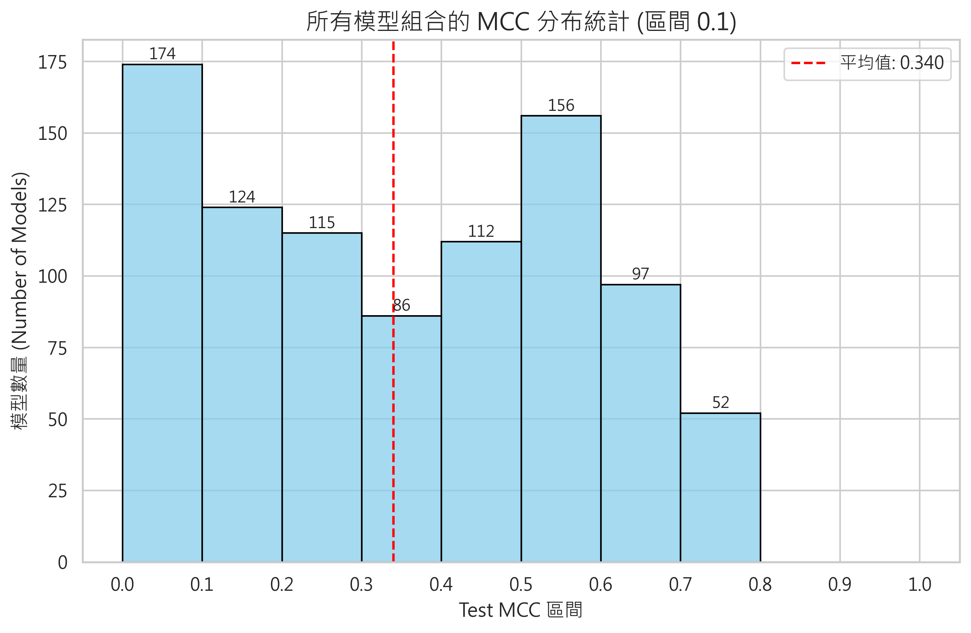
預計先篩選掉0.2以下
用boruta進行篩選

Slide 8
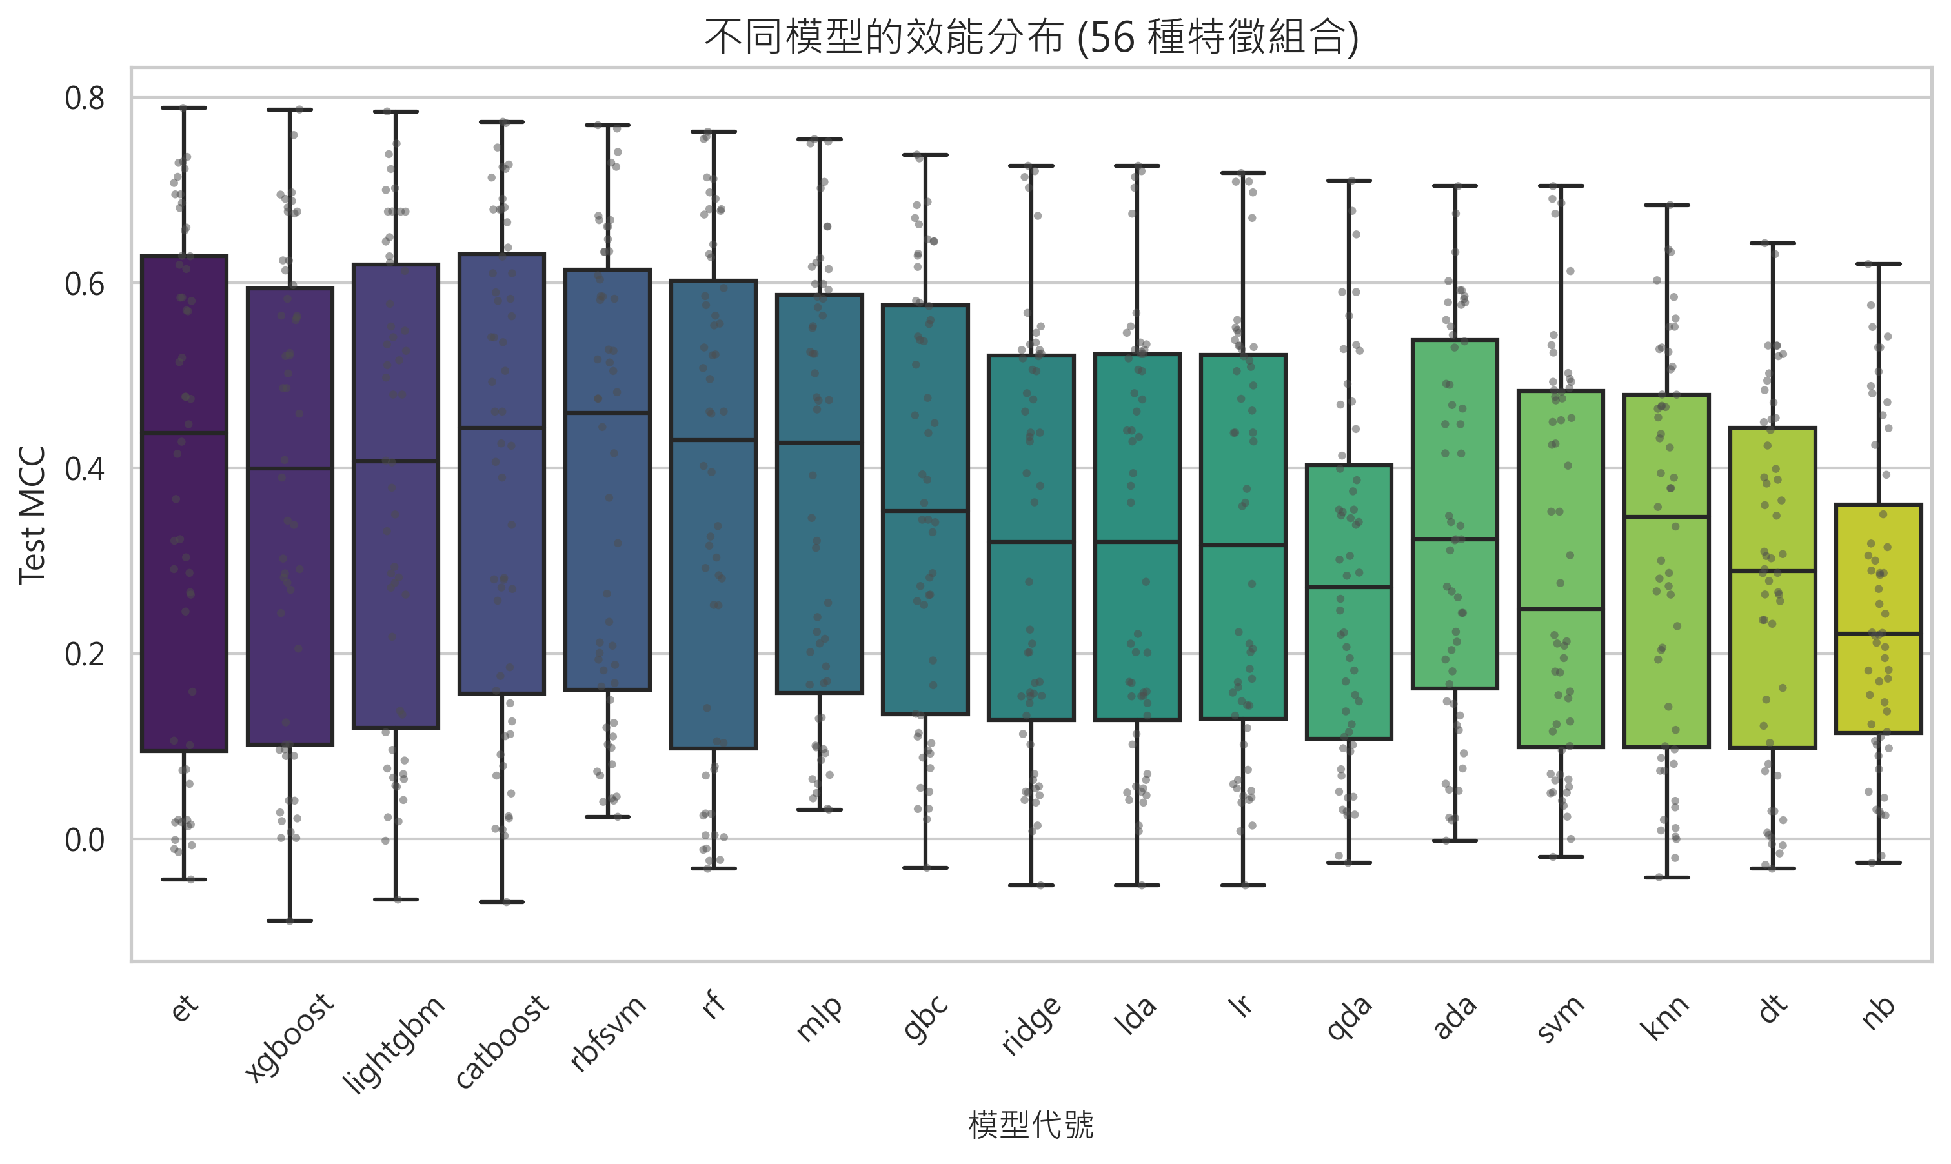
畫feature type，MCC分數畫box plot，用中位數排序
用1.5倍的IQR畫圖
用random forest作第二層，模型可以用前幾名模型測試

Slide 9
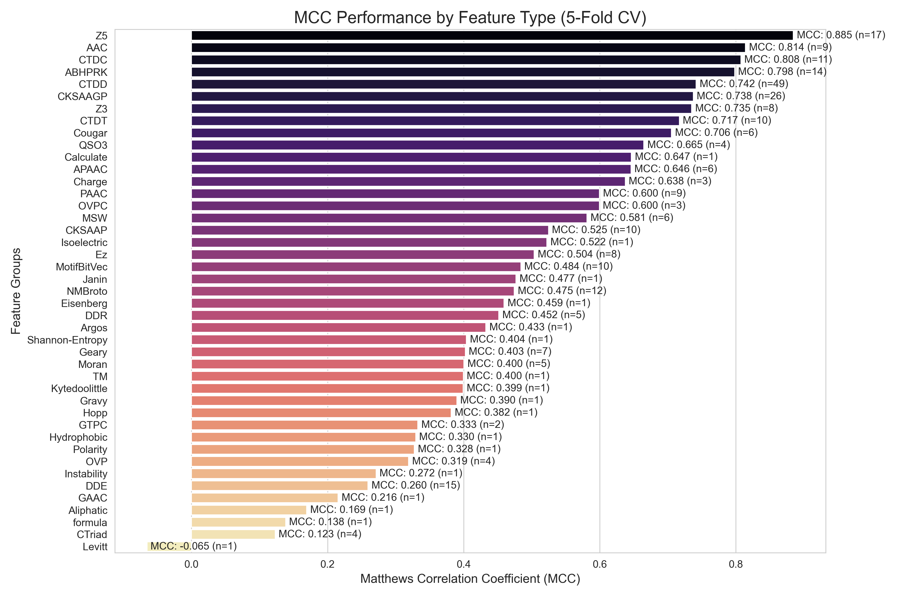
Featuretype vs mcc plot

Slide 10
畫18 model 對 feature types box plot

Slide 11
Generate sequence peptide
15% mask 480條
25% mask 596條
10% ~ 30% total seq PLDDT > 70% 2391條
= > 挑一個mcc最高的

Slide 12
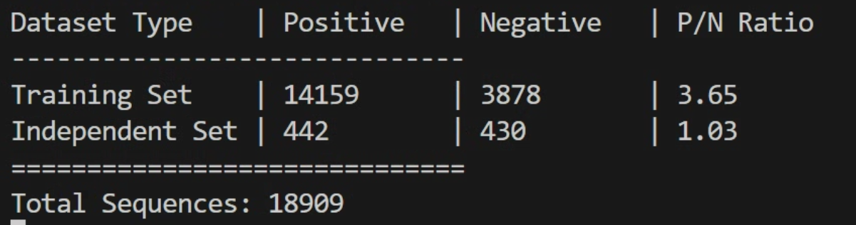
Using generate sequence + pos_train to try ML
Data detail imformation
正負樣本比例適合ML嗎
可以從UniProt讓pos : neg = 1: 1?

Slide 13
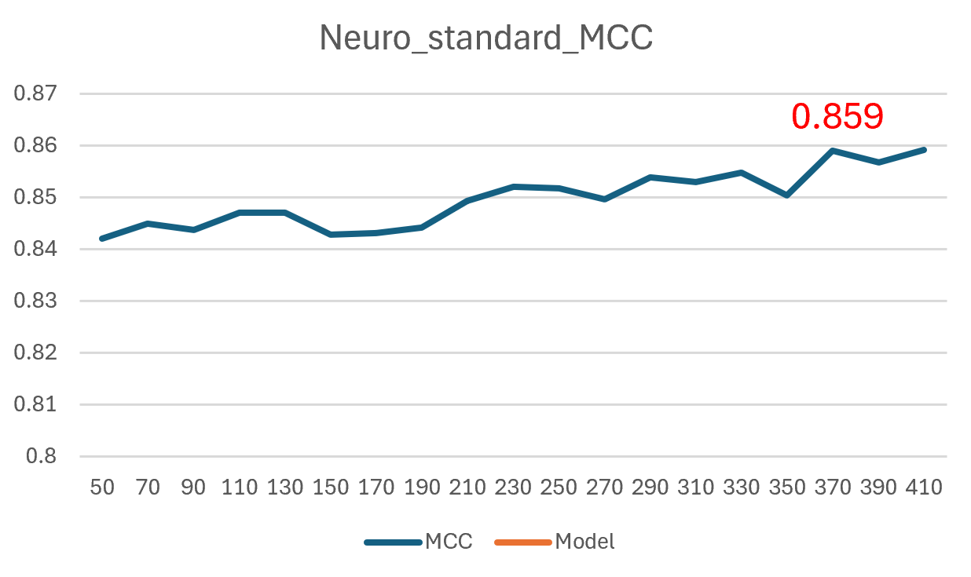
Main_feature result of mcc

Slide 14
Ridge 移除
產生normal前的data OK
數據改用neuropeptide OK
Normal test set 用 train set OK
跑Boruta max_limit = 400
和沒有Boruta
都做ML

