Slide 1
0407 weekly progress
U11216002 資科三 黃瑞麟

Slide 2
Table of Contents
Recover environment
Run stacking python code

Slide 3
Recover environment
Vscode build in desktop
Download python 3.8 version
Download minanaconda
Link : https://www.anaconda.com/docs/getting-started/miniconda/main
Build peptideML_env with anaconda python version 3.8.20
Install vscode extend package about python
Install requirements.txt in pythonML_env

Slide 4
Run stacking python - All data is disappear
Run feature_encode.py -> create big table
Run feature_split.py -> split train, test
Run meta_feature_gent.py -> 機率表
Draw_featuretype_mcc_plot

Slide 5
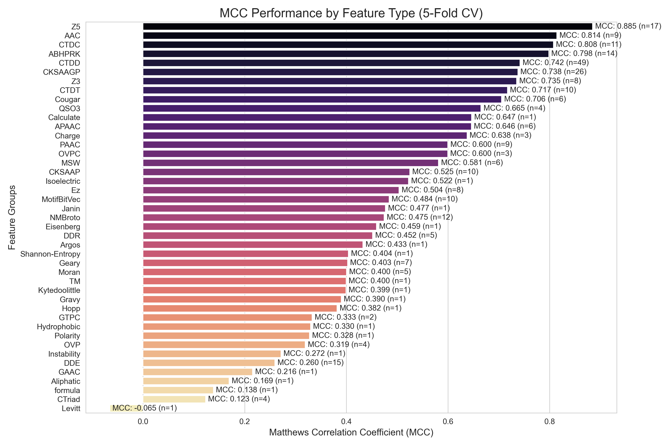
Featuretype vs mcc plot 畫盒鬚圖(用全部17種model) 做 optuna stacking不要挑feature number 56 * 17 = 中間做boruta random foreset , xgboost

Slide 6
Lstm + CNN
用ML方式做 10row做一個window

