Slide 1

National Parks Service
Conservation Study
An analysis of different species at Yosemite, Bryce,
Yellowstone, and Great Smokey Mountains
National Parks.

Slide 2
Endangered Species Analysis
Analysis started with using the python pandas package to make a dataframe from
the raw data contained in ‘species_info.csv’. Investigating the data we see that the
table formed by ‘species_info.csv’ contains 4 columns and 5541 unique species.
 | category | scientific_name | common_names | conservation_status
0 | Mammal | Clethrionomys gapperi gapperi | Gapper's Red-Backed Vole | NaN
1 | Mammal | Bos bison | American Bison, Bison | NaN
2 | Mammal | Bos taurus | Aurochs, Aurochs, Domestic Cattle (Feral), Dom... | NaN
3 | Mammal | Ovis aries | Domestic Sheep, Mouflon, Red Sheep, Sheep (Feral) | NaN
4 | Mammal | Cervus elaphus | Wapiti Or Elk | NaN
5 | Mammal | Odocoileus virginianus | White-Tailed Deer | NaN
6 | Mammal | Sus scrofa | Feral Hog, Wild Pig | NaN
7 | Mammal | Canis latrans | Coyote | Species of Concern
8 | Mammal | Canis lupus | Gray Wolf | Endangered
9 | Mammal | Canis rufus | Red Wolf | Endangered
number_of_species = species.scientific_name.nunique() # 5541

Slide 3
Endangered Species Analysis
Taking this analysis a step further, we can see all the categories of species contained
within this data.
 | category | species_per_category
0 | Amphibian | 80
1 | Bird | 521
2 | Fish | 127
3 | Mammal | 214
4 | Nonvascular Plant | 333
5 | Reptile | 79
6 | Vascular Plant | 4470
And by manipulating information about conservation status, we can summarize the conservation status per category.
 | conservation_status | species_per_conservation_status
0 | In Recovery | 4
1 | Threatened | 10
2 | Endangered | 16
3 | Species of Concern | 161
4 | No Intervention | 5633

Slide 4
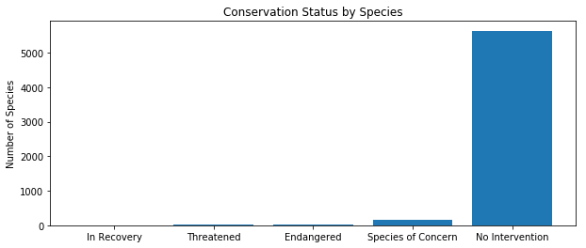
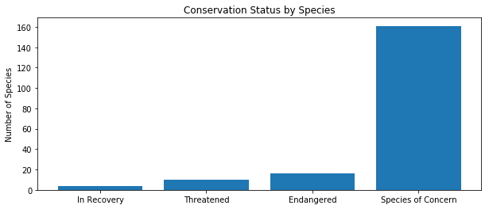
Endangered Species Analysis
No one likes tables – the previous table can easily be represented by a bar chart.
Clearly the majority of species are not endangered! Removing ‘No Intervention’ status, we can read the categories of interest more easily:

Slide 5
Endangered Species Analysis
As we saw in from the last bar chart, there are about 200 species that are classified as ‘Species of Concern’ or worse. In order to make conservation efforts for these species, we’ll need to gather more information from this data. First, we can create a new column to isolate all of the species that we’re concerned with:
 | category | scientific_name | common_names | conservation_status | is_protected
0 | Mammal | Clethrionomys gapperi gapperi | Gapper's Red-Backed Vole | No Intervention | False
1 | Mammal | Bos bison | American Bison, Bison | No Intervention | False
2 | Mammal | Bos taurus | Aurochs, Aurochs, Domestic Cattle (Feral), Dom... | No Intervention | False
3 | Mammal | Ovis aries | Domestic Sheep, Mouflon, Red Sheep, Sheep (Feral) | No Intervention | False
4 | Mammal | Cervus elaphus | Wapiti Or Elk | No Intervention | False
Using this column and our knowledge of pivot tables, we can create a count of the species of concern in each category and compare it with the total to get a percentage :
 | category | not_protected | protected | percent_protected
0 | Amphibian | 72 | 7 | 8.860759
1 | Bird | 413 | 75 | 15.368852
2 | Fish | 115 | 11 | 8.730159
3 | Mammal | 146 | 30 | 17.045455
4 | Nonvascular Plant | 328 | 5 | 1.501502
5 | Reptile | 73 | 5 | 6.410256
6 | Vascular Plant | 4216 | 46 | 1.079305

Slide 6
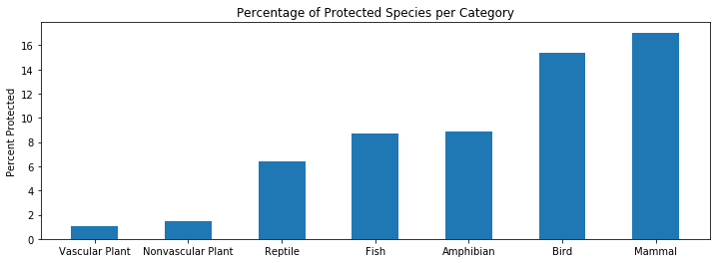
Endangered Species Analysis
We can also graph the percentage of protected species per category to get a visual
understanding of the species affected:
Here, we see ‘Mammals’ has a higher percentage of protected species than ‘Birds’, but does that mean that mammals are more likely to be at risk of endangerment than birds?
For two or more categorical datasets, we use the Chi-Square test to answer this question.

Slide 7
Endangered Species Analysis
Here is the data that we compare using the Chi-Square test:
 | protected | not protected
Mammal | 30 | 146
Bird | 75 | 413
Which returns a p-value (probability that the sample data doesn’t represent reality) of 68.75%. Here we conclude that there is no significant difference between the data sets, and mammals are not more at risk than birds.
We can run the same test against any other category, like ‘Reptiles’.
 | protected | not protected
Mammal | 30 | 146
Reptile | 5 | 73
This time the test returns a p-value = 3.84%, meaning there is a significant difference between these datasets. Mammals are more likely to be a species of concern compared to reptiles.
Typically p-values less than 5% is deemed as significant.

Slide 8
Endangered Species Recommendation
Based on the overall breakdown of this information, I would recommend that conservation efforts be focused on mammals and birds. These categories have a high percentage of their species at risk, and are significantly more likely to be at risk when compared to other categories.
It should also be noted that while vascular plants have a relatively high number of species at risk, this comprises a very small percentage of their overall population.

Slide 9
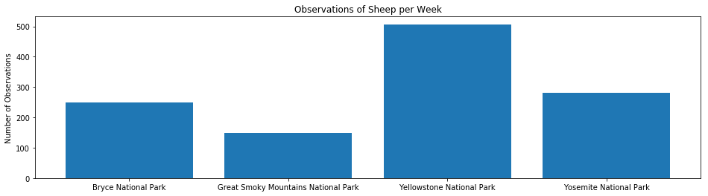
Foot and Mouth Disease Analysis
Data shows that 15% of the sheep at Bryce and Yellowstone national park have foot and mouth disease. A program has been running to reduce the number of sheep infected by the disease.
Our scientists want to be able to detect reductions of 5% with 90% confidence. By setting our values as shown below, we can determine we need a sample size of 510 observations to achieve this.
Baseline Conversion Rate = 15%
Minimum Detectable Effect = (Old - New)/Old = 33%
Statistical Significance = 90%
This study will take approximately 1 week at Yellowstone, and approximately 2 weeks at Bryce National Park.

Slide 10


