Slide 1

MUSIC NFTs MARKETPLACE

Slide 2
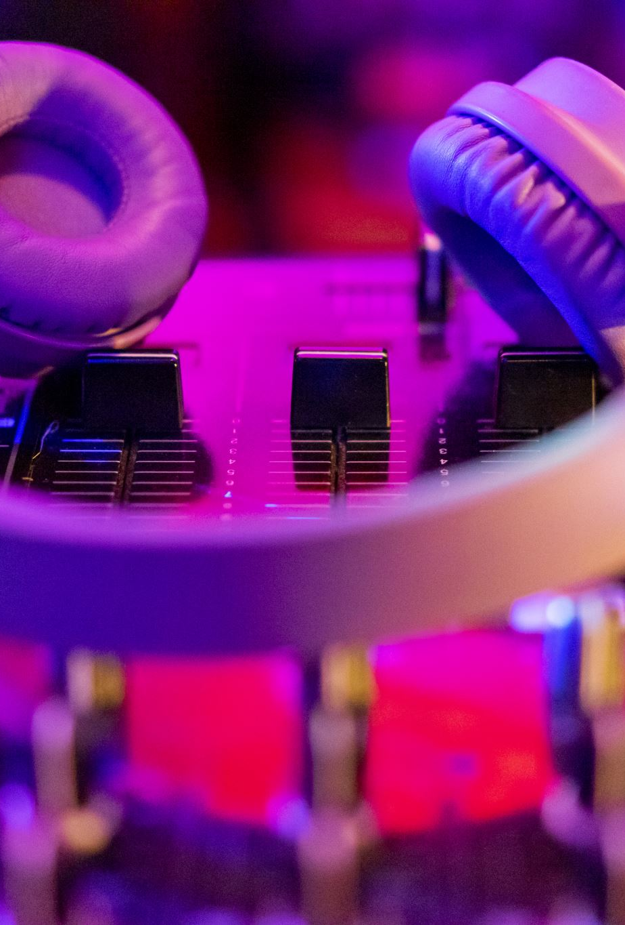
INTRODUCTION
Consume without Owning
Evolution of the Earning Model since 2000
Smart Contract to ensure Music Authenticity
Smart Contract to ensure Royalty Fee Distribution

Slide 3
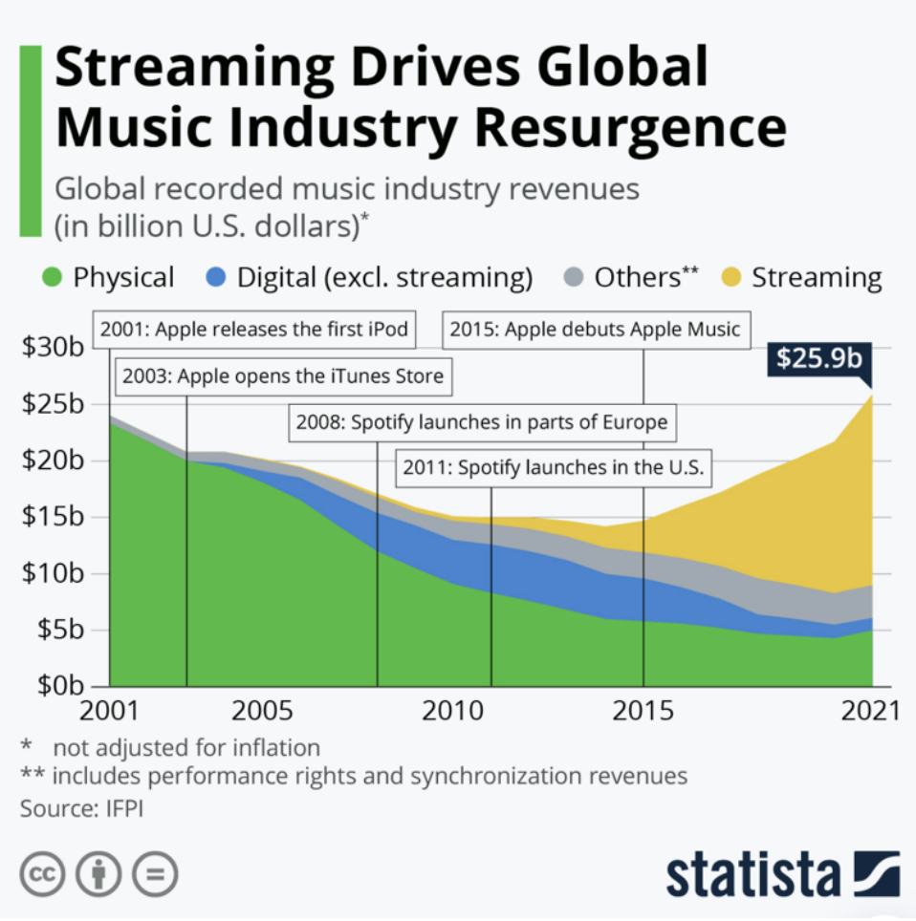

Slide 4
INTRODUCTION
Consume without Owning
Evolution of the Earning Model since 2020
Smart Contract to ensure Music Authenticity
Smart Contract to ensure Royalty Fee Distribution

Slide 5

PROBLEM
Need to trust a third party
Unequal competition between artists
Unequal distribution of royalties
Inability to buy music content online

Slide 6

SOLUTION
Web 3.0-based Music Player App
Stream, Buy & Resell Music NFTs
Home Page - Artist Mint Music as NFTs & Users are able to Stream/Buy it
Tokens Page – Dashboard with every token that own the connected account
Resell Page – Dashboard with every token that an account is selling/has sold

Slide 7

DATA STORAGE
Google Cloud
Web3.0.storage
.json file with each NFT’s metadata
Format .json files as an unique .CAR file
NFT.storage
Insert the IPFS link into our smart contract - Will act as a pointer to retrieve the data

Slide 8

NETWORK & SCALABILITY
Test Realised on Ethereum Based Network
Hardhat Local Development Blockchain Environment
Easy implementation on Polygon Network

Slide 9
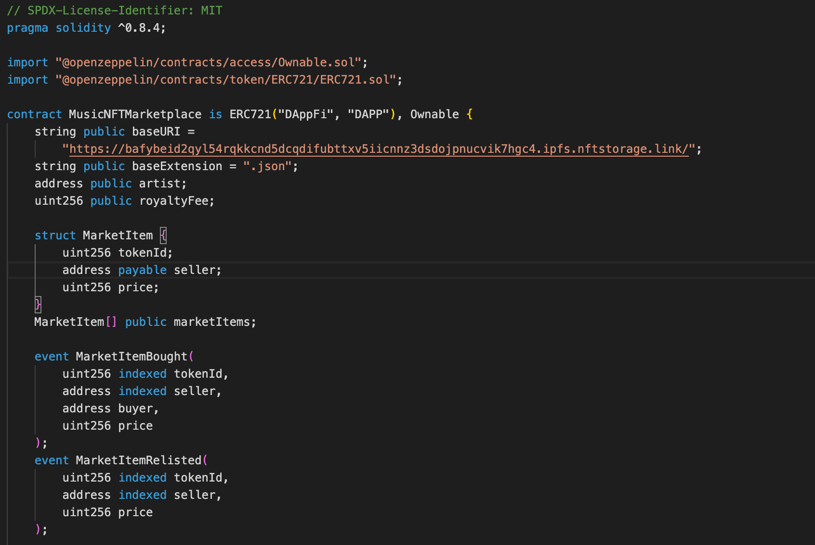
SMART CONTRACT (1)

Slide 10
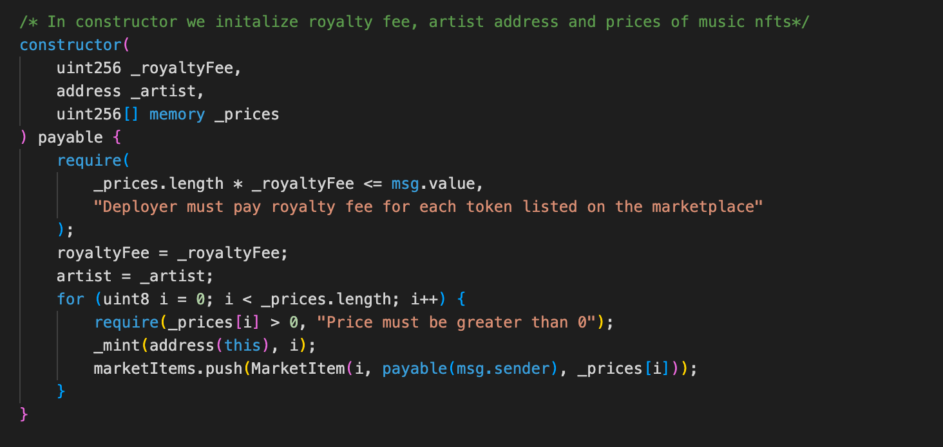
SMART CONTRACT (2)

Slide 11
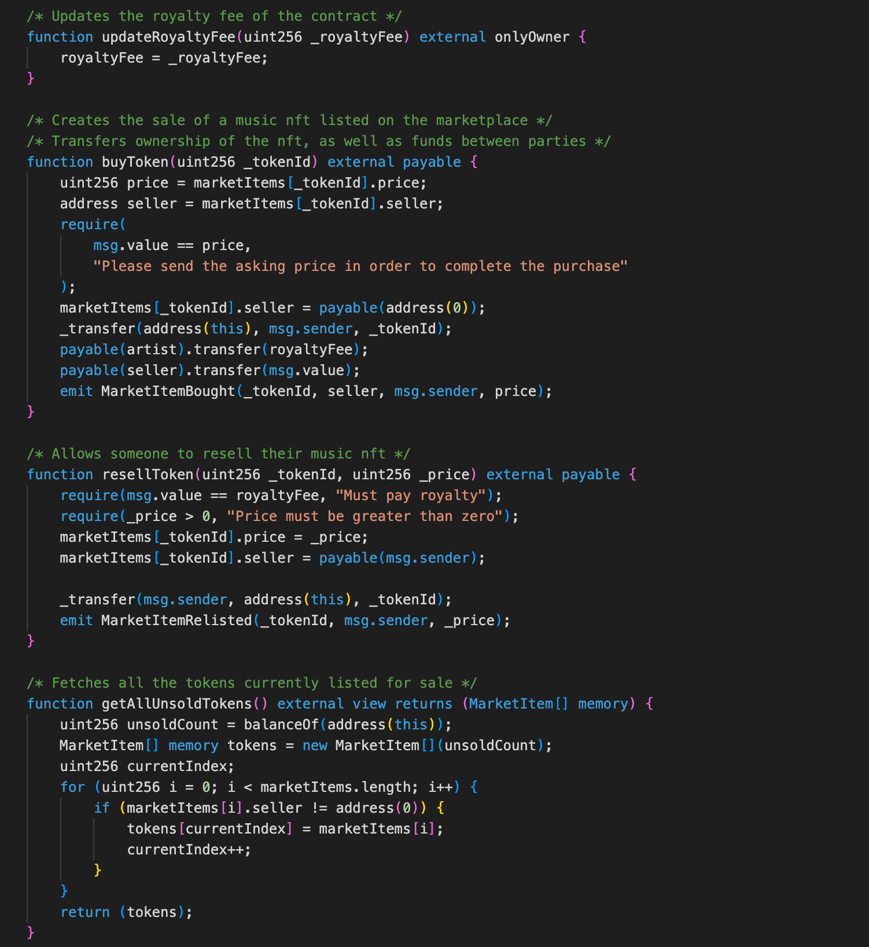
SMART CONTRACT (3)

Slide 12
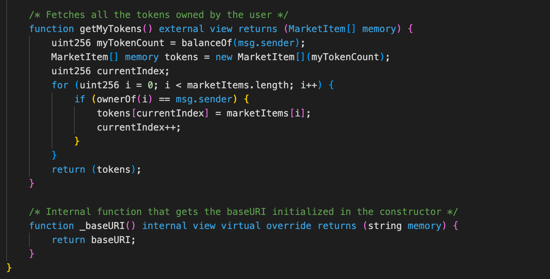
SMART CONTRACT (4)

Slide 13
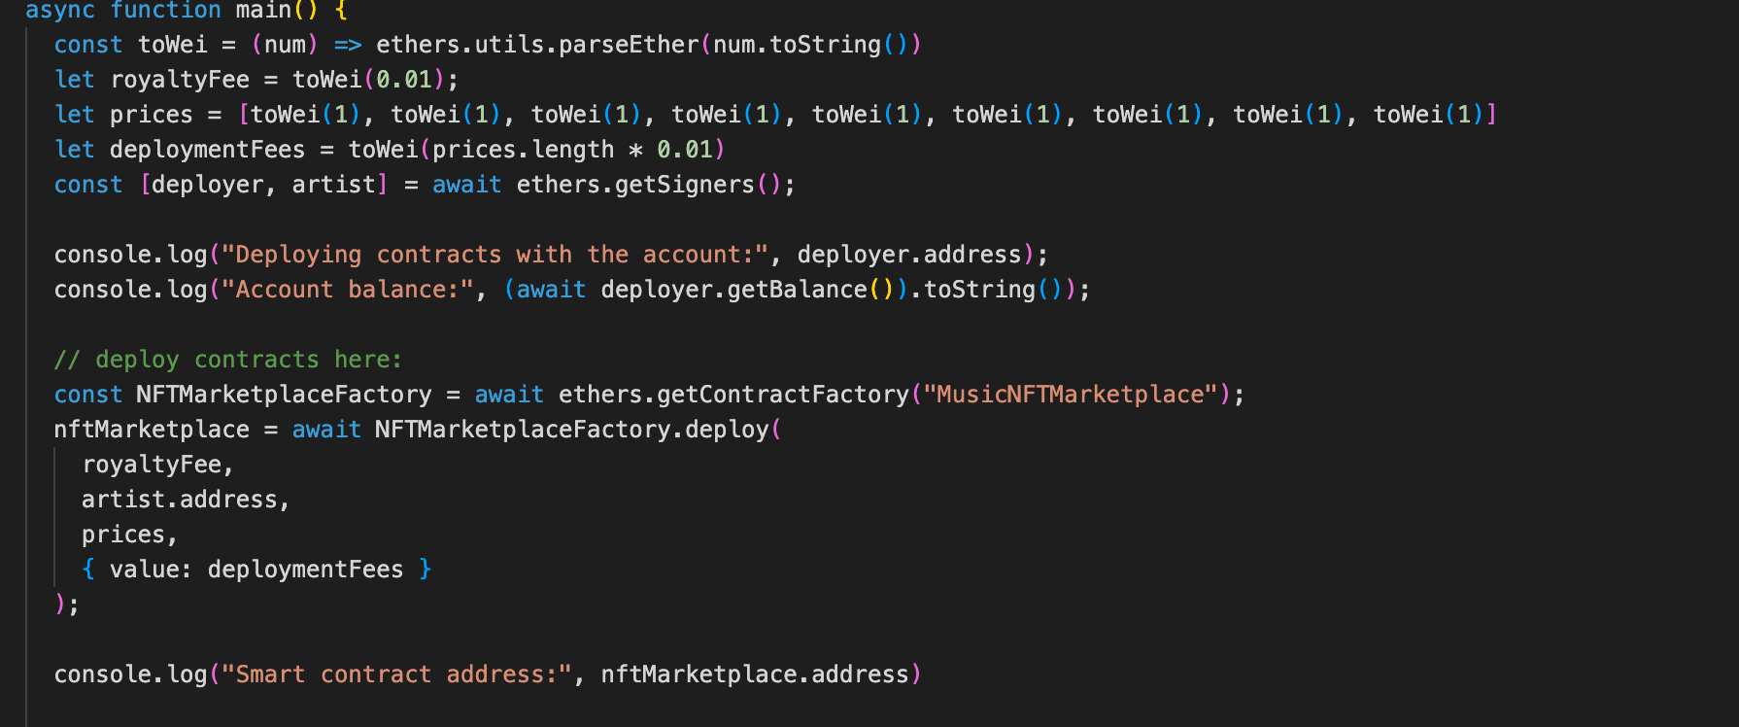
DEPLOYMENT

Slide 14
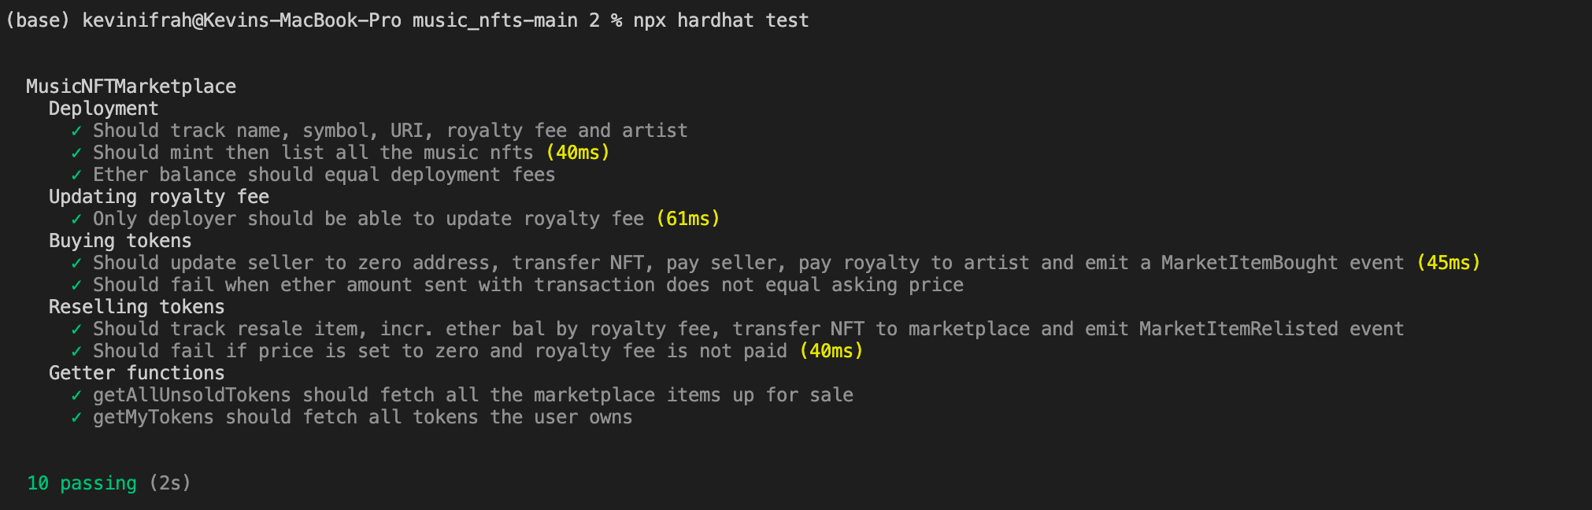
TESTING

Slide 15
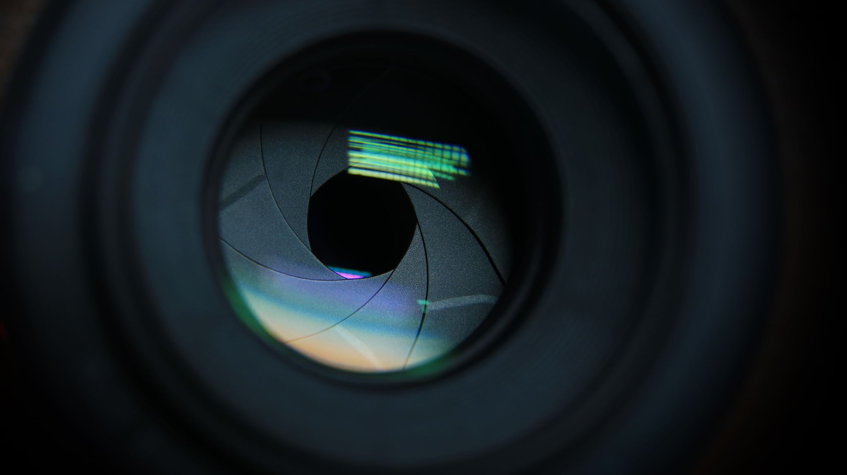
DEMO

Slide 16
THOUGHT & FUTURE WORK
Develop Tools with New Smart Contracts
Subscription Token
Stream Revenu Redistribution
Vote for a favourite artist
Follow a favourit artist, label, collective and be involved in their personal community
Ticket Marketplace Tool
Develop the Frontend
Separate Marketplace & Streaming Tool
Develop a more autonomous page to mint easily Music NFTs
Gather all the tool in the same page as a unique Music OS

Slide 17

CHALLENGES
Lack of Programming Knowledge
Deployment & Interaction with Metamask
Data Storage Process

Slide 18
THANK YOU FOR YOUR ATTENTION!

