Slide 1
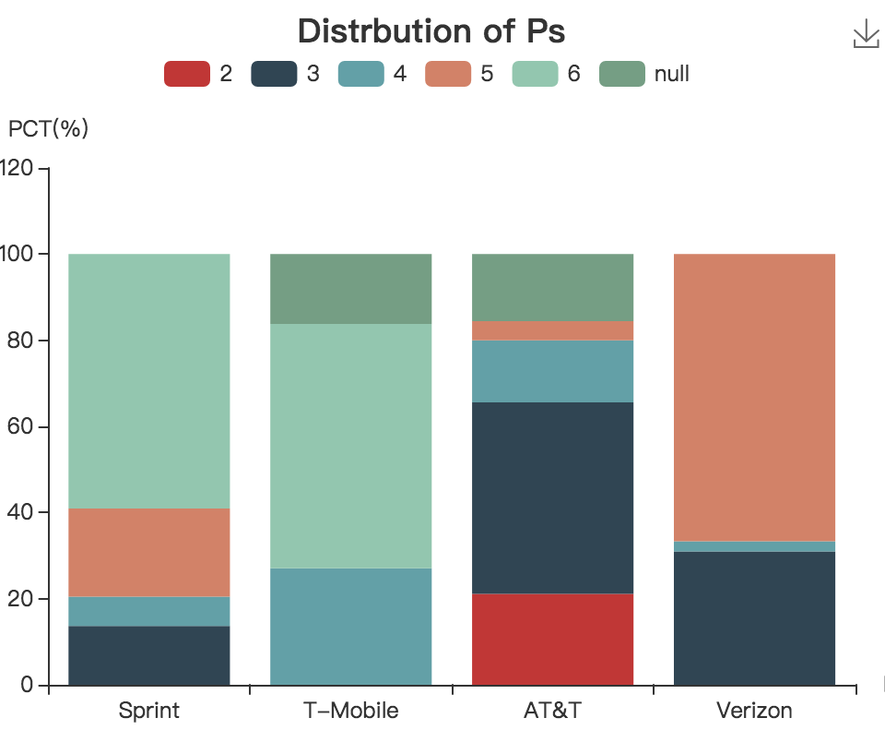
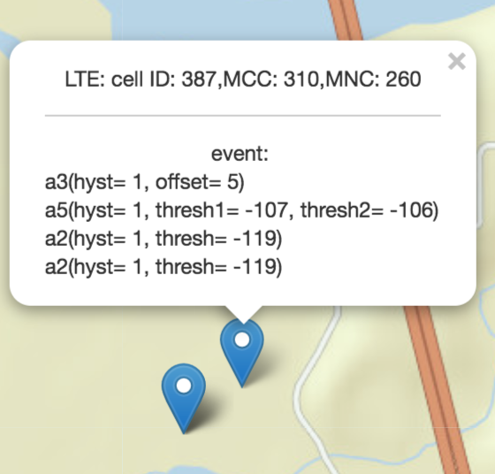
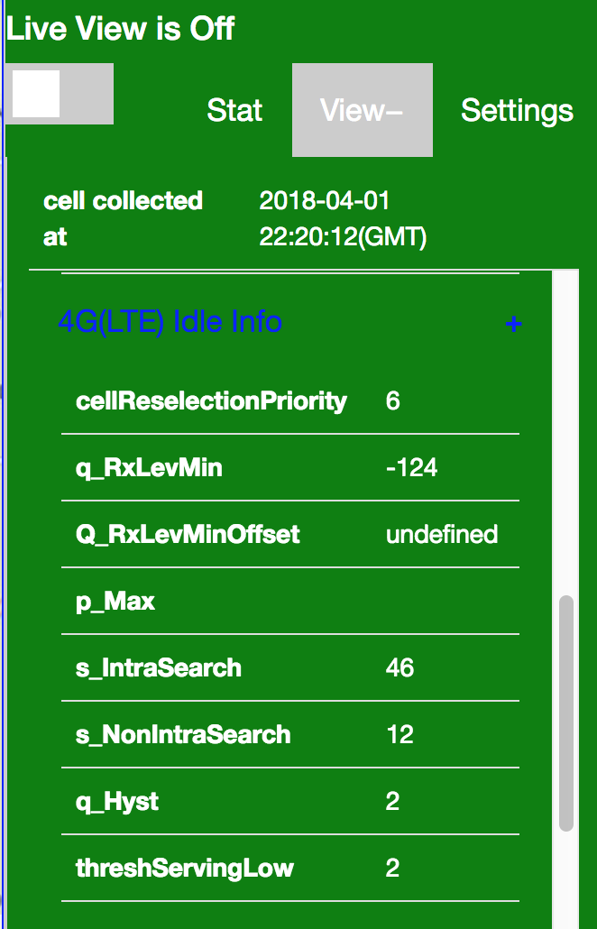
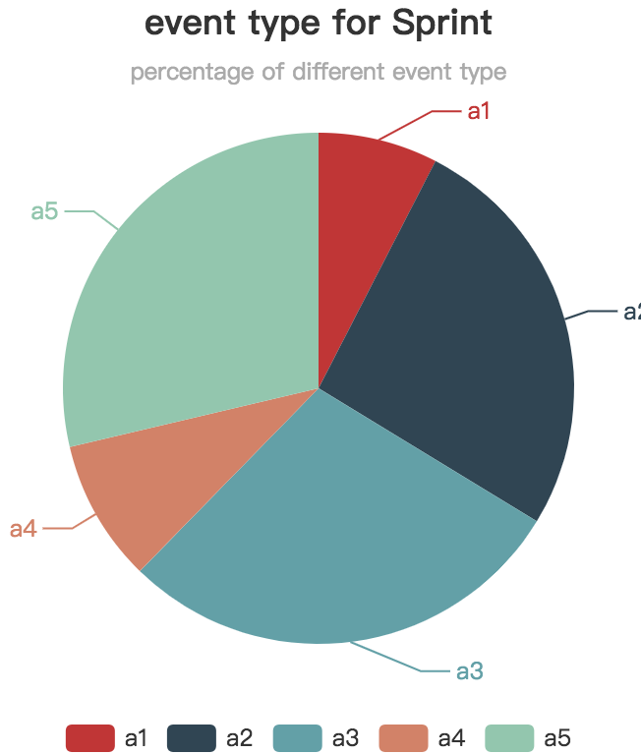
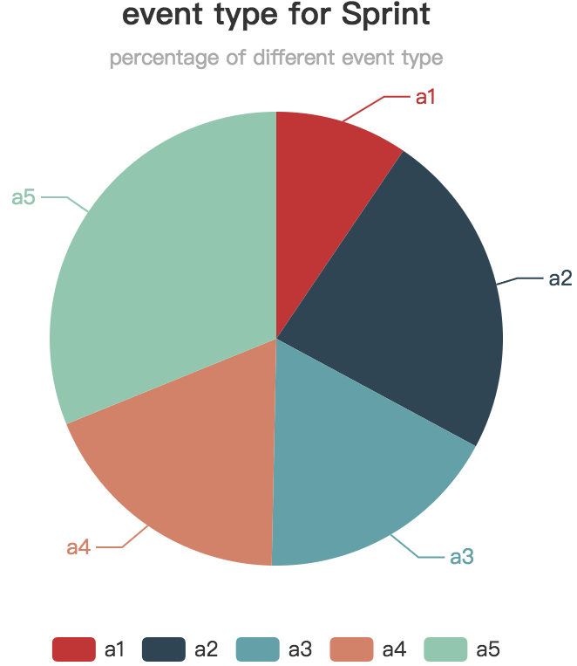
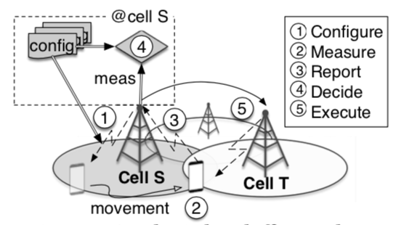
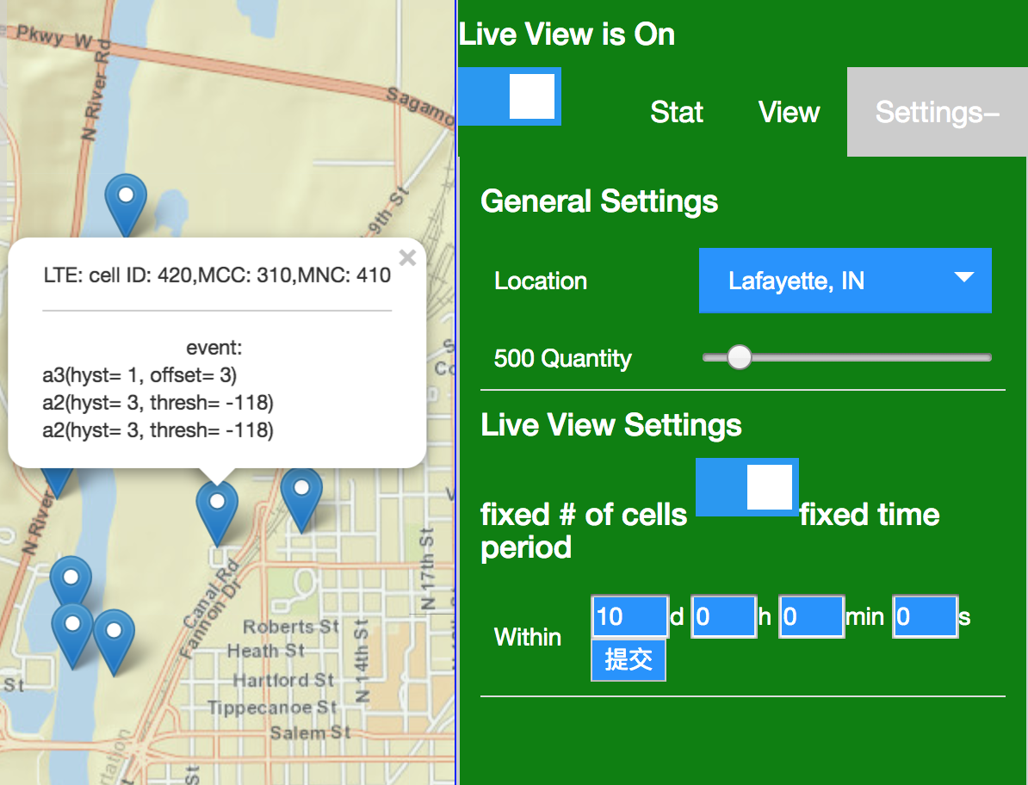
MMMap: Mobility Management Map
of Global Carriers Networks At Your Hands
Kai Ling*^{1,2}, Jiaqi Xu *^{1,3}, Zhuo Jiang*¹, Haotian Deng ¹, Chunyi Peng ¹
¹ Purdue University, USA ²Huazhong University of Science and Technology, China ³Peking University, China
*: co-primary authors; Kai and Jiaqi did this work during their visits at Purdue.
What is MMMap?
MMMap(Mobility Management Map) is an interactive map service to visualize mobility management configuration parameters used by operational cellular networks in the wild.
Background
MMMap Features
Mobility is supported by handoffs in cellular networks.
Carriers manage handoffs with configuration parameters, which cover all the handoff steps, including
when and what to measure
whether and what to report
which cell to select
…
Handoff configurations help us to understand how and why handoffs perform in the wild
1. Geo-centric view
Locating the cells in the area of your interest
Offering per-cell handoff configuration view
Figure5: Distribution of cell reselection priority
Figure3: Geo centric view of MMMap
2.Live data cycle
See and check what you have contributed to recently
A complete cycle of data processing along with MMLab
Figure6: Event type(sprint) distribution at one area of west lafayette(left) and chicago(right)
Open to community
Figure1: Handoff procedure
Open experiments, anyone can join
Downloadable dataset
http://mssn2.cs.purdue.edu/mmmap/download
MMMap and MMLab
1. MMLab ^{[1,2]}: Data collection
A device-centric approach
Dataset is always growing
2. MMMap: Data visualization
Load the dataset we already have in IMC paper²
Live data cycle with MMLab
Offers a user-friendly way to release handoff configuration dataset
Figure 4: Live view of MMMap
Reference
3. Statistics and friendly visualization
Seizing what you care with view filters
Providing spatial/temporal statistics in an area
MI-Lab website, http://milab.cs.purdue.edu
Haotian Deng, Chunyi Peng, Ans Fida, Jiayi Meng, Charlie Hu, “Mobility Support in Cellular Networks: A Measurement Study on Its Configurations and Implications”, IMC’18
MMMap: http://mssn2.cs.purdue.edu/mmmap
MMMap presents a user friendly way to release a large scale handoff configuration dataset
Use MMMap to understand, analyze and improve handoff configuration in the wild
Notes:
1

