Slide 1
Weekly Report
Presenter: Sheng-Hsing Hsiao
Advisor: Jyh-Shing Roger Jang
Dept. of CSIE, National Taiwan University, Taiwan

Slide 2
Outline
Transfer Learning on MobileNetV2
Tensorflow.js
Demo

Slide 3
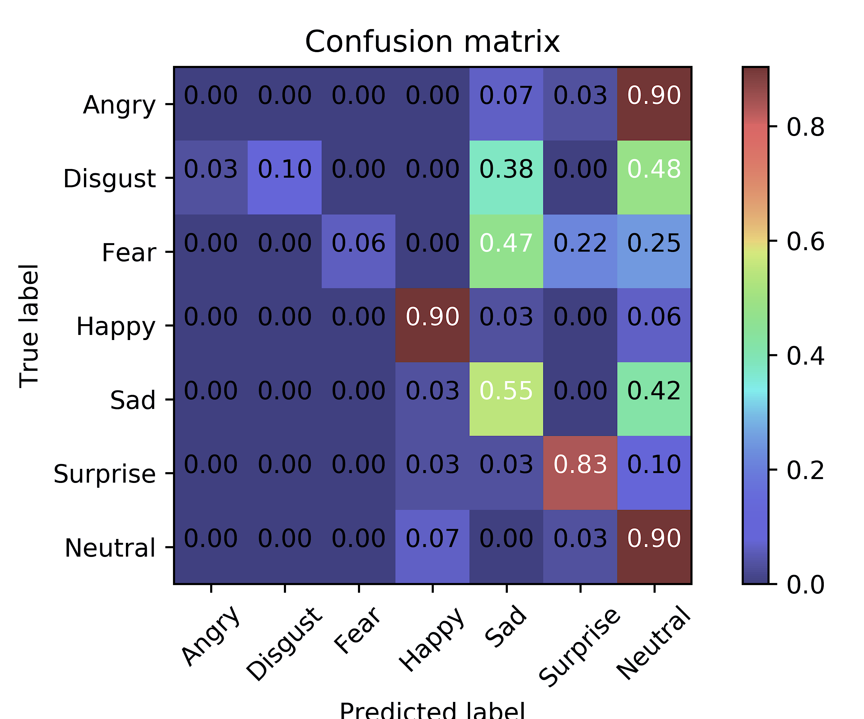
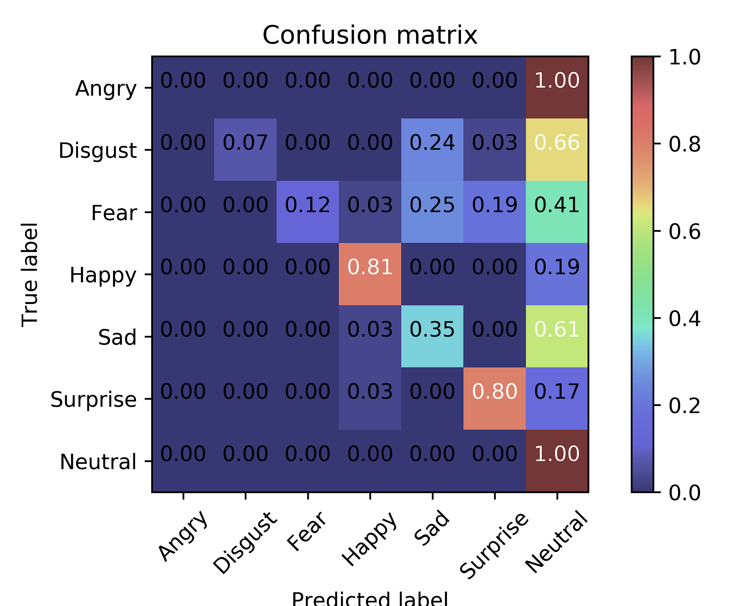
Transfer Learning on MobileNetV2
Outside test on Jaffe dataset
MobileNetV1
MobileNetV2

Slide 4
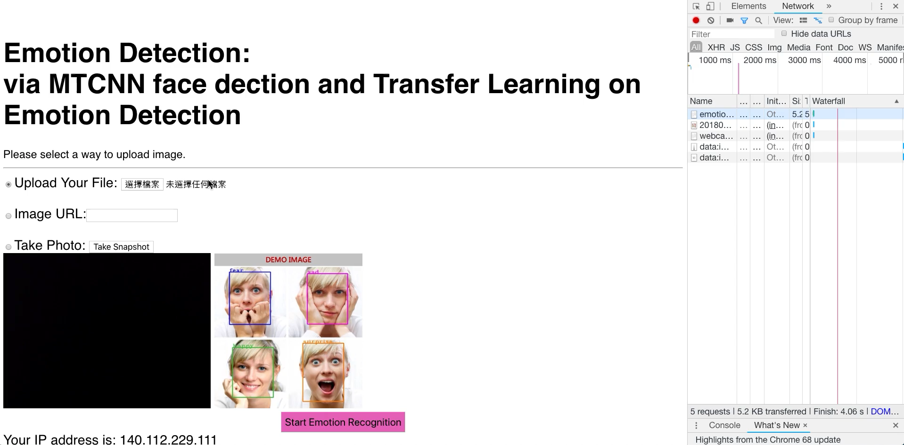
Tensorflow.js
Original
11s

Slide 5
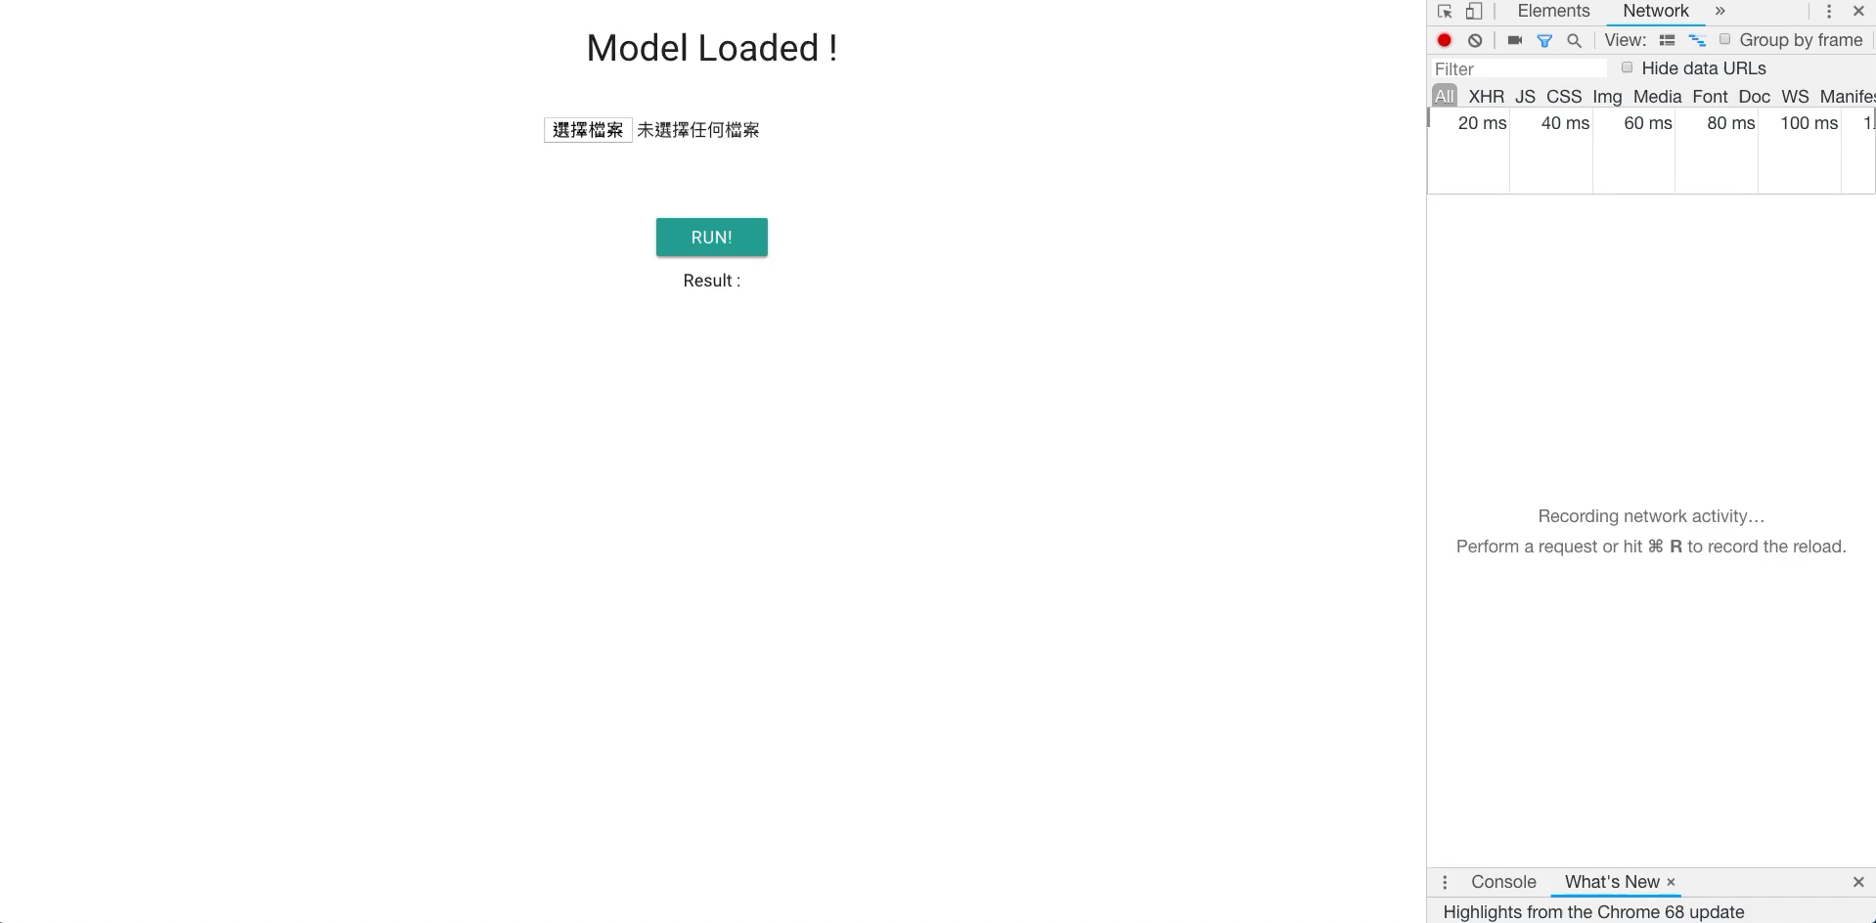
Tensorflow.js
Using tensorflow.js
6s

Slide 6
Related Work
Reference
Tensorflow.js
zaidalyafeai.github.io
Tfjs-converter

Slide 7
Thank you for your attention

