Slide 1
Weekly Report
Presenter: Sheng-Hsing Hsiao
Advisor: Jyh-Shing Roger Jang
Dept. of CSIE, National Taiwan University, Taiwan

Slide 2
Outline
Add functions on Demo page
Test Multiprocessing
Demo

Slide 3
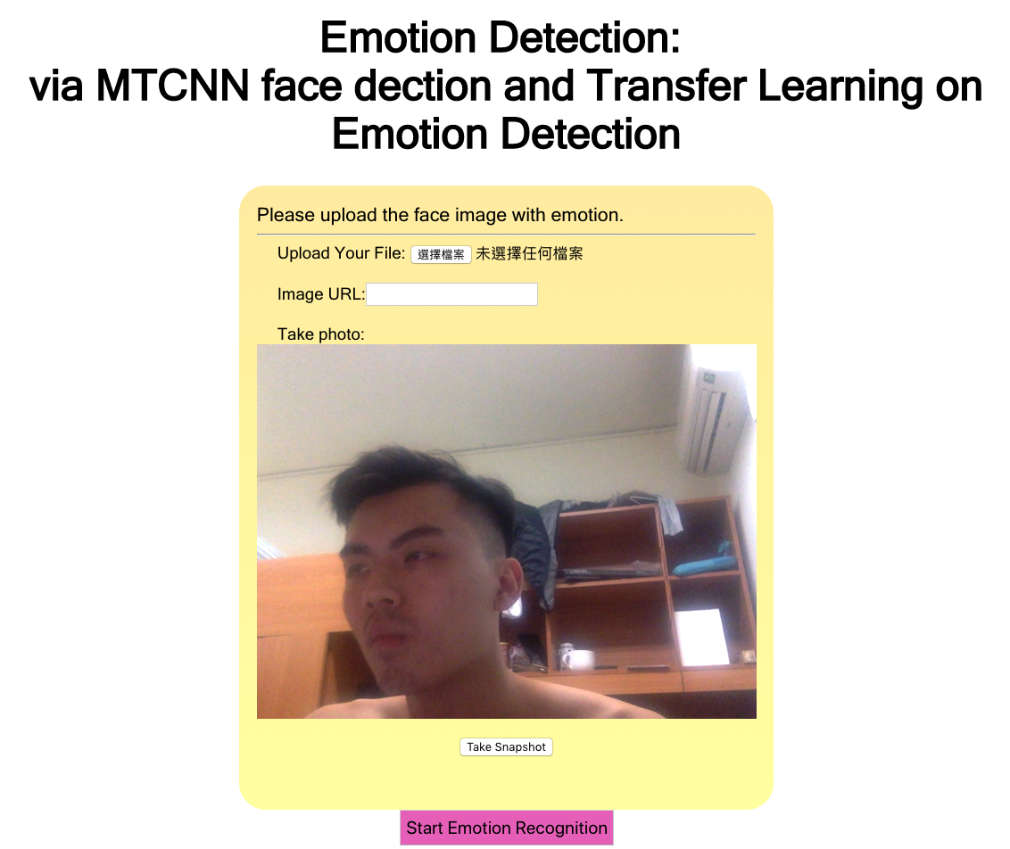
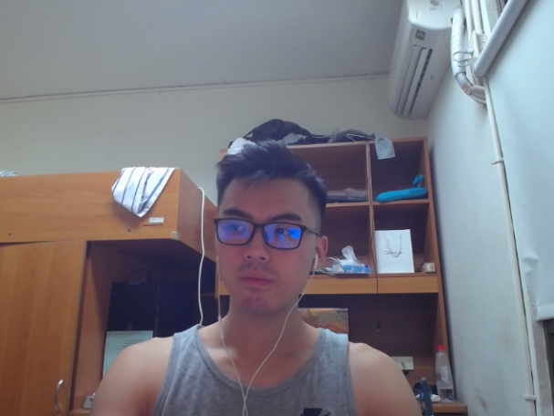
Add functions on Demo page
Camera and URL images

Slide 4

Add functions on Demo page
Detect .png and .jpg/.jpeg files

Slide 5
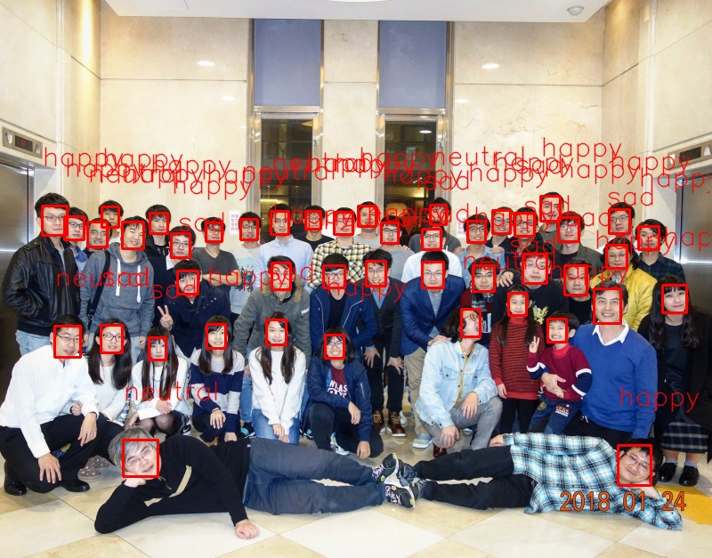
Test Multiprocessing
Without multi-process:
Detect : 1.084s
Classify : 4.063s
With multi-process:
Detect : 10.859s
Classify : 10.87s
Notes:
我覺得是在tensorflow裡面就有自己分配好幾個process了
匡太粗
不同情緒用不同顏色

Slide 6
DEMO

Slide 7
Thank you for your attention

