Slide 1
Weekly Report
Presenter: Sheng-Hsing Hsiao
Advisor: Jyh-Shing Roger Jang
Dept. of CSIE, National Taiwan University, Taiwan

Slide 2
Outline
Add functions on Demo page
Implementation ShuffleNet
Demo

Slide 3
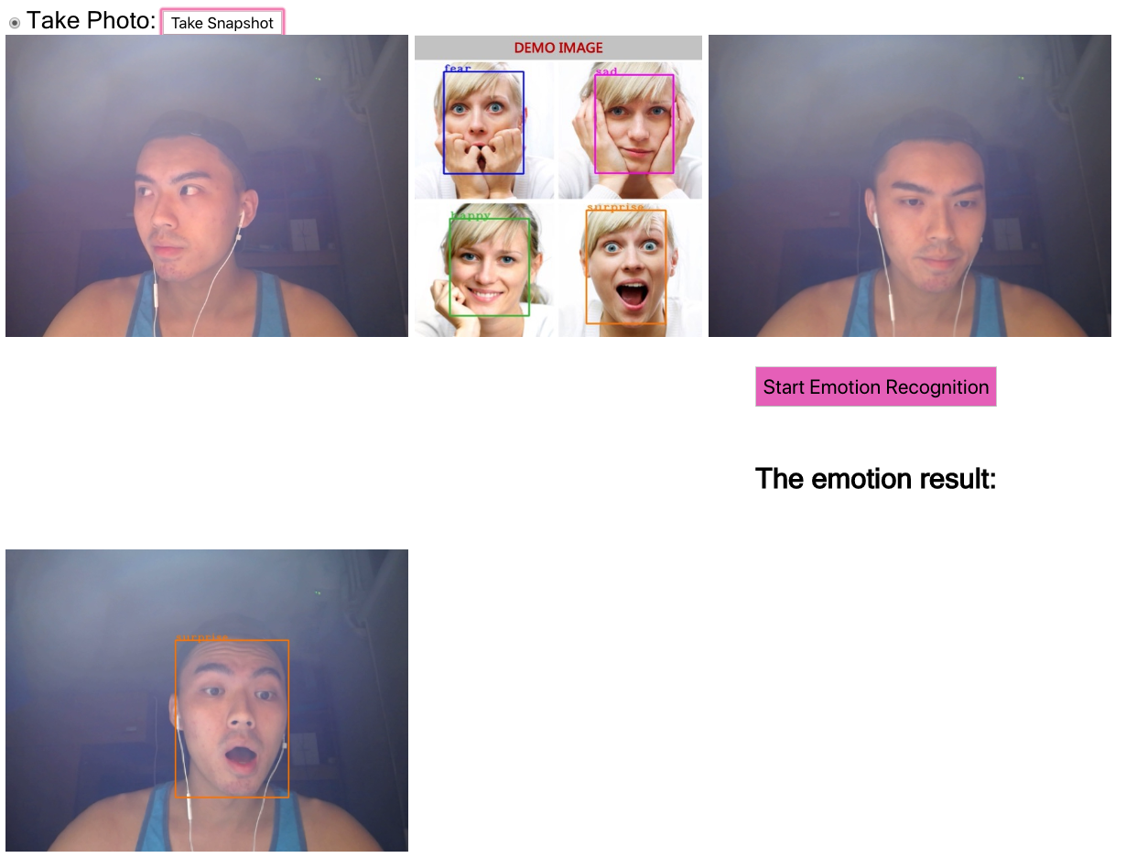
Add functions on Demo page
Different color for different emotion

Slide 4
Implementation ShuffleNet
ShuffleNet implementation using Keras
ShuffleNet implementation using Tensorflow

Slide 5
Related Work
Reference
https://github.com/scheckmedia/keras-shufflenet
https://github.com/MG2033/ShuffleNet

Slide 6
Thank you for your attention

