Slide 1

Continuous Integration With Travis CI

Slide 2
What is continuous integration?
Continuous Integration (CI) is a development practice that involves merging code changes frequently into a shared repository.
CI is essential for detecting and resolving integration issues early in the development process.
Benefits of CI include improved code quality, faster feedback loops, and smoother collaboration among team members.

Slide 3
What is Travis CI
Travis CI is a cloud-based CI service that seamlessly integrates with GitHub repositories.
It automates the process of building, testing, and deploying software projects.
Travis CI supports a wide range of programming languages and provides a flexible and scalable infrastructure for CI workflows.

Slide 4
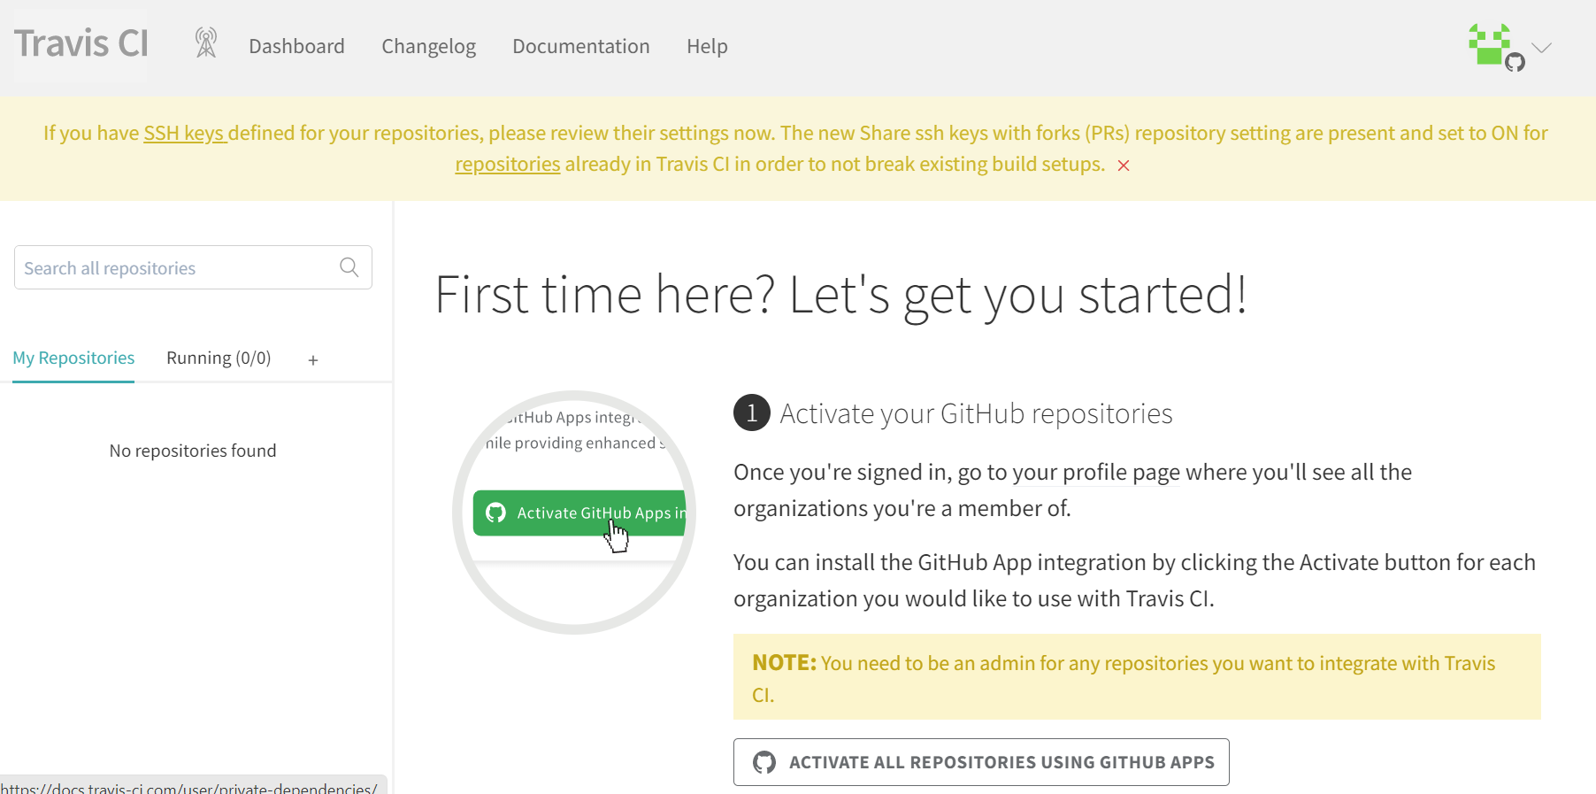
Travis CI Steps:

Slide 5
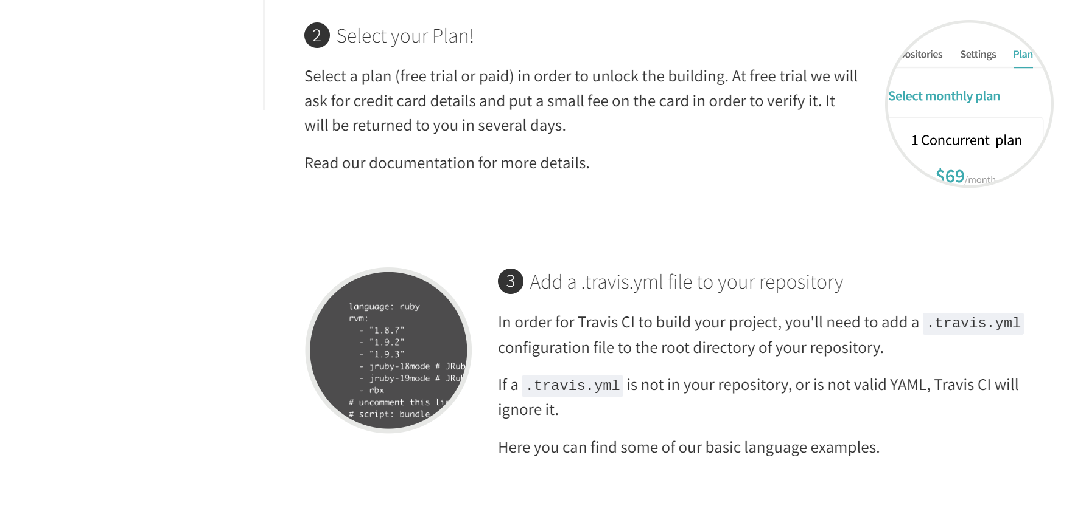

Slide 6
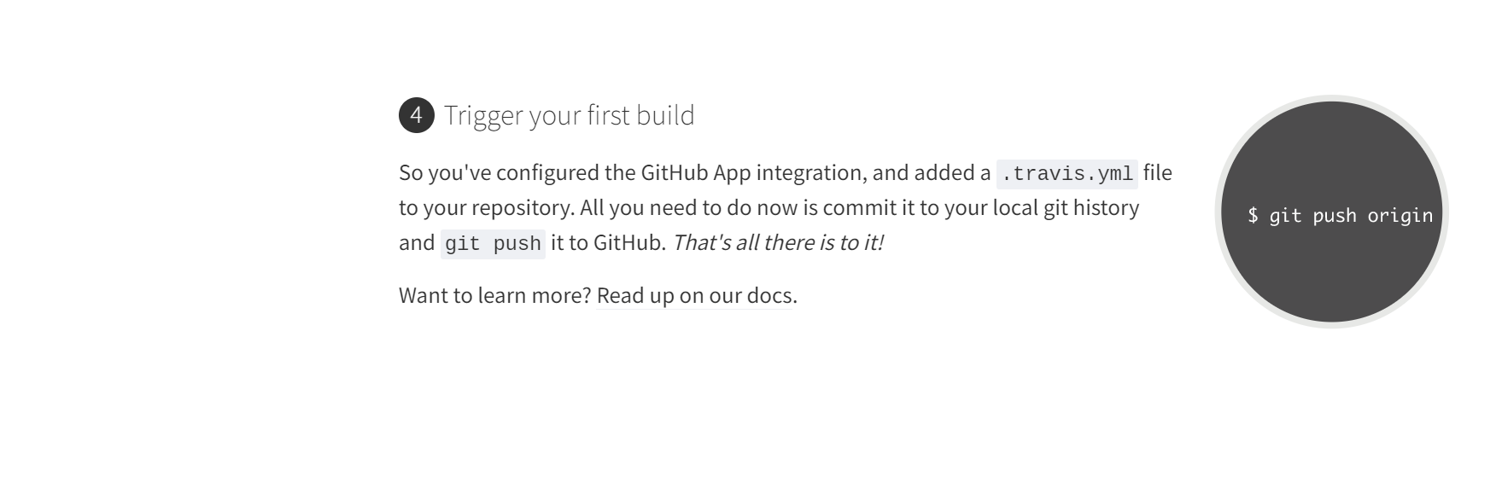

Slide 7
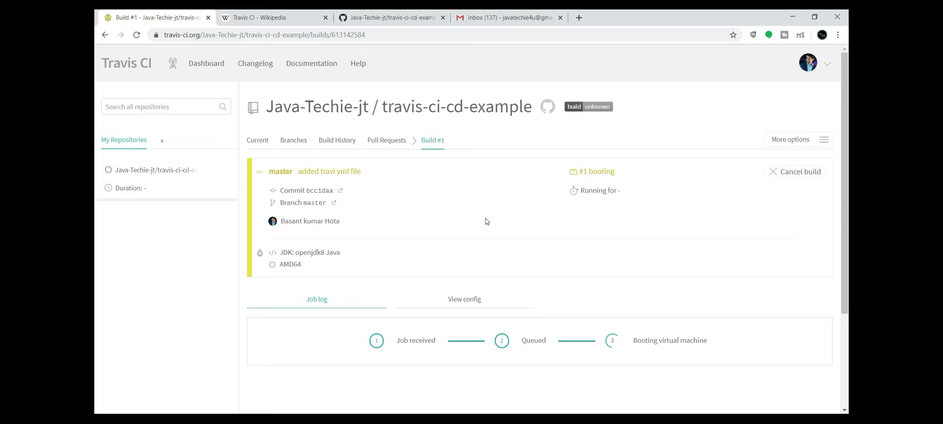

Slide 8
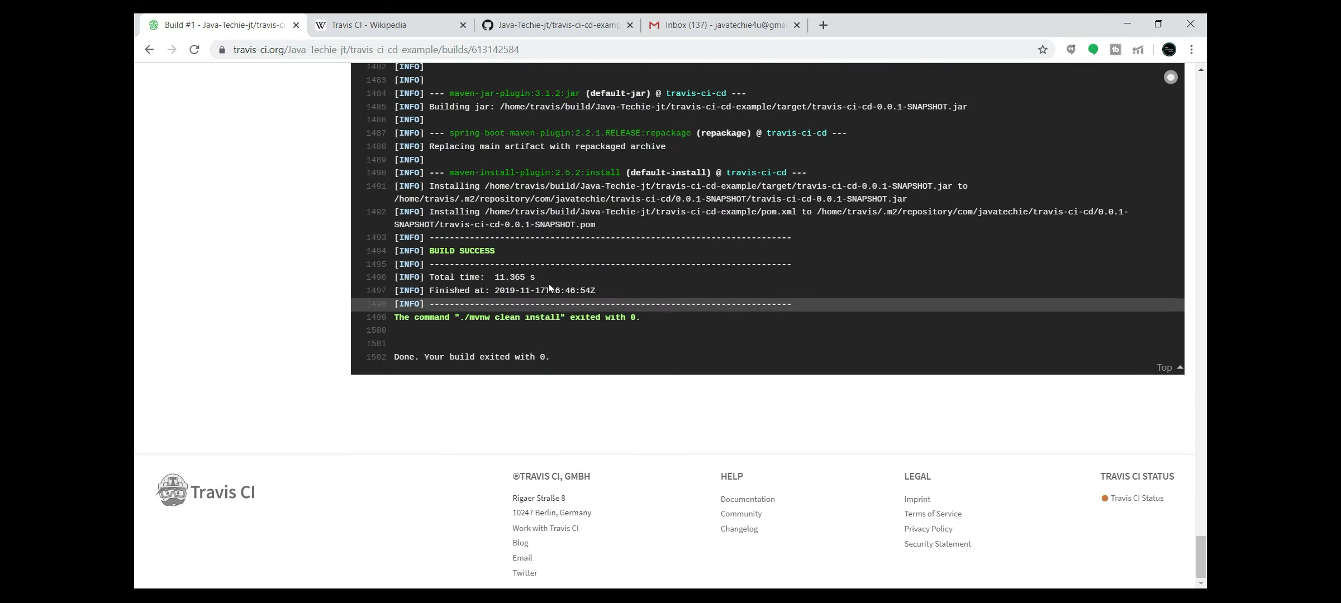

Slide 9


Slide 10
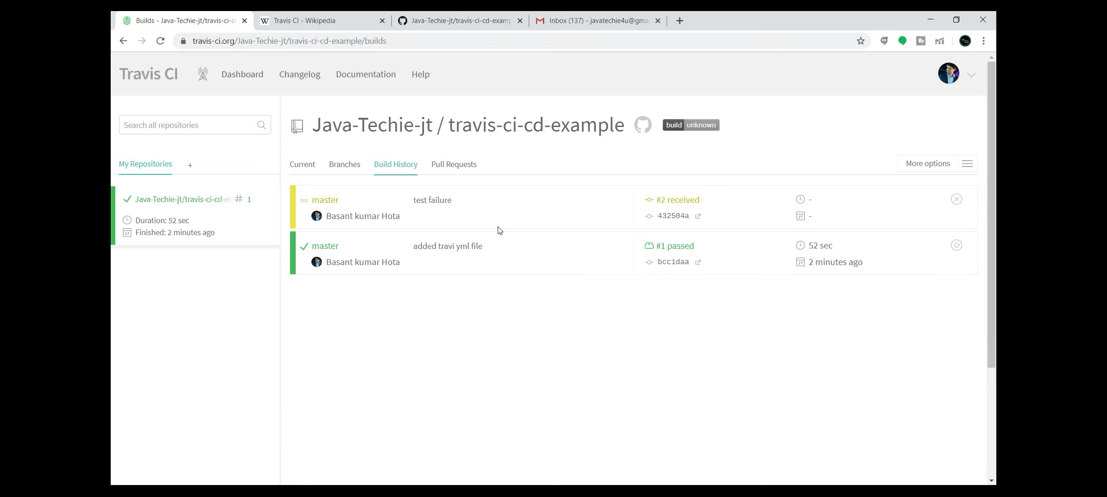

Slide 11
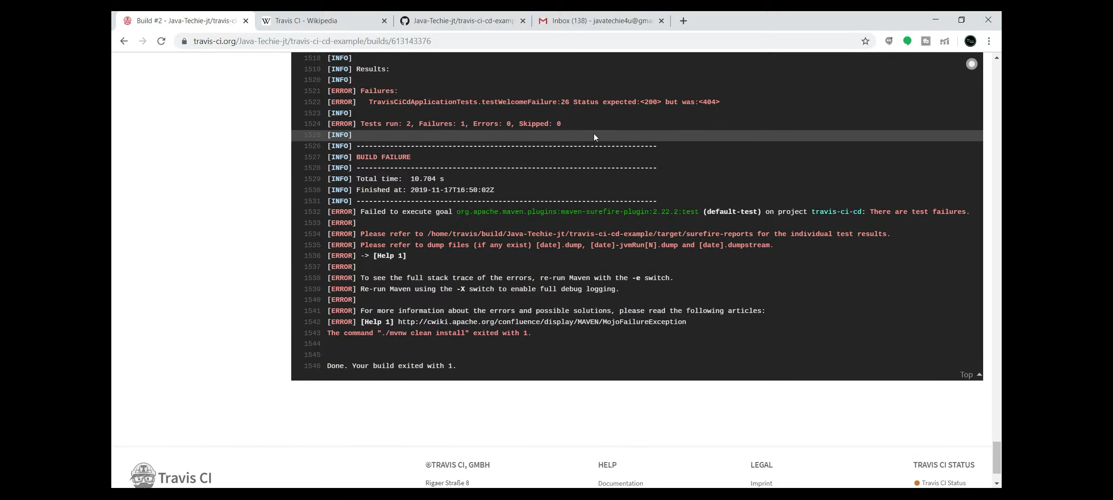

Slide 12
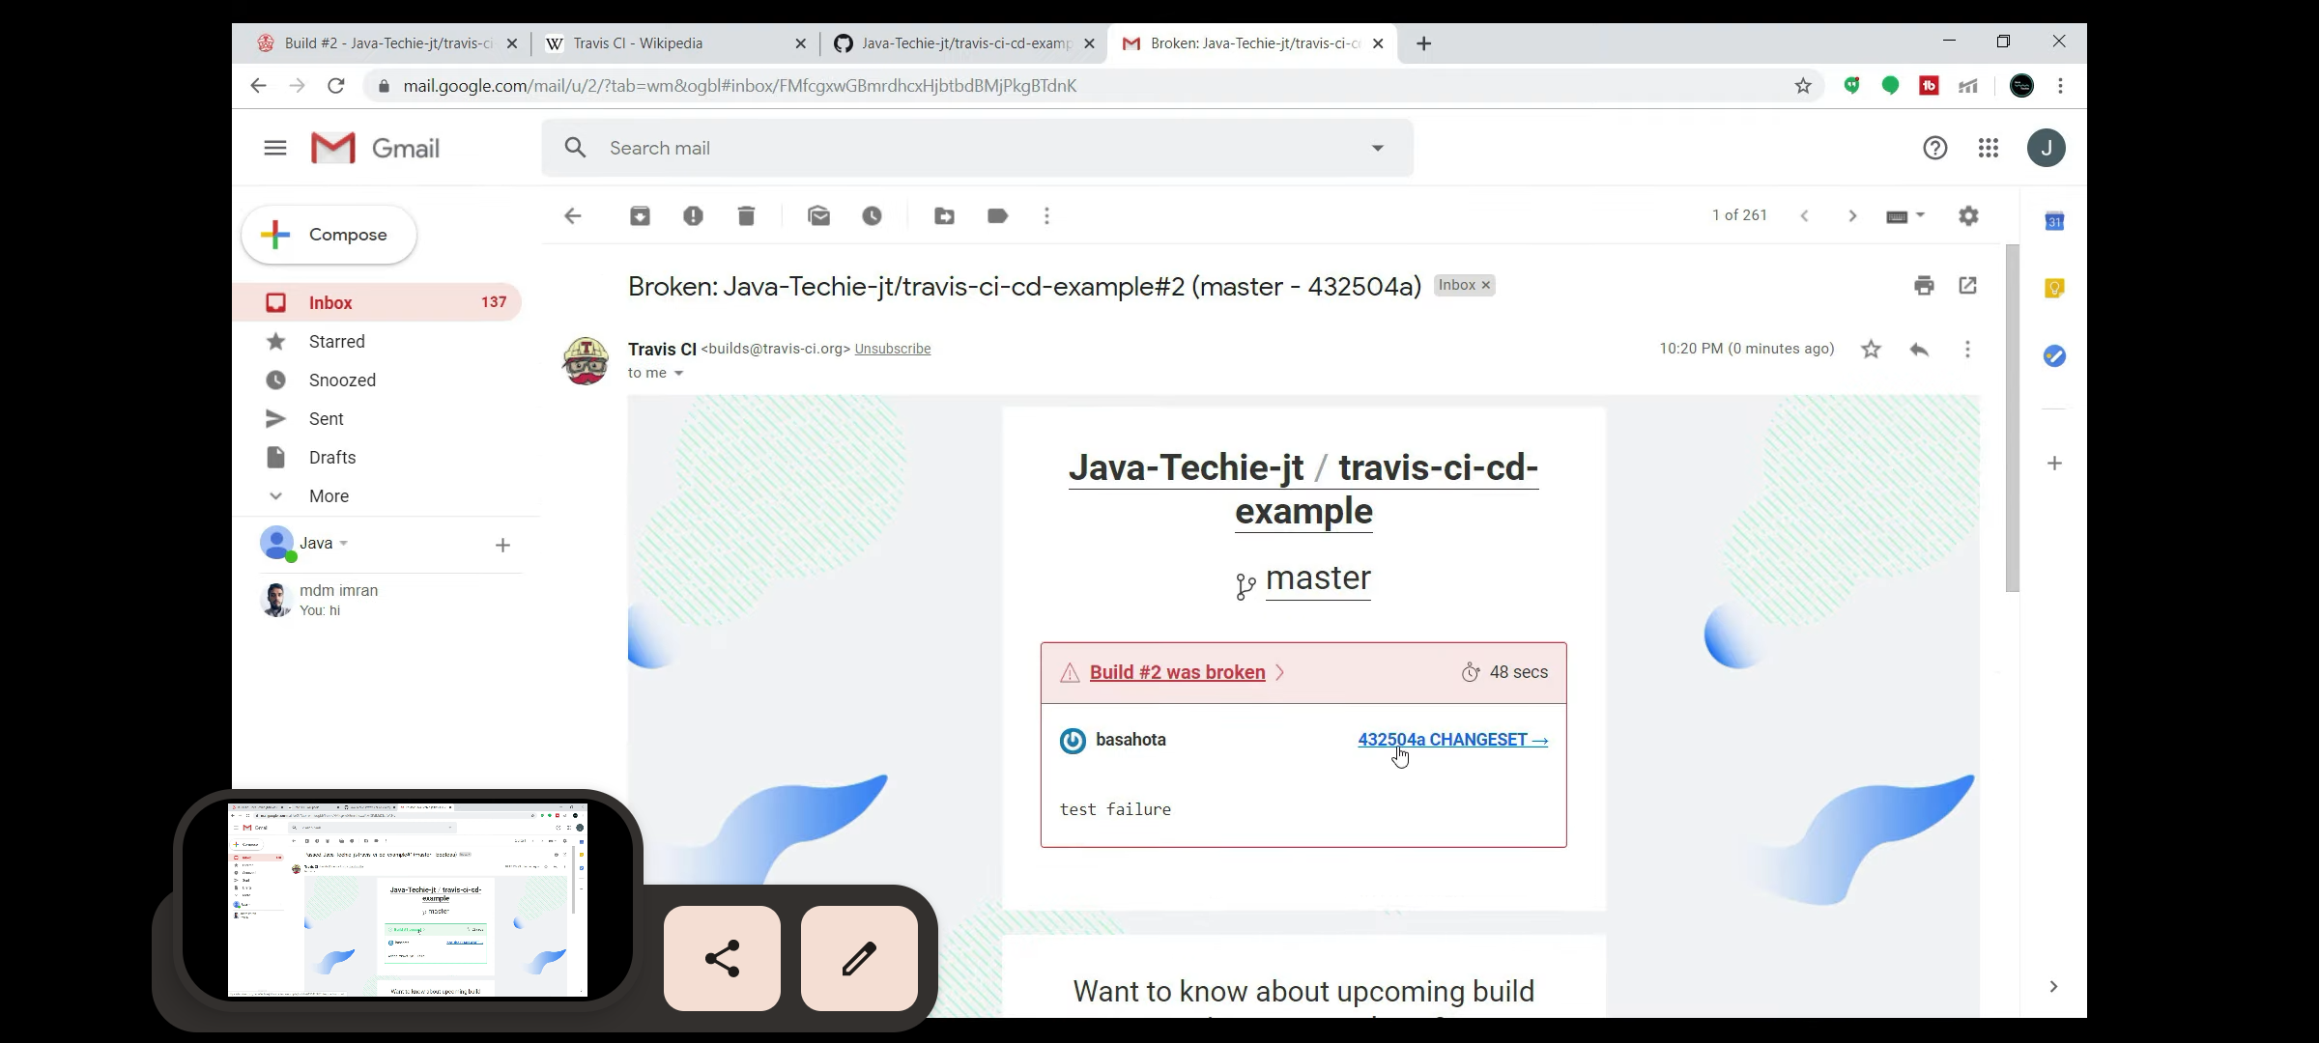

Slide 13
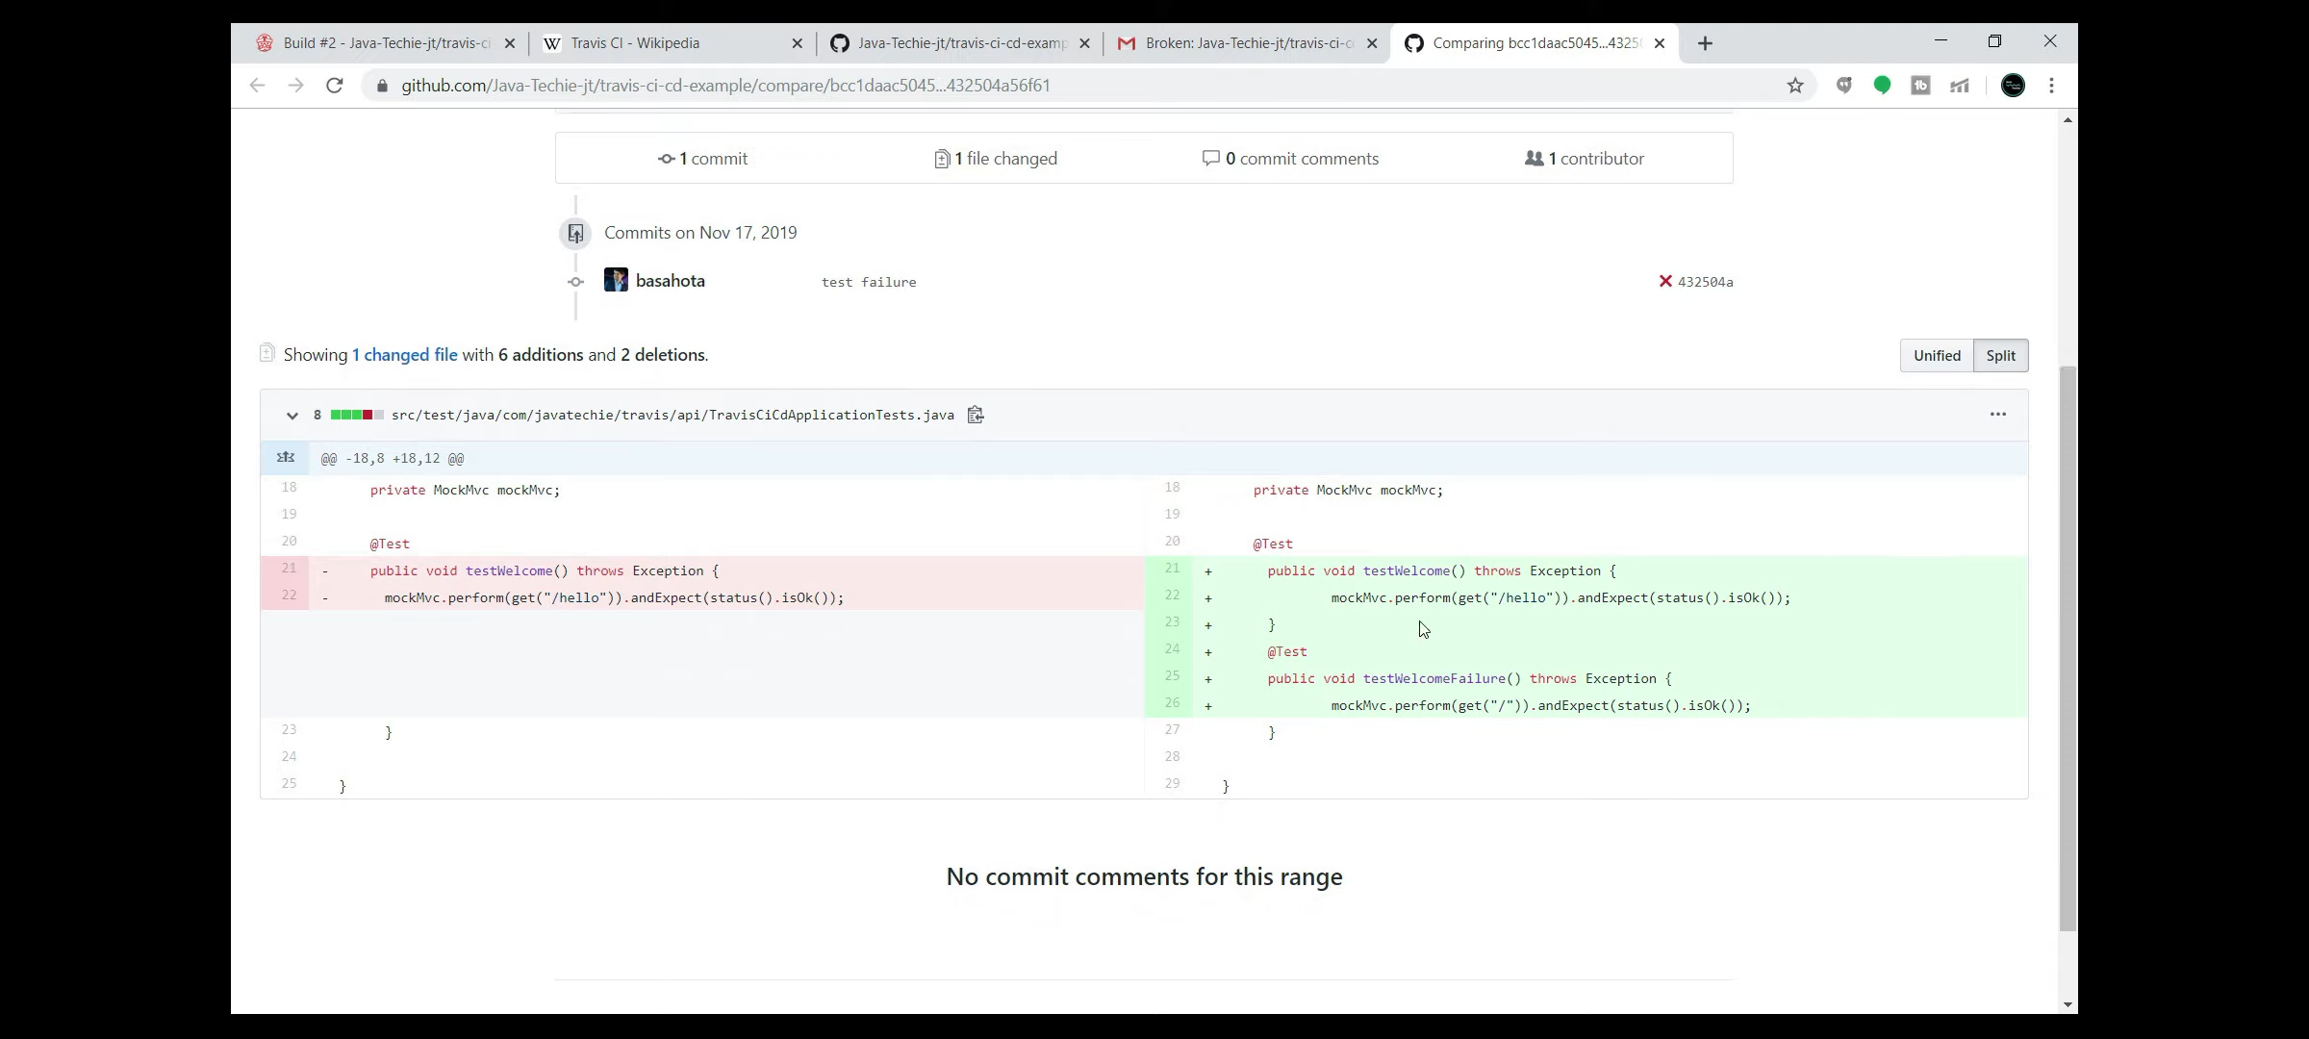

Slide 14
Travis CI vs Jenkins
Travis CI provides simplicity and ease of use, particularly with GitHub integration.
Jenkins offers extensive flexibility and customization options for complex scenarios.
Travis CI is a hosted solution, while Jenkins requires self-hosting.
Travis CI has a free tier, while Jenkins is entirely open-source.

