Slide 1
Reading a motor's current to catch failure
Real-time stall detection — live, and on the chip
Toyota Innovation Challenge · Fault Prediction
Notes:
Unexpected machine downtime costs manufacturers millions a year. The earliest warning a motor gives before it fails is its own current — so we built a system that reads that current in real time and catches a stall the instant it happens.

Slide 2
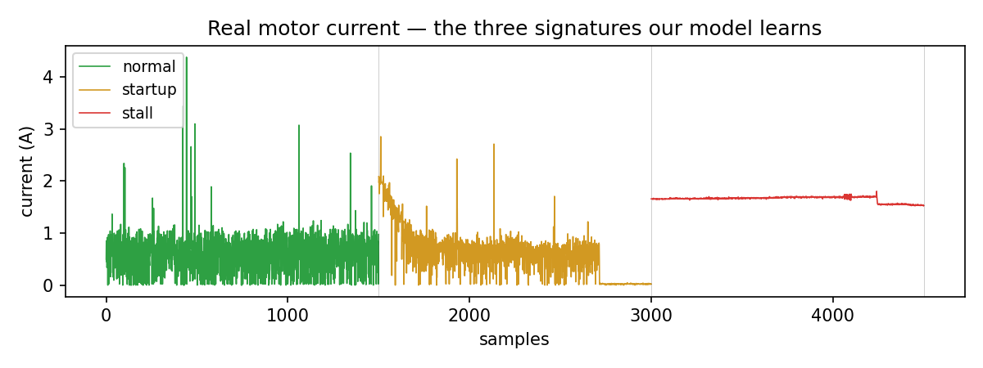
The trap: a stall looks like a start-up
• Unplanned downtime costs manufacturers millions / year.
• A motor's earliest warning is its own current.
• A stall spikes the current — but so does every start-up (inrush).
• The signal isn't *high* current. It's high current that *stays* high.
• Stall = sustained. Start-up = decays. Telling them apart is the whole game.
Notes:
Here's what makes this hard. When a motor stalls, current spikes — but current also spikes every time the motor starts, the inrush. A naive 'current too high' alarm cries wolf on every power-on. The real signal isn't high current — it's high current that STAYS high. A stall is sustained; a start-up just decays. Telling those apart is the heart of our project.

Slide 3
Current → 6 features → an interpretable tree
• Slice the current into short windows; extract 6 features — level, spread, slope, trend.
• Feed a small decision tree — chosen on purpose: interpretable, and tiny enough to run on a chip.
• A debounced state machine turns it into green / orange / red.
The rule it LEARNED (not hand-written):
mean high & steady (low spread) → STALL
mean high & spiky / decaying → start-up (no alarm)
Notes:
Under the hood: six windowed features — level, slope, and whether the current is still rising or holding. We feed a decision tree, on purpose: it's interpretable — here are the exact rules it learned — and it's tiny. The algorithm itself discovered that steadiness (low spread) is what separates a real stall from a start-up inrush.

Slide 4
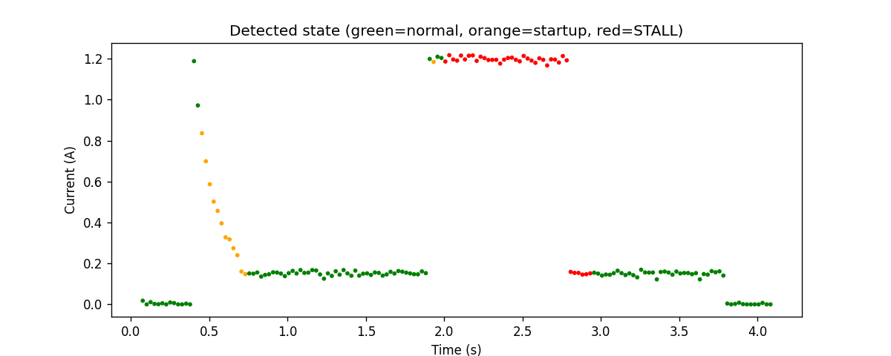
Live demo
running
→ GREEN
power-cycle a few times
→ stays green — no false alarm on inrush
hold the shaft (stall)
→ RED in ~0.1 s
Notes:
Let me show you. Running — green. Watch when I power-cycle it — current spikes, but it stays GREEN, no false alarm. Now I actually stall it — RED, in under a tenth of a second. Release — back to green. Start-up ignored, real stall caught instantly.

Slide 5
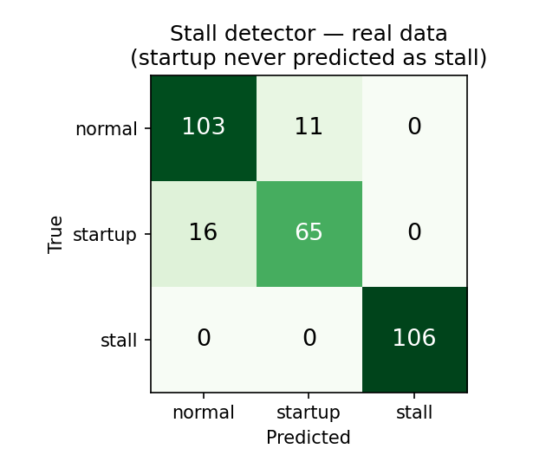
It works — and never cries wolf
• Stall: 100% separated — never missed, never falsely raised.
• Start-up is NEVER predicted as a stall (the red-alarm property).
• 18 automated tests; a physics simulator verified the pipeline before any hardware.
• The tree is readable — we can show a judge exactly why it fired.
Notes:
On our collected data the detector cleanly separates the three states. Stall is perfectly classified, and crucially a start-up is never predicted as a stall — that's the property that matters. 18 automated tests, simulator-verified before we touched hardware.

Slide 6
No laptop: the tree runs on the chip
• We compiled the same decision tree into C and flashed it onto the Arduino itself.
• The board runs inference on-chip and lights an LED on a stall.
• Pull the laptop — power it from a charger — and it still works. No PC, no cloud.
• Detection at the edge, on a microcontroller — exactly where a factory sensor lives.
Notes:
And it doesn't need a laptop. We compiled that same tree into C and flashed it onto the Arduino. The board runs inference on-chip and lights this LED on a stall. Pull the laptop and it still fires — detection at the edge, on a microcontroller.

Slide 7
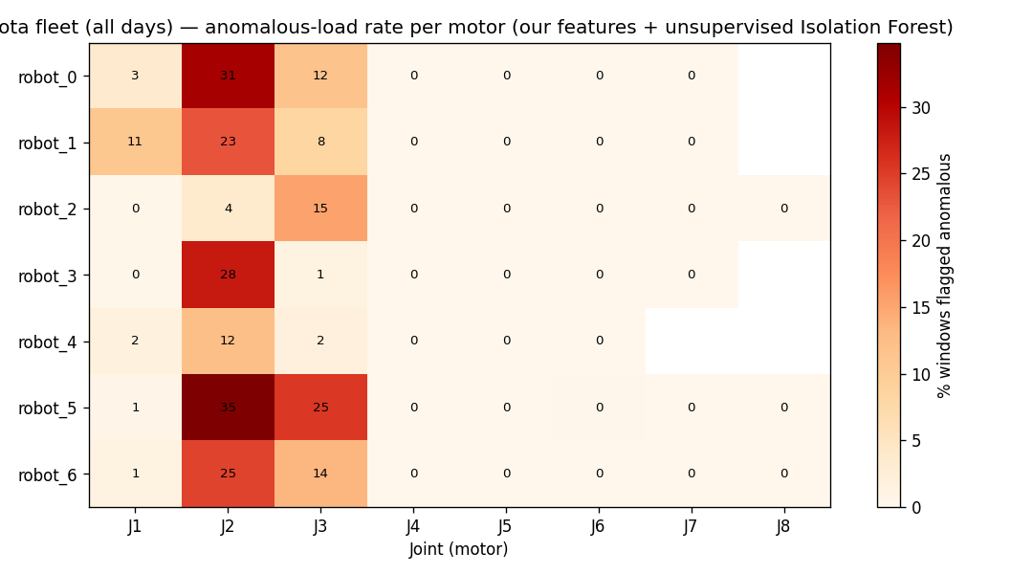
The method scales to the factory floor
• The exact same feature code runs unchanged on Toyota's real 8-DOF arm telemetry — fleet-wide.
• An unsupervised pass flags the most mechanically-stressed joints (the shoulder/elbow) — physically right.
• With labeled fault data, the same approach becomes production predictive maintenance.
(Real faults aren't labeled in this data — this shows the method transfers, not arm fault detection.)
Notes:
And the method isn't locked to our bench — the same feature code runs unchanged on Toyota's real 8-DOF arm telemetry, across the whole fleet, and surfaces the most stressed joints. With labeled fault data it scales to production predictive maintenance. (Be honest: this shows the method transfers — we are NOT claiming we detected stalls on the arm; that data is unlabeled.)

Slide 8
Catches failures before they cascade
• Safety: an early stall alarm prevents motor burnout and equipment damage.
• Human-centered: less unplanned downtime, fewer line stops, workers kept out of harm's way.
• Built and verified safely on a low-voltage, current-limited bench.
From a $3 motor to a robot fleet — same physics, same code.
We turn a motor's current into an early-warning system. Thank you.
Notes:
It's human-centered: it catches failures before they cascade — protecting equipment, preventing unplanned line stops, keeping workers out of harm's way. From a 3-dollar motor to a robot fleet — same physics, same code. We turn a motor's current into an early-warning system. Thank you.

