Slide 1
Reading a motor's current to catch failure
Real-time stall detection — live, and on the chip
Toyota Innovation Challenge · Fault Prediction
Notes:
Unexpected machine downtime costs manufacturers millions a year. The earliest warning a motor gives before it fails is its own current — so we read that current in real time and catch a stall the instant it happens.

Slide 2
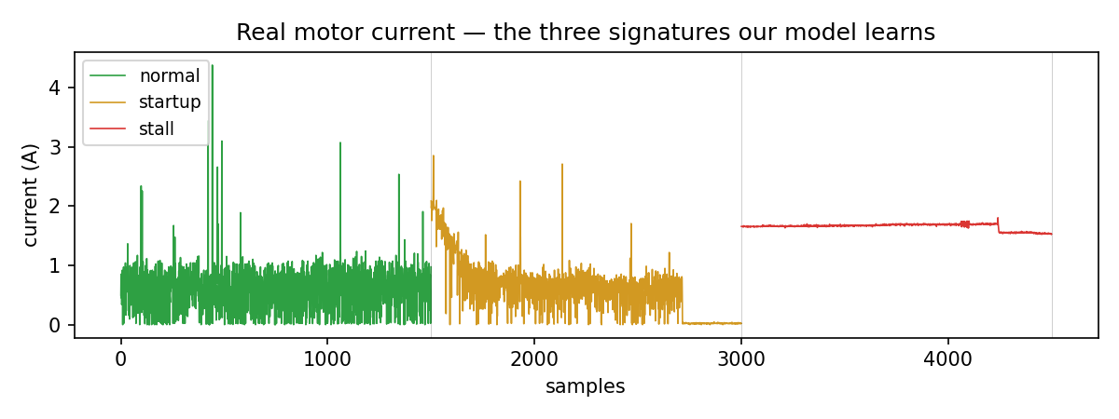
The trap: a stall looks like a start-up
Unplanned downtime costs manufacturers millions / year.
A motor's earliest warning is its own current.
A stall spikes the current — but so does every start-up (inrush).
The signal isn't high current. It's high current that STAYS high.
Stall = sustained. Start-up = decays. Telling them apart is the whole game.
Notes:
When a motor stalls, current spikes — but it also spikes on every start-up, the inrush. A naive 'too-high' alarm cries wolf on every power-on. The real signal is high current that STAYS high. A stall is sustained; a start-up decays. Telling them apart is the heart of the project.

Slide 3
Current → 6 features → an interpretable tree
Slice the current into short windows; extract 6 features — level, spread, slope, trend.
Feed a small decision tree — interpretable, and tiny enough to run on a chip.
A debounced state machine turns it into green / orange / red.
The rule it LEARNED (not hand-written):
mean high & steady (low spread) → STALL
mean high & spiky / decaying → start-up (no alarm)
Notes:
Six windowed features — level, slope, and whether the current is still rising or holding — into a decision tree. We chose a tree: interpretable, and tiny enough to run on a chip. The algorithm itself found that steadiness separates a real stall from a start-up.

Slide 4
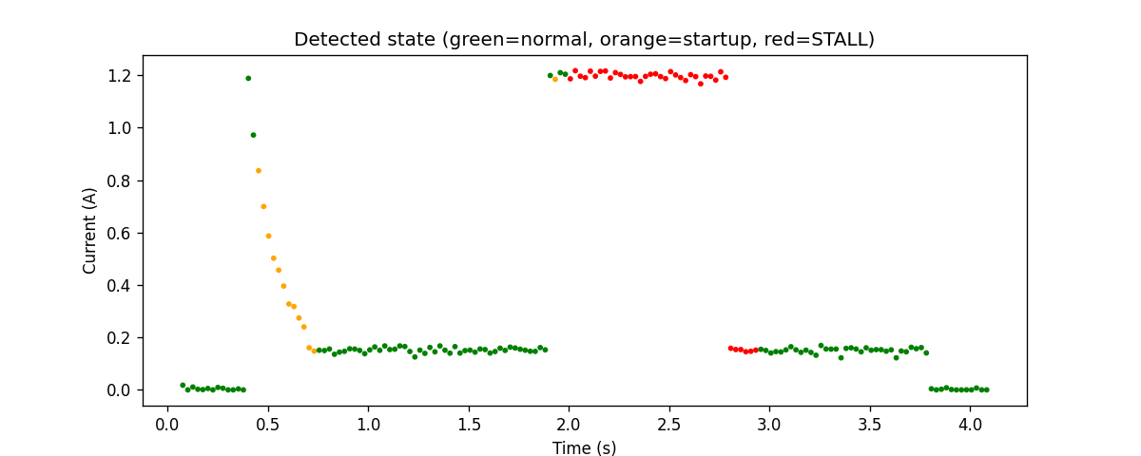
Live demo
Running → GREEN.
Power-cycle a few times → stays green (no false alarm on inrush).
Hold the shaft (stall) → RED in ~0.1 s.
Release → back to green.
Notes:
Running — green. Power-cycle it — current spikes but it stays green, no false alarm. Stall it — RED in under a tenth of a second. Release — back to green. Start-up ignored, real stall caught instantly.

Slide 5
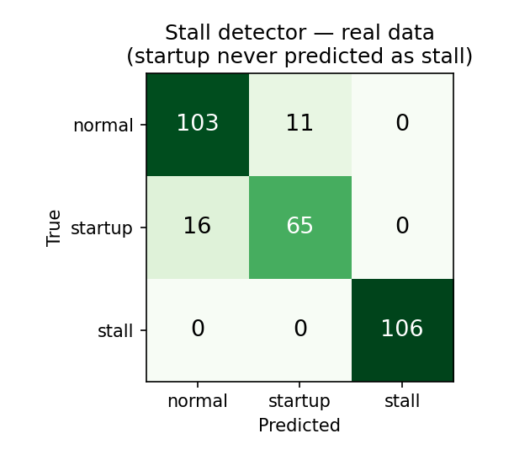
It works — and never cries wolf
Stall: 100% separated — never missed, never falsely raised.
Start-up is NEVER predicted as a stall (the red-alarm property).
18 automated tests; a physics simulator verified it before any hardware.
The tree is readable — we can show a judge exactly why it fired.
Notes:
It cleanly separates the three states. Stall is perfect, and a start-up is never predicted as a stall — the property that matters. 18 automated tests, simulator-verified before hardware.

Slide 6
No laptop: the tree runs on the chip
We compiled the same decision tree into C and flashed it onto the Arduino itself.
The board runs inference on-chip and lights an LED on a stall.
Pull the laptop — power it from a charger — and it still works. No PC, no cloud.
Detection at the edge, on a microcontroller — where a factory sensor lives.
Notes:
It doesn't need a laptop. We compiled the same tree into C and flashed it onto the Arduino; it runs inference on-chip and lights an LED on a stall. Pull the laptop and it still fires — at the edge.

Slide 7
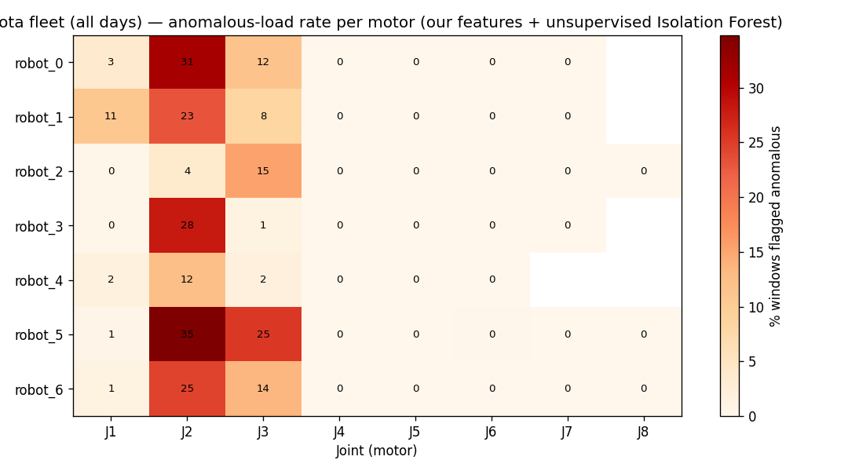
The method scales to the factory floor
The exact same feature code runs unchanged on Toyota's real 8-DOF arm telemetry — fleet-wide.
An unsupervised pass flags the most mechanically-stressed joints (shoulder/elbow) — physically right.
With labeled fault data, the same approach becomes production predictive maintenance.
Real faults aren't labeled here — this shows the method transfers, not arm fault detection.
Notes:
The same feature code runs unchanged on Toyota's real 8-DOF arm telemetry, fleet-wide, and surfaces the most stressed joints. With labeled fault data it scales to production predictive maintenance. (Honest: this shows the method transfers — not that we detected stalls on the arm; that data is unlabeled.)

Slide 8
From a $3 motor to a robot fleet — same physics, same code. We turn a motor's current into an early-warning system. Thank you.
Notes:
It's human-centered: catches failures before they cascade — protecting equipment, preventing line stops, keeping workers safe. From a $3 motor to a robot fleet — same physics, same code. Thank you.

