Slide 1
Brain Age in Epilepsy
Kevin Mathew

Slide 2
Motivating Research

Slide 3
Brain Age Definition
The predicted age of an individual derived using high- dimensional neuroimaging data in a machine learning framework.
Brain age potentially represents a biomarker of the underlying ‘age’ of the brain, whereby an ‘older’ brain in adults indicates increased risks of neurodegenerative diseases and mortality.

Slide 4
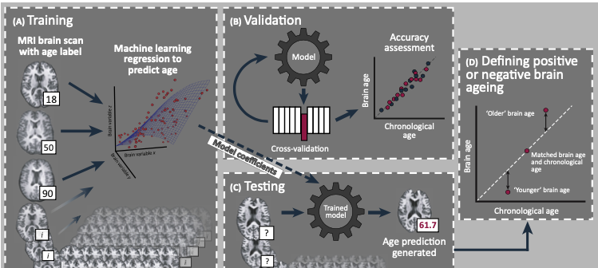
Predicting Age Using Neuroimaging – James H. Cole et al.

Slide 5
Supervised Machine Learning Method
Neuroimaging data, usually T1-weighted structural MRI scans, from healthy individuals (training set) are labelled with the participants’ chronological age and put into a machine learning regression model.
To validate the accuracy of the model, a proportion of the participants’ images are left out of the model.
Assuming that the model is sufficiently accurate, the model is trained using the entire training set and the resulting model coefficients are applied to new participants’ brain scans (test set) to generate unbiased individual brain age predictions
The predicted brain age can then be compared with the chronological age of test-set participants

Slide 6
Model Validation

Slide 7
Validation on Healthy Population
Average error of 3.6 years

Slide 8
Brain Age and Epilepsy

Slide 9
Brain Age Differences in Epilepsy Population
Aimed to assess whether brain age was different between healthy population and epilepsy surgical population
Explore the relationship between brain age, epilepsy subtype, and surgical outcome

Slide 10
Control Population Brain Age
Average actual age of 30.3 years
Average predicted age of 31.8 years
Average brain age difference of 1.54 years

Slide 11
Epilepsy Population Brain Age
Average actual age of 39.1 years
Average predicted age of 42.9 years
Average brain age difference of 3.78 years

Slide 12
Observations
Brain Age Difference between two populations was not statistically significant
Younger subjects tended to be overpredicted while older patients tended to be underpredicted

Slide 13
Regression to the Mean
Common statistical issue that if a sample point of a random variable is extreme, a future point will be closer to the mean or average on further measurements
Discussed techniques to fix for this issue but there are many statistical pitfalls to such analysis (Butler et. al 2020)

Slide 14
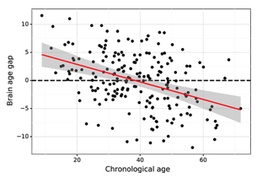
Correcting for Regression to the Mean
Liang et.al 2019
Butler et.al 2020

Slide 15
Conclusion
Boiling down features such as gray matter volume to a single value (brain age) is not a good way to characterize epilepsy as brain age varies due to many other reasons
Unlikely to yield predictive insights for so many varied applications/different domains (epilepsy outcome, Alzheimer’s)

Slide 16
Research Shift
Morphometric Features
Brain Age
Outcome
A)
Morphometric Features
Outcome
B)

Slide 17
Future Direction
Currently working on extracting and examining cortical thickness values across epilepsy patients with varying degree of surgical outcome
Aim to use cortical thickness as an estimator for whether a patient is a good surgical candidate

Slide 18
Thank You!

