Slide 1
Managing Flash In OpenSDS For Cloud Native Frameworks
STEVEN TAN, OpenSDS TSC Chair, VP & CTO Cloud Storage Solution - Huawei @stevenphtan
ANJANEYA ‘REDDY’ CHAGAM, OpenSDS TSC, Chief SDS Architect – Intel

Slide 2

Overview
Control/ Management Plane
Standard REST API, Single Pane Management, Policy- Based, Storage and Data Services, Orchestration and Automation
Open SDS Platform
Data Plane
Data Reliability, High Availability, Data Protection, Data Mobility, Data Reduction, I/O Performance
Storage/Service Layer
DAS (HDD/Flash), SAN, NAS, AFA, Commodity, Private Cloud, Public Cloud
Decoupled control plane from data plane and storage/service layer

Slide 3














The Projects
CLOUD
ENTERPRISE
SUSHI
The Northbound Plug-ins Project
Common plug-ins to enable OpenSDS storage services for cloud and application frameworks
Plug-in
Plug-in
Plug-in
Plug-in
Plug-in
Plug-in
Plug-in
Plug-in
OpenSDS Hotpot
Discover, Pool, Provision, Orchestrate
HOTPOT
The Storage Controller Project
Single control for block, file, and object services across storage on premise and in clouds
CONTROLLER- SERVICE API Block File Object
DOCK – STORAGE DRIVERS
 | Native | Cinder | Manila | Swordfish | Multi- Cloud
Direct Attached Software- Storage Defined Storage
Enterprise Storage
Cloud Storage

Slide 4


The
OpenSDS Kubernetes Architecture
Kubernetes Master Server
Create PVC (Storage Class = Faster)
Node
Node
Pod
Pod
OpenSDS CSI Plugin
OpenSDS Hotpot
OpenSDS CSI Plugin
Pod
Pod
OpenSDS Dock
Controller
OpenSDS Dock
Vol
Driver
Driver
Vol
Storage
Storage
Storage
Storage
Storage
Storage
Storage Profile Fast
Storage Profile Faster
Storage Profile Object

Slide 5
The
OpenSDS Kubernetes Flash Solution
Kubernetes Master Server
Node
Node
Pod
Pod
OpenSDS CSI Plugin
OpenSDS Hotpot
OpenSDS CSI Plugin
Pod
Pod
OpenSDS Dock
Controller
OpenSDS Dock
Vol1
Driver Driver
Driver Driver
Vol1
Cache
Cache
NVMe
Storage Profile::Flash
NVMe
Storage Profile::Capacity
Storage

Slide 6
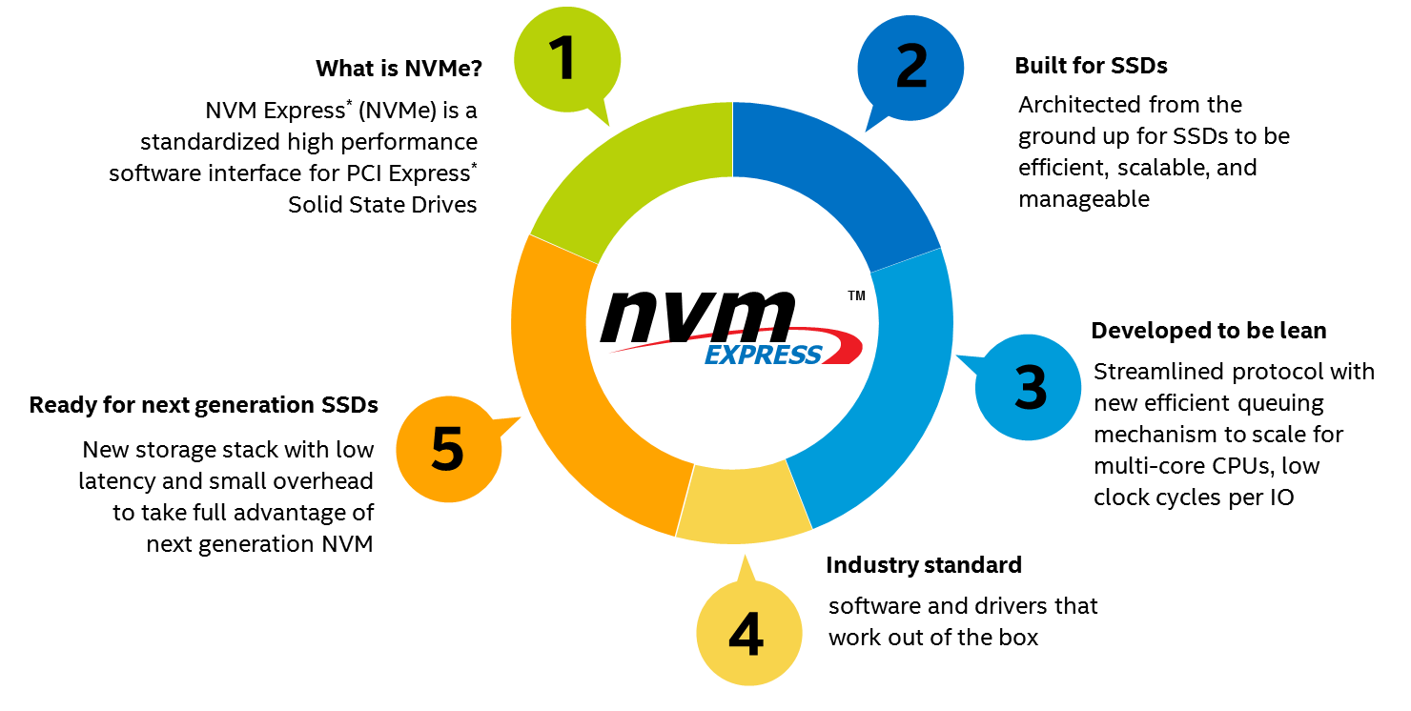
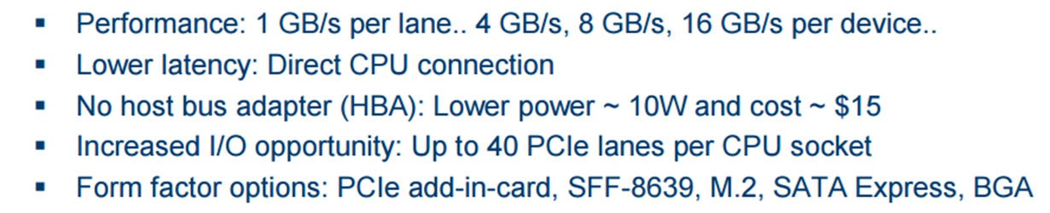
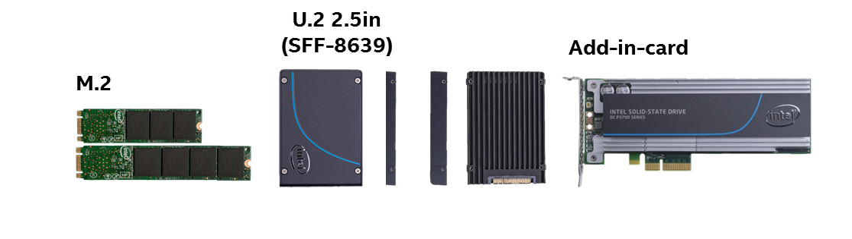
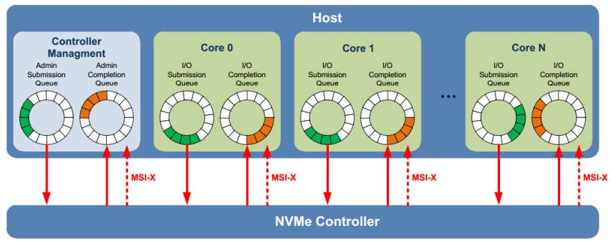
NVM Express (NVMe)
Standardized interface for non-volatile memory, http://nvmexpress.org
Source: Intel. Other names and brands are property of their respective owners. Technology claims are based on comparisons of latency, density and write cycling metrics amongst memory technologies recorded on published specifications of in-market memory products against internal Intel specifications.
6

Slide 7
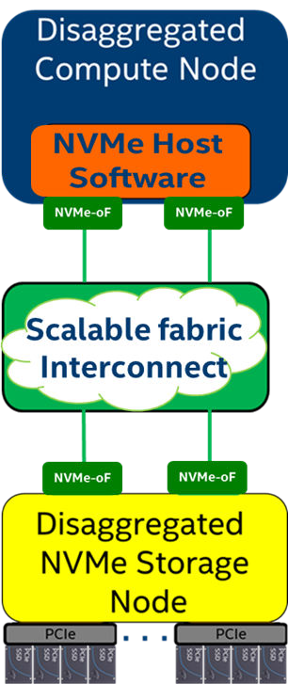
Remote Access To Storage – iSCSI and NVMe-oF
Disaggregated Cloud Deployment Model
Network
NVMe-over-Fabrics
– NVMe commands over storage networking fabric
iSCSI
Target
NVMe-oF* Target
NVMe-oF supports various fabric transports
SCSI
NVMe
RDMA (RoCE, iWARP)
InfiniBand™
Fibre Channel
Intel® Omni-Path Architecture
Future Fabrics
Block Device Abstraction (BDEV)
SCSI
Devices
NVMe
Devices

Slide 8
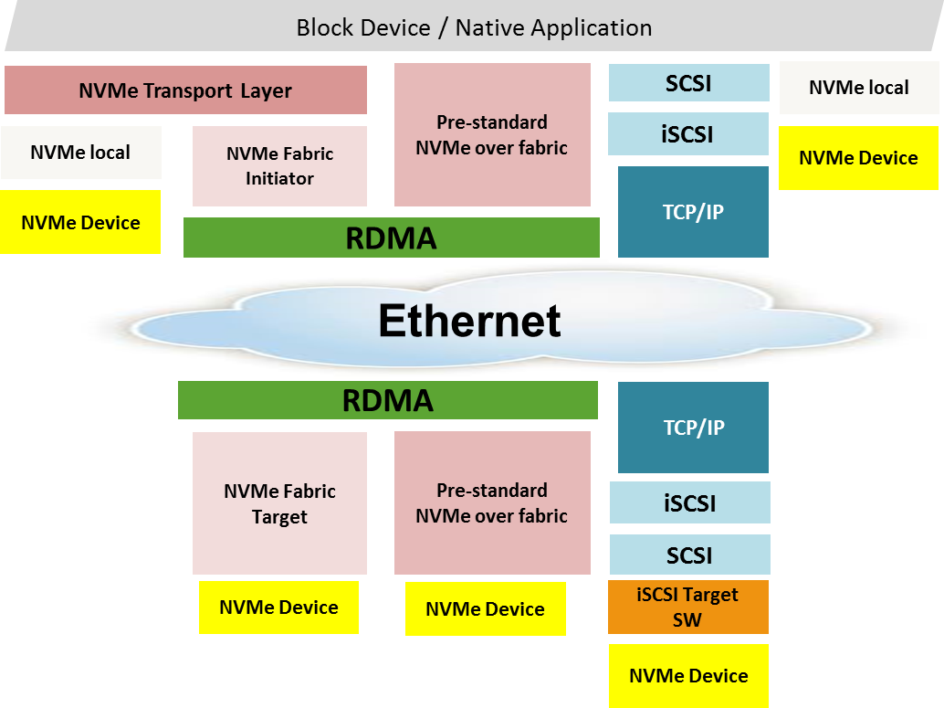

NVMe-oF: Local NVMe Performance
The idea is to extend the efficiency of the local NVMe interface over a network fabric
  Ethernet or IB
  NVMe commands and data structures are transferred end to end
Relies on RDMA for performance
  Bypassing TCP/IP
For more Information on NVMe over Fabrics (NVMe-oF) http://www.nvmexpress.org/wp-content/
uploads/NVMe_Over_Fabrics.pdf

Slide 9
NVMe-oF: Kernel Initiator
Uses nvme-cli package implement the kernel initiator side
Connect to remote target
nvme connect –t rdma –n <conn_nqn> –a <target_ip> –s <target_port>
nvme list - to get all the nvme devices

Slide 10

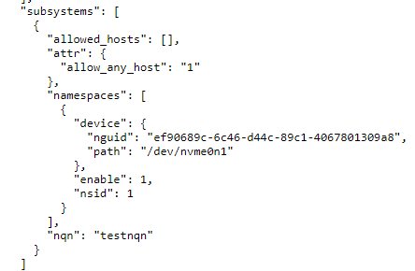
NVMe-oF: Kernel Target
Uses nvmetcli package implement the kernel target side
nvme save <file_name>– to create new subsystem
nvme restore – to load existing subsystems
10

Slide 11
















NVMe-oF in OpenSDS
Container
Work In Progress
Linux Kernel Driver
nvme commands for connect
Drive assignment
Specs include target info
Docker Runtime
K8s Dashboard (or) kubectl w/ SDS plug-in
Create SDS
7 Launch Docker Container
K8s Services (API, Master, Rep, Kubelet)
volume
Discover storage (REST API)
Create volume pool (REST API)
Create sds volume
OpenSDS (Discover, Pool)
OpenSDS (Provisioning)
₈ Mount volume on
2019 Plans
Pooling
Rack aware scheduling
User mode target (SPDK)
NVMe over TCP/IP
host, format
Discover NVMe-oF targets – ip sweep
Create volume
#nvme connect -t
<proto> -a <ip> -s
<port> -n <nqn>
#nvme discover -t <transport> -a <ip>
on backend
-s <port>
NVMe-oF Driver
9
NVMe submission, completion commands over Fabrics
Legend:
Control Plane
Data Plane

Slide 12
















OpenSDS Roadmap v0.17
2017H2
ZEALAND
2018H1
ARUBA
2018H2
BALI
2019H1
CAPRI*
2019H2++
Optimization
Tiering
Security
Sharing
Networking
SCM
Kubernetes FlexVolume
Vol CRUD
Standalone Cinder Integration
CSI Support
Ceph, LVM
OpenStack
Replication
Array-Based,
Host-Based
Dashboard
Storage Profiles
Enumeration
Block Storage
  Cinder Drivers
  Ceph
  LVM
  Huawei: Dorado
S3 Object
Multi-Cloud Data Control
Multi-OpenStack
Monitoring
Storage Groups
Snapshots, Replication
Southbound Swordfish*
NVMeoF Preview
File Share
Analytics
Lifecycle
Migration
Data Protection
NVMeoF
12

Slide 13





THANK YOU
FIND OUT MORE
OpenSDS @ SNIA SDC
Santa Clara, Sep 24-27
https://www.opensds.io https://github.com/opensds info@opensds.io
@opensds_io
BE A MEMBER
Accepting New Members
Vendors And End Users Welcome

