Slide 1
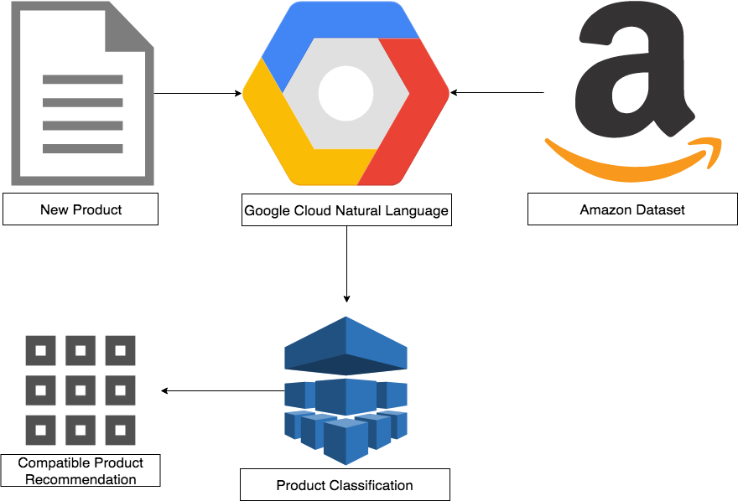

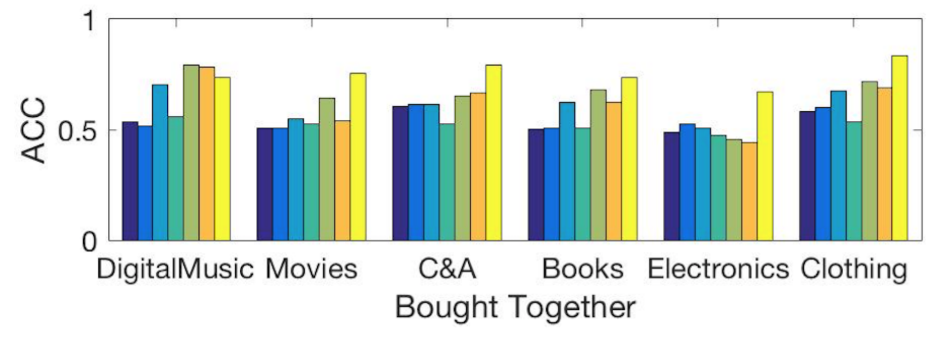
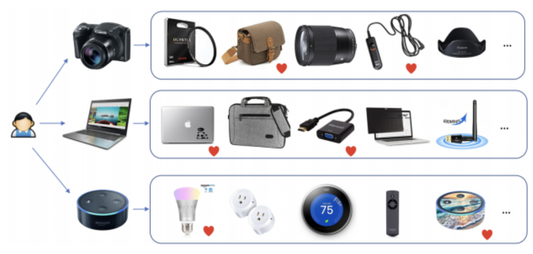
Compatible Item Recommendation
Kevin J Nguyen, Victoria Wei, James Caverlee, Yin Zhang
Computer Science and Engineering, Texas A&M University
Motivation
Challenges
There are billions of products on Amazon, eBay, and other retailers
How do customers quickly and efficiently find personalized products of interest?
Traditional methods make one of several critical assumptions:
Manual labeling of compatible products, especially brand-new products
Co-purchased/similar products are compatible
In contrast, we will investigate the actual relationships between products in a large product dataset by creating our own definition of compatibility to propose a new and hopefully-improved recommender system
We provide the first study of utilizing machine learning and compatibility of recommender systems in this manner
Definition of Compatibility – Constructing a completely brand-new definition of compatibility based on categories and text recognition
Utilizing Google Cloud Natural Language platform
Creating own model with compatibility-based relationship mappings
Cold Start Problem – Because traditional recommender systems recommend compatible items based on co-purchasing, it is harder for new products to be recommended to the active user in this way
Solution: Our definition of compatibility will eliminate the cold start problem when recommending compatible products
Overall Approach
Preliminary Results
ENCORE Model
Utilizes image-based, text input, and user rating relationships to recommend compatible products
(1)
Distance between product images, text input, and user ratings based on compatibility relationships
– Low-rank Mahalanobis transformation matrix
(2)
Sigmoid function – probability that relationships exist among two products
(3)
Embedded features concatenated amongst learned spaces to produce a multi-model space
Amazon Dataset – Product information of around 500,000 electronic products including title, description, category, co-purchased products, and other metadata
Google Natural Language – Machine learning framework designed for natural language processing to classify products based on entity – consumer good
Product Classification – Store and analyze product relations from GNL in association with product categories to create a new model for compatibility
New Product – A new product that requires recommendations would be passed through GNL and our product classification model
Compatible Product Recommendation – Result set of compatible products based on the classification and compatibility of this new product
Next Steps
References
Using our compatibility definition, we will run a fraction of the Amazon dataset through our recommendation system and record results
Compare and contrast results from preliminary results
Currently, we are looking at only electronic data. We are hoping to also look into other categories:
Clothing
Movies
Books
[1] R. P. J. J. McAuley and J. Leskovec, “Inferring networks of substitutable and complementary products,” KDD, 2015.
[2] Q. S. J. J. McAuley, C. Targett and A. van den Hengel, “Image-based recommendations on styles and substitutes,” SIGIR, 2015.
[3] A. K. Menon and C. Elkan, “Link prediction via matrix factorization,” ECML, 2011.
[4] B. S. G. Linden and J. York, “Amazon.com recommendations:Item-to-item collaborative filtering,” IEEE Internet Computing, 2003.
Notes:
archi - Page 1.png

