Slide 1
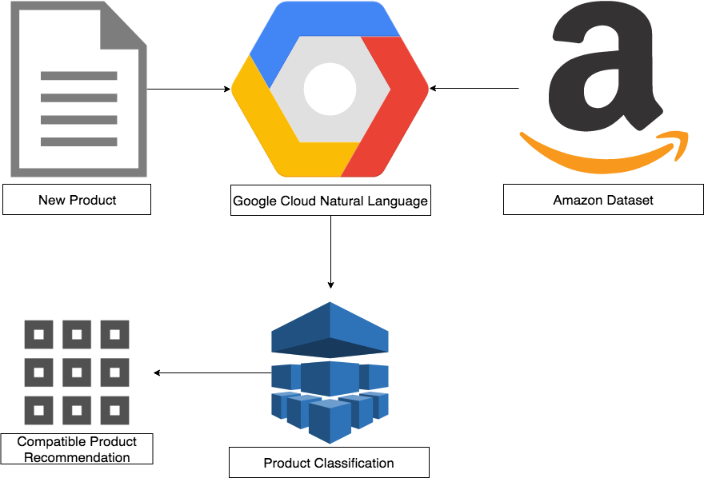
Compatibility for Electronic Recommender Systems
Kevin J Nguyen, Victoria Wei, James Caverlee
Computer Science and Engineering, Texas A&M University
Motivation
Challenges
We quantify compatibility as the measure of systematic similarity and differences between products.
Traditional methods make one of several critical assumptions:
Manual labeling of compatible products
Co-purchased products are compatible
In contrast, we investigate the relationship between large product datasets of electronic products to propose a recommender system focused on compatibility.
We provide the first study of utilizing machine learning and compatibility in electronic recommender systems.
.
Overall Approach
Preliminary Results
- Reason why
Problem
Accomplish
Amazon Dataset – Product information including title, description, category, co-purchased products, and other metadata.
Google Natural Language – Machine learning framework designed for natural language processing to classify products based on entity and consumer good.
Product Classification – Store and analyze product relations from GNL in association with product categories to create a new model for compatibility.
New Product – A new product that would require recommendations would be passed through GNL and our product classification model.
Compatible Product Recommendation – Result set of compatible products based on the classification and compatibility.
Next Steps
References
B. S. G. Linden and J. York, “Amazon.com recommendations:Item-to-item collaborative filtering,” IEEE Internet Computing, 2003.
R. P. J. J. McAuley and J. Leskovec, “Inferring networks of substitutable and complementary products,” KDD, 2015.
Q. S. J. J. McAuley, C. Targett and A. van den Hengel, “Image-based recommendations on styles and substitutes,” SIGIR, 2015.
A. K. Menon and C. Elkan, “Link prediction via matrix factorization,” ECML, 2011.
Notes:
archi - Page 1.png

