Slide 1

By Kevin Jordan
DevOps Architect & Consultant

Slide 2
The Opportunity
Client XYZ wants to modernize their product suite & architecture. They have an interest in containerization.
Development
Operations
Wants to increase environment creation speed
Improve environment consistency
Reduce lead & cycle times
Reduce downtime
Improve code quality into production

Slide 3
Technical

Slide 4
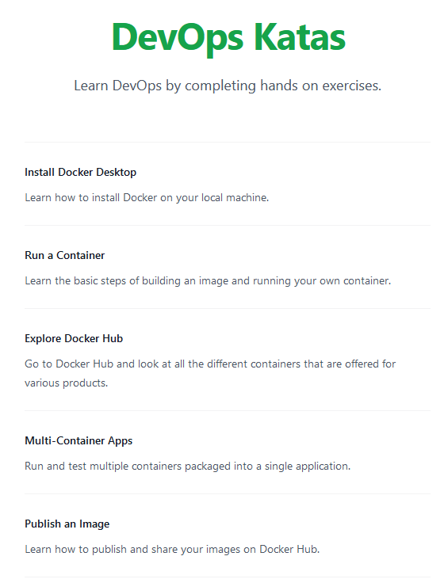
The PoC
DevOps Katas provides practitioners a way to hone their craft through different learning exercises.
The site also serves as a proof of concept for modern application architecture. It includes a front-end built with Tailwind CSS and Alpine.js. It talks to a REST-based backend written in C#. The site is deployed on Docker containers in Azure.
Links: GitHub Project / Prod API / Prod Web Site

Slide 5
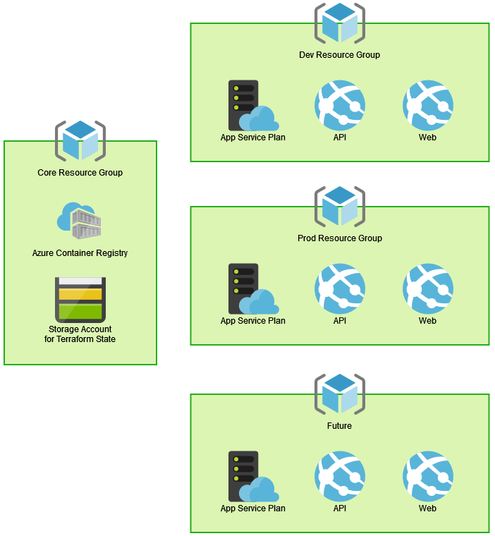
Azure Infrastructure
For simplicity, the Core Resource Group was manually configured. It contains resources that will be used by all environments.
Each environment resource group is deployed dynamically from a reusable Terraform module via GitHub Actions.
Links: Terraform Provider Code (GitHub)
Terraform Workflow (GitHub)

Slide 6

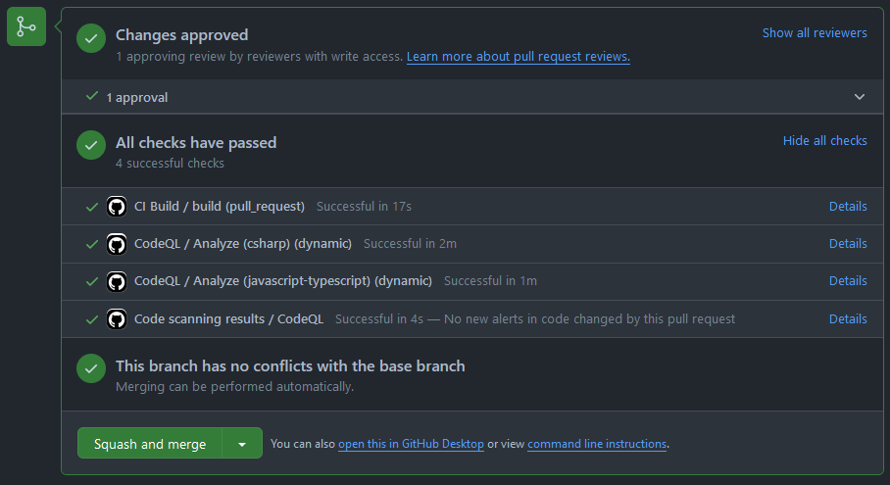
Continuous Integration
Branch Protection Rules are configured to require code review.
PR Builds ensure successful compilation and passed unit tests
Security is ensured w/ CodeQL, Dependabot, and Secret Scanning

Slide 7
Continuous Delivery
Build Once. Deploy Many.
Ensure they passing of all unit tests, SAST, and SCA.
Deploy previously published container images to dev environment.
Deploy verified container images to production environment.
Build Code
Automated Testing
ACR Publish
Dev Deploy
Prod Approval
Prod Deploy
Checkout and compile the application code
Generate container images and publish to Azure Container Regristry
Send notifications and await approval in order to deploy to production.

Slide 8
Challenges
Improvements
Limited experience with containerization.
Passing Azure Provider parameters to Terraform init for multiple state files.
Statefulness of databases is always a challenge.
Publish profile must be manually entered into GitHub secrets.
Intentionally chose GitHub Actions over Azure DevOps Pipelines.
Create re-usable workflows for deployment steps.
Better fault tolerance (availability zone or multi-region if necessary, load balancing).
Auto-scaling if necessary.
Logging improvements (APM and Log Analytics).
Security improvements (network segmentation / private link, Azure policy, WAF).
&

Slide 9
Strategy

Slide 10

Pillars of DevSecOps
Culture
Lean Product
Architecture
Technology
“DevOps is a journey full of challenges, and rarely are those challenges simply because of the wrong technology or the wrong processes. In fact, the biggest and most difficult obstacles tend to be cultural. “
- Gene Kim
“Product-mode allows teams to reorient quickly, reduces their end-to-end cycle time, and allows validation of actual benefits by using short-cycle iterations while maintaining the architectural integrity of their software to preserve their long-term effectiveness.”
- Martin Fowler
“Architecture is an important predictor for achieving continuous delivery. Your architecture enables teams to adopt practices that foster higher levels of software delivery performance.”
- DevOps Research
& Assessment (DORA)
“Platforms are a foundation of self-service APIs, tools, services, knowledge and support, which are arranged as a compelling internal product. Autonomous delivery teams can make use of the platform to deliver product features at a higher pace, with reduced coordination.”
- Evan Bottcher

Slide 11


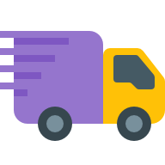




DevOps Capabilities & Practices
Continuous Planning
Continuous Integration
Continuous Delivery
Continuous Operations
Objectives and key results (OKRs)
Agile development
Design thinking
Lean product management
Architecture design
Threat modeling
Sprint & release planning
Prioritization and estimation
Source control
Trunk-based development
Code review and pull requests
Build automation
Unit testing / code coverage
Static code analysis
Everything as code
Predictable releases
Configuration management
Database change management
Blue / green
Feature flags
Canary deployments
Site reliability engineering (SRE)
Telemetry / monitoring
Application performance monitoring (APM)
Auto scaling
High availability and resiliency
Incident and escalation management
AI Ops
Continuous Quality
Unit testing
Integration testing
Regression testing
Load and performance testing
User acceptance testing
Synthetic transaction monitoring
Test data management
Chaos engineering
Continuous Security
Static Application Security Testing (SAST)
Software Compositional Analysis (SCA)
Dynamic Application Security Testing (DAST)
Interactive Application Security Testing (IAST)
Web Application Firewalls (WAF)
Governance and Compliance
Continuous Improvement
Value stream mapping
Change lead time
Deployment frequency
Mean time to restore
Change fail percentage
Continuous feedback

Slide 12
Engagement Kick-Off
Discovery Workshop
Understand customers’ vision, ambition, mission, as well as the current challenges and ongoing initiatives in their DevOps Transformation
DevOps Sprint Zero
Sprint 0 defines prioritized action items, OKRs, and reports for the DevOps transformation strategy and roadmap.
Targeted Training
An immersive class for teams designed to provide a deeper understanding of best practices, challenges, and labs.
Implementation
Build a strategy with customers on how to mature their DevOps capability and delivery of an MVP together with customers.

Slide 13
Scaling DevOps
Internal Developer Platform for speed, consistency, security, and compliance
Application Configuration Management
Manage application configuration in a dynamic, scalable and reliable way.
Engineered Governance
Infrastructure Orchestration
Orchestrate your infrastructure in a dynamic and intelligent way depending on the context.
Define mandatory functions such as security, risk, compliance, and repos in source control.
Create Centers of Excellence (CoE) to enable and support product teams.
Environment Management
Enable developers to create new and fully provisioned environments whenever needed.
Deployment Management
Implement a delivery pipeline for Continuous Delivery or even Continuous Deployment (CD).
Role-Based Access Control
Manage who can do what in a scalable way.

Slide 14
Thank you!

Slide 15
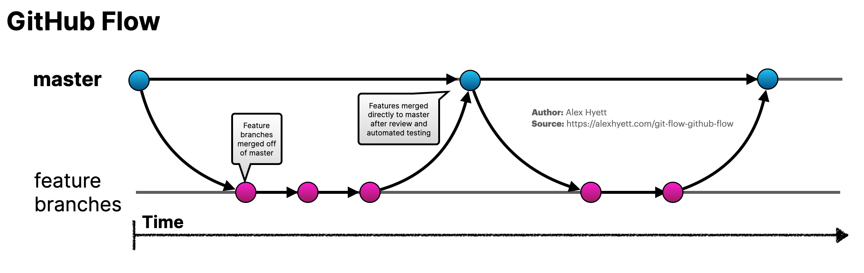
Branching Strategy
Perfection is achieved, not when there is nothing more to add, but when there is nothing left to take away.

Slide 16
Ideal Pipeline
Develop
Build
Deploy (Prod)
Use Built in IDE Tools
Compliance Gates
Change Management
Operate
Deploy (Non-Prod)
Unit Tests
SAST
Integration Tests
UI Tests
DAST Tests
Infrastructure as Code
SCA
Peer Code Review / Pull Requests
Check-in Early & Often
Auto Scaling
Feature Flags
Blue / Green or Rings
Demos & UAT
Runbook Automation
Metrics, Traces, Logs
Synthetics Transaction Monitoring
Business Metric Monitoring

Slide 17
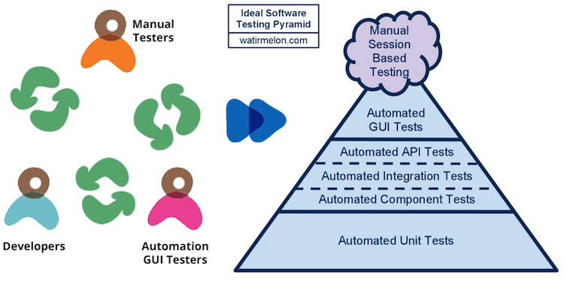
Testing Pyramid

Slide 18
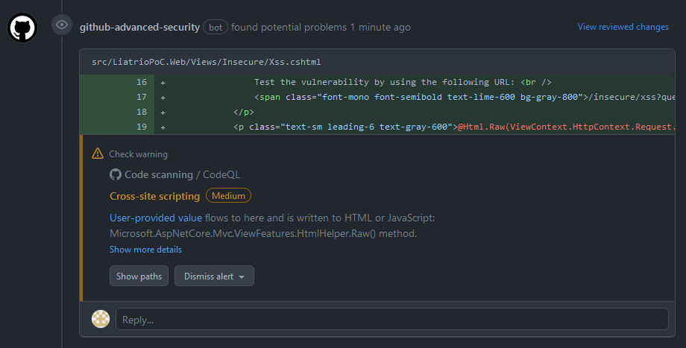
CodeQL Vulnerability (SAST)

Slide 19
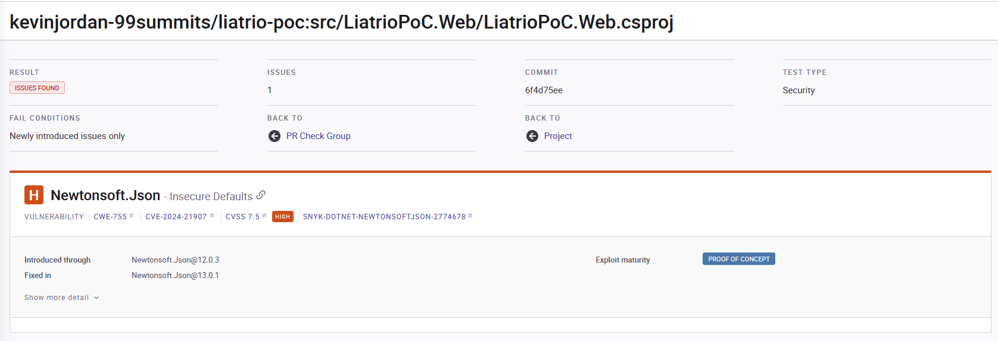
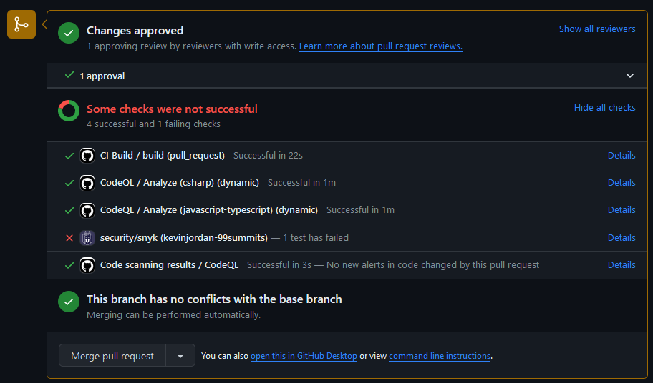
Snyk Vulnerability (SCA)

Slide 20
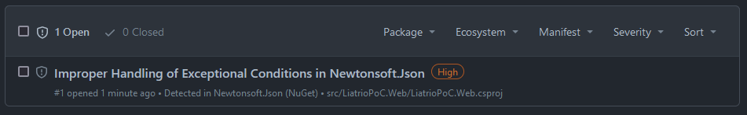
SCA Vulnerability

