Slide 1




EMBEDDED SYSTEMS PROJECT
SMART
REFRIGERATOR
HEALTH MONITORING & ENERGY OPTIMIZATION
An ESP32-based edge solution for thermal recovery analysis and trend-based predictive maintenance
REAL-TIME SENSING
LOCAL DASHBOARD
ON-DEVICE ANALYTICS
ALINA PALERI
25BCE0411
KEVIN JOSEPH
25BCE2971
SHASMEEN ALESHA
25BCE2928

Slide 2

PROBLEM STATEMENT
& MOTIVATION
WHY REFRIGERATOR MONITORING NEEDS MORE THAN A SINGLE TEMPERATURE DISPLAY
01 Temperature excursions
02 Limited visibility
03 Energy uncertainty
Door openings and changing conditions can raise compartment temperature and delay return to the target range.
Basic monitors often show current readings but little context about door behaviour or recovery over time.
Usage conditions affect energy demand; direct measurement requires extra power-monitoring hardware.
PROJECT PROBLEM
How can a low-cost embedded system combine temperature, humidity and door-state sensing with recovery analysis, local alerts and historical trends—without cloud dependence or compressor control?

Slide 3

OBJECTIVES
& SCOPE
DESIGNED AROUND LOW-COST HARDWARE AND SELF-CONTAINED EDGE PROCESSING
Monitor
Read temperature, humidity and door state.
Estimate
Model energy use; label it as an estimate.
Detect
Identify prolonged door-open conditions.
Present
Show status on OLED and local web dashboard.
Analyse
Track cooling-recovery duration.
Retain
Store day summaries across restarts.
Summarise
Calculate a transparent 0–100 health score.
Flag trends
Use recovery history for maintenance advisories.
Out of scope: food-freshness prediction, cloud dependence, direct compressor control and measured power consumption.

Slide 4

LITERATURE
SURVEY
PUBLISHED WORK SUPPORTS THE IMPORTANCE OF SENSING, DOOR EVENTS AND ENERGY BEHAVIOUR
STUDY
FOCUS
KEY TAKEAWAY
RELEVANCE
Masjuki et al. (2000)
Experimental energy factors
Temperature, loading and door use influence energy consumption.
Motivates combined monitoring.
Saidur et al. (2002)
Usage conditions and energy
Room temperature and door openings significantly affect energy use.
Context matters.
Harrington et al. (2019)
235 household refrigerators
Door openings correlate with user-related heat loads; impact varies by home.
Log door events.
Pratikto et al. (2023)
ESP32 temperature acquisition
Embedded sensing with online display is feasible.
Supports low-cost MCU.
IEEE (2025)
Integrated IoT + AI refrigerator
Combines temperature, humidity, door and power data with analytics.
Richer systems need more resources.
Summaries are paraphrased from available publisher/repository records; consult full papers before formal citation.

Slide 5

RESEARCH GAP
& PROPOSED CONTRIBUTION
A PRAGMATIC INTEGRATION TARGET—NOT A CLAIM THAT NO PRIOR SYSTEM EXISTS
Existing direction
Practical trade-off
Our focus
Prior systems demonstrate IoT sensing, online dashboards, power metering, cloud analytics or ML.
Feature-rich designs may require extra sensors, cloud infrastructure, power meters or external compute.
A low-cost ESP32 local system combining recovery, door behaviour, history and transparent scoring.
GAP ADDRESSED
Combine sensor readings and door events into a simple recovery-based health indicator.
Keep dashboard and analysis available on a local Wi-Fi access point without internet.
Make energy estimate and maintenance heuristic interpretable and explicit about limitations.

Slide 6


SYSTEM
ARCHITECTURE
SENSOR ACQUISITION → EDGE ANALYTICS → LOCAL PRESENTATION AND PERSISTENT HISTORY
LOCAL WEB
SoftAP + HTTP · Live cards / trends
SENSORS
ESP32 EDGE
ANALYTICS
DS18B20
DHT22
MC-38
Sampling
Validation / debounce
Event timing
Health score
Recovery analysis
Energy model
OLED + BUZZER
Local readings · Audible door alert
PERSISTENCE
Preferences / NVS · LittleFS history
Phone/laptop joins ESP32 SoftAP. No router or cloud is required.

Slide 7


HARDWARE COMPONENTS
& GPIO MAPPING
LOW-COST MODULES; NO MAINS SWITCHING OR EXTRA POWER SENSOR
COMPONENT
PURPOSE
CONNECTION
ESP32-WROOM-32
Controller, Wi-Fi SoftAP and web server
—
DS18B20 waterproof probe
Refrigerator temperature
GPIO 4 + 4.7 kΩ pull-up to 3V3
DHT22 / AM2302
Humidity and ambient temperature
GPIO 16
MC-38 magnetic switch
Door open / closed
GPIO 17, INPUT_PULLUP
0.96” SSD1306 OLED
Local status display
SDA 21, SCL 22, I²C
Active buzzer module
Audible alert
GPIO 25
Breadboard + jumpers
Prototyping / connections
Common GND
Safety: the prototype monitors the refrigerator only; it does not control the compressor or mains supply.

Slide 8


SOFTWARE
WORKFLOW
LOCAL ACQUISITION, VALIDATION, ANALYTICS, STORAGE AND SERVING
1
Acquire
2
Validate
3
Detect events
Read DS18B20/DHT22 at safe intervals; debounce door input.
Track valid/invalid readings; avoid stale data presented as live.
Door-open duration, alerts, recovery start and completion.
4
Analyse
5
Persist
6
Serve UI
Temperature stability, door behaviour, recovery and energy model.
Preferences for compact state; LittleFS for history.
SoftAP web server; JSON endpoints update browser without reload.
Connect to the ESP32 Wi-Fi network, then open http://192.168.4.1

Slide 9
HEALTH SCORE
& ANALYTICAL LOGIC
TRANSPARENT WEIGHTED INDICATOR—NOT A CERTIFIED APPLIANCE DIAGNOSTIC
0–100
HEALTH SCORE
40%
Temperature stability
How consistently the compartment stays near the selected target/range.
20%
Door behaviour
Frequency/duration of door-open events and alert behaviour.
20%
Cooling recovery
Time taken for temperature to return toward acceptable range.
20%
Energy efficiency
Model-based estimate using reference power and assumed duty cycle.
Four weighted components
Energy is estimated, not metered. Predictive maintenance is trend-based and needs sufficient recovery history.

Slide 10
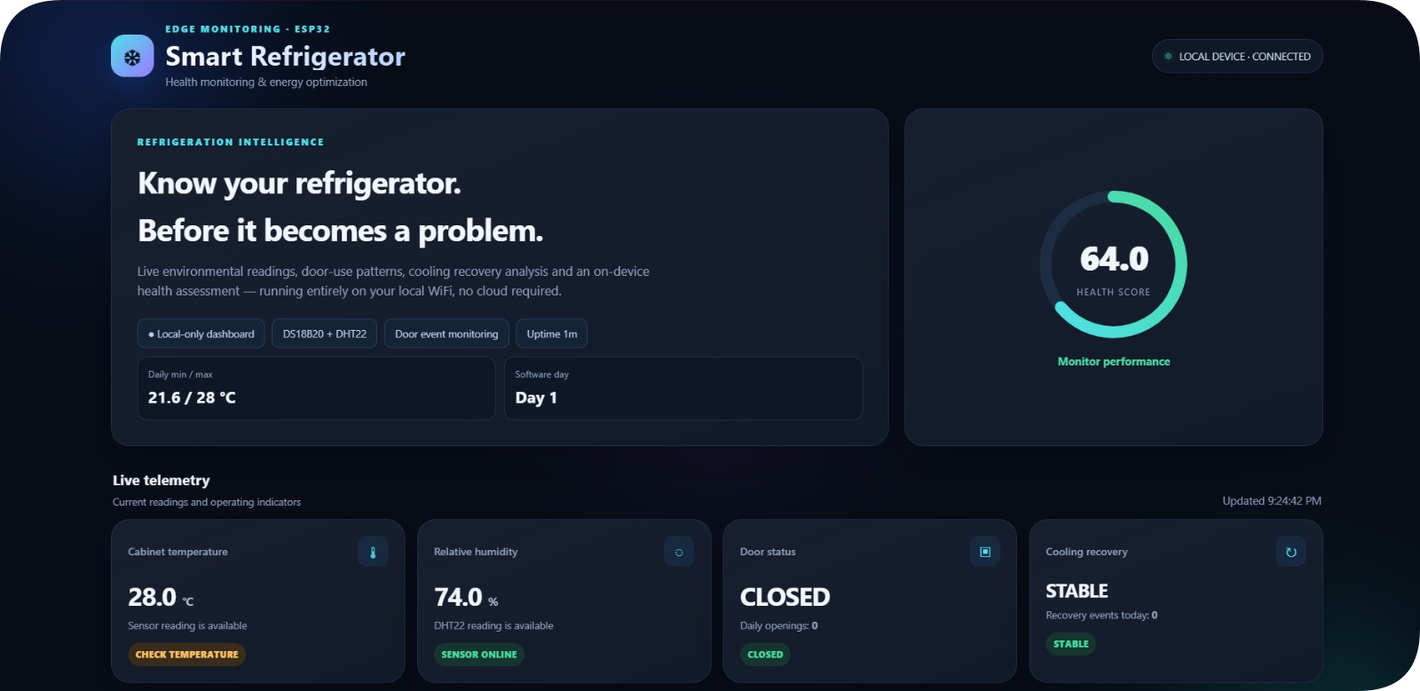
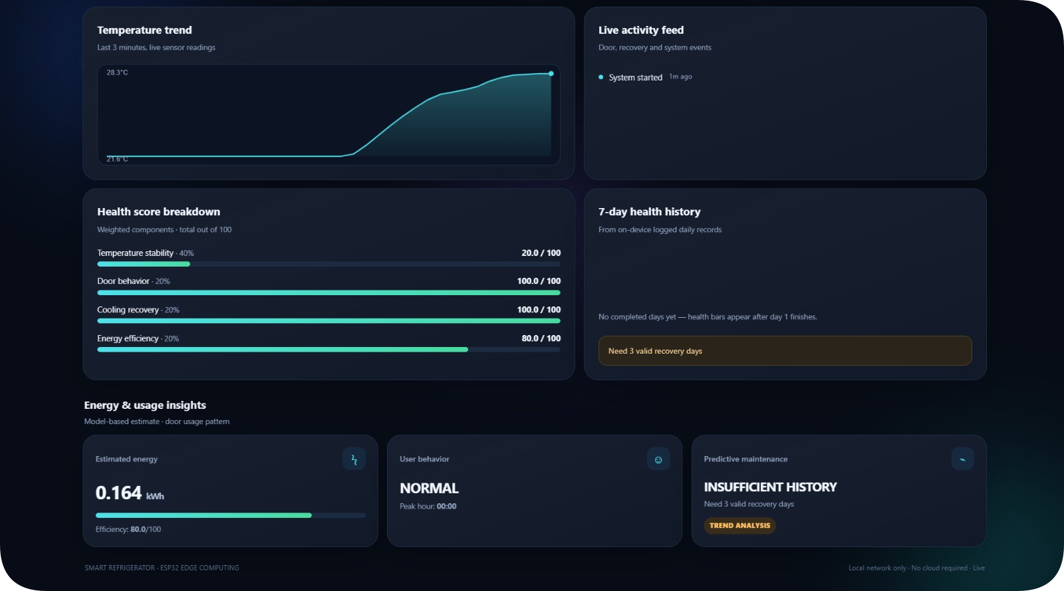
DASHBOARD &
USER-FACING
FEATURES
A LOCAL-FIRST INTERFACE FOR LIVE STATUS, TRENDS AND EVENTS
Live monitoring
Temperature, humidity, door state and sensor validity.
Temperature sparkline
Rolling ~3-minute trend buffer in RAM.
Health history
Daily health-score bars from saved history when available.
Activity feed
Door, recovery and day-rollover events with elapsed-time labels.
Alert banner
Visible warning for door-alert or maintenance-advised state.
OLED + buzzer
On-device status and audible alert without a phone.
Charts/history need valid readings and populated records; an empty history is normal during initial testing.

Slide 11









TESTING
& VALIDATION PLAN
DEMONSTRATE EACH FUNCTION WITH A REPEATABLE PHYSICAL TEST
DS18B20
DHT22
MC-38
OLED
Read stable temperature; test disconnected-sensor warning.
Check plausible humidity; respect 2-second polling.
Move magnet; verify OPEN/CLOSED and alert timing.
Confirm live readings and warning display.
Buzzer
Dashboard
Persistence
Recovery logic
Trigger door-alert condition; verify GPIO 25 output.
Connect phone to SoftAP; verify live endpoint updates.
Restart ESP32; check saved day counter/history.
Open door, close it, observe temperature recovery event.
Report measured outcomes only after testing; do not invent accuracy, uptime or energy-saving percentages.

Slide 12



IMPLEMENTATION STATUS
& LIMITATIONS
SEPARATE DEMONSTRATED FEATURES FROM FUTURE VALIDATION
IMPLEMENTED IN PROTOTYPE
LIMITATIONS
ESP32 local access point and web dashboard
Energy is estimated, not measured
Temperature, humidity and door sensing
Maintenance needs sufficient real history
OLED status and buzzer output
Health score is a heuristic, not diagnosis
Health score, recovery logic and local history
Accuracy depends on placement/calibration
NEXT STEPS
Collect multi-day temperature, door and recovery data.
Compare energy model with a plug-in energy meter in future work.
Add calibration, exportable reports and formal accuracy testing.

Slide 13

CONCLUSION
LOW-COST EDGE INTELLIGENCE FOR REFRIGERATOR CONDITION AWARENESS
The prototype combines sensing, door-event tracking, cooling-recovery analysis, a weighted health score and a local dashboard on a single ESP32.
01
02
03
Affordable
Local-first
Interpretable
PRESENTED BY
Uses accessible sensors and a microcontroller.
Works over ESP32 SoftAP without cloud services.
Shows how sensor and event behaviour affect the score.
ALINA PALERI 25BCE0411
THANK YOU
KEVIN JOSEPH 25BCE2971
SHASMEEN ALESHA 25BCE2928
QUESTIONS?

Slide 14
REFERENCES
SELECTED LITERATURE AND BACKGROUND SOURCES
[1]
H. H. Masjuki et al., “Factors effecting energy consumption of household refrigerator-freezers,” TENCON, 2000. https://knova.um.edu.my/research_publications_2000_2005/44/
[2]
R. Saidur et al., “Role of ambient temperature, door opening, thermostat setting position and their combined effect on refrigerator-freezer energy consumption,” Energy Conversion and Management, 2002. https://doi.org/10.1016/S0196-8904(01)00069-3
[3]
L. Harrington et al., “Peering into the cabinet: Quantifying the energy impact of door openings and food loads in household refrigerators during normal use,” International Journal of Refrigeration, 2019. https://doi.org/10.1016/j.ijrefrig.2019.05.040
[4]
P. et al., “Temperature Data Acquisition System for Showcase Refrigerator Based on ESP32 and Online Remote Display,” Sensors and Materials, 2023. https://doi.org/10.18494/SAM4691
[5]
“Integrated IoT and AI-Driven Smart Refrigerator System,” IEEE MOCAST, 2025. DOI: 10.1109/MOCAST65744.2025.11083919
[6]
M. F. Bizdadea et al., “Modular IoT system for monitoring, control and alerting in refrigeration systems using ESP32 and Raspberry Pi 4,” EAI. https://doi.org/10.4108/dtip.9792
Literature summaries are paraphrased from publisher/repository records; verify full papers before formal citation.

