Slide 1
Database Design Basics
Microsoft SQL Server

Slide 2
What is a Database?
Collection of structured information
Controlled by a DBMS
The data, DBMS, and associated programs are the database system
Notes:
A database is an organized collection of structured information, or data, typically stored electronically in a computer system. A database is usually controlled by a database management system (DBMS). Together, the data and the DBMS, along with the applications that are associated with them, are referred to as a database system, often shortened to just database.
DBMS = Oracle, MSSQL, POSTGRES, DB2, etc

Slide 3

Database vs Spreadsheet
Single to small user base
Small Data Collections
Not incredibly complex data
Notes:
Spreadsheets were originally designed for one user, and their characteristics reflect that. They’re great for a single user or small number of users who don’t need to do a lot of incredibly complicated data manipulation.

Slide 4

Database vs Spreadsheet Continued
Multiple Simultaneous Users
Large Collections of Data
Highly Complex Logic and Language
Notes:
Databases, on the other hand, are designed to hold much larger collections of organized information—massive amounts, sometimes. Databases allow multiple users at the same time to quickly and securely access and query the data using highly complex logic and language.

Slide 5
Relational Databases
Based on Relational Model
Database Objects - Tables
Unique IDs - Keys
Relationships
Conceptual, Logical and Physical Models
Relational Database Info
Notes:
The relational model provided a standard way of representing and querying data that could be used by any application. From the beginning, developers recognized that the chief strength of the relational database model was in its use of tables, which were an intuitive, efficient, and flexible way to store and access structured information. The link has good, simple explanation of the relational model.
Table format to hold the data
Primary Keys for each row within a table.
Keys (PK and FK) used to relate between the tables.

Slide 6
Database Schema
What is a schema?
Collection of database objects associated with a username that is a schema owner.
dbo – default schema within MSSQL

Slide 7
Database Objects
A relational database data structure used to either store or reference data.

Slide 8
Database Objects - Continued
Common DB Objects:
Tables
Views
Triggers
Indexes
Sequences
Synonyms

Slide 9

Tables
Elements of a Relational DB table:
Named vertical columns
Horizontal rows
Cell
Primary Key column
Think Spreadsheet!

Slide 10
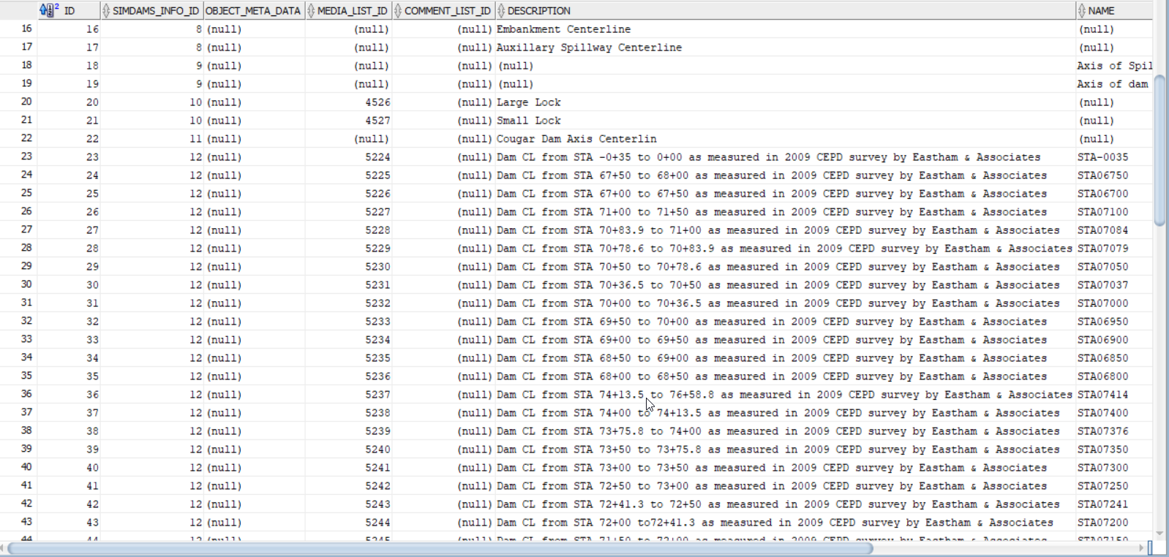
Tables Continued
Notes:
Cell – the intersection of a row and column

Slide 11
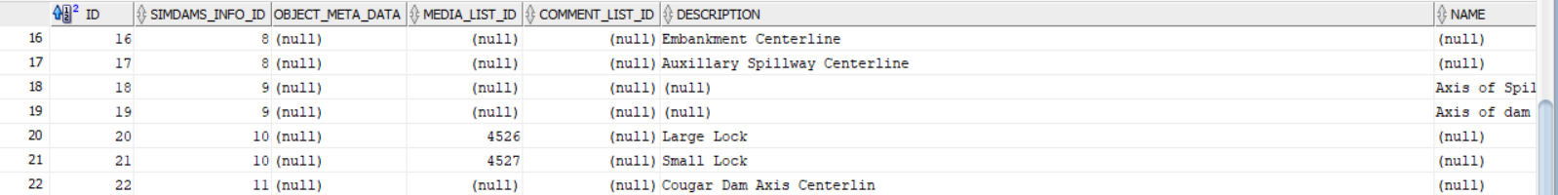
Tables continued
Tuple
All data for an individual record.
Notes:
Record = each row

Slide 12
Structured Query Language (SQL)
SQL:
Query
Manipulate
Define Data
Access Control
MSSQL uses TRANSACT-SQL.
Notes:
SQL is the programming language used by nearly all relational databases to query, manipulate, and define data, and to provide access control. SQL was first developed at IBM in the 1970s with Oracle as a major contributor, which led to implementation of the SQL ANSI standard, SQL has spurred many extensions from companies such as IBM, Oracle, and Microsoft.

Slide 13
Structured Query Language (SQL) Continued
UPPERCASE vs lowercase
CREATE TABLE or create table
Notes:
Personal preference

Slide 14
Tables Continued
Common Table SQL:
CREATE TABLE
DROP TABLE
This is to delete a db object
INSERT
UPDATE
DELETE

Slide 15
Tables Continued – SQL Examples
CREATE Table
CREATE TABLE dbo.NAME (
ID int PRIMARY KEY,
FIRST_NAME varchar (50) NOT NULL,
LAST_NAME varchar (50) NOT NULL,
phone varchar (20));
GO

Slide 16
Tables Continued – SQL Examples
DROP Example
DROP TABLE dbo.NAME;
GO

Slide 17
Tables Continued – SQL Examples
INSERT Example
INSERT INTO dbo.NAME (ID, FIRST_NAME, LAST_NAME, PHONE) VALUES (1, 'Jon', 'Hall', '555-111-2222');
INSERT INTO dbo.NAME (ID, FIRST_NAME, LAST_NAME, PHONE) VALUES (2, 'Paul', 'Deatrick', '555-222-3333');
INSERT INTO dbo.NAME (ID, FIRST_NAME, LAST_NAME, PHONE) VALUES (3, 'Lance', 'Filiatreau', '555-333-4444');
INSERT INTO dbo.NAME (ID, FIRST_NAME, LAST_NAME, PHONE) VALUES (4, 'Julia', 'Gailor', '555-444-5555');
INSERT INTO dbo.NAME (ID, FIRST_NAME, LAST_NAME, PHONE) VALUES (5, 'Laurel', 'Robison', '555-555-6666');
INSERT INTO dbo.NAME (ID, FIRST_NAME, LAST_NAME, PHONE) VALUES (6, 'Jessica', 'Hinton', '555-666-7777');
INSERT INTO dbo.NAME (ID, FIRST_NAME, LAST_NAME, PHONE) VALUES (7, 'Joelle', 'Carney', '555-777-8888');
GO

Slide 18
Tables Continued – SQL Examples
Update Example
UPDATE dbo.NAME
SET PHONE = '555-888-9999’
WHERE ID = 1;
GO

Slide 19
Tables Continued – SQL Examples
DELETE Example
DELETE FROM dbo.NAME
WHERE ID = 8;
GO

Slide 20
Queries
A request for data or information from a database table or combination of tables.

Slide 21
Queries Continued
SELECT Statement
SELECT * FROM dbo.NAME;
GO
SELECT FIRST_NAME, LAST_NAME FROM dbo.NAME;
GO
* In a SELECT statement means ALL columns within the table.

Slide 22
Views
What is a view?
Similar to a virtual table
Data from 1+ tables and/or 1+ databases
Built on SQL queries.
Notes:
Views won’t update when a table is updated, but when the view is referenced, the query will re-run with the updated data included.

Slide 23
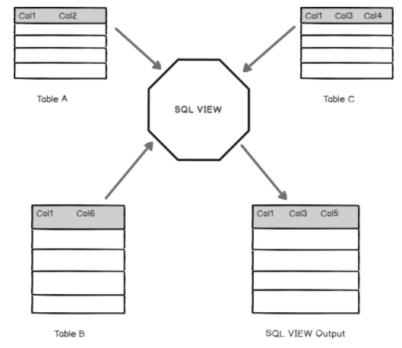
Views Continued

Slide 24
Views Continued – SQL
Common View SQL
CREATE VIEW
ALTER VIEW

Slide 25
Views Continued – SQL
CREATE VIEW
CREATE VIEW v_FULLNAME AS
SELECT FIRST_NAME, LAST_NAME
FROM dbo.NAME;
GO

Slide 26
Views Continued – SQL
ALTER VIEW
ALTER VIEW v_FULLNAME AS
SELECT FIRST_NAME, LAST_NAME, PHONE
FROM dbo.NAME;
GO

Slide 27
Triggers
Defined as:
A stored procedure that runs when an event occurs on a table or view in the database. (INSERT, UPDATE, DELETE)
Uses:
Maintaining Integrity
Historical Log

Slide 28
Triggers Continued – SQL
Common Trigger SQL
CREATE TRIGGER
ALTER TRIGGER

Slide 29
Triggers Continued – SQL
CREATE Trigger
CREATE TRIGGER t_INSERT_DELETE_NAME
ON dbo.NAME
AFTER INSERT, DELETE
AS RAISERROR ('Insert or delete complete!', 16, 10);
GO

Slide 30
Triggers Continued – SQL
ALTER Trigger
ALTER TRIGGER t_INSERT_DELETE_NAME
ON dbo.NAME
AFTER INSERT
AS RAISERROR ('Insert complete!', 16, 10);
GO

Slide 31
Indexes
Indexes are objects that are used to quickly locate and access data within the database during a query.
Look-up table created:
Column 1 is a search key
Column 2 is the data reference
Notes:
Indexes create look up tables.
The first column is the Search key that contains a copy of the primary key or candidate key of the table. These values are stored in sorted order so that the corresponding data can be accessed quickly. Note: The data may or may not be stored in sorted order.
The second column is the Data Reference or Pointer which contains a set of pointers holding the address of the disk block where that particular key value can be found.

Slide 32
Indexes Continued
Use when:
Frequent retrieval of approximately 15% of a large table.
Use to perform join performance.
Consider for use on foreign keys.

Slide 33
Indexes Continued
Not to use:
Small tables
Tables that have frequent, large batch updates/inserts.
Columns with a high number of NULL values.
Columns that are frequently manipulated.
Primary keys (already indexed)

Slide 34
Indexes Continued – SQL
CREATE Index
CREATE INDEX iFirst ON dbo.NAME(FIRST_NAME);
CREATE INDEX iLast ON dbo.NAME(LAST_NAME);
GO

Slide 35
Sequences
Sequence:
An object that allows for user generated unique INTEGER values.
CREATE Sequence
CREATE SEQUENCE SEQ_NAME_ID
START WITH 1
INCREMENT BY 1;
GO
Notes:
After the sequence is created within the DB, delete the rows from dbo.NAME and INSERT using NEXT VALUE FOR syntax.

Slide 36
Synonyms
Synonyms:
An alias for other database objects.
CREATE Synonym
CREATE SYNONYM THENAMES FOR dbo.NAME;
GO
Notes:
When to use synonyms
You will find some situations which you can effectively use synonyms.
1) Simplify object names
If you refer to an object from another database (even from a remote server), you can create a synonym in your database and reference to this object as it is in your database.
2) Enable seamless object name changes
When you want to rename a table or any other object such as a view, stored procedure, user-defined function, or a sequence, the existing database objects that reference to this table need to be manually modified to reflect the new name. In addition, all current applications that use this table need to be changed and possibly to be recompiled. To avoid all of these hard work, you can rename the table and create a synonym for it to keep existing applications function properly.

Slide 37

Keys
What are keys?
Identifies a record
Used to generate relationships
Types
Primary Key (PK)
Foreign Key (PK)

Slide 38
Keys Continued
Primary Keys
Ensures unique values within a column
Unique ID
One per table
No duplicate values
Does not allow NULL values
Cannot be deleted

Slide 39
Keys Continued
Foreign Keys
Provides link between two tables.
Refers to the primary key of another table.
Multiple FKs per table
Duplicate values
NULL values allowed
Can be deleted

Slide 40
Keys Continued
Primary Key Creation
CREATE TABLE dbo.NAME(
ID int PRIMARY KEY,
FIRST_NAME varchar(50) NOT NULL,
LAST_NAME varchar(50) NOT NULL,
PHONE varchar(12)
);
GO

Slide 41
Keys Continued
Foreign Key Creation
ALTER TABLE dbo.NAME
ADD CONSTRAINT fk_name_to_dis FOREIGN KEY (DISTRICT_ID)
REFERENCES dbo.DISTRICTS(ID)
ON UPDATE CASCADE
ON DELETE CASCADE;
GO
Notes:
Use the FK example code. Create dbo.DISTRICTS, INSERT INTO the dbo.DISTRICTS, add DISTRICT_ID to dbo.NAME, UPDATE the rows with the correct DISTRICT_ID,
run the ALTER TABLE add constraint. Run the Query showing the FK Worked.

Slide 42
Relationships
Database relationships are associations between tables that are created using join statements to retrieve data. ... Both tables can have only one record on each side of the relationship. Each primary key value relates to none or only one record in the related table.

Slide 43
Relationships Continued
Cardinality:
The possible number of occurrences in one entity which is associated with the number of occurrences in another.

Slide 44
Relationships Continued
Relationship (Cardinality) Types:
One-to-One (1-1)
One-to-Many (1-M)
Many-to-Many (M-N)

Slide 45
Relationships Continued One-to-One
One-to-One:
Both tables can have only one record on each side of the relationship.
Each primary key value relates to none or only one record in the related table.
Most one-to-one relationships are forced by business rules.
Notes:
Most one-to-one relationships are forced by business rules and do not flow naturally from the data. Without such a rule, you can typically combine both tables without breaking any normalization rules.

Slide 46
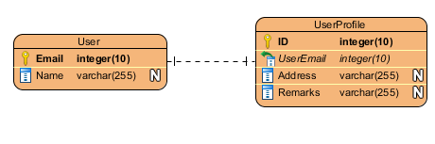
Relationships Continued One-to-One
Notes:
Related based on the Email PK and FK

Slide 47
Relationships Continued One-to-Many
One-to-Many:
The primary key table contains only one record that relates to none, one, or many records in the related table.

Slide 48
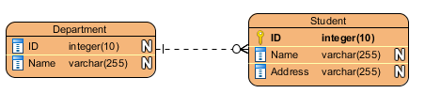
Relationships Continued One-to-Many
Notes:
Not a great example, but gets the point across. 1 department to multiple students.

Slide 49
Relationships Continued Many-to-Many
Many-to-Many:
Each record in both tables can relate to none or any number of records in the other table.
NOTE: Linking / Associate table required.
Notes:
These relationships require a third table, called an associate or linking table, because relational systems cannot directly accommodate the relationship.

Slide 50
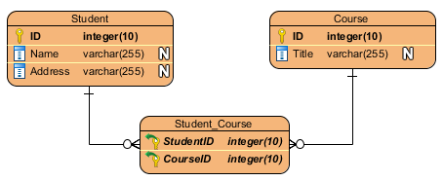
Relationships Continued Many-to-Many
Notes:
Linking table used to create the relationship between the two tables. Based on each table’s PK.

Slide 51
Data Types
Numeric
Date and Time
Character Strings
NULL vs Empty String
Notes:
Make a note that there are other data types, but these are the out of the scope of this training. Binary, cursor, xml etc

Slide 52
Data Types – Numeric
Exact Numeric
Integer Types (bigint, int, smallint, tinyint)
decimal or numeric
bit
Money Types (money and smallmoney)
Not relevant to this project, but wanted to make mention
Approximate Numeric
float and real

Slide 53
Data Type – Numeric Exact Types
Integer Types
The int data type is the primary integer data type.
Type | Range | Storage
bigint | -2^63 to 2^63 | 8 bytes
int | -2,147,483,684 to 2,147,483,647 | 4 bytes
smallint | -32,768 to 32,767 | 2 bytes
tinyint | 0 to 255 | 1 byte

Slide 54
Data Type – Numeric Exact Types Continued
CREATE TABLE dbo.MyTable
( MyBigIntColumn bigint
,MyIntColumn int
,MySmallIntColumn smallint
,MyTinyIntColumn tinyint);
GO
INSERT INTO dbo.MyTable VALUES (9223372036854775807, 2147483647, 32767, 255);
GO

Slide 55
Data Type – Numeric Exact Types Continued
MyBigIntColumn MyIntColumn MySmallIntColumn MyTinyIntColumn
------------------------------- ---------------- ----------------------- ----------------------
9223372036854775807 2147483647 32767 255

Slide 56
Data Type – Numeric Exact Types Continued
decimal and numeric
Functionally identical
-10^38+1 to 10^38-1
Precision (p) vs Scale (s)
SQL Statement Arguments
decimal(p,s) numeric(p,s)
Notes:
Precision: The maximum total number of decimal digits to be stored. This number includes both the left and the right sides of the decimal point. The precision must be a value from 1 through the maximum precision of 38. The default precision is 18.
Scale: The number of decimal digits that are stored to the right of the decimal point. This number is subtracted from p to determine the maximum number of digits to the left of the decimal point. Scale must be a value from 0 through p, and can only be specified if precision is specified.

Slide 57
Data Type – Numeric Exact Types Continued
CREATE TABLE dbo.MyTable
( MyDecimalColumn decimal(5,2),
MyNumericColumn numeric(10,5));
GO
INSERT INTO dbo.MyTable VALUES (123, 12345.12);
GO

Slide 58
Data Type – Numeric Exact Types Continued
MyDecimalColumn MyNumericColumn
------------------------------- -------------------------------
123.00 12345.12000

Slide 59
Data Type – Numeric Exact Types Continued
bit
Can be a value of 1, 0, or NULL
This will be used as a Boolean value (T/F, Y/N, etc)
The 1,0 values can reflect whichever Boolean value.

Slide 60
Data Type – Numeric Exact Types Continued
CREATE TABLE dbo.MyTable(
bit_col bit );
INSERT INTO dbo.MyTable(bit_col) VALUES(1);
bit_col
---------
1

Slide 61
Data Type – Numeric Approximate Types
float and real data types
Floating point data.
Approx data in which all values cannot be accurately represented.
Best to use when there can be a margin of error.
real = float(24)
Notes:
Max precision is 53.

Slide 62
Data Type – Numeric Approximate Types
Data Type | Range | Storage
float | - 1.79E+308 to -2.23E-308, 0 and 2.23E-308 to 1.79E+308 | n 1-24 4 bytes n 25-53 8 bytes
real | - 3.40E + 38 to -1.18E - 38, 0 and 1.18E - 38 to 3.40E + 38 | 4 bytes
Single Precision n 1-24
Double Precision n 25-53

Slide 63
Data Type – Numeric Approximate Types
1 2 3 4 5 | DECLARE @dividend REAL = 1 DECLARE @divisor REAL =3 SELECT Str(@dividend /@divisor,20,16) as quotient --produces 0.3333333432674408 --should be 0.3333333333333333
Notes:
This means that 11.22 and 11.2222 are different types though this is not the case for float. For FLOAT(6) 11.22 and 11.2222 are same data types.
STR ( float_expression [ , length [ , decimal ] ] )

Slide 64
Data Types – Date
date
time
datetime
datetime2
datetimeoffset
smalldatetime

Slide 65
Data Types – Date Continued
date
Default: 1900-01-01
Range: January 1, 1 CE through December 31, 9999 CE
Syntax: date
time
Default: 00:00:00
Range: 00:00:00.0000000 through 23:59:59.9999999
Syntax: time(fractional seconds)
Notes:
Fractional Seconds 0-7

Slide 66
Data Types – Date Continued
datetime
Default: 1900-01-01 00:00:00
Date Range: January 1, 1753, through December 31, 9999
Time Range: 00:00:00 through 23:59:59.997
Syntax: datetime
datetime2
Default: 1900-01-01 00:00:00
Date Range: January 1,1 CE through December 31, 9999 CE
Time Range: 00:00:00 through 23:59:59.9999999
Syntax: datetime2 (fraction seconds precision)
Notes:
datetime: Defines a date that is combined with a time of day with fractional seconds that is based on a 24-hour clock. Fractional seconds cannot be user defined.
datetime2: Can be considered as an extension of the existing datetime type that has a larger date range, a larger default fractional precision, and optional user-specified precision. User defined fractional seconds precision.
Fractional Seconds 0-7

Slide 67
Data Types – Date Continued
datetimeoffset
Default: 1900-01-01 00:00:00 00:00
Date Range: January 1,1 CE through December 31, 9999 CE
Time Range: 00:00:00 through 23:59:59.9999999
Syntax: datetimeoffset (fractional seconds precision)
smalldatetime
Default: 1900-01-01 00:00:00
Date Range: January 1, 1900, through June 6, 2079
Time Range: 00:00:00 through 23:59:59
Syntax: smalldatetime
Notes:
datetimeoffset: Same as a datetime2, but has time zone awareness (-14:00 through +14:00)
smalldatetime: Date with time (based on 24 hour clock) with seconds always 00 and no fractional seconds. 23:59:59 will round to 00:00:00
Fractional Seconds 0-7

Slide 68
Data Types – Character Strings
Fixed Length:
char
nchar
Variable Length:
varchar
nvarchar

Slide 69
Data Types – Character Strings Continued
Fixed Length Character Strings
char:
Syntax: char(n)
n = 0 through 8000
Storage = n bytes
nchar:
Syntax: nchar(n)
n = 0 through 4000
Storage: n * 2 bytes
Notes:
Fixed string size. If the input has less bytes than n, “blank space” takes up the remaining available space.

Slide 70
Data Types – Character Strings Continued
Variable Length Character Strings
varchar:
Syntax: varchar(n) OR varchar(max)
n = 0 through 8000
max = 2 GB
Storage = actual data length + 2 bytes
nvarchar:
Syntax: nvarchar(n) OR nvarchar(max)
n = 0 through 4000
max = 2 GB
Storage = (actual data length + 2) * 2 bytes

Slide 71
Data Types – Character Strings Continued
Use char or nchar:
when the data entries are consistent size.
Use varchar(n) or nvarchar(n):
when the data entries vary in size.

Slide 72

Data Types – Character Strings Continued
Unicode Character Strings
nchar and nvarchar
String size in byte-pairs
Encoding differences
https://home.unicode.org/
Notes:
Unicode is an IT standard for consistent encoding, representation, and handling of text expressed in most of the world’s writing systems.
Likely won’t use in a USACE system.

Slide 73
Data Types – NULL vs Empty String
NULL:
Refers to nothing or the absence of value.
Empty String:
Refers to a unique string with value of zero length.

Slide 74
Entity Relationship Diagram (ERD)
An entity-relationship diagram (ERD) is a data modeling technique that graphically illustrates an information system’s entities and the relationships between those entities.

Slide 75
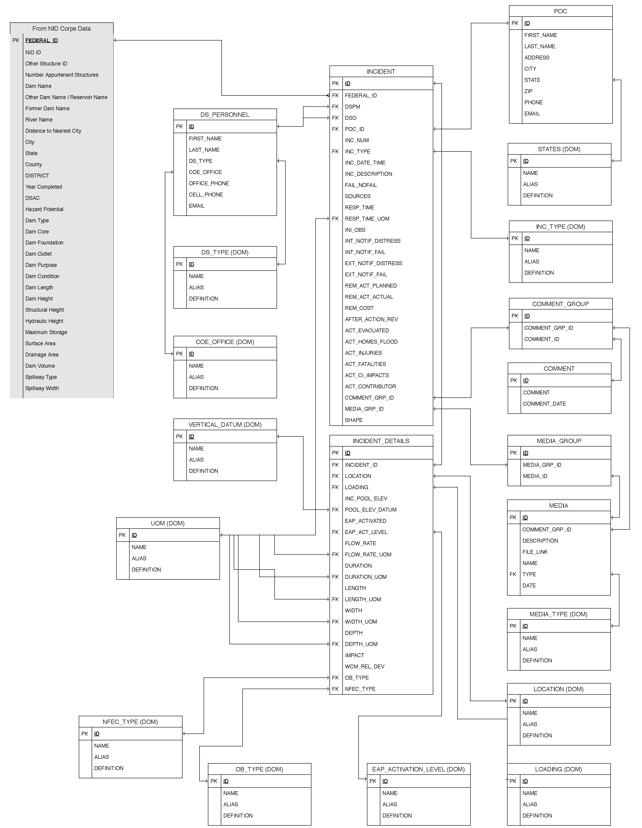
Entity Relationship Diagram (ERD) Continued

Slide 76
Entity Relationship Diagram (ERD) Continued
Basic Components:
Entities / Tables
Keys (Primary and Foreign)
Relationships
Attributes / Columns

Slide 77
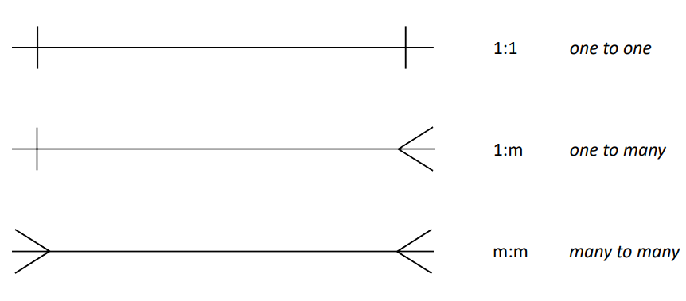
Entity Relationship Diagram (ERD) Continued - Cardinality
Crows Feet Notation (Mandatory):
1-1
1-M
M-N

Slide 78
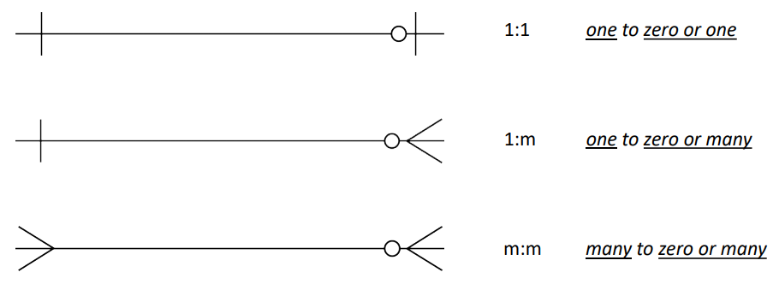
Entity Relationship Diagram (ERD) Continued - Cardinality
Crows Feet Notation (Optional):
1-1
1-M
M-N
Notes:
These allow NULL values in FK.

Slide 79
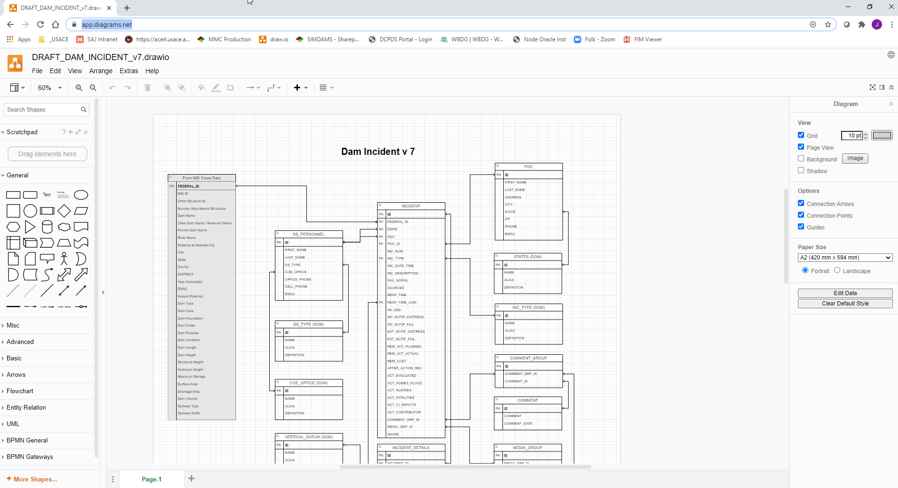
Entity Relationship Diagram (ERD) Continued
app.diagrams.net

Slide 80

Design Process
Requirements Gathering
Conceptual Design
Logical Design
Physical Design

Slide 81



Design Process – Step 1 Requirements Gathering
Needed and Feasible
Requirements
Group Requirements
Confirm data requirements

Slide 82
Design Process – Step 2 Conceptual Design
Conceptual Diagram / Model:
Models business objects that should exist in a system and the relationships between them.
Highest Level
DB System independent

Slide 83
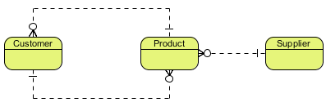
Design Process – Step 2 Conceptual Design Continued
ERD Example:
Notes:
The relationships don’t need to be defined in a conceptual. It is also acceptable to just use arrows showing the relationships between entities.

Slide 84
Design Process – Step 3 Logical Design
Logical Diagram / Model:
Detailed version of the Conceptual diagram/model.
Entity attribution added.
Relationships better defined.

Slide 85
Design Process – Step 3 Logical Design Continued
Logical Diagram / Model:
DB System independent.
Normalization

Slide 86
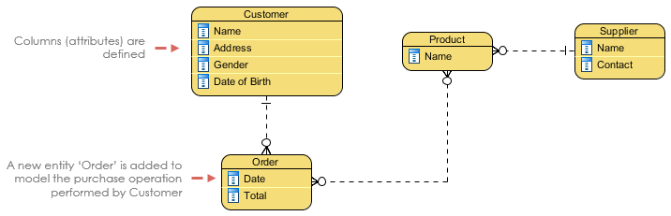
Design Process – Step 3 Logical Design Continued
ERD Example:

Slide 87
Design Process – Step 3 Normalization
A database technique that attempts to eliminate redundant data and to ensure that the data is stored logically.

Slide 88
Design Process – Step 3 Normalization Continued
Non-Normalized Anomalies:
Insertion Anomaly
Update Anomaly
Deletion Anomaly
Notes:
Delete Anomaly: The unintended loss of data due to the deletion of other data.
Insertion Anomaly: The inability to add data to the database due to the absence of other data.
Update Anomaly: A data inconsistency that results from data redundancy and a partial update.

Slide 89
Design Process – Step 3 Normalization Continued
Employee_ID | Name | Department | Student_Group
123 | J. Longfellow | Accounting | Beta Alpha Psi
234 | B. Rech | Marketing | Marketing Club
234 | B. Rech | Marketing | Management Club
456 | A. Bruchs | CIS | Technology Org.
456 | A. Bruchs | CIS | Beta Alpha Psi
Notes:
Update anomaly: If there is an error with Bruchs’ department, it needs to be updated multiple times or there will be inconsistency.
Insertion anomaly: Assume Student_Group is defined so that null values are not allowed. If a new employee is hired but not immediately assigned to a Student_Group then this employee could not be entered into the database. This results in database inconsistencies due to omission.
Deletion anomaly: If the student group Beta Alpha Psi disbanded and was deleted from the table above, J. Longfellow and the Accounting department would cease to exist. This results in database inconsistencies and is an example of how combining information that does not really belong together into one table can cause problems.

Slide 90
Design Process – Step 3 Normalization Continued
First Normal Form
Second Normal Form
Third Normal Form
Forth Normal Form or Boyce Codd Normal Form
Fifth Normal Form
Notes:
There are 5 normalization rules. Rules 1-3 area always used. 4NF/BCNF and 5NF are rarely considered in practical design.

Slide 91
Design Process – Step 3 Normalization Continued
Student_ID | Name | Subject | Instructor | Period | C_Rank
1 | S. Spencer | Communication, Psychology | C. Lassiter, H. Spencer | First, Third | First
2 | B. Guster | Communication, Pharmacology | C. Lassiter, B. McNab | First, Second | Second
3 | J. O’Hara | Communication, Criminal Justice | C. Lassiter, K. Vick | First, Fourth | Third

Slide 92
Design Process – Step 3 Con’t First Normal Rule
Single Valued Attributes
Attribute Domains should not change
Unique Attribute / Column names
Order doesn’t matter

Slide 93
Design Process – Step 3 Con’t First Normal Rule
Student_ID | Name | Subject | Instructor | Period | C_Rank
1 | S. Spencer | Communication | C. Lassiter | First | First
1 | S. Spencer | Psychology | H. Spencer | Third | First
2 | B. Guster | Communication | C. Lassiter | First | Second
2 | B. Guster | Pharmacology | B. McNab | Second | Second
3 | J. O’Hara | Communication | C. Lassiter | First | Third
3 | J. O’Hara | Criminal Justice | K. Vick | Fourth | Third

Slide 94
Design Process – Step 3 Con’t Second Normal Rule
Follows 1NF
Create separate tables for sets of values that apply to multiple records.
Relate these tables with a foreign key.

Slide 95
Design Process – Step 3 Con’t Second Normal Rule
Student_ID | Name | Rank
1 | S. Spencer | First
2 | B. Guster | Second
3 | J. O’Hara | Third
Student_ID | Subject_ID
1 | 1
1 | 3
2 | 1
2 | 2
3 | 1
3 | 4
This is a M-N relationship.
Subject_ID | Subject | Instructor | Period
1 | Communication | C. Lassiter | First
2 | Psychology | H. Spencer | Third
3 | Pharmacology | B. McNab | Second
4 | Criminal Justice | K. Vick | Fourth

Slide 96
Design Process – Step 3 Con’t Third Normal Rule
Follows 2NF
Eliminate fields that do not depend on the key.
NOTE: This not always practical.
Notes:
Adhering to the third normal form, while theoretically desirable, is not always practical. If you have a Customers table and you want to eliminate all possible interfield dependencies, you must create separate tables for cities, ZIP codes, sales representatives, customer classes, and any other factor that may be duplicated in multiple records. In theory, normalization is worth pursing. However, many small tables may degrade performance or exceed open file and memory capacities.

Slide 97
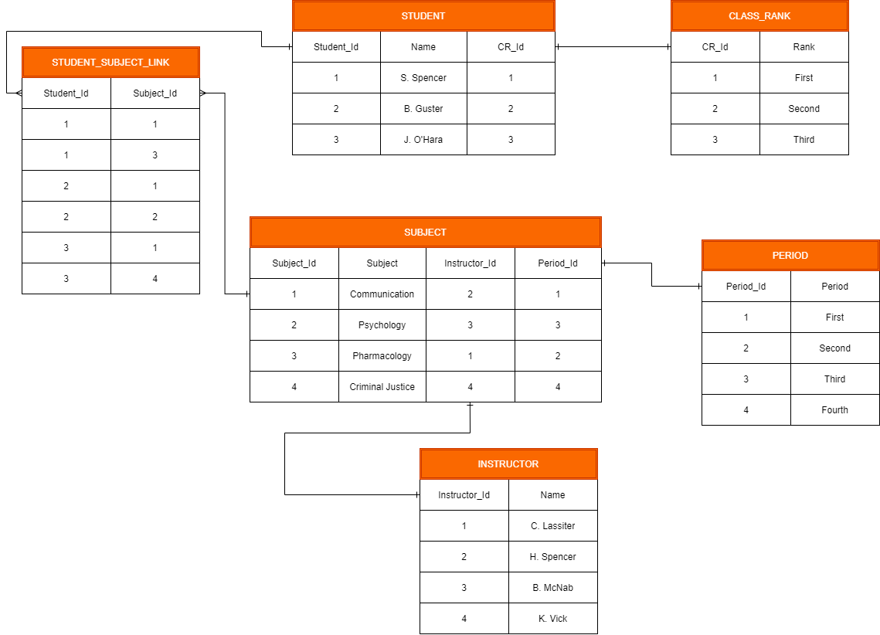
Design Process – Step 3 Con’t Third Normal Rule

Slide 98
Design Process - Step 4 Physical Design
Physical Diagram / Model:
The actual design/blueprint of the database.
Data types, nullable, length, etc are defined.
Database dependent

Slide 99
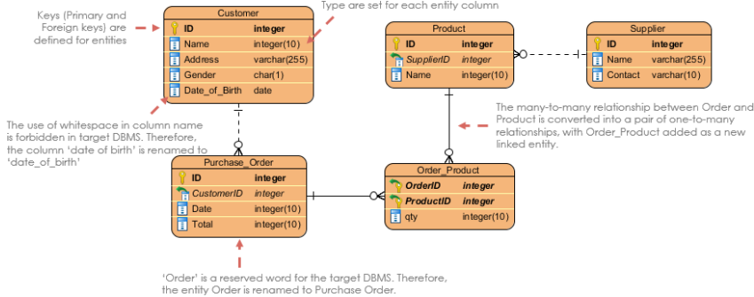
Design Process - Step 4 Physical Design Continued
ERD Example:

Slide 100
Design Process Continued
Features | Conceptual | Logical | Physical
Entity (Name) | Yes | Yes | Yes
Relationship | Yes | Yes | Yes
Columns |  | Yes | Yes
Column Types |  | Optional | Yes
Primary Key |  |  | Yes
Foreign Key |  |  | Yes

Slide 101
Online Sources
Stackoverflow:
https://stackoverflow.com/
MSSQL Documentation:
https://docs.microsoft.com/en-us/sql/?view=sql-server-ver15
w3schools:
https://www.w3schools.com/sql/

