Slide 1

Database Design Basics
ORACLE and Git

Slide 2
What is a Database?
Collection of structured information
Controlled by a DBMS
The data, DBMS, and associated programs are the database system
Notes:
A database is an organized collection of structured information, or data, typically stored electronically in a computer system. A database is usually controlled by a database management system (DBMS). Together, the data and the DBMS, along with the applications that are associated with them, are referred to as a database system, often shortened to just database.
DBMS = Oracle, MSSQL, POSTGRES, DB2, etc

Slide 3

Database vs Spreadsheet
Single to small user base
Small Data Collections
Not incredibly complex data
Notes:
Spreadsheets were originally designed for one user, and their characteristics reflect that. They’re great for a single user or small number of users who don’t need to do a lot of incredibly complicated data manipulation.

Slide 4

Database vs Spreadsheet Continued
Multiple Simultaneous Users
Large Collections of Data
Highly Complex Logic and Language
Notes:
Databases, on the other hand, are designed to hold much larger collections of organized information—massive amounts, sometimes. Databases allow multiple users at the same time to quickly and securely access and query the data using highly complex logic and language.

Slide 5
Relational Databases
Based on Relational Model
Database Objects - Tables
Unique IDs - Keys
Relationships
Conceptual, Logical and Physical Models
Relational Database Info
Notes:
The relational model provided a standard way of representing and querying data that could be used by any application. From the beginning, developers recognized that the chief strength of the relational database model was in its use of tables, which were an intuitive, efficient, and flexible way to store and access structured information. The link has good, simple explanation of the relational model.
Table format to hold the data
Primary Keys for each row within a table.
Keys (PK and FK) used to relate between the tables.

Slide 6
Database Schema
What is a schema?
Collection of database objects associated with a username that is a schema owner.
Current user = default schema within Oracle

Slide 7
Structured Query Language (SQL)
SQL:
Query
Manipulate
Define Data
Access Control
Oracle uses PL/SQL (Procedural Language/ SQL)
Notes:
SQL is the programming language used by nearly all relational databases to query, manipulate, and define data, and to provide access control. SQL was first developed at IBM in the 1970s with Oracle as a major contributor, which led to implementation of the SQL ANSI standard, SQL has spurred many extensions from companies such as IBM, Oracle, and Microsoft.

Slide 8
Structured Query Language (SQL) Continued
UPPERCASE vs lowercase Keywords
CREATE TABLE or create table
Notes:
Personal preference

Slide 9

Design Process
Requirements Gathering
Conceptual Design
Logical Design
Physical Design

Slide 10



Design Process – Step 1 Requirements Gathering
Needed and Feasible
Requirements
Group Requirements
Confirm data requirements

Slide 11
Design Process – Step 2 Conceptual Design
Conceptual Diagram / Model:
Models business objects that should exist in a system and the relationships between them.
Highest Level
DB System independent

Slide 12
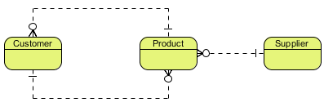
Design Process – Step 2 Conceptual Design Continued
ERD Example:
Notes:
The relationships don’t need to be defined in a conceptual. It is also acceptable to just use arrows showing the relationships between entities.

Slide 13
Design Process – Step 3 Logical Design
Logical Diagram / Model:
Detailed version of the Conceptual diagram/model.
Entity attribution added.
Relationships better defined.

Slide 14
Design Process – Step 3 Logical Design Continued
Logical Diagram / Model:
DB System independent.
Normalization

Slide 15
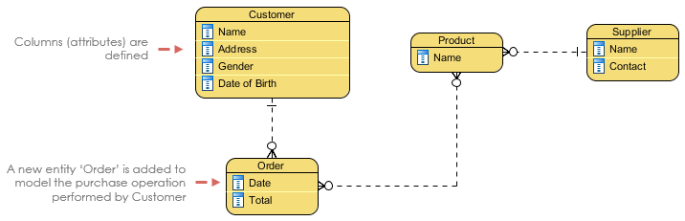
Design Process – Step 3 Logical Design Continued
ERD Example:

Slide 16
Design Process – Step 3 Normalization
A database technique that attempts to eliminate redundant data and to ensure that the data is stored logically.

Slide 17
Design Process – Step 3 Normalization Continued
Non-Normalized Anomalies:
Insertion Anomaly
Update Anomaly
Deletion Anomaly
Notes:
Delete Anomaly: The unintended loss of data due to the deletion of other data.
Insertion Anomaly: The inability to add data to the database due to the absence of other data.
Update Anomaly: A data inconsistency that results from data redundancy and a partial update.

Slide 18
Design Process – Step 3 Normalization Continued
Employee_ID | Name | Department | Student_Group
123 | J. Longfellow | Accounting | Beta Alpha Psi
234 | B. Rech | Marketing | Marketing Club
234 | B. Rech | Marketing | Management Club
456 | A. Bruchs | CIS | Technology Org.
456 | A. Bruchs | CIS | Beta Alpha Psi
Notes:
Update anomaly: If there is an error with Bruchs’ department, it needs to be updated multiple times or there will be inconsistency.
Insertion anomaly: Assume Student_Group is defined so that null values are not allowed. If a new employee is hired but not immediately assigned to a Student_Group then this employee could not be entered into the database. This results in database inconsistencies due to omission.
Deletion anomaly: If the student group Beta Alpha Psi disbanded and was deleted from the table above, J. Longfellow and the Accounting department would cease to exist. This results in database inconsistencies and is an example of how combining information that does not really belong together into one table can cause problems.

Slide 19
Design Process – Step 3 Normalization Continued
First Normal Form
Second Normal Form
Third Normal Form
Forth Normal Form or Boyce Codd Normal Form
Fifth Normal Form
Notes:
There are 5 normalization rules. Rules 1-3 area always used. 4NF/BCNF and 5NF are rarely considered in practical design.

Slide 20
Design Process – Step 3 Normalization Continued
Student_ID | Name | Subject | Instructor | Period | C_Rank
1 | S. Spencer | Communication, Psychology | C. Lassiter, H. Spencer | First, Third | First
2 | B. Guster | Communication, Pharmacology | C. Lassiter, B. McNab | First, Second | Second
3 | J. O’Hara | Communication, Criminal Justice | C. Lassiter, K. Vick | First, Fourth | Third

Slide 21
Design Process – Step 3 Con’t First Normal Rule
Single Valued Attributes
Attribute Domains should not change
Unique Attribute / Column names
Order doesn’t matter

Slide 22
Design Process – Step 3 Con’t First Normal Rule
Student_ID | Name | Subject | Instructor | Period | C_Rank
1 | S. Spencer | Communication | C. Lassiter | First | First
1 | S. Spencer | Psychology | H. Spencer | Third | First
2 | B. Guster | Communication | C. Lassiter | First | Second
2 | B. Guster | Pharmacology | B. McNab | Second | Second
3 | J. O’Hara | Communication | C. Lassiter | First | Third
3 | J. O’Hara | Criminal Justice | K. Vick | Fourth | Third

Slide 23
Design Process – Step 3 Con’t Second Normal Rule
Follows 1NF
Create separate tables for sets of values that apply to multiple records.
Relate these tables with a foreign key.

Slide 24
Design Process – Step 3 Con’t Second Normal Rule
Student_ID | Name | Rank
1 | S. Spencer | First
2 | B. Guster | Second
3 | J. O’Hara | Third
Student_ID | Subject_ID
1 | 1
1 | 3
2 | 1
2 | 2
3 | 1
3 | 4
This is a M-N relationship.
Subject_ID | Subject | Instructor | Period
1 | Communication | C. Lassiter | First
2 | Psychology | H. Spencer | Third
3 | Pharmacology | B. McNab | Second
4 | Criminal Justice | K. Vick | Fourth

Slide 25
Design Process – Step 3 Con’t Third Normal Rule
Follows 2NF
Eliminate fields that do not depend on the key.
NOTE: This not always practical.
Notes:
Adhering to the third normal form, while theoretically desirable, is not always practical. If you have a Customers table and you want to eliminate all possible interfield dependencies, you must create separate tables for cities, ZIP codes, sales representatives, customer classes, and any other factor that may be duplicated in multiple records. In theory, normalization is worth pursing. However, many small tables may degrade performance or exceed open file and memory capacities.

Slide 26
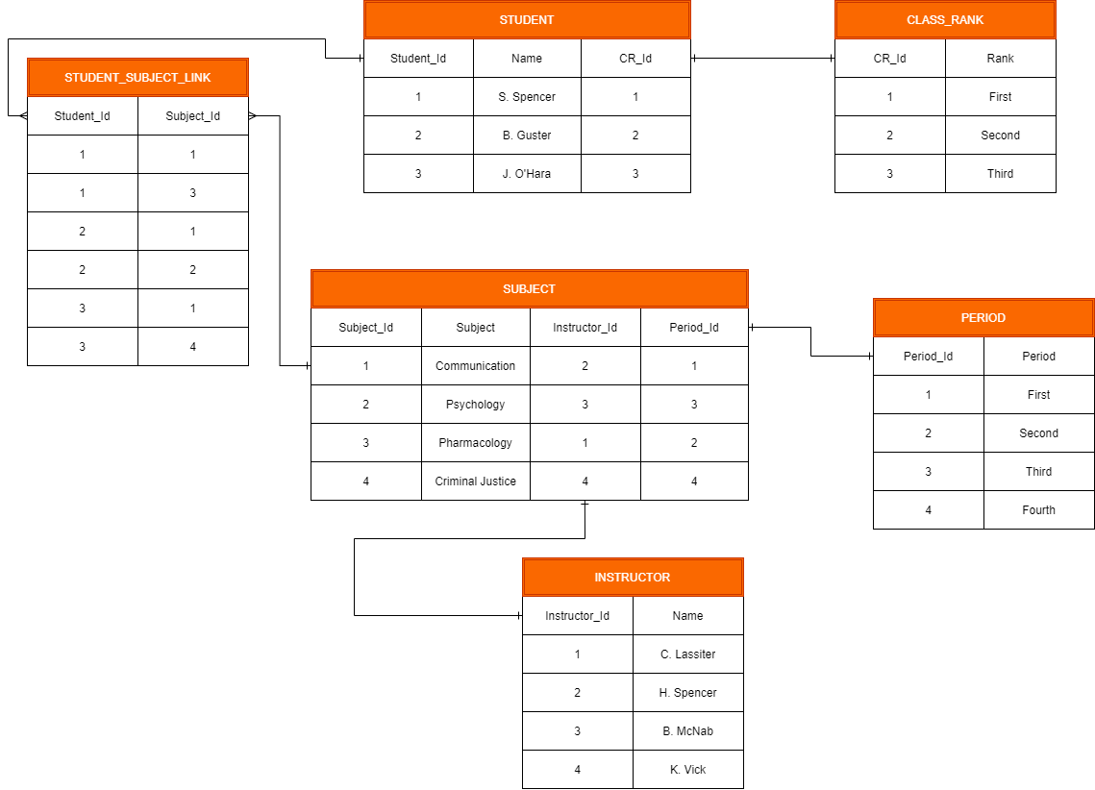
Design Process – Step 3 Con’t Third Normal Rule

Slide 27
Design Process - Step 4 Physical Design
Physical Diagram / Model:
The actual design/blueprint of the database.
Data types, nullable, length, etc are defined.
Database dependent

Slide 28
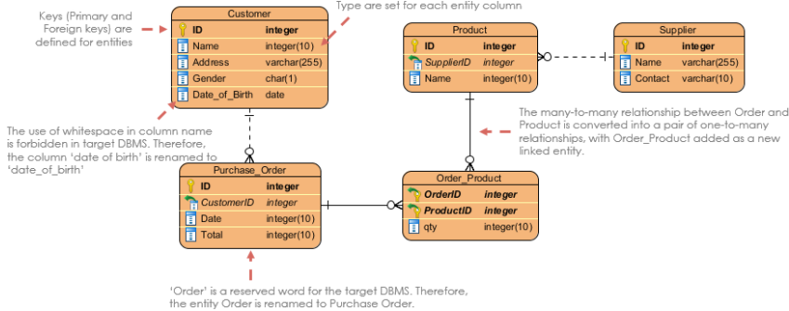
Design Process - Step 4 Physical Design Continued
ERD Example:

Slide 29
Design Process Continued
Features | Conceptual | Logical | Physical
Entity (Name) | Yes | Yes | Yes
Relationship | Yes | Yes | Yes
Columns |  | Yes | Yes
Column Types |  | Optional | Yes
Primary Key |  |  | Yes
Foreign Key |  |  | Yes

Slide 30

Keys
What are keys?
Identifies a record
Used to generate relationships
Types
Primary Key (PK)
Foreign Key (PK)

Slide 31
Keys Continued
Primary Keys
Ensures unique values within a column
Unique ID
One per table
No duplicate values
Does not allow NULL values
Cannot be deleted

Slide 32
Keys Continued
Foreign Keys
Provides link between two tables.
Refers to the primary key of another table.
Multiple FKs per table
Duplicate values
NULL values allowed
Can be deleted

Slide 33
Relationships
Database relationships are associations between tables that are created using join statements to retrieve data. ... Both tables can have only one record on each side of the relationship. Each primary key value relates to none or only one record in the related table.

Slide 34
Relationships Continued
Cardinality:
The possible number of occurrences in one entity which is associated with the number of occurrences in another.

Slide 35
Relationships Continued
Relationship (Cardinality) Types:
One-to-One (1-1)
One-to-Many (1-M)
Many-to-Many (M-N)

Slide 36
Relationships Continued One-to-One
One-to-One:
Both tables can have only one record on each side of the relationship.
Each primary key value relates to none or only one record in the related table.
Most one-to-one relationships are forced by business rules.
Notes:
Most one-to-one relationships are forced by business rules and do not flow naturally from the data. Without such a rule, you can typically combine both tables without breaking any normalization rules.

Slide 37
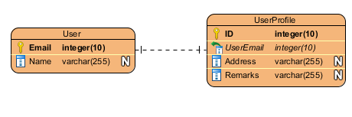
Relationships Continued One-to-One
Notes:
Related based on the Email PK and FK

Slide 38
Relationships Continued One-to-Many
One-to-Many:
The primary key table contains only one record that relates to none, one, or many records in the related table.

Slide 39
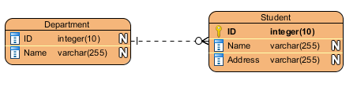
Relationships Continued One-to-Many
Notes:
Not a great example, but gets the point across. 1 department to multiple students.

Slide 40
Relationships Continued Many-to-Many
Many-to-Many:
Each record in both tables can relate to none or any number of records in the other table.
NOTE: Linking / Associate table required.
Notes:
These relationships require a third table, called an associate or linking table, because relational systems cannot directly accommodate the relationship.

Slide 41
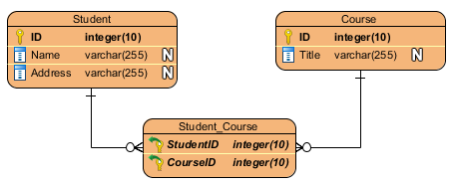
Relationships Continued Many-to-Many
Notes:
Linking table used to create the relationship between the two tables. Based on each table’s PK.

Slide 42
Entity Relationship Diagram (ERD)
An entity-relationship diagram (ERD) is a data modeling technique that graphically illustrates an information system’s entities and the relationships between those entities.

Slide 43
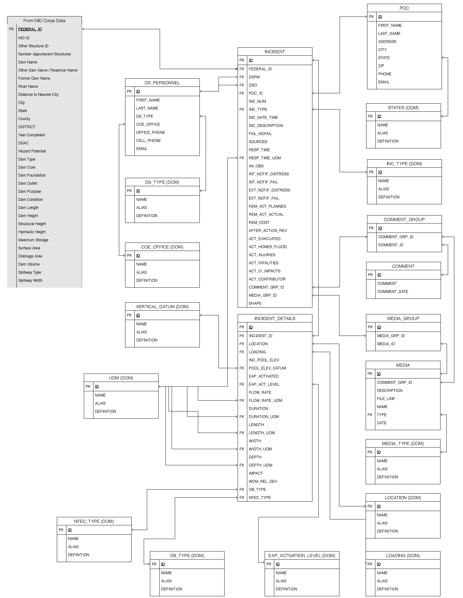
Entity Relationship Diagram (ERD) Continued

Slide 44
Entity Relationship Diagram (ERD) Continued
Basic Components:
Entities / Tables
Keys (Primary and Foreign)
Relationships
Attributes / Columns

Slide 45
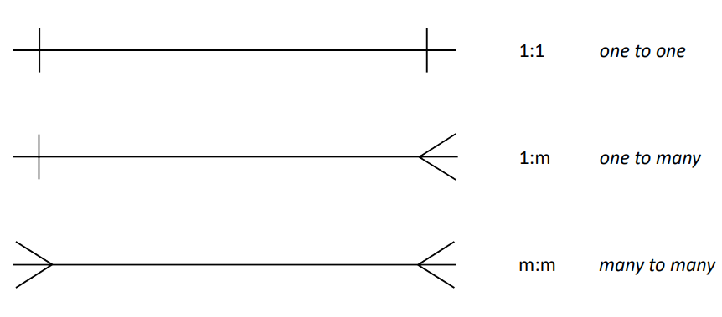
Entity Relationship Diagram (ERD) Continued - Cardinality
Crows Feet Notation (Mandatory):
1-1
1-M
M-N

Slide 46
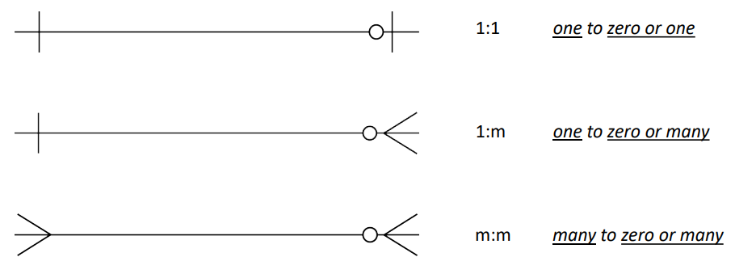
Entity Relationship Diagram (ERD) Continued - Cardinality
Crows Feet Notation (Optional):
1-1
1-M
M-N
Notes:
These allow NULL values in FK.

Slide 47
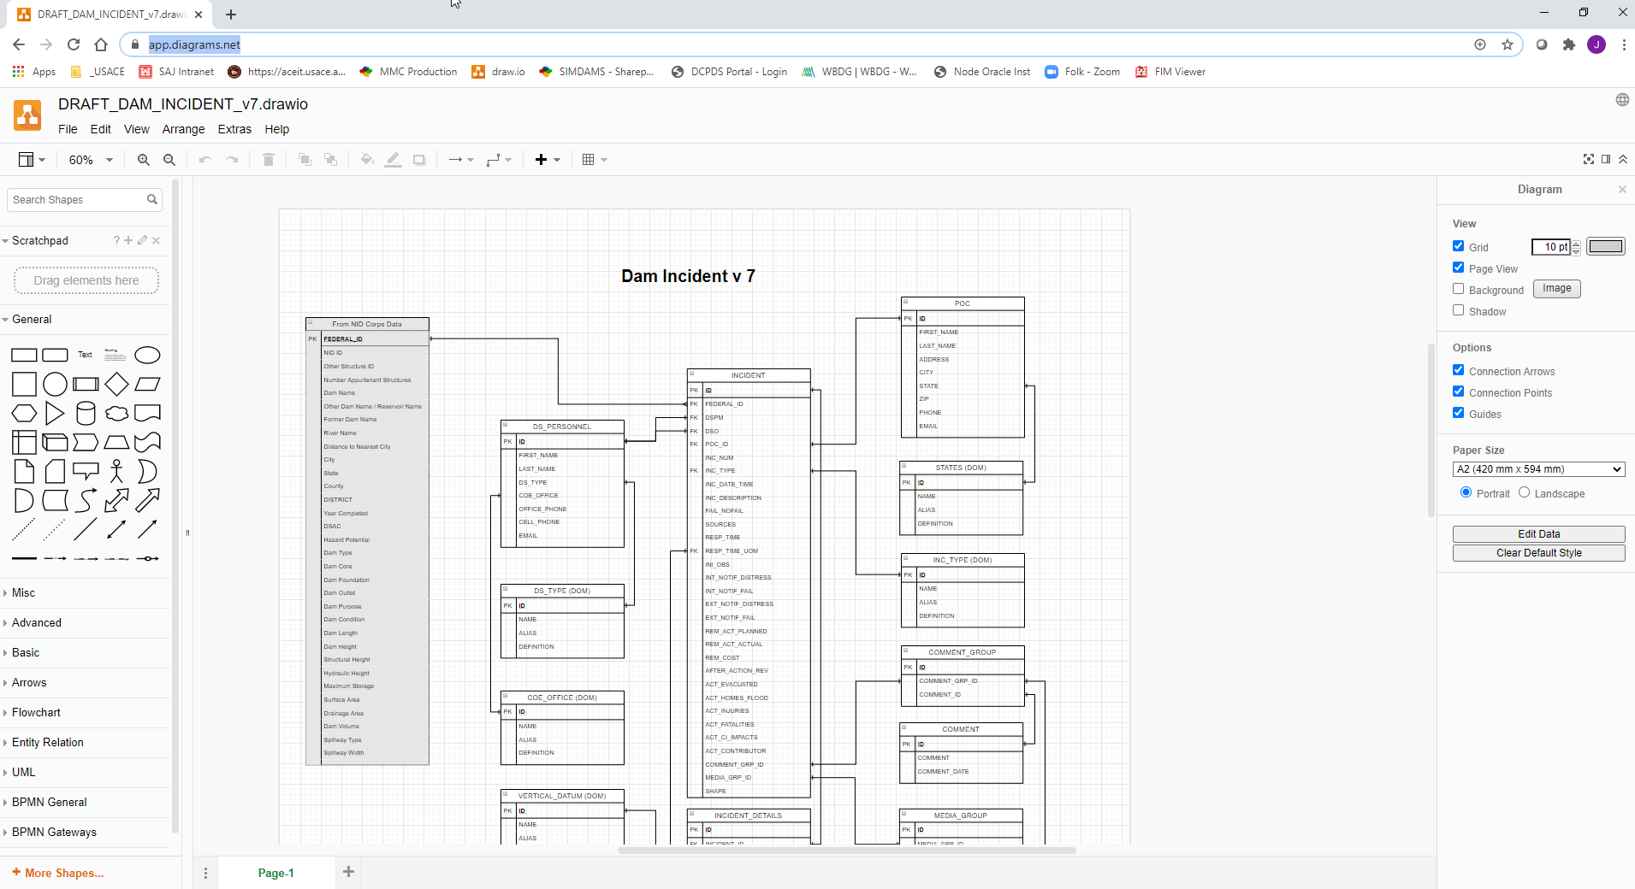
Entity Relationship Diagram (ERD) Continued
app.diagrams.net

Slide 48
Design Process Exercise
Normalization and Diagram Exercises
(Exercises 1 & 2)

Slide 49
Data Types
Numbers
Character Strings
Date and Time
NULL vs Empty String
Notes:
Make a note that there are other data types, but these are the out of the scope of this training. Binary, cursor, xml etc

Slide 50
Data Types – Numeric
Exact
NUMBER
Approximate Numeric
Floating-Point Numbers (BINARY_FLOAT, BINARY_DOUBLE)

Slide 51
Data Type – Numeric Precision vs Scale
Precision (p)
Maximum number of significant decimal digits.
Most significant is the left most nonzero digit.
Least significant is the right most known digit.
The total number of numbers.
Scale (s)
The number of digits from the decimal point to the least significant digit.
12345.6789
p = 9
s = 4

Slide 52
Data Type – Numeric NUMBER
ALL numeric data is stored as the NUMBER data type.
NUMBER(p,s)
For decimal numbers:
NUMBER(38,16)
For integer numbers:
NUMBER(38,0)

Slide 53
Data Type – Numeric NUMBER Continued
ACTUAL DATA | SPECIFIED AS | STORED AS
123.89 | NUMBER | 123.89
123.89 | NUMBER (3) | 124
123.89 | NUMBER (6,1) | 123.9

Slide 54
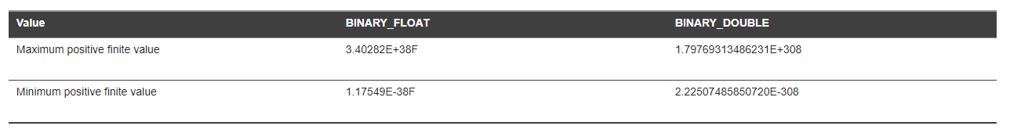
Data Type – Numeric Approximate Types
Floating-Point Numbers:
Unlike the NUMBER data type, both Floating-Point Numbers are stored using binary precision (0,1)

Slide 55
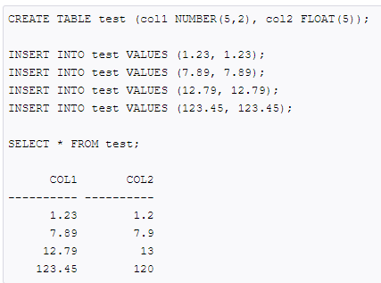
Data Type – Numeric Comparison of Types

Slide 56
Data Types – Character Strings
Fixed Length:
CHAR
NCHAR
Variable Length:
VARCHAR2
NVARCHAR2

Slide 57
Data Types – Character Strings Continued
Fixed Length Character Strings
CHAR:
Syntax: CHAR (n [BYTE | CHAR])
n = Maximum 2000 byte/char
NCHAR:
Syntax: NCHAR (n [CHAR])
n = Maximum 2000 byte
UNICODE only
Notes:
Fixed string size. If the input has less bytes than n, “blank space” takes up the remaining available space.

Slide 58
Data Types – Character Strings Continued
Variable Length Character Strings
VARCHAR2:
Syntax: VARCHAR2 (n)
n = Maximum 4000 bytes or characters (Can be extended to 32,767)
NVARCHAR2:
Syntax: NVARCHAR2 (n)
n =
AL16UTF16 Max 2000 (13,383 Extended)
UTF8 Max 4000 (32,767 Extended)
UNICODE Only

Slide 59
Data Types – Character Strings Continued
Use CHAR or NCHAR:
when the data entries are consistent size.
Use VARCHAR2(n) or NVARCHAR2(n):
when the data entries vary in size.

Slide 60

Data Types – Character Strings Continued
Unicode Character Strings
nchar and nvarchar
String size in byte-pairs
Encoding differences
https://home.unicode.org/
Notes:
Unicode is an IT standard for consistent encoding, representation, and handling of text expressed in most of the world’s writing systems.
Likely won’t use in a USACE system.

Slide 61
Data Types – NULL vs Empty String
NULL:
Refers to nothing or the absence of value.
Empty String:
Refers to a unique string with value of zero length.

Slide 62
Data Types – Date
Common Date Types
DATE
TIMESTAMP

Slide 63
Data Types – Date DATE
DATE
Default Values:
The year is the current year (from SYSDATE)
The month is the current month (from SYSDATE)
The day is 01
Hour, Minute, Second set to 0
SYNTAX: DATE

Slide 64
Data Types – Date TIMESTAMP
TIMESTAMP
Default Values:
The year is the current year (from SYSDATE)
The month is the current month (from SYSDATE)
The day is 01
Hour, Minute, Second set to 0
Fractional Seconds is 6
SYNTAX: TIMESTAMP (fractional seconds)
Fractional Seconds 0-9

Slide 65
Database Objects
A relational database data structure used to either store or reference data.

Slide 66
Database Objects - Continued
Common DB Objects:
Tables
Sequences
Synonyms
Indexes
Constraints
Views (and Queries)
Triggers

Slide 67

Tables
Elements of a Relational DB table:
Named vertical columns
Horizontal rows
Cell
Primary Key column
Think Spreadsheet!

Slide 68
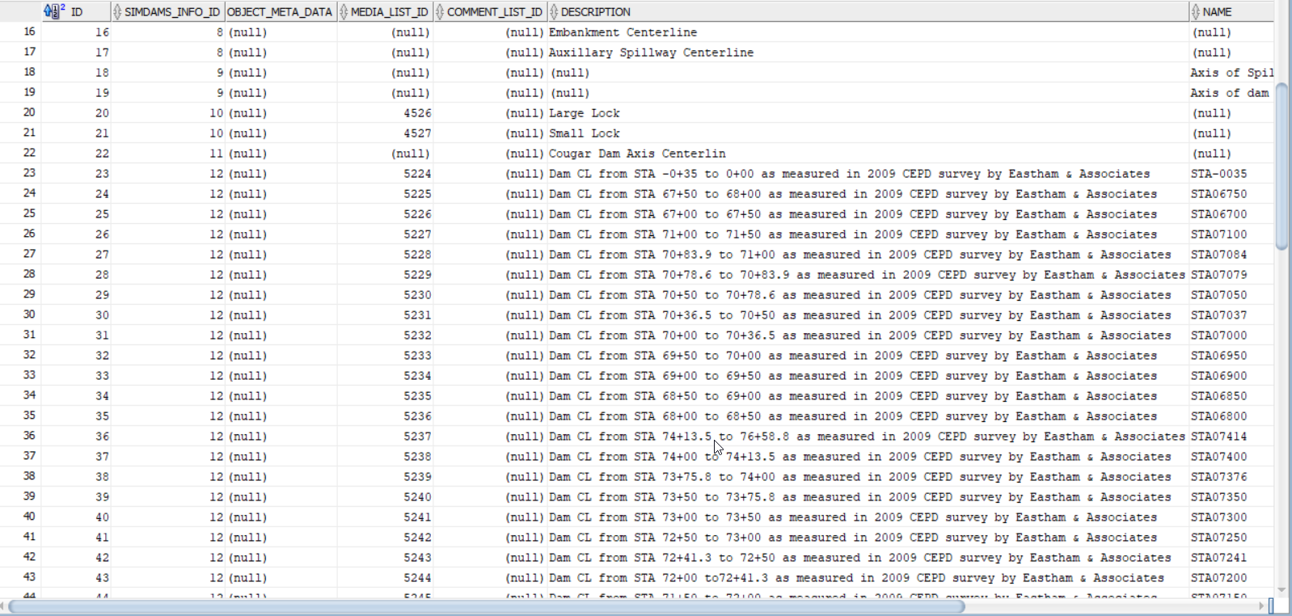
Tables Continued
Notes:
Cell – the intersection of a row and column

Slide 69
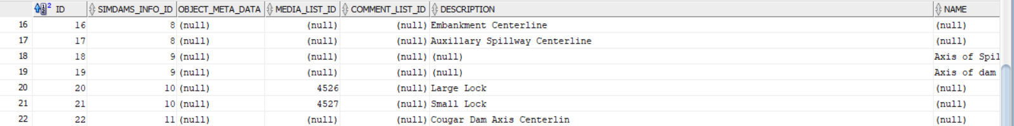
Tables continued
Tuple
All data for an individual record.
Notes:
Record = each row

Slide 70
Tables Continued
Common Table SQL:
CREATE TABLE
DROP TABLE
This is to delete a db object
INSERT
UPDATE
DELETE

Slide 71
Sequences
Sequence:
An object that allows for user generated unique INTEGER values.
CREATE Sequence
CREATE SEQUENCE SEQ_NAME_ID START WITH 1 INCREMENT BY 1 NOCACHE;
Notes:
After the sequence is created within the DB, delete the rows from NAME and INSERT using NEXT VALUE FOR syntax.

Slide 72
Tables Continued – SQL Examples
CREATE Table with Sequenced PK
CREATE SEQUENCE seq_name START WITH 1 INCREMENT BY 1 NOCACHE
CREATE TABLE NAME (
ID number(38,0) DEFAULT seq_name.nextval NOT NULL PRIMARY KEY,
FIRST_NAME varchar2 (50) NOT NULL,
LAST_NAME varchar2 (50) NOT NULL,
PHONE varchar2 (20);

Slide 73
Tables Continued – SQL Examples
DROP Example
DROP TABLE NAME;

Slide 74
Tables Continued – SQL Examples
INSERT Example
INSERT INTO NAME(FIRST_NAME, LAST_NAME, PHONE)VALUES(Malinda’, Thorne', '555-111-2222');
INSERT INTO NAME(FIRST_NAME, LAST_NAME, PHONE)VALUES(Anita’, Holt', '555-222-3333');
INSERT INTO NAME(FIRST_NAME, LAST_NAME, PHONE)VALUES('Kevin', ’Parish', '555-333-44444');
INSERT INTO NAME(FIRST_NAME, LAST_NAME, PHONE)VALUES(‘Rebecca', ’Ivers', '555-444-5555');
INSERT INTO NAME(FIRST_NAME, LAST_NAME, PHONE)VALUES(‘Jamison', ’Selby', '555-555-6666');
INSERT INTO NAME(FIRST_NAME, LAST_NAME, PHONE)VALUES(‘Christa', ’Rowland', '555-666-7777');
INSERT INTO NAME(FIRST_NAME, LAST_NAME, PHONE)VALUES(‘Nova', ’Wynne', '555-777-8888');
COMMIT;

Slide 75
Tables Continued – SQL Examples
Update Example
UPDATE NAME
SET PHONE = '555-888-9999'
WHERE ID = 1;
COMMIT;

Slide 76
Tables Continued – SQL Examples
DELETE Example
DELETE FROM NAME
WHERE ID = 1;
COMMIT;

Slide 77
Synonyms
Synonyms:
An alias for other database objects.
CREATE Synonym
CREATE SYNONYM THENAMES FOR NAME;
Notes:
When to use synonyms
You will find some situations which you can effectively use synonyms.
1) Simplify object names
If you refer to an object from another database (even from a remote server), you can create a synonym in your database and reference to this object as it is in your database.
2) Enable seamless object name changes
When you want to rename a table or any other object such as a view, stored procedure, user-defined function, or a sequence, the existing database objects that reference to this table need to be manually modified to reflect the new name. In addition, all current applications that use this table need to be changed and possibly to be recompiled. To avoid all of these hard work, you can rename the table and create a synonym for it to keep existing applications function properly.

Slide 78
Indexes
Indexes are objects that are used to quickly locate and access data within the database during a query.
Look-up table created:
Column 1 is a search key
Column 2 is the data reference
Notes:
Indexes create look up tables.
The first column is the Search key that contains a copy of the primary key or candidate key of the table. These values are stored in sorted order so that the corresponding data can be accessed quickly. Note: The data may or may not be stored in sorted order.
The second column is the Data Reference or Pointer which contains a set of pointers holding the address of the disk block where that particular key value can be found.

Slide 79
Indexes Continued
Use when:
Frequent retrieval of approximately 15% of a large table.
Use to perform join performance.
Consider for use on foreign keys.

Slide 80
Indexes Continued
Not to use:
Small tables
Tables that have frequent, large batch updates/inserts.
Columns with a high number of NULL values.
Columns that are frequently manipulated.
Primary keys (already indexed)

Slide 81
Indexes Continued – SQL
CREATE Index
CREATE INDEX iFirst ON NAME(FIRST_NAME);
CREATE INDEX iLast ON NAME(LAST_NAME);

Slide 82
Constraints
Primary Key Creation
CREATE TABLE NAME (
ID number(38,0) DEFAULT seq_name.nextval NOT NULL PRIMARY KEY,
FIRST_NAME varchar2(50) NOT NULL,
LAST_NAME varchar2(50) NOT NULL,
PHONE varchar2(20);
Notes:
You can use a sequence or an IDENTITY column. I prefer the IDENTITY column.

Slide 83
Constraints Con’t
Foreign Key Creation
ALTER TABLE NAME
ADD CONSTRAINT fk_name_to_dis FOREIGN KEY(DISTRICT_ID)
REFERENCES DISTRICTS(ID)
ON DELETE CASCADE;
Notes:
Use the FK example code. Create DISTRICTS, INSERT INTO the DISTRICTS, add DISTRICT_ID to NAME, UPDATE the rows with the correct DISTRICT_ID,
run the ALTER TABLE add constraint. Run the Query showing the FK Worked.

Slide 84
Queries
A request for data or information from a database table or combination of tables.

Slide 85
Queries Continued
SELECT Statement
SELECT * FROM NAME;
SELECT FIRST_NAME, LAST_NAME FROM NAME;
* In a SELECT statement means ALL columns within the table.

Slide 86
Queries Continued – Where Clause
The WHERE clause is used to specify a condition for filtering and returning rows within a SELECT statement.

Slide 87
Queries Continued – Where Clause
SELECT STATEMENT USING WHERE CLAUSE
SELECT FIRST_NAME, LAST_NAME
FROM NAME
WHERE ID = 2;
Returns ‘Anita’ and ‘Holt’

Slide 88
Queries Continued – Where Clause
Comparison Operators
= Equality
!=, <> Inequality
>, >= Greater Than, greater than or equal to
<, <= Less Than, less than or equal to
IN Equal to any value in a list of values
NOT IN Not equal to any value in a list of values
[NOT] BETWEEN n and m Equivalent to [NOT] >= n and <= m
[NOT] EXISTS Return true if subquery returns at least one row
IS [NOT] NULL NULL Test

Slide 89
Database Object Exercise
Database Creation, Modification, and Querying Exercises
(Exercises 3, 4, 5, 6, & 7)
Notes:
Use the FK example code. Create DISTRICTS, INSERT INTO the DISTRICTS, add DISTRICT_ID to NAME, UPDATE the rows with the correct DISTRICT_ID,
run the ALTER TABLE add constraint. Run the Query showing the FK Worked.

Slide 90
Views
What is a view?
Similar to a virtual table
Data from 1+ tables and/or 1+ databases
Built on SQL queries.
Notes:
Views won’t update when a table is updated, but when the view is referenced, the query will re-run with the updated data included.

Slide 91
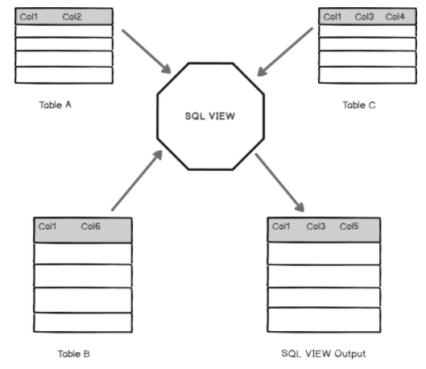
Views Continued

Slide 92
Views Continued – SQL
Common View SQL
CREATE OR REPLACE VIEW

Slide 93
Views Continued – SQL
CREATE VIEW
CREATE OR REPLACE VIEW v_NAME AS
SELECT FIRST_NAME AS "FIRST NAME", LAST_NAME AS "LAST NAME"
FROM NAME;

Slide 94
Views Continued – SQL
Modify a view
CREATE OR REPLACE VIEW v_NAME AS
SELECT FIRST_NAME AS "FIRST NAME", LAST_NAME AS "LAST NAME", PHONE
FROM NAME;

Slide 95
Triggers
Defined as:
A stored procedure that runs when an event occurs on a table or view in the database. (INSERT, UPDATE, DELETE)
Uses:
Maintaining Integrity
Historical Log

Slide 96


git and TortoiseGit

Slide 97
GIT and TortoiseGit
Git is a version-control system for tracking changes in computer files and coordinating work on those files among multiple people.
Git is a Distributed Version Control System.
Git does not necessarily rely on a central server to store all the versions of a project's files

Slide 98
GIT and TortoiseGit Continued
Common Commands:
git clone (cmd)
git branch (tg)
git pull (tg)
git push (tg)
git commit (tg)

Slide 99
GIT and TortoiseGit - git clone
Clones (copies) the repo onto your local machine.
The repo can be local or remote.

Slide 100
GIT and TortoiseGit - git clone Continued
git clone https://github.com/jahall1119/DB_Training.git
CMD Prompt Commands needed
cd – change directory
<directory letter>: - change to a different drive. e.g. d:

Slide 101
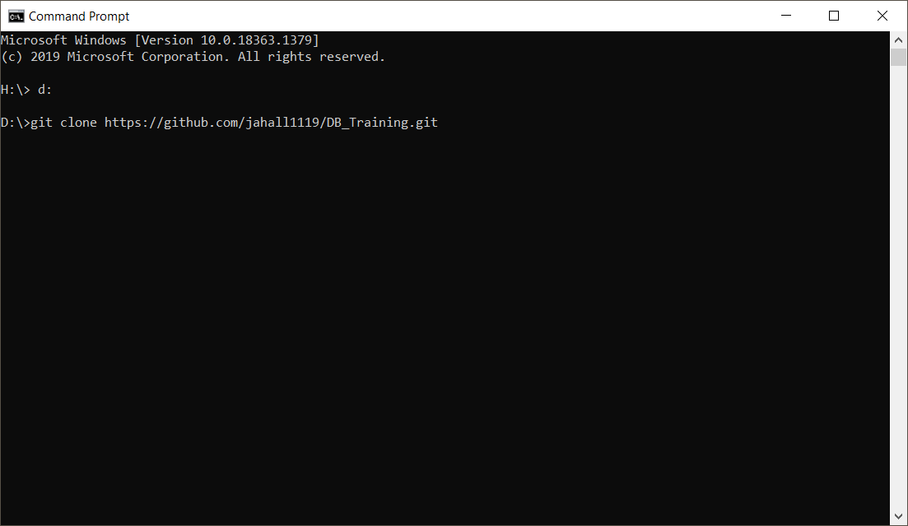
GIT and TortoiseGit - git clone Continued

Slide 102
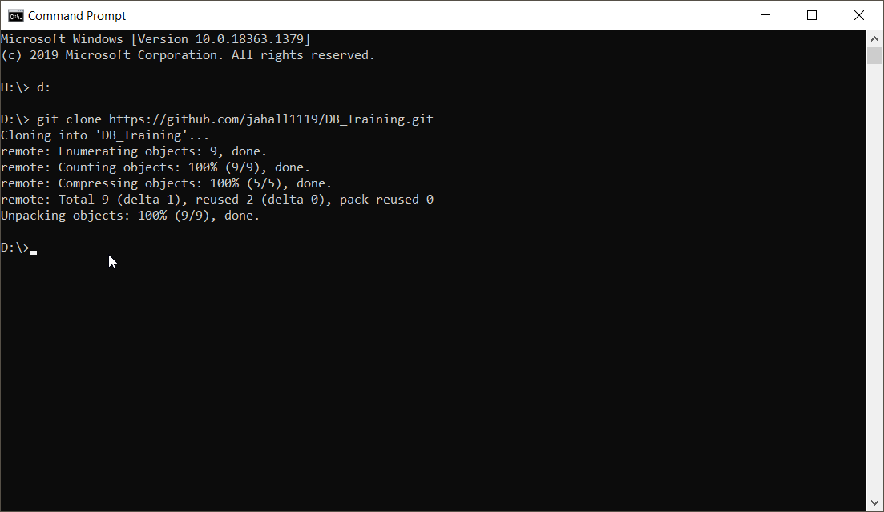
GIT and TortoiseGit - git clone Continued

Slide 103
GIT and TortoiseGit - git branch & git commit
git branch
An offshoot of the code that is separate from the main branch of the code.
Changes to the code can be made without affecting the main / parent branch.
NOTE: Everyone doing scripting on the DB will have their own branch.

Slide 104
GIT and TortoiseGit - git branch & git commit continued
git commit
Record your changes to the local repository.

Slide 105
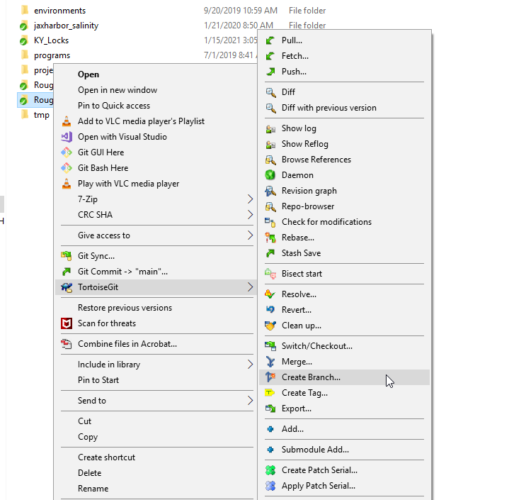
GIT and TortoiseGit - git branch & git commit continued

Slide 106
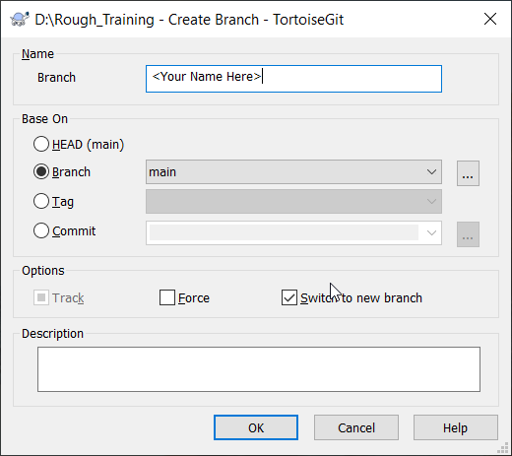
GIT and TortoiseGit - git branch & git commit continued

Slide 107
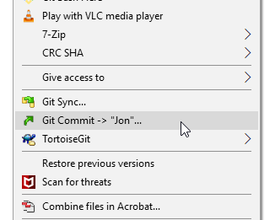
GIT and TortoiseGit - git branch & git commit continued

Slide 108
GIT and TortoiseGit - git push
Incorporate changes made in your local repository to the remote repository.

Slide 109
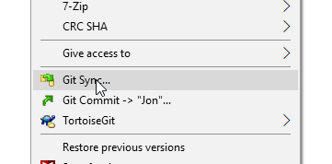
GIT and TortoiseGit - git push continued

Slide 110
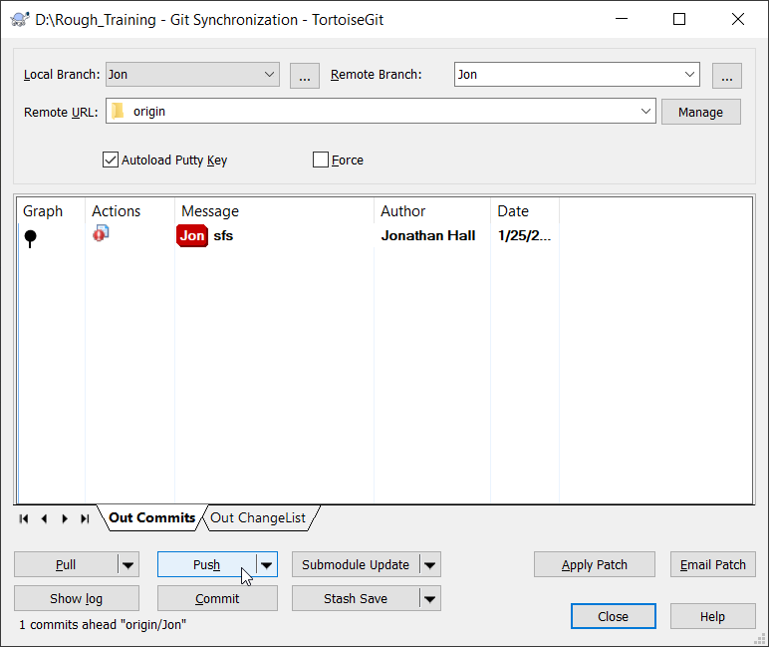
GIT and TortoiseGit - git push continued

Slide 111
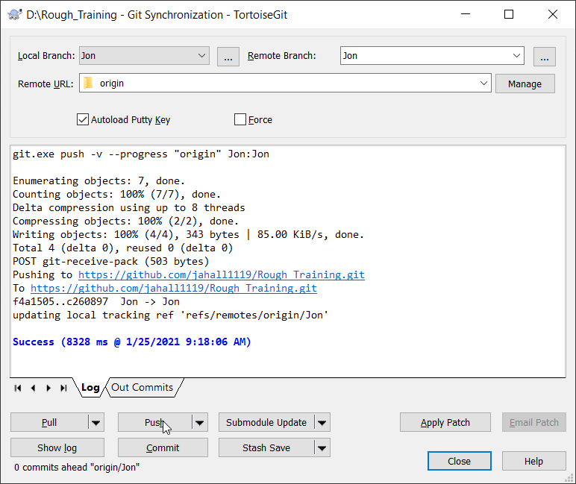
GIT and TortoiseGit - git push continued

Slide 112
GIT and TortoiseGit - git pull
Incorporate changes made in a remote (online) repository into your current branch.

Slide 113
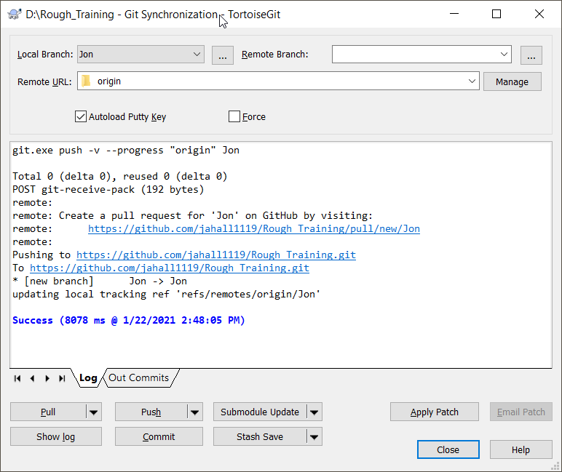
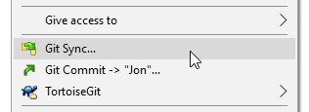
GIT and TortoiseGit - git pull Continued

Slide 114
GIT and TortoiseGit Exercise
GIT and TORTOISEGIT Exercise
(Exercise 8)

Slide 115
Online Sources - Oracle
Oracle Online Documentation
https://docs.oracle.com/database/121/
Stackoverflow:
https://stackoverflow.com/
w3schools:
https://www.w3schools.com/sql/default.asp

Slide 116
Online Sources – Git and TortoiseGit
GIT
https://www.atlassian.com/git/tutorials/what-is-git
https://www.atlassian.com/git/tutorials/atlassian-git-cheatsheet
https://www.freecodecamp.org/news/learn-the-basics-of-git-in-under-10-minutes-da548267cc91/#:~:text=Git%20is%20a%20version%2Dcontrol,versions%20of%20a%20project's%20files
http://joelabrahamsson.com/remote-branches-with-tortoisegit/
https://git-scm.com/docs/
https://github.com/

