Slide 1
CS425 SWE Project
Kevin Justice

Slide 2
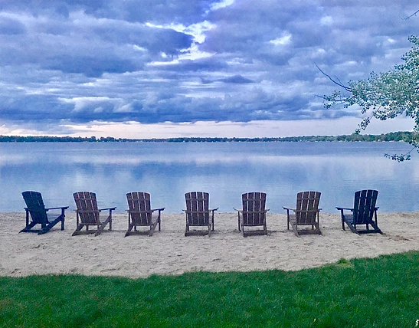
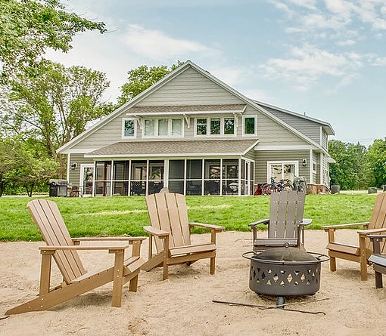
Lake Darling Resort

Slide 3
About Lake Darling Resort
Managed by a Property Management Company(My Client)
Each Villa has an owner
Owners get a percentage of Rental Fees monthly
Customers Can Book Villa’s by making a Reservation
Each Reservation consists of 1 Customer for 1 Villa
Customer info is needed to make reservation

Slide 4
Problem & Vision
Lake Darling Resort needs an upgrade.
Currently using paper, excel, word to handle reservations.
Not very efficient for checking availability and booking
No 24/7 Service
Gathering data for monthly reports is time consuming
The Lake Darling Resort App Solves These Problems

Slide 5
Technologies Used
Spring Framework
Spring Boot
Spring Data JPA
Spring Security
Thymeleaf
MySQL database
Maven Project in IntelliJ

Slide 6
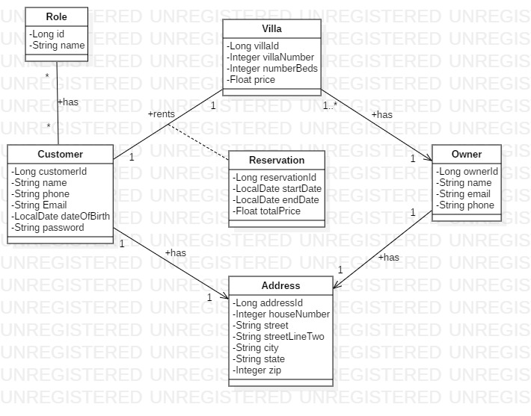

Slide 7
Core Use Case 1: View Villa Availability Actor: Anonymous User
User Action
System
Clicks “View Availability”
Selects Dates and Clicks “Check Availability”
Returns Form with Date Pickers
Returns List of Villa’s Available For Those Dates

Slide 8
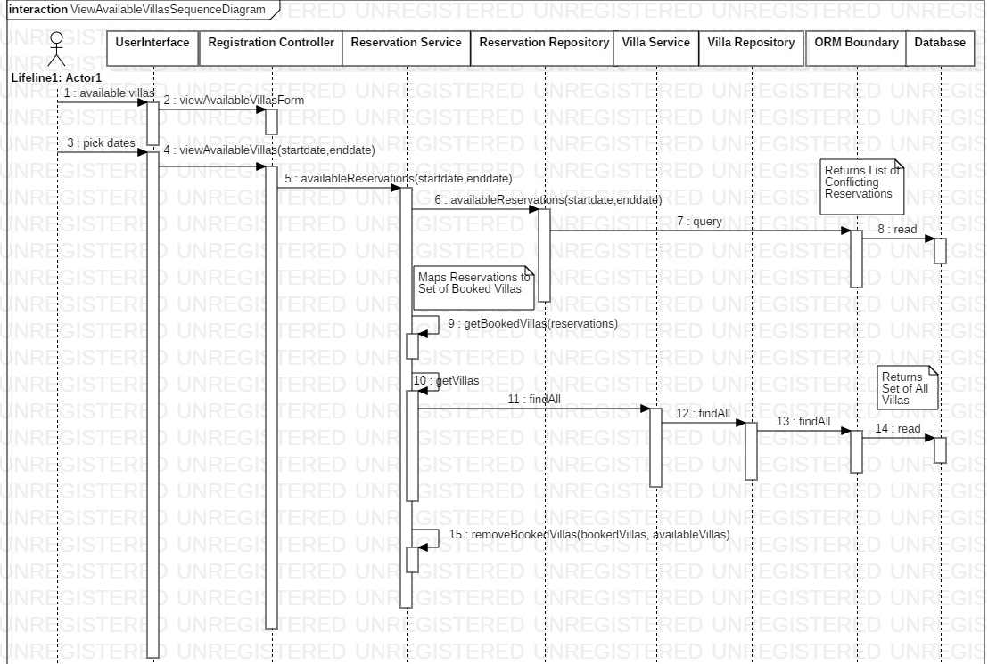

Slide 9
Core Use Case 2: Book A Reservation Actor: Logged in Customer
User Action
System Action
Customer Clicks “Book Now”
Customer Selects Dates and Number Beds Clicks “Checkout”
Customer Clicks “Book Stay”
Returns Reservation Form with Date and Number Beds Pickers
Returns Checkout Form with Reservation Info and Price
Returns Success Page

Slide 10
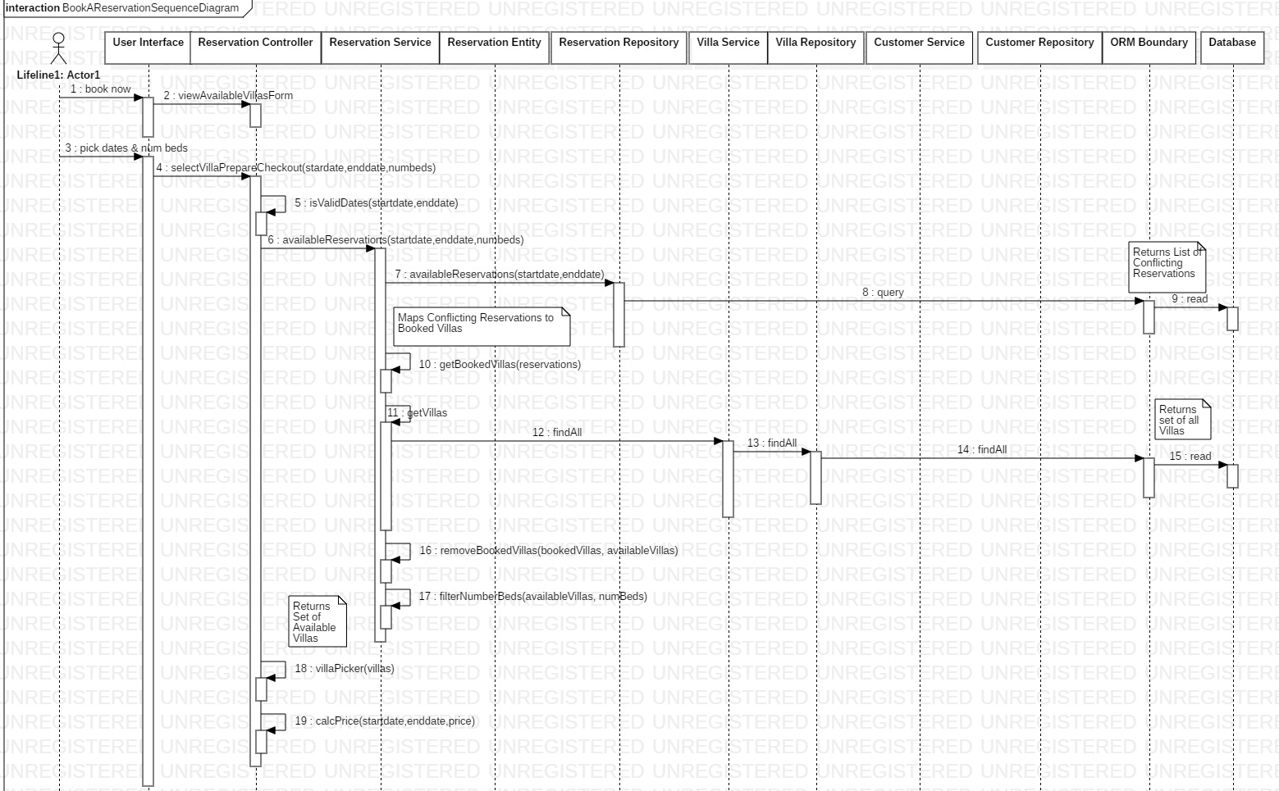

Slide 11
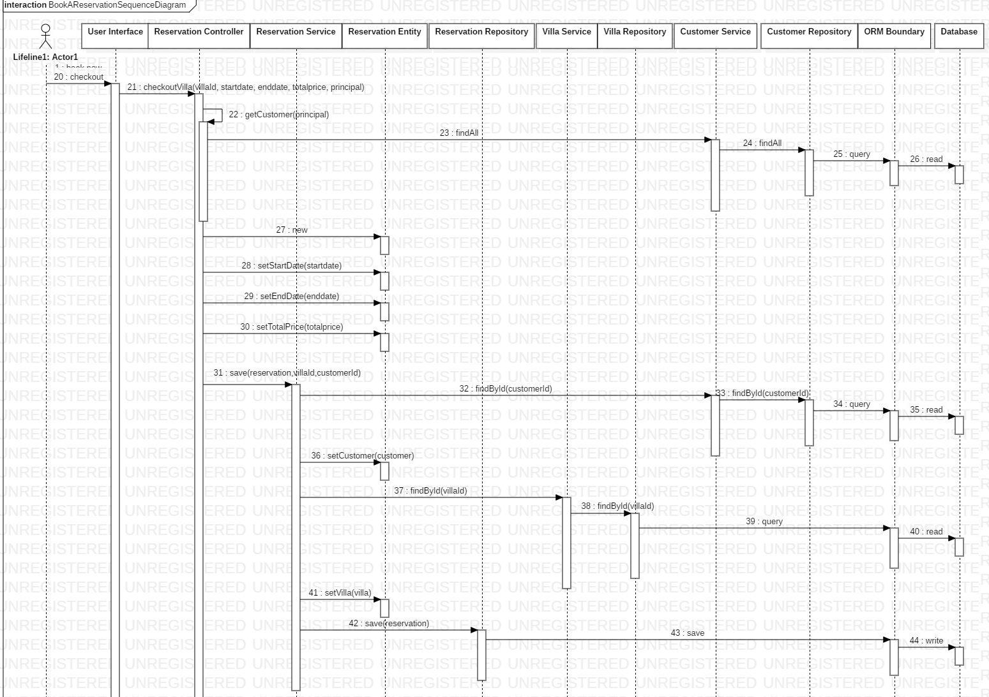

Slide 12
Supplemental Use Cases: CRUD Operations Actor: Logged in Admin
Forms to Add New
Custom
Villa
Owner
Not Implemented Yet
Edit Forms
Delete Operations
Tables to View
Customer
Villa
Owner
Reservations

Slide 13
Application Demo

