Slide 1
EE 445L – Embedded System Design Lab
Lab 7 decisions
Spring 2012 https://docs.google.com/spreadsheet/ccc?key=0ArNoO7MMFPE0dE1CX01XUEJVbVNMWWpVTm9WaFRWUFE#gid=0
Fall 2012 https://docs.google.com/spreadsheet/ccc?key=0AuBzSLNB7L15dE52SVRFdTk2SnQyVGFOMWljM0EtYWc#gid=0
Fall 2013 https://docs.google.com/document/d/1xxQRXdXPOshF8ZRLsbFsvigfQGiEOBVbb00By9n6DlA
EE 445L – Bard, Valvano
1

Slide 2
What should it do?
Game (graphics, sound, keys)
Measure something
Medical (hearing aid, heart sounds, ekg)
Sell yourself
  Resume, grad school application
  Web presence (YouTube, blogs, wikis)
EE 445L – Bard, Valvano

Slide 3
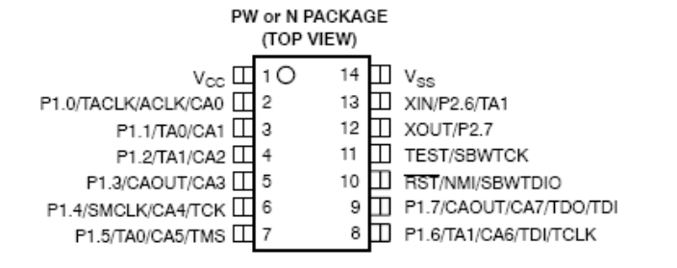
Microcontroller
TM4C123 like Lab 6
MSP430F2012 or MSP430F2013
    1.8V to 3.7V, very low power
    2 KiB EEPROM, 128 bytes RAM
    14-pin PDIP package, 10 I/O pins
    SCI, SPI, I²C, 10/16-bit ADC
    Debugger, assembler, compiler for free
    Samtec SLM-104-01-G-S
    TI MSP430F2012IN or MSP430F2013IN
EE 445L – Bard, Valvano

Slide 4
Input devices
Switches (B3Fxxx.pdf)
Keypad
Microphone (Electretxxx.pdf)
Accelerometer (ADXL202.pdf)
Sparkfun sensor page
  https://www.sparkfun.com/categories/23
Adafruit
EE 445L – Bard, Valvano

Slide 5
Output devices
LEDs
  1mA red, 2mA yellow, 2mA green
  20 mA orange, 20 mA blue
32 ohm speaker
  Go stereo
Solid state relay
EE 445L – Bard, Valvano

Slide 6
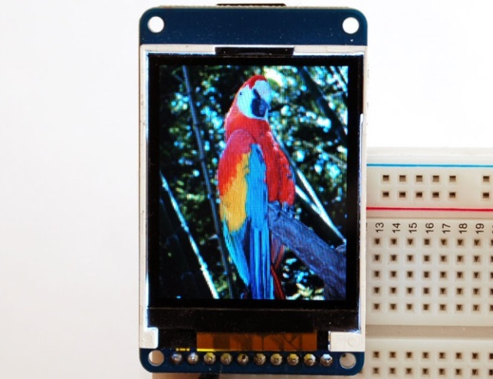
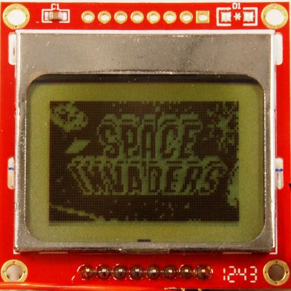
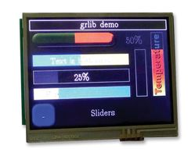
Displays
ST7735 LCD
LCD (16 by 2 line) from Valvano
Nokia 5110
Kentec (Lab checkout, have to return)
  Big screen, touch pad
EE 445L – Bard, Valvano

Slide 7
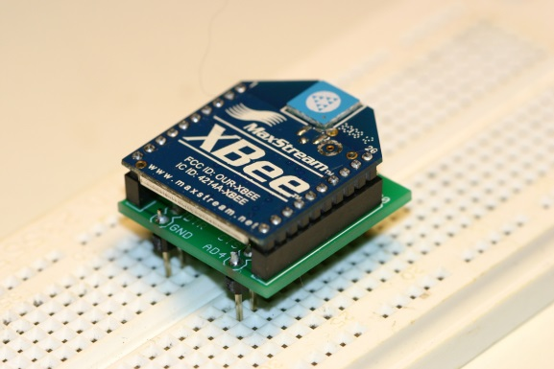
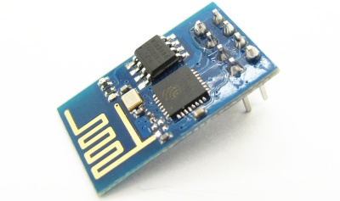
Wireless
ZigBee
  lab checkout (return it)
  simple UART, low power
CC3100
  lab checkout (have to return it)
  A lot of board space
  Lots of example code
ESP8266
  Inexpensive, small size,
  www.openweathermap.org example
  ESP8266_4C123.zip
EE 445L – Bard, Valvano

Slide 8
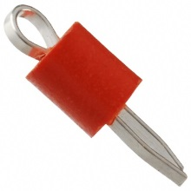
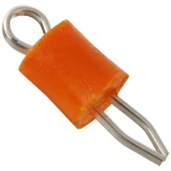
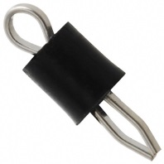
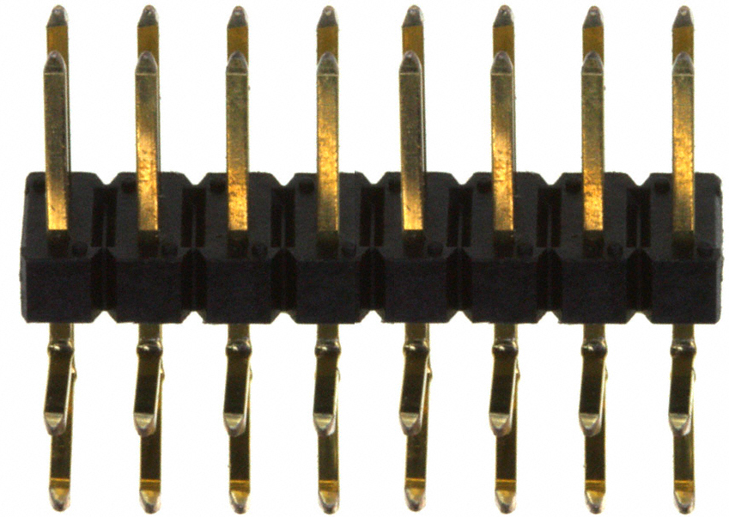
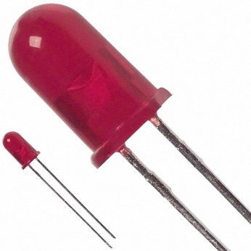
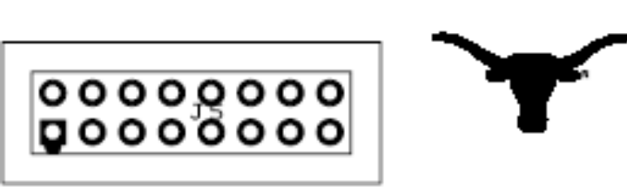
Design for test
Test points
  Powers
  Two ground
  Analog signals
Logic analyzer header
  Important digital signals
  Unused GPIO
Heartbeat LEDs
SDC or flash log
EE 445L – Bard, Valvano

Slide 9
Need more I/O?
SPI
  74HC595 outputs
  74HC165 inputs
Use two processors
  Put them on the same side
Scanning,
  Organize in rows/columns
  MatrixKeypadPeriodic_4C123
EE 445L – Bard, Valvano

Slide 10
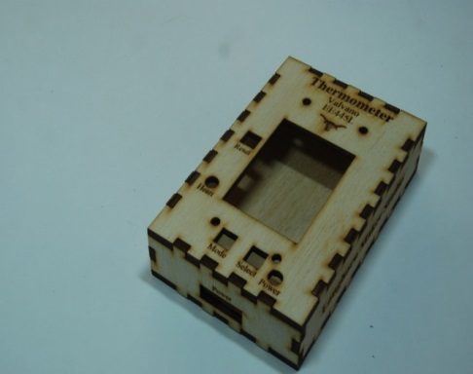
Enclosure
Mount devices
  Switches, LEDs
  LCD, I/O
Hammond 1591ESBK
  Black case,
  7.5" by 4.3" by 2.2"
  Needs drilling, cutting, and labels
Makerspace
  Needs training on Laser cutter
  Design it in PCB artist, print onto acrylic/wood
EE 445L – Bard, Valvano

Slide 11
Lab 7 Decisions
Power
  Wall-wart
  Battery
Enter it into TI Design Competition
  Lab 11 report follows competition format
  Web page
  YouTube video
Risk versus Reward
EE 445L – Bard, Valvano

