Slide 1
CHEMICALQDEVICE | INDEPENDENT RESEARCH
LLM Pancreatic Oncology Clinical Trial System:
Large Documents, Funding, and AI Peer Review
Twenty deposited papers, and the Phase 1 trial they were written to support
20
4 days
n = 18
$1.6M
deposited papers
to assemble a 12-module IND
Phase 1, 3+3 escalation
small-business ask
June 2025 to August 2026
594,657 characters
behind a 1000-simulation gate
against a $3.5M direct program
Kevin Kawchak, Chief Executive Officer, ChemicalQDevice
San Diego, CA | kevink@chemicalqdevice.com | ORCID 0009-0007-5457-8667
Oncology Trials Seminar | University Comprehensive Cancer Center
Friday, August 14, 2026
Independent research. Not medical or regulatory advice, and not endorsed by the FDA, NIH, HHS, an IRB, ICH, or any sponsor. No trial described here is active or approved.
Kevin Kawchak, CEO ChemicalQDevice
Friday, August 14, 2026
1

Slide 2
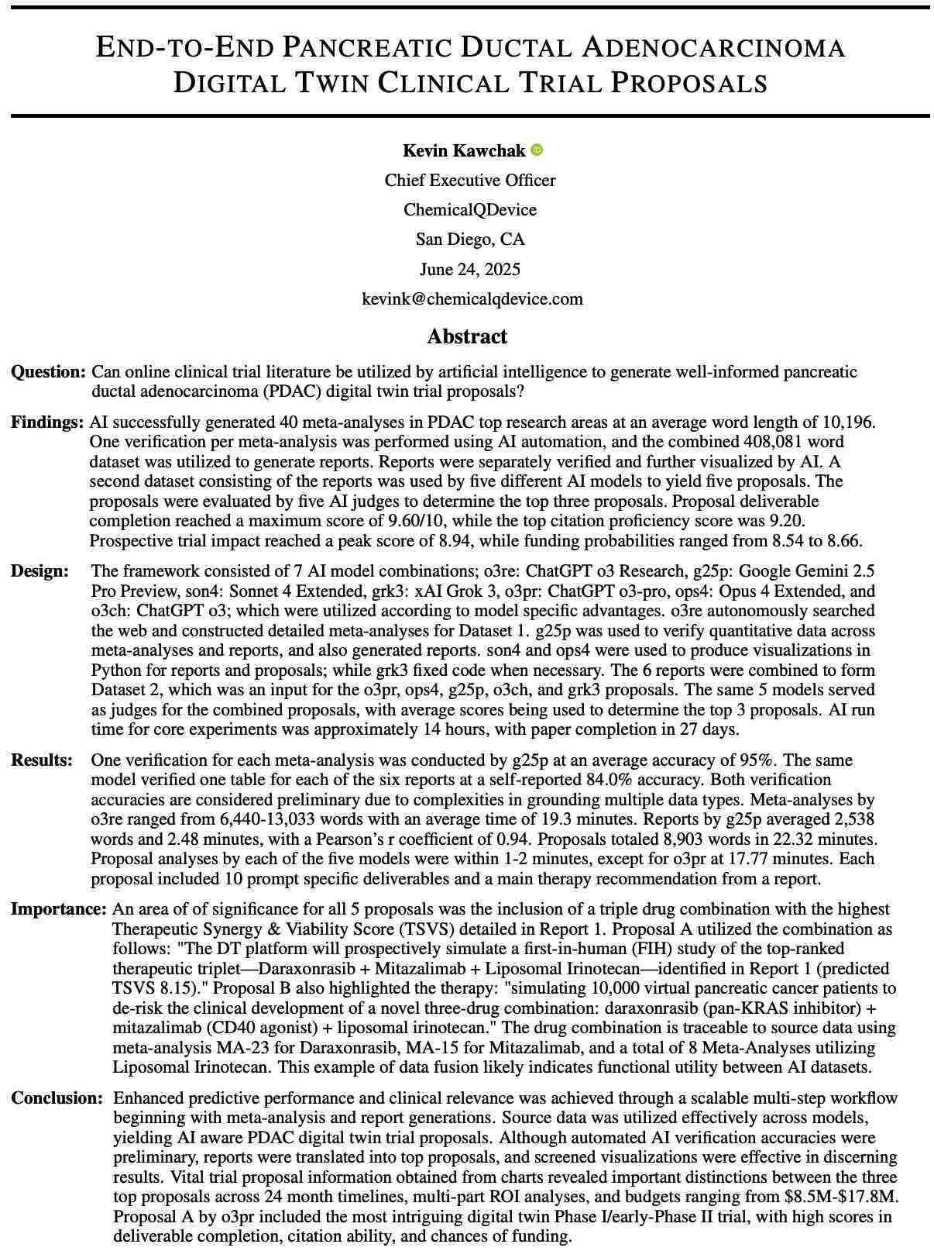
LLM Pancreatic Oncology Clinical Trial System: Large Documents, Funding, and AI Peer Review
Paper 01 of 20 | 10.5281/zenodo.15735068
01. End-to-End PDAC Digital Twin Clinical Trial Proposals
Paper Title: End-to-End PDAC Digital Twin Clinical Trial Proposals, deposited June 24, 2025
Abstract: Seven AI model combinations built 40 PDAC meta-analyses that five AI judges then ranked
Strengths: A 408,001-word source corpus, automated verification, and five judges scoring one rubric
Limitations: Models self-reported 84.0% accuracy against 95% verified; grounding remains preliminary
Results: Top proposal scored 9.60/10 on deliverable completion, 9.20 on citation, 8.94 on trial impact
LLM Trust: Cross-model verification, not one model's word, is what made the meta-analysis defensible
LLM Benefit: Named the daraxonrasib triplet the trial carries, traced to meta-analyses MA-23 and MA-15
Kevin Kawchak, CEO ChemicalQDevice
Friday, August 14, 2026
2

Slide 3
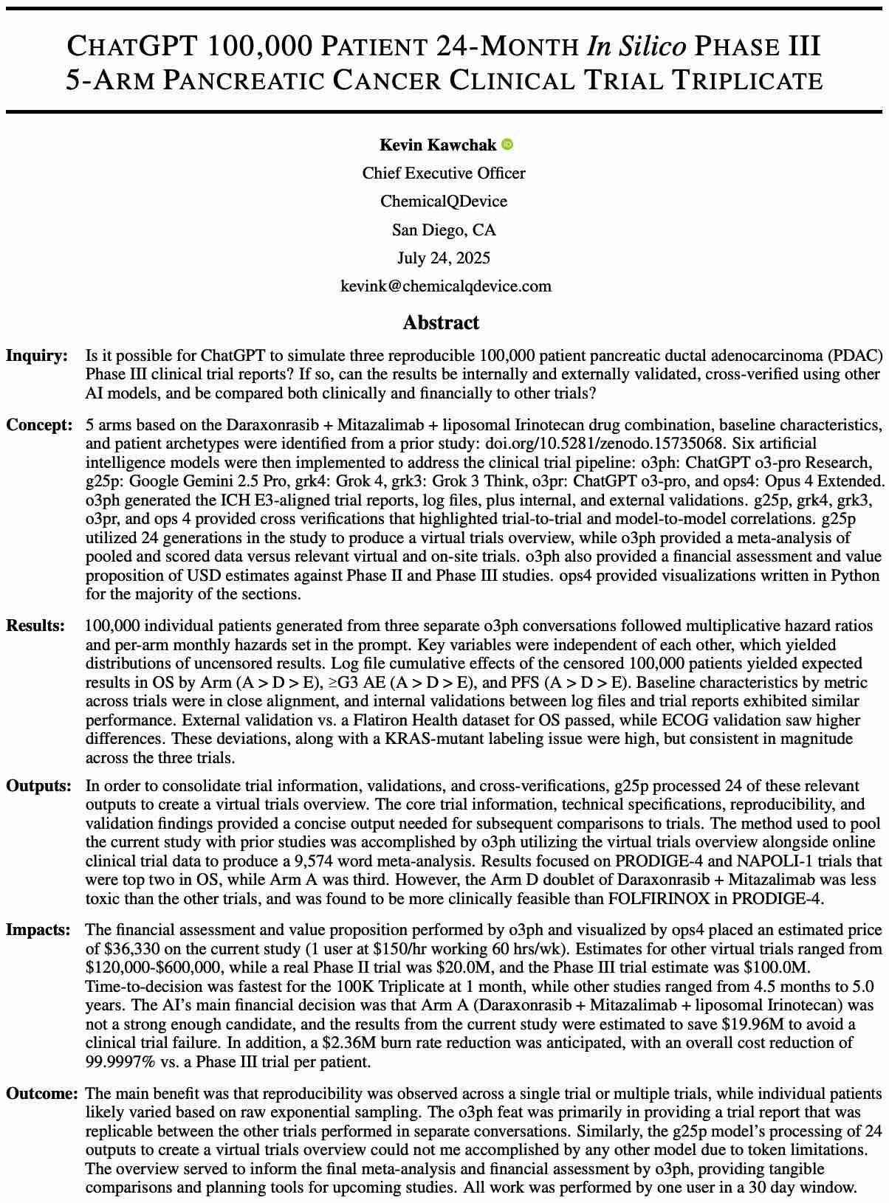
LLM Pancreatic Oncology Clinical Trial System: Large Documents, Funding, and AI Peer Review
Paper 02 of 20 | 10.5281/zenodo.16415815
02. ChatGPT 100,000 Patient In Silico Phase III Triplicate
Paper Title: ChatGPT 100,000 Patient 24-Month In Silico Phase III 5-Arm PDAC Triplicate, July 24, 2025
Abstract: One user ran a 100,000-patient, five-arm, 24-month Phase III on the LLM three times in 30 days
Strengths: Three LLM trial runs, six-model cross-verification, external validation on Flatiron OS
Limitations: ECOG validation diverged, a KRAS-mutant labeling issue persisted, patients were synthetic
Results: $36,304 total against a $20.0M Phase II and a $100.0M Phase III; 4.5 months against 5.0 years
LLM Trust: Three LLM trial runs, with divergence published, give a trialist-checkable record
LLM Benefit: Screened Arm A out before any enrollment, avoiding an estimated $19.96M failed trial
Kevin Kawchak, CEO ChemicalQDevice
Friday, August 14, 2026
3

Slide 4
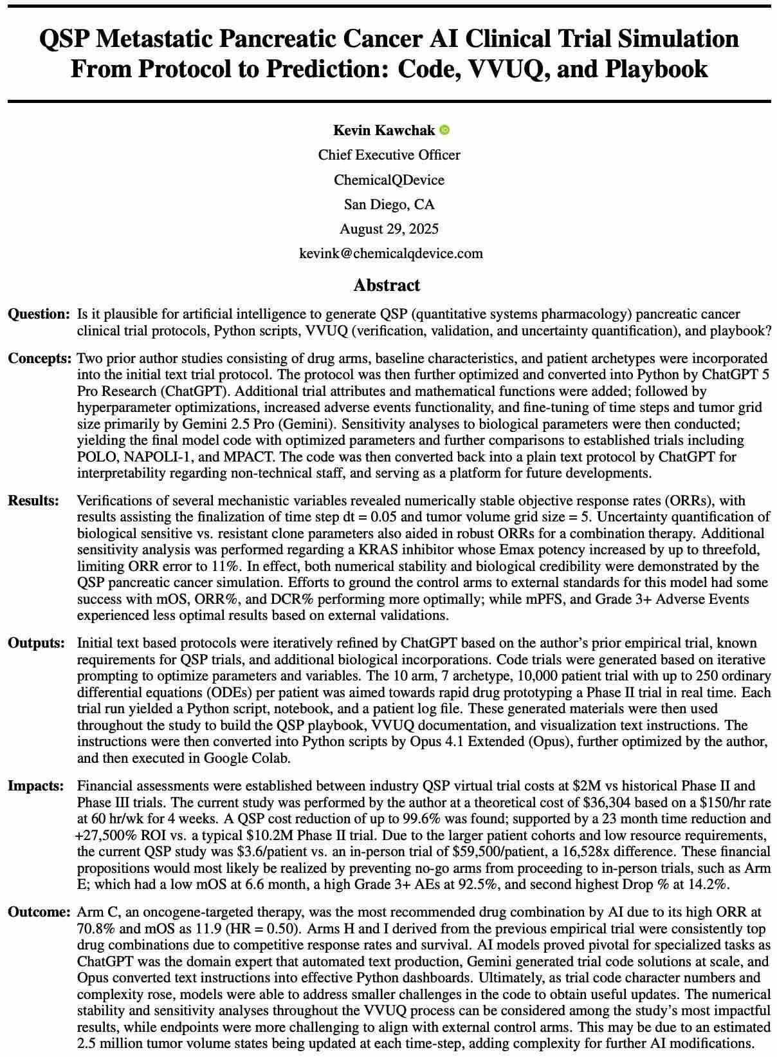
LLM Pancreatic Oncology Clinical Trial System: Large Documents, Funding, and AI Peer Review
Paper 03 of 20 | 10.5281/zenodo.17001137
03. QSP Metastatic PDAC Simulation: Code, VVUQ, and Playbook
Paper Title: QSP Metastatic PDAC AI Trial Simulation: Code, VVUQ, and Playbook, August 29, 2025
Abstract: A text protocol became Python, then a 10-arm trial of 10,000 patients at 250 ODEs each
Strengths: Numerically stable at dt = 0.05, VVUQ throughout, and a plain-text protocol regenerated
Limitations: mPFS and Grade 3+ adverse events grounded poorly to external controls; 2.5M states
Results: Arm C reached ORR 70.8% and mOS 11.9 months at HR 0.50; ORR error bounded at 11%
LLM Trust: VVUQ, not model authority, is what made the simulation admissible to a trial reviewer
LLM Benefit: Set the verification discipline the Phase 1 protocol's Phase 0 simulation gate now requires
Kevin Kawchak, CEO ChemicalQDevice
Friday, August 14, 2026
4

Slide 5
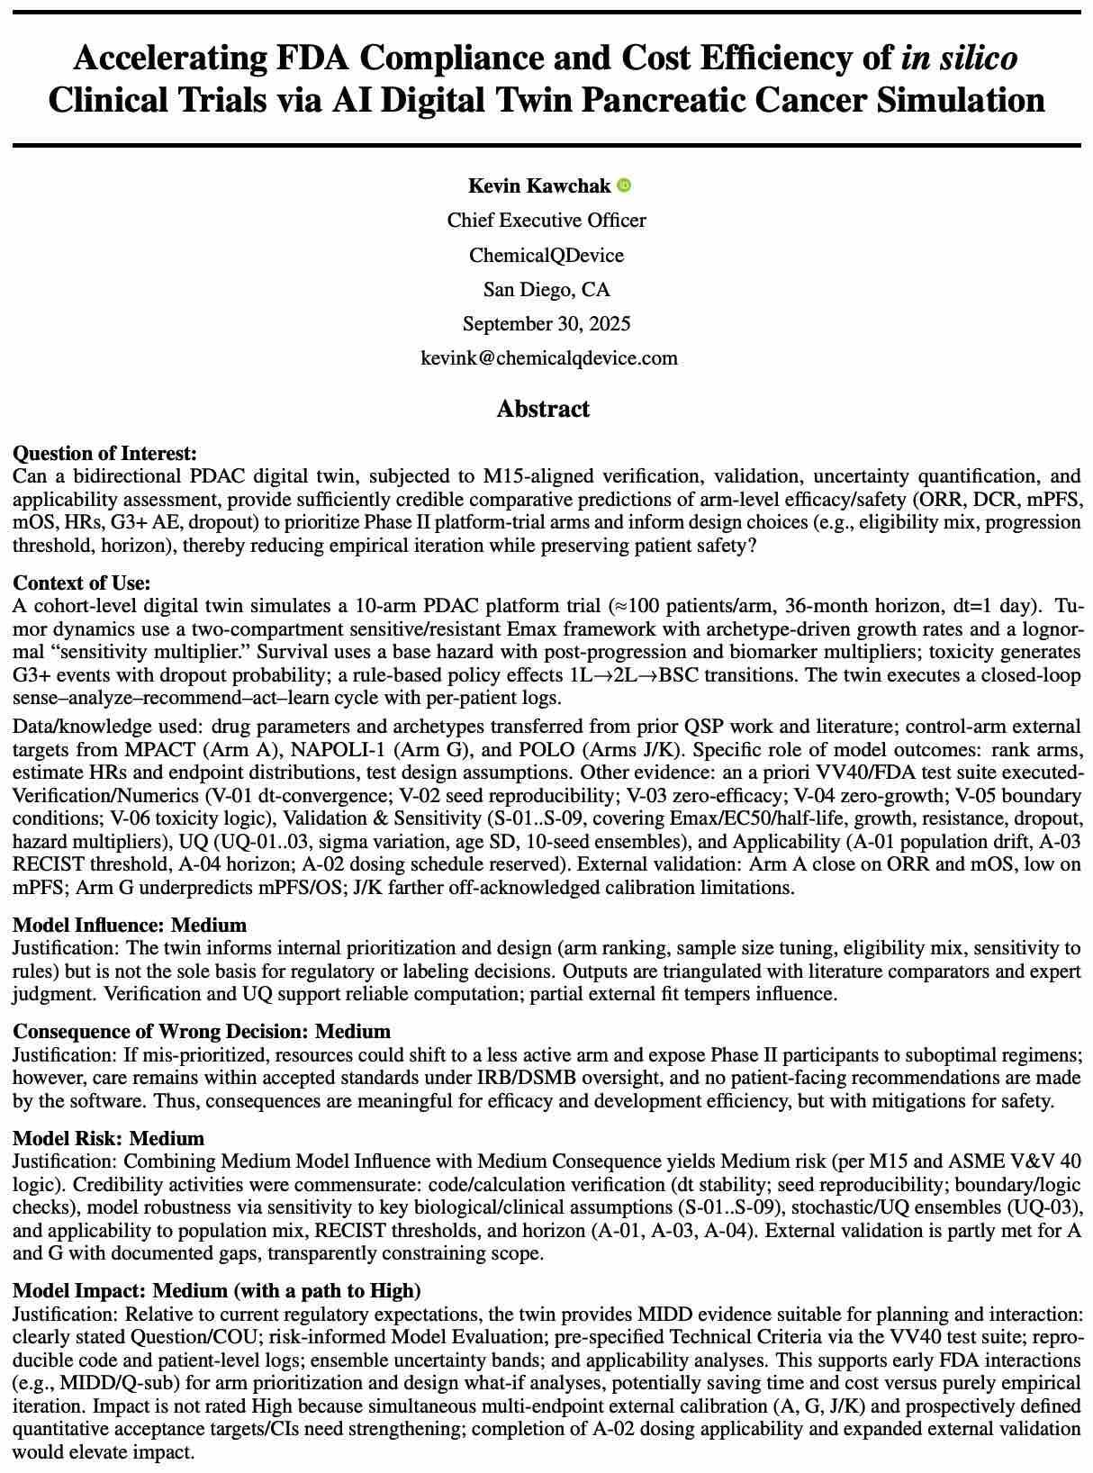
LLM Pancreatic Oncology Clinical Trial System: Large Documents, Funding, and AI Peer Review
Paper 04 of 20 | 10.5281/zenodo.17239510
04. Accelerating FDA Compliance of in silico Trials via Digital Twin
Paper Title: Accelerating FDA Compliance and Cost Efficiency of in silico Trials, September 30, 2025
Abstract: A 10-arm, 36-month PDAC platform twin assessed under ICH M15 and ASME V&V 40
Strengths: Technical criteria pre-specified across a VV40 suite, with model risk stated before results
Limitations: Model risk graded Medium, not High; multi-endpoint external calibration is open
Results: Arm A tracked external ORR and mOS closely; Arm G underpredicted mPFS and OS
LLM Trust: Grading against a published credibility framework lets a regulator audit a claim, not a word
LLM Benefit: Supplies MIDD evidence for FDA Type C and pre-submission meetings before the IND
Kevin Kawchak, CEO ChemicalQDevice
Friday, August 14, 2026
5

Slide 6
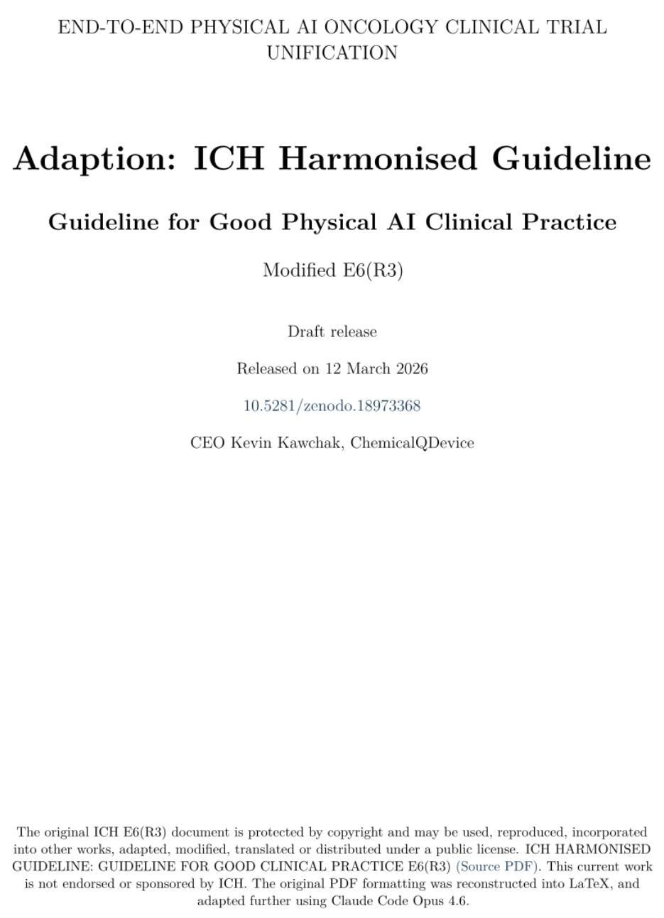
LLM Pancreatic Oncology Clinical Trial System: Large Documents, Funding, and AI Peer Review
Paper 05 of 20 | 10.5281/zenodo.18973368
05. Adaption: ICH Harmonised Guideline for Good Physical AI Practice
Paper Title: Adaption: ICH Harmonised Guideline, Physical AI Oncology Trial Unification, March 12, 2026
Abstract: ICH E6(R3) rebuilt in LaTeX and modified into a Good Physical AI Clinical Practice draft
Strengths: Works inside the guideline sites already run on rather than proposing a parallel standard
Limitations: An independent adaptation, not endorsed or sponsored by ICH, and not adopted
Results: A clause-level text naming the sponsor, investigator, and monitor duties a Physical AI arm adds
LLM Trust: Mapping the new modality onto E6(R3) means an IRB reads a familiar document
LLM Benefit: Gives the LLM-directed Whipple its GCP spine, cited at Section 1.4 of both trial protocols
Kevin Kawchak, CEO ChemicalQDevice
Friday, August 14, 2026
6

Slide 7
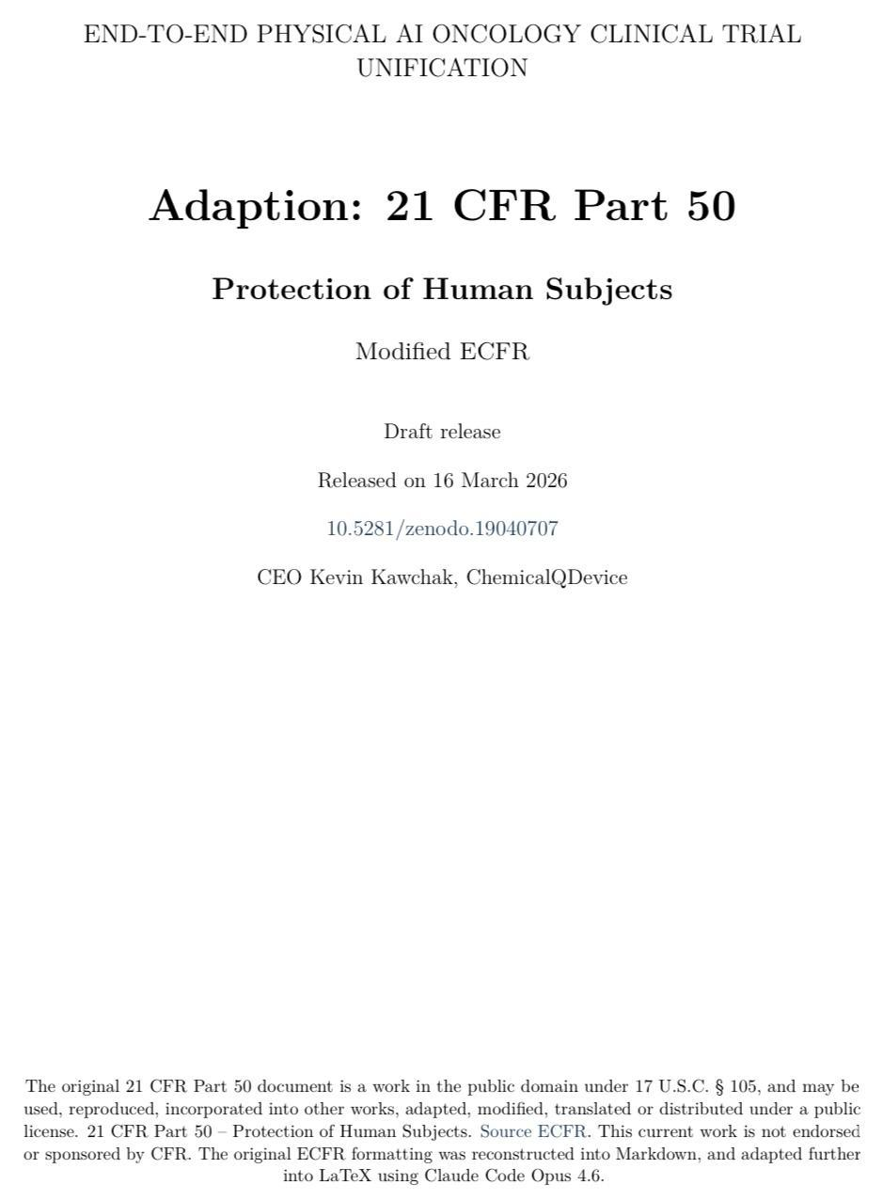
LLM Pancreatic Oncology Clinical Trial System: Large Documents, Funding, and AI Peer Review
Paper 06 of 20 | 10.5281/zenodo.19040707
06. Adaption: 21 CFR Part 50, Protection of Human Subjects
Paper Title: Adaption: 21 CFR Part 50, Physical AI Oncology Trial Unification, March 16, 2026
Abstract: Public-domain eCFR text rebuilt in Markdown, then LaTeX, around human-subject protection
Strengths: Human-subject protection is settled first, before any autonomy claim is made for the system
Limitations: An independent modified regulatory draft, not endorsed by the FDA or by the eCFR
Results: Consent elements restated so a participant can check each one against the trial's own record
LLM Trust: Consent written as a participant capability, not a sponsor obligation, is checkable at bedside
LLM Benefit: Underwrites the seven commitments the Phase 1 advocacy paper makes enforceable
Kevin Kawchak, CEO ChemicalQDevice
Friday, August 14, 2026
7

Slide 8
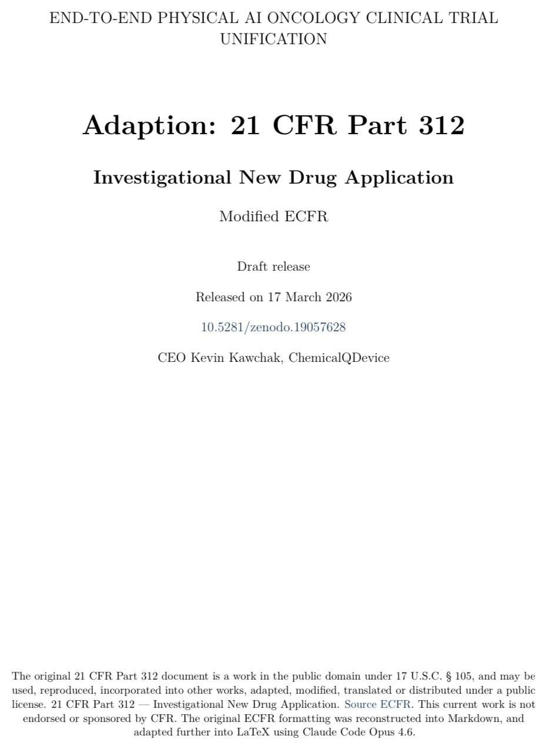
LLM Pancreatic Oncology Clinical Trial System: Large Documents, Funding, and AI Peer Review
Paper 07 of 20 | 10.5281/zenodo.19057628
07. Adaption: 21 CFR Part 312, Investigational New Drug Application
Paper Title: Adaption: 21 CFR Part 312, Physical AI Oncology Trial Unification, March 17, 2026
Abstract: Part 312 rebuilt in Markdown and LaTeX around investigational-drug rules for Physical AI
Strengths: Content items map one to one onto the codified section a reviewer opens; nothing invented
Limitations: An independent modified regulatory draft, not endorsed by the FDA, and not an active IND
Results: A Subpart J overlay carrying the robot and the model alongside the drug in a single dossier
LLM Trust: The IND answers to 21 CFR 312.23 line by line, which is where a regulatory reviewer starts
LLM Benefit: Became the skeleton the twelve-module daraxonrasib IND was built against in four days
Kevin Kawchak, CEO ChemicalQDevice
Friday, August 14, 2026
8

Slide 9
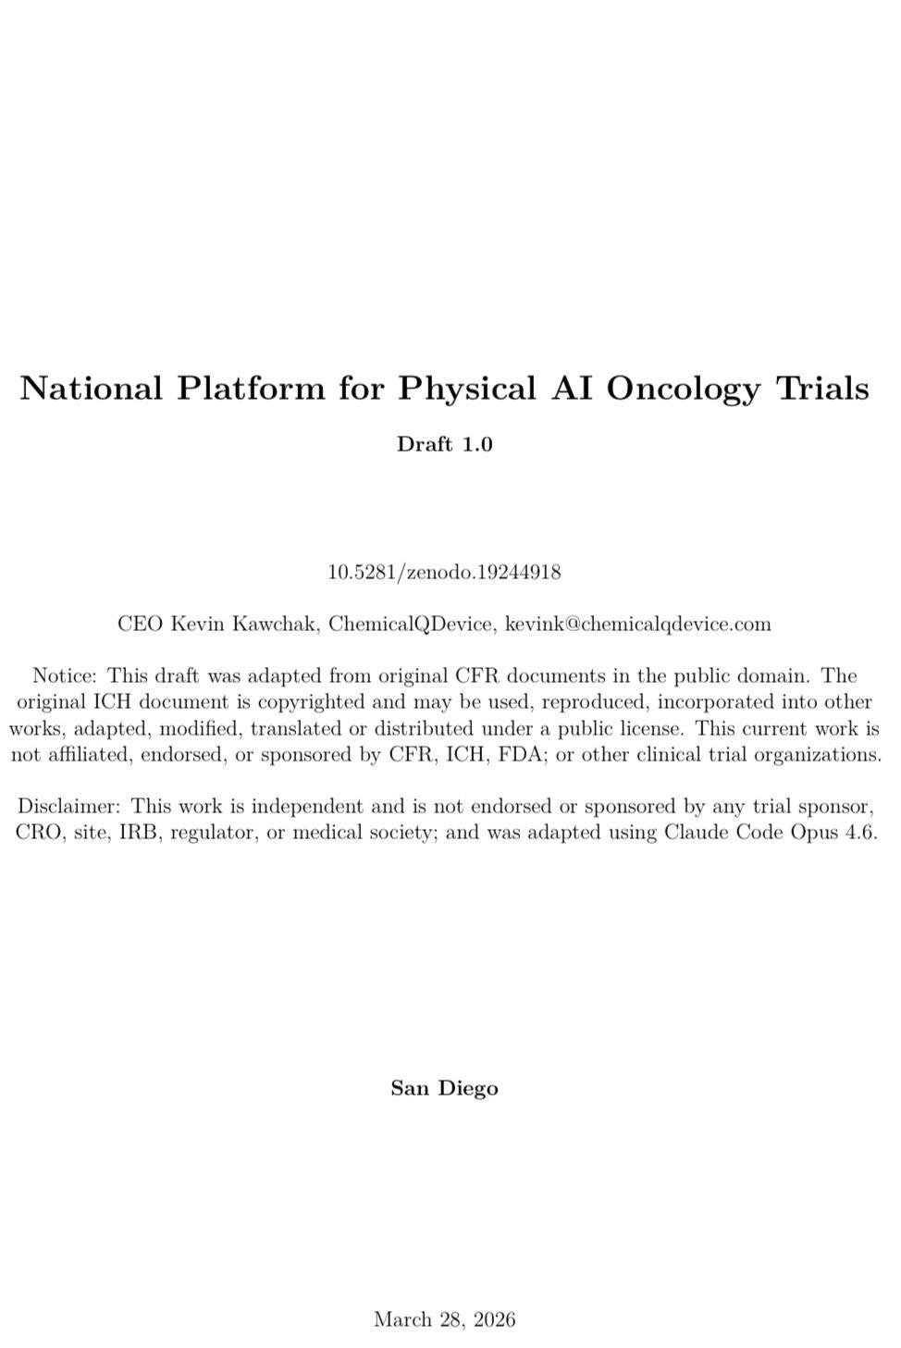
LLM Pancreatic Oncology Clinical Trial System: Large Documents, Funding, and AI Peer Review
Paper 08 of 20 | 10.5281/zenodo.19244918
08. National Platform for Physical AI Oncology Trials
Paper Title: National Platform for Physical AI Oncology Trials, deposited March 28, 2026
Abstract: Public-domain federal material and licensed ICH guidance unified into one governance draft
Strengths: One resource covering governance and implementation, not three a site has to reconcile
Limitations: A draft, unaffiliated with CFR, ICH, FDA, a sponsor, a CRO, a site, an IRB, or a regulator
Results: A platform text a comprehensive cancer center can adopt without writing its own crosswalk
LLM Trust: One reconciled source closes the gaps between guidance documents where deviations start
LLM Benefit: Sets the multi-site governance the Phase 2 eight-center study runs under a single IRB
Kevin Kawchak, CEO ChemicalQDevice
Friday, August 14, 2026
9

Slide 10
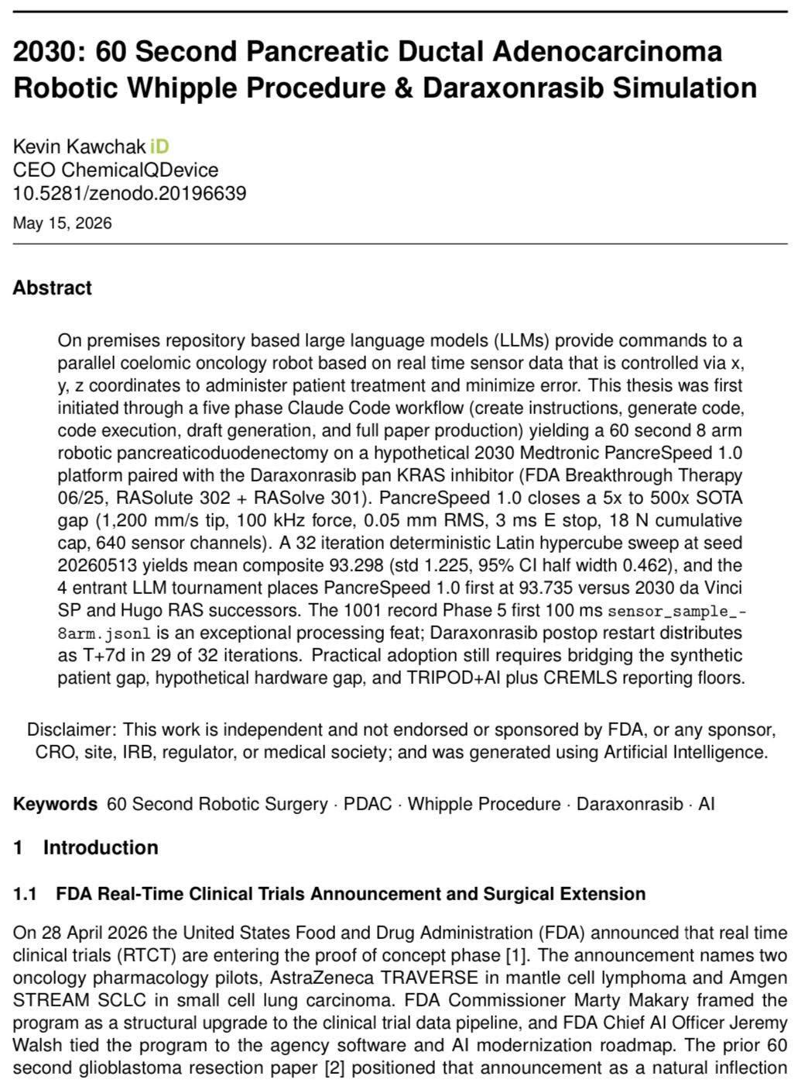
LLM Pancreatic Oncology Clinical Trial System: Large Documents, Funding, and AI Peer Review
Paper 09 of 20 | 10.5281/zenodo.20196639
09. 2030: 60 Second PDAC Robotic Whipple and Daraxonrasib Simulation
Paper Title: 2030: 60 Second PDAC Robotic Whipple and Daraxonrasib Simulation, May 15, 2026
Abstract: On-premises LLMs command an eight-arm coelomic robot from real-time x, y, z sensor data
Strengths: A five-phase build, a seeded deterministic sweep, and a four-entrant simulation tournament
Limitations: A synthetic patient gap, a hypothetical hardware gap, and TRIPOD+AI and CREMLS floors
Results: Mean composite 93.298, SD 1.225, 95% CI half width 0.462; PancreSpeed 1.0 led at 93.735
LLM Trust: Seed 20260513 and a 1,001-record sensor log make the run reproducible, not reported
LLM Benefit: Fixes the device envelope the IDE arm specifies: 0.05 mm RMS, 3 ms E-stop, 18 N cap
Kevin Kawchak, CEO ChemicalQDevice
Friday, August 14, 2026
10

Slide 11
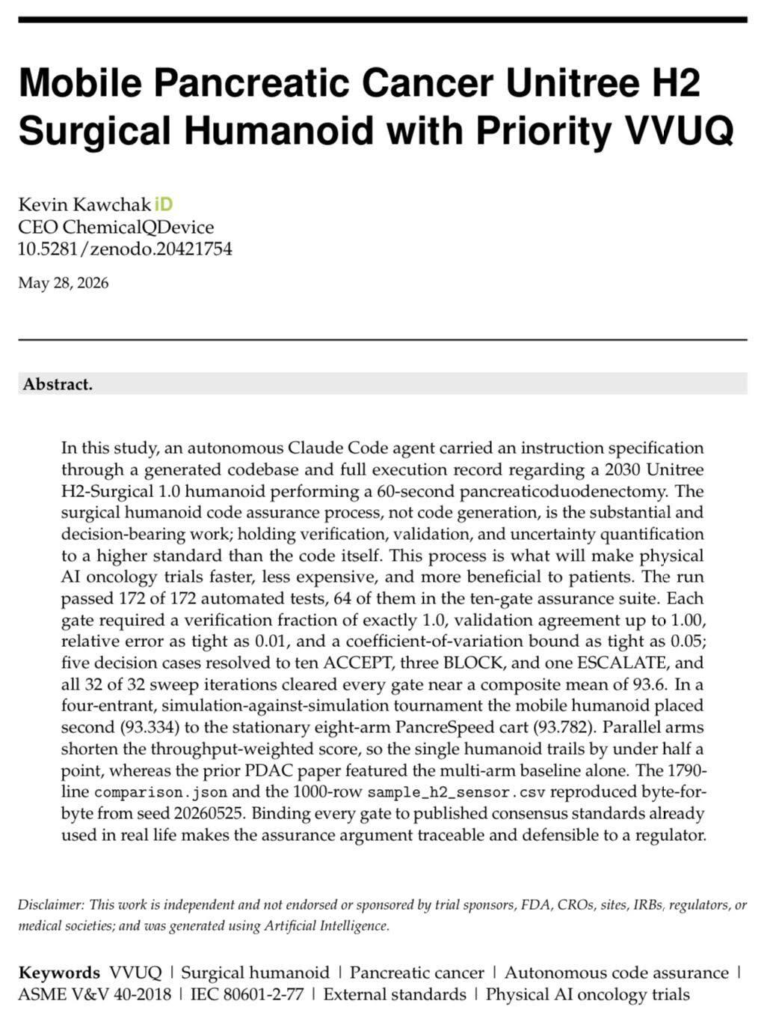
LLM Pancreatic Oncology Clinical Trial System: Large Documents, Funding, and AI Peer Review
Paper 10 of 20 | 10.5281/zenodo.20421754
10. Mobile Pancreatic Cancer Unitree H2 Humanoid with Priority VVUQ
Paper Title: Mobile Pancreatic Cancer Unitree H2 Surgical Humanoid with Priority VVUQ, May 28, 2026
Abstract: An autonomous agent carried a spec to a codebase and a full 60-second Whipple record
Strengths: Code assurance, not code generation, is treated as the decision-bearing work and held higher
Limitations: Simulation against simulation only; the humanoid trails the eight-arm cart on throughput
Results: 172 of 172 automated tests passed, 64 in a ten-gate suite; 32 of 32 sweeps cleared every gate
LLM Trust: Ten ACCEPT, three BLOCK and one ESCALATE is the gate refusing the model, as intended
LLM Benefit: Binds every gate to a published consensus standard, making the argument defensible
Kevin Kawchak, CEO ChemicalQDevice
Friday, August 14, 2026
11

Slide 12
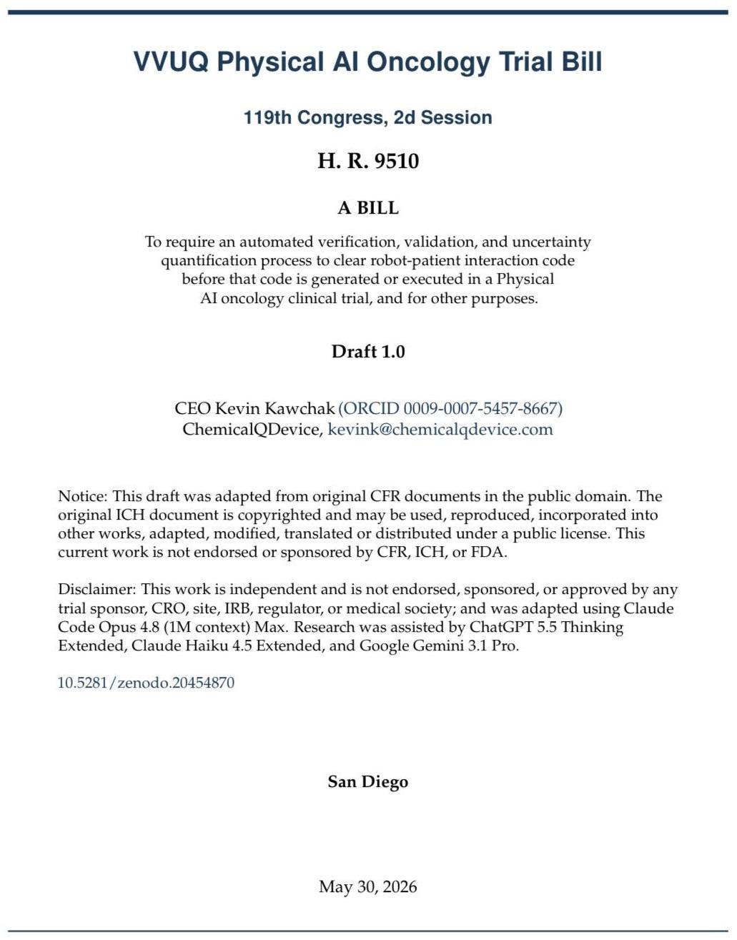
LLM Pancreatic Oncology Clinical Trial System: Large Documents, Funding, and AI Peer Review
Paper 11 of 20 | 10.5281/zenodo.20454870
11. VVUQ Physical AI Oncology Trial Bill
Paper Title: VVUQ Physical AI Oncology Trial Bill, 119th Congress draft, deposited May 30, 2026
Abstract: A draft bill requiring automated VVUQ before robot-patient interaction code is generated or run
Strengths: The duty attaches before code generation, not after execution, where harm is preventable
Limitations: An independent legislative draft: not enacted law, not legal advice, not endorsed
Results: A statutory rule that a verification gate, not a policy commitment, clears code to reach a patient
LLM Trust: Verification before generation turns a voluntary practice into a duty a sponsor is held to
LLM Benefit: Names in statute the gate the Phase 1 trial already implements as a Phase 0 entry criterion
Kevin Kawchak, CEO ChemicalQDevice
Friday, August 14, 2026
12

Slide 13
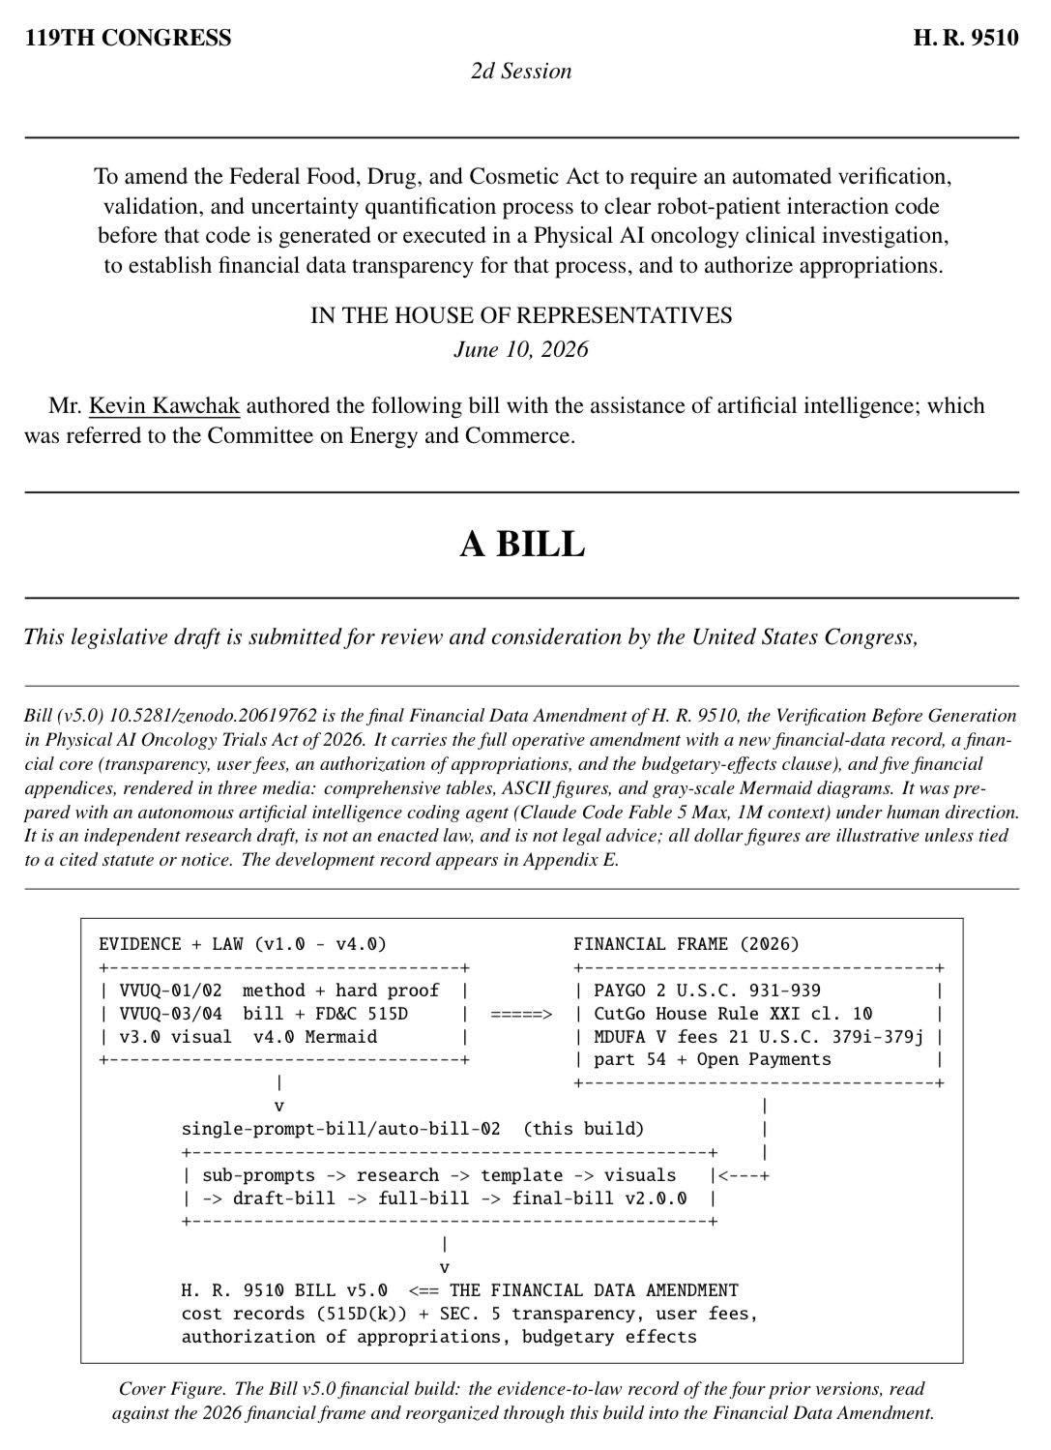
LLM Pancreatic Oncology Clinical Trial System: Large Documents, Funding, and AI Peer Review
Paper 12 of 20 | 10.5281/zenodo.20619762
12. H. R. 9510 (Bill v5.0) 2026, the Financial Data Amendment
Paper Title: H. R. 9510 (Bill v5.0) 2026, the Financial Data Amendment, deposited June 10, 2026
Abstract: An FD&C Act amendment adding a financial-data record, transparency, fees and appropriations
Strengths: Five versions in nineteen days, each adding what its predecessor lacked, on the record
Limitations: Dollar figures are illustrative unless tied to a cited statute or notice; the bill is not enacted
Results: A cost ledger attaches to every verification run, so assurance is priced on the same record
LLM Trust: Publishing what verification costs stops assurance being an unpriced promise
LLM Benefit: Gives a cancer center a fee and appropriations basis for hosting a Physical AI oncology trial
Kevin Kawchak, CEO ChemicalQDevice
Friday, August 14, 2026
13

Slide 14
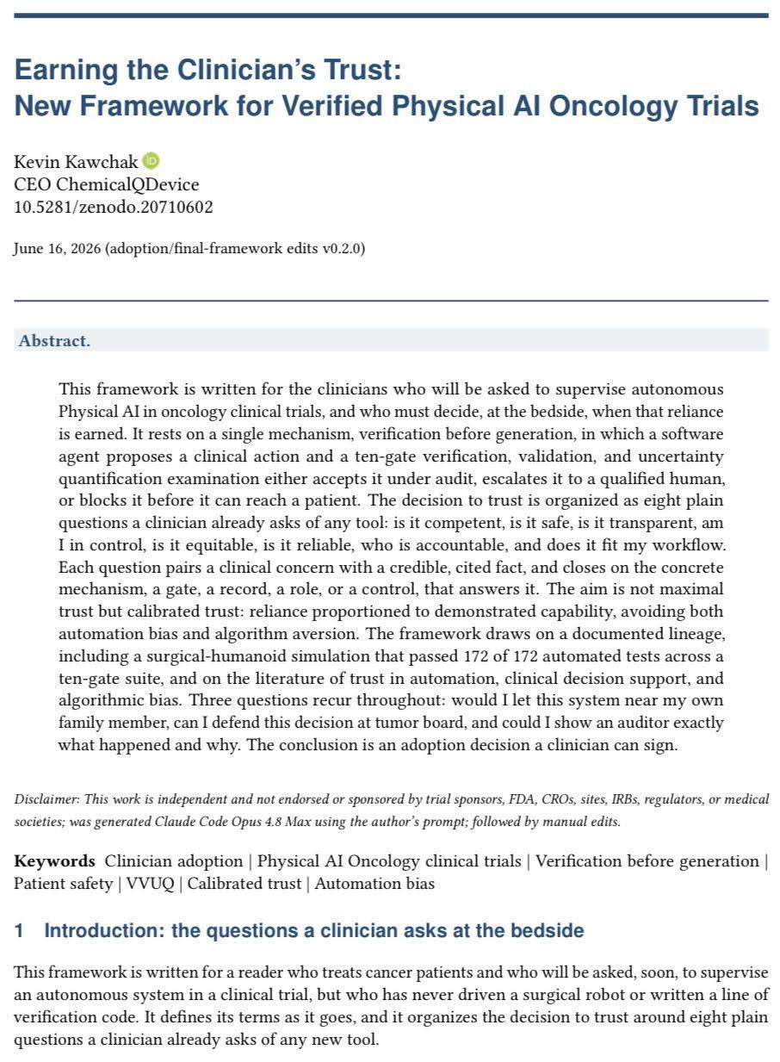
LLM Pancreatic Oncology Clinical Trial System: Large Documents, Funding, and AI Peer Review
Paper 13 of 20 | 10.5281/zenodo.20710602
13. Earning the Clinician's Trust: A Framework for Verified Trials
Paper Title: Earning the Clinician's Trust: New Framework for Verified Physical AI Trials, June 16, 2026
Abstract: Written for the clinician who must decide at the bedside when reliance on Physical AI is earned
Strengths: Eight questions a clinician already asks, each closing on a gate, a record, a role or a control
Limitations: Calibrated trust, not maximal trust; it governs reliance without replacing clinical judgment
Results: An adoption decision a clinician can sign, on a lineage of 172 of 172 tests in a ten-gate suite
LLM Trust: Every clinical concern closes on a mechanism rather than on reassurance
LLM Trust: Automation bias and algorithm aversion are named as the two failure modes, and mitigated
LLM Benefit: Answers the three questions a PI asks: my own family member, tumor board, auditor
Kevin Kawchak, CEO ChemicalQDevice
Friday, August 14, 2026
14

Slide 15
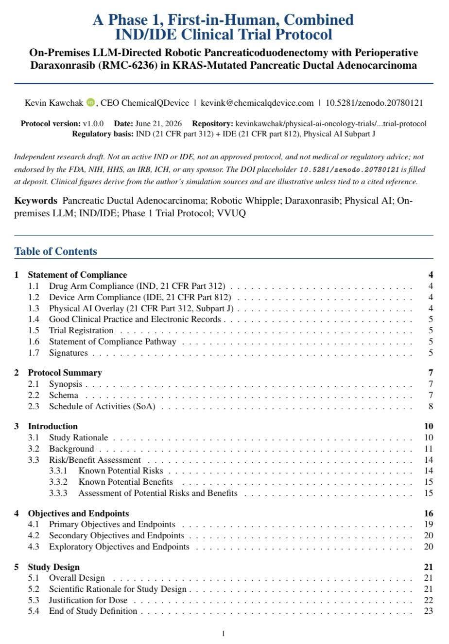
LLM Pancreatic Oncology Clinical Trial System: Large Documents, Funding, and AI Peer Review
Paper 14 of 20 | 10.5281/zenodo.20780121
14. On-Premises LLM-Directed Robotic Whipple, Phase 1 IND/IDE Protocol
Paper Title: On-Premises LLM-Directed Robotic Whipple with Perioperative Daraxonrasib, June 21, 2026
Abstract: A first-in-human combined IND/IDE protocol in KRAS-mutated PDAC: drug arm and device arm
Strengths: Drug, device and Physical AI compliance are settled in one Section 1, not across three filings
Limitations: A draft protocol: not an active or approved IND/IDE, and not medical or regulatory advice
Results: n = 18 on a 3+3 escalation behind a Phase 0 gate of 1000+ simulations across two frameworks
LLM Trust: The model cannot reach a participant until the simulation gate clears, written into entry criteria
LLM Benefit: This is the trial this seminar is about; the other nineteen papers are its supporting evidence
LLM Benefit: 369,299 characters and 42 figures across both protocols, deposited two days apart
Kevin Kawchak, CEO ChemicalQDevice
Friday, August 14, 2026
15

Slide 16
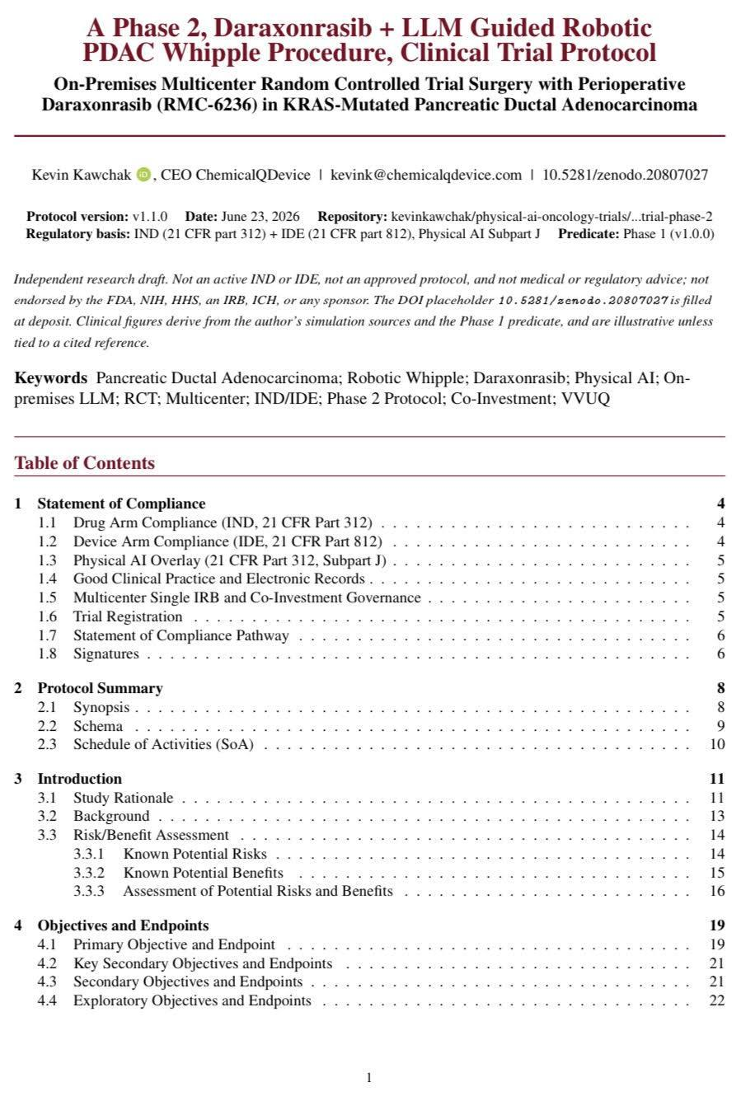
LLM Pancreatic Oncology Clinical Trial System: Large Documents, Funding, and AI Peer Review
Paper 15 of 20 | 10.5281/zenodo.20807027
15. Phase 2 Daraxonrasib + LLM Guided Robotic PDAC Whipple Protocol
Paper Title: A Phase 2, Daraxonrasib + LLM Guided Robotic PDAC Whipple Protocol, June 23, 2026
Abstract: A multicenter randomized Phase 2 on the Phase 1 predicate, under single-IRB governance
Strengths: Co-investment governance and single-IRB oversight are specified before any site is activated
Limitations: A draft contingent on a Phase 1 predicate that has not yet enrolled a first participant
Results: n = 220 across eight high-volume centers, targeting a hazard ratio of 0.60 on the endpoint
LLM Trust: Randomization against standard of care converts a simulation result into a comparative claim
LLM Benefit: Shows a cancer center the multi-site path, deposited two days after the Phase 1 protocol
Kevin Kawchak, CEO ChemicalQDevice
Friday, August 14, 2026
16

Slide 17
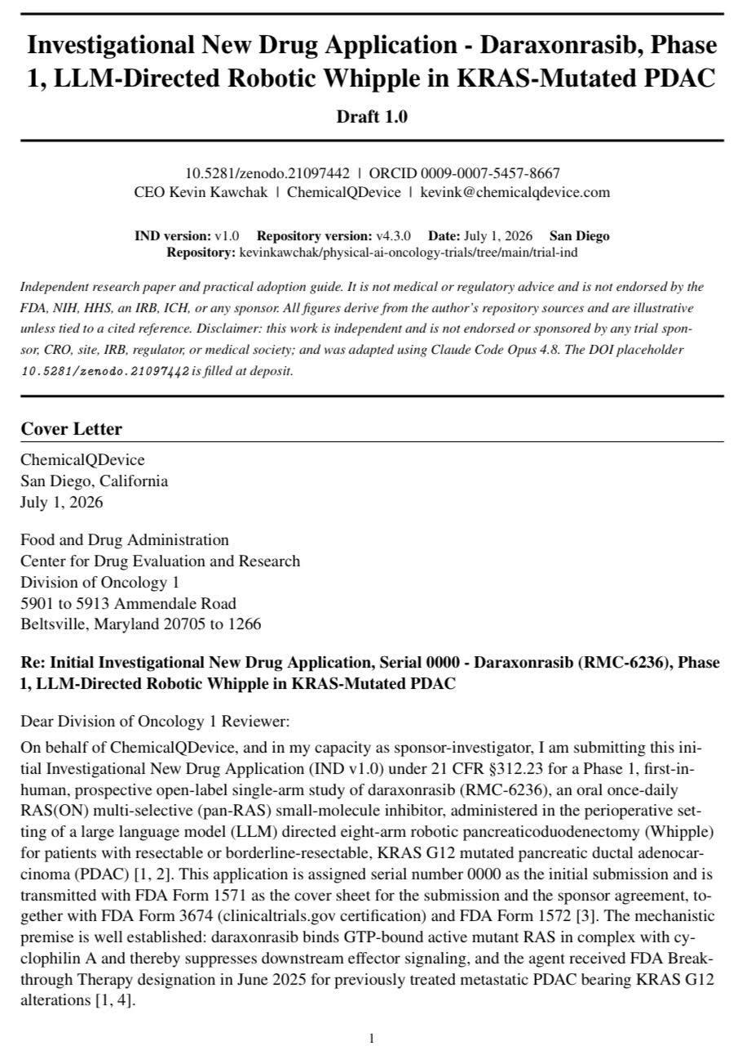
LLM Pancreatic Oncology Clinical Trial System: Large Documents, Funding, and AI Peer Review
Paper 16 of 20 | 10.5281/zenodo.21097442
16. Investigational New Drug Application, Daraxonrasib Phase 1
Paper Title: Investigational New Drug Application, Daraxonrasib, Phase 1 Robotic Whipple, July 1, 2026
Abstract: A draft initial IND under 21 CFR 312.23 for perioperative daraxonrasib with a robotic Whipple
Strengths: FDA forms, clinical rationale and the RAS(ON) multi-selective mechanism in a single dossier
Limitations: A draft: not an active or agency-endorsed IND, and the live submission system applies
Results: 12 modules, 594,657 characters, 22 figures, 84 tables and 52 cross-references, in four days
LLM Trust: Every module carries a commit and a source, so a reviewer audits provenance
LLM Benefit: This is the filing the trial turns on, and it exists today as a deposited, readable object
Kevin Kawchak, CEO ChemicalQDevice
Friday, August 14, 2026
17

Slide 18
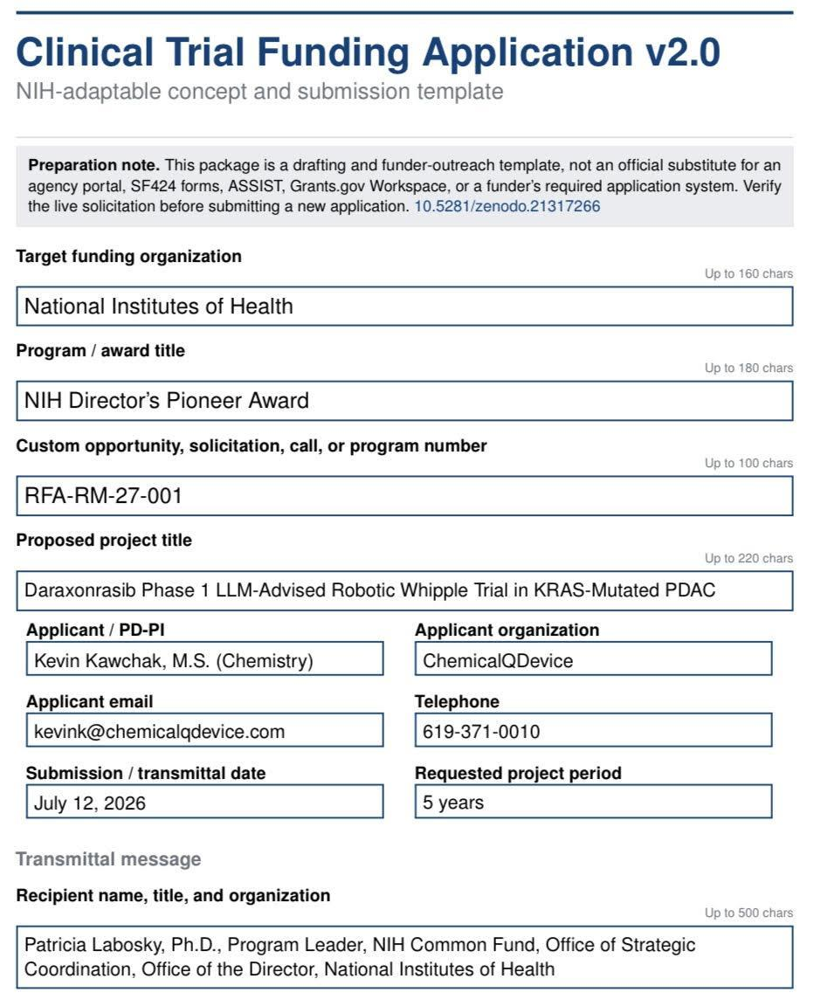
LLM Pancreatic Oncology Clinical Trial System: Large Documents, Funding, and AI Peer Review
Paper 17 of 20 | 10.5281/zenodo.21317266
17. Clinical Trial Funding Application v2.0, RFA-RM-27-001
Paper Title: Clinical Trial Funding Application v2.0, RFA-RM-27-001, deposited July 12, 2026
Abstract: An NIH-adaptable application for a five-year daraxonrasib Phase 1 robotic Whipple
Strengths: Twelve section files carrying cover, strategy, trial synopsis, human subjects and regulatory
Limitations: A drafting resource, not a substitute for SF424, ASSIST or Grants.gov; verify the solicitation
Results: The most complete single funding document in the set, written against a named opportunity
LLM Trust: The AI peer review roster is disclosed inside the application, so a funder sees who reviewed it
LLM Benefit: Puts a named project and a named applicant in front of a specific NIH mechanism
Kevin Kawchak, CEO ChemicalQDevice
Friday, August 14, 2026
18

Slide 19
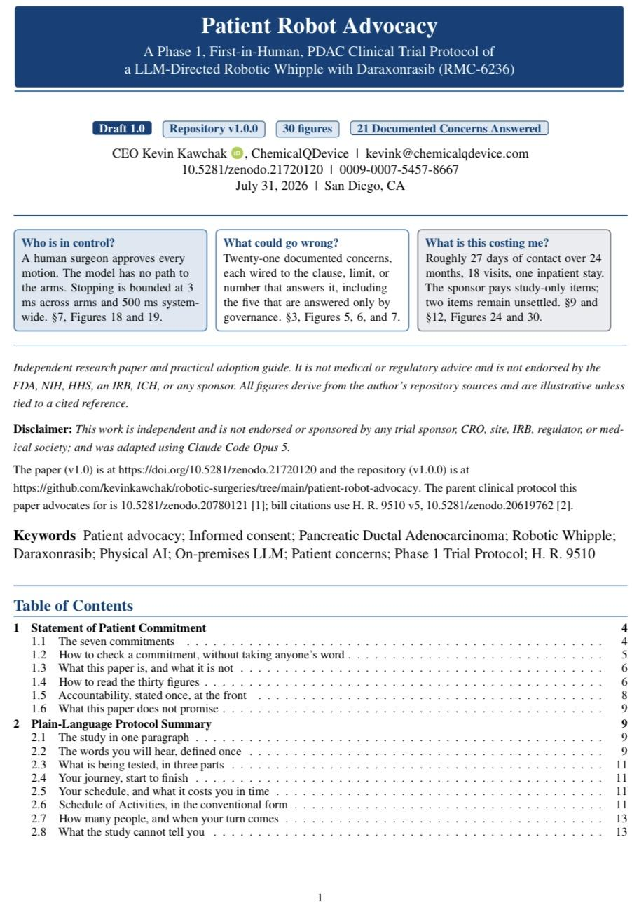
LLM Pancreatic Oncology Clinical Trial System: Large Documents, Funding, and AI Peer Review
Paper 18 of 20 | 10.5281/zenodo.21720120
18. Patient Robot Advocacy: Read Before the Consent Conversation
Paper Title: Patient Robot Advocacy: A Phase 1 First-in-Human PDAC Trial Protocol, July 31, 2026
Abstract: The seven things the Phase 1 protocol commits to the participant, each tied to a clause
Strengths: Every commitment names something a participant can check, not something to take on faith
Limitations: Not the consent form and not a substitute for one; two of the cost items remain unsettled
Results: 21 documented concerns answered across 30 figures; 27 days of contact, 18 visits
LLM Trust: A human surgeon approves every motion, the model has no path to the arms, stop is 3 ms
LLM Benefit: Gives the cancer center a document to hand a patient before the consent conversation
Kevin Kawchak, CEO ChemicalQDevice
Friday, August 14, 2026
19

Slide 20
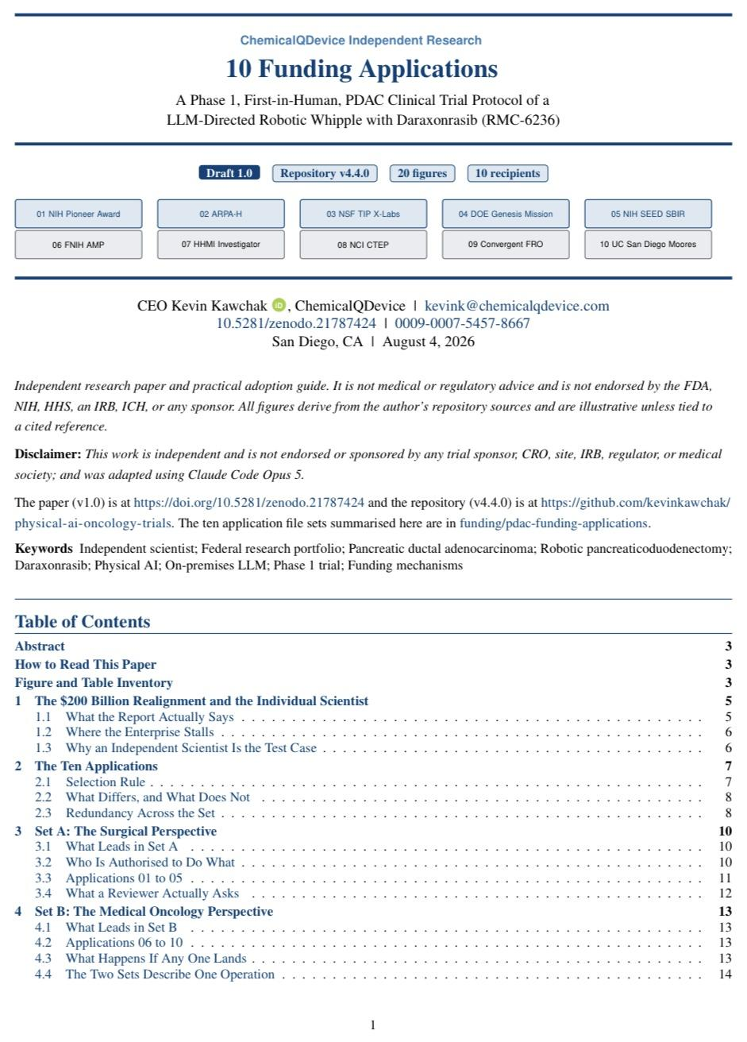
LLM Pancreatic Oncology Clinical Trial System: Large Documents, Funding, and AI Peer Review
Paper 19 of 20 | 10.5281/zenodo.21787424
19. 10 Funding Applications for the Phase 1 Robotic Whipple
Paper Title: 10 Funding Applications for the Phase 1 LLM-Directed Robotic Whipple, August 4, 2026
Abstract: Ten applications filed as an independent scientist, each answering a specific federal clause
Strengths: Set A leads on the surgical perspective and Set B on medical oncology, redundancy stated
Limitations: Nine of the ten mechanisms fund a person or an institution, not a firm; 05 was the shortest
Results: NIH Pioneer, ARPA-H, NSF TIP, DOE Genesis, NIH SEED, FNIH, HHMI, CTEP, FRO, Moores
LLM Trust: Ten filings in one production window is throughput made checkable
LLM Benefit: Application 10 asks a comprehensive cancer center for one meeting, which is this seminar
Kevin Kawchak, CEO ChemicalQDevice
Friday, August 14, 2026
20

Slide 21
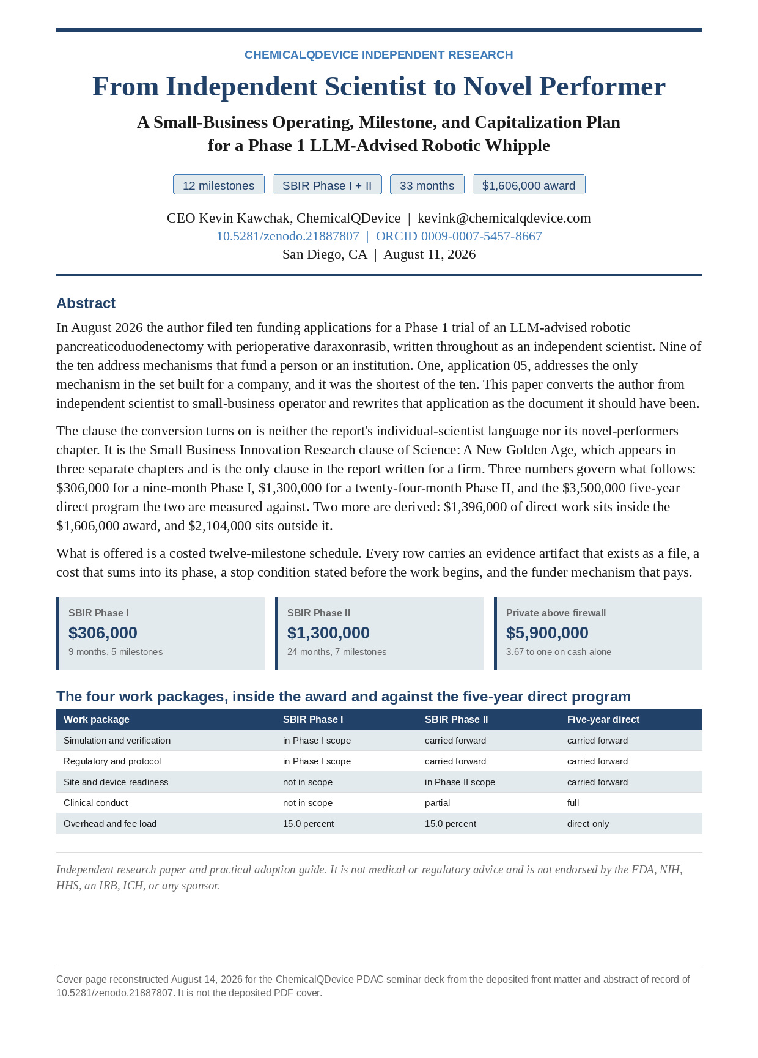
LLM Pancreatic Oncology Clinical Trial System: Large Documents, Funding, and AI Peer Review
Paper 20 of 20 | 10.5281/zenodo.21887807
20. From Independent Scientist to Novel Performer: The Capitalization Plan
Paper Title: From Independent Scientist to Novel Performer: A Capitalization Plan, August 11, 2026
Abstract: The author converts to small-business operator and rewrites application 05 properly
Strengths: Twelve costed milestones, each with an evidence artifact, a stop condition and a payer
Limitations: $2,104,000 of the five-year direct program sits outside the award and is funded another way
Results: $306,000 Phase I plus $1,300,000 Phase II, against a $3,500,000 five-year direct program
LLM Trust: A stop condition written before the work begins is what makes a milestone auditable
LLM Benefit: A 15.0% company load against $2,137,000 for identical direct work at a 57% university rate
LLM Benefit: $5,900,000 of private capital above the firewall at 3.67 to one, released only on a milestone
Kevin Kawchak, CEO ChemicalQDevice
Friday, August 14, 2026
21

Slide 22
LLM Pancreatic Oncology Clinical Trial System: Large Documents, Funding, and AI Peer Review
References | part 1 of 2
References (1 to 10 of 20)
1. Kawchak, K. (2025). End-to-End Pancreatic Ductal Adenocarcinoma Digital Twin Clinical Trial Proposals. Zenodo. https://doi.org/10.5281/zenodo.15735068
2. Kawchak, K. (2025). ChatGPT 100,000 Patient 24-Month In Silico Phase III 5-Arm Pancreatic Cancer Clinical Trial Triplicate. Zenodo. https://doi.org/10.5281/zenodo.16415815
3. Kawchak, K. (2025). QSP Metastatic Pancreatic Cancer AI Clinical Trial Simulation From Protocol to Prediction: Code, VVUQ, and Playbook. Zenodo. https://doi.org/10.5281/zenodo.17001137
4. Kawchak, K. (2025). Accelerating FDA Compliance and Cost Efficiency of in silico Clinical Trials via AI Digital Twin Pancreatic Cancer Simulation. Zenodo. https://doi.org/10.5281/zenodo.17239510
5. Kawchak, K. (2026). Adaption: ICH Harmonised Guideline, End-to-End Physical AI Oncology Clinical Trial Unification. Zenodo. https://doi.org/10.5281/zenodo.18973368
6. Kawchak, K. (2026). Adaption: 21 CFR Part 50, End-to-End Physical AI Oncology Clinical Trial Unification. Zenodo. https://doi.org/10.5281/zenodo.19040707
7. Kawchak, K. (2026). Adaption: 21 CFR Part 312, End-to-End Physical AI Oncology Clinical Trial Unification. Zenodo. https://doi.org/10.5281/zenodo.19057628
8. Kawchak, K. (2026). National Platform for Physical AI Oncology Trials. Zenodo. https://doi.org/10.5281/zenodo.19244918
9. Kawchak, K. (2026). 2030: 60 Second Pancreatic Ductal Adenocarcinoma Robotic Whipple Procedure & Daraxonrasib Simulation. Zenodo. https://doi.org/10.5281/zenodo.20196639
10. Kawchak, K. (2026). Mobile Pancreatic Cancer Unitree H2 Surgical Humanoid with Priority VVUQ. Zenodo. https://doi.org/10.5281/zenodo.20421754
All twenty works are deposited under a DOI and readable today. Digital object identifiers resolve through https://doi.org.
Kevin Kawchak, CEO ChemicalQDevice
Friday, August 14, 2026
22

Slide 23
LLM Pancreatic Oncology Clinical Trial System: Large Documents, Funding, and AI Peer Review
References | part 2 of 2
References (11 to 20 of 20)
11. Kawchak, K. (2026). VVUQ Physical AI Oncology Trial Bill. Zenodo. https://doi.org/10.5281/zenodo.20454870
12. Kawchak, K. (2026). H. R. 9510 (Bill v5.0) 2026. Zenodo. https://doi.org/10.5281/zenodo.20619762
13. Kawchak, K. (2026). Earning the Clinician's Trust: New Framework for Verified Physical AI Oncology Trials. Zenodo. https://doi.org/10.5281/zenodo.20710602
14. Kawchak, K. (2026). On-Premises LLM-Directed Robotic Pancreaticoduodenectomy with Perioperative Daraxonrasib (RMC-6236) in KRAS-Mutated Pancreatic Ductal Adenocarcinoma. Zenodo. https://doi.org/10.5281/zenodo.20780121
15. Kawchak, K. (2026). A Phase 2, Daraxonrasib + LLM Guided Robotic PDAC Whipple Procedure, Clinical Trial Protocol. Zenodo. https://doi.org/10.5281/zenodo.20807027
16. Kawchak, K. (2026). Investigational New Drug Application - Daraxonrasib, Phase 1, LLM-Directed Robotic Whipple in KRAS-Mutated PDAC. Zenodo. https://doi.org/10.5281/zenodo.21097442
17. Kawchak, K. (2026). Clinical Trial Funding Application v2.0, RFA-RM-27-001, Kawchak K.. Zenodo. https://doi.org/10.5281/zenodo.21317266
18. Kawchak, K. (2026). Patient Robot Advocacy: A Phase 1, First-in-Human, PDAC Clinical Trial Protocol of a LLM-Directed Robotic Whipple with Daraxonrasib (RMC-6236). Zenodo. https://doi.org/10.5281/zenodo.21720120
19. Kawchak, K. (2026). 10 Funding Applications: A Phase 1, First-in Human, PDAC Clinical Trial Protocol of a LLM-Directed Robotic Whipple with Daraxonrasib (RMC-6236). Zenodo. https://doi.org/10.5281/zenodo.21787424
20. Kawchak, K. (2026). From Independent Scientist to Novel Performer: A Small-Business Operating, Milestone, and Capitalization Plan for a Phase 1 LLM-Advised Robotic Whipple. Zenodo. https://doi.org/10.5281/zenodo.21887807
All twenty works are deposited under a DOI and readable today. Digital object identifiers resolve through https://doi.org.
Kevin Kawchak, CEO ChemicalQDevice
Friday, August 14, 2026
23

