Slide 1
AngularJS
What a weird name.

Slide 2
What is AngularJS?
AngularJS is a super heroic Javascript MVVM framework written by Google. No, seriously.
Single Page Application (SPA) framework.
Server side interaction only needed to download your “app”. Typically, there will probably be some interaction with web services, but not necessary depending on the application.

Slide 3
What is a SPA?
An application with only a single page, duh.
Runs completely client side (Javascript)
Canonical example: the TO-DO app
http://todomvc.com/architecture-examples/angularjs/

Slide 4
Why should I care?
Web pages that respond like native applications
Client-side routing
Can function better than traditional web pages with intermittent connectivity (mobile)
Clients are getting beefier
Javascript provides short feedback loops

Slide 5
But what about other SPA frameworks?
Backbone (very minimalist… not a comparable feature set)
EmberJS
Lots of others

Slide 6
Why AngularJS then?
Full stack solution
Built to be testable (dependency injection)
2-way databinding (with plain old Javascript objects!)
Can be added to projects
Small footprint (minified ~80kb)
Popular

Slide 7
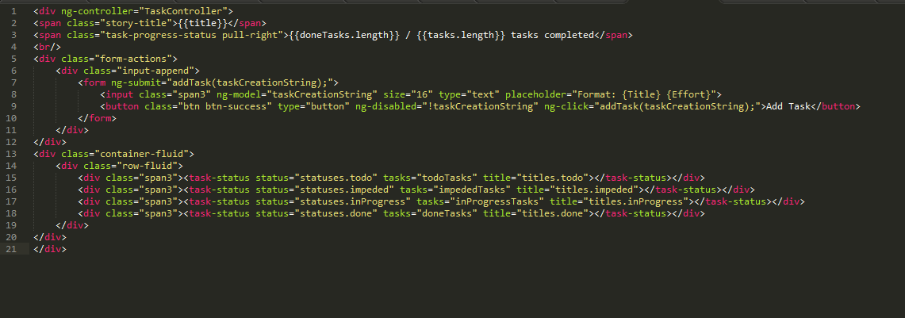
Re-usable components (directives)
Declarative HTML (with semantic markup!)
Templates don’t feature string manipulation

Slide 8
Full toolstack?
Text editor (SublimeText)
Web server (NodeJS)
Test runner (Testacular)
Console (Powershell)
Web services
Quick feedback loop + all driven by keyboard = happy dev = mo features = mo money $

Slide 9
What sucks about AngularJS?
I told you, it’s super heroic.

Slide 10
No, really. Here’s the list.
Could be more mature. It’s fairly new.
Docs are pretty bad in some areas. Filled with examples that don’t follow best practice. Some areas are simply incomplete. Really, they’re horrible. (I did read they are in the process of redoing them all, though)
Some things are magic that will be hard to debug if you do them wrong
Performance is subpar compared to other similar platforms (but really, they’re all extremely fast) (source: http://stackoverflow.com/questions/9682092/databinding-in-angularjs)

Slide 11
Where can I learn more?
Official site: http://angularjs.org/
Official blog: http://blog.angularjs.org/
Github seed: https://github.com/angular/angular-seed
Batarang: https://chrome.google.com/webstore/detail/angularjs-batarang/ighdmehidhipcmcojjgiloacoafjmpfk?hl=en
Scope: http://thenittygritty.co/angularjs-pitfalls-using-scopes
Cheat sheet: http://www.cheatography.com/proloser/cheat-sheets/angularjs/
Dev approach: http://stackoverflow.com/questions/14994391/how-do-i-think-in-angularjs-if-i-have-a-jquery-background
Screencasts: http://www.egghead.io/
Scrum App: https://github.com/kevinkemp/Angular-Scrum

Slide 12
Can I get this presentation?
No.
Just kidding. Here it is, on my github:
https://github.com/kevinkemp/Presentations

