Slide 1
Evaluating Webpage Performance and DNS latency
during a DoS attack on SDN Controller
Kevin Zhao | Tandon School of Engineering | CS-GY 6233

Slide 2

Software Defined Networking is…
Separation of control and data planes
Centralization at the controller → global view of topology
Northbound API
E.g. RESTConf
Southbound API
We use OpenFlow for updating flows on switching devices/querying flow tables/maintaining communication with controller
Flows
Match (input port, ethernet layer, IP layer, transport layer) + action (forward, drop, modify)
Counters
# of packets, byte count
Notes:
“learn once, switch many”
Controller =/= VPN, but full tunneling can be enabled through middleboxes and programmed flows
https://www.linkedin.com/learning/practical-software-defined-networking-2-sdn-and-openflow-foundations/sdn-architecture?u=2131553
We’ll begin by providing a high-level overview of software-defined networking. A large traditional networking environment will commonly have many switching devices and specialized appliances like firewalls and IDS, and any policy configurations will be done individually through the UI or over the CLI. The primary challenge is that we want a homogenous set of interfaces for not only programming them but have them respond to dynamic network conditions. With this layer of abstraction in place, we can increase the number and variety of networking devices in an organization without worry about increasing complexity, opportunity costs, and operational costs.
In software-defined networking, the “brains”—ie. control plane—is lifted from switching devices and centralized in a controller for easier programmability and a comprehensive view of the topology. The northbound interface provides a standard for how our configurations like updating/modifying flow entries via a flow manager app or pushing a network policy can reach a controller in a way that it can understand. The southbound interface facilitates updating flows, configurations, and message communication on switching devices. In our experiment, we use OpenFlow 1.0. An OpenFlow flow informs switching devices on how a packet arriving on a certain port should be addressed using a MATCH plus ACTION technique. We can match on properties from the link, network, or transport layers. Each flow will also have some statistical information like # of packets, byte count which can be queried.

Slide 3
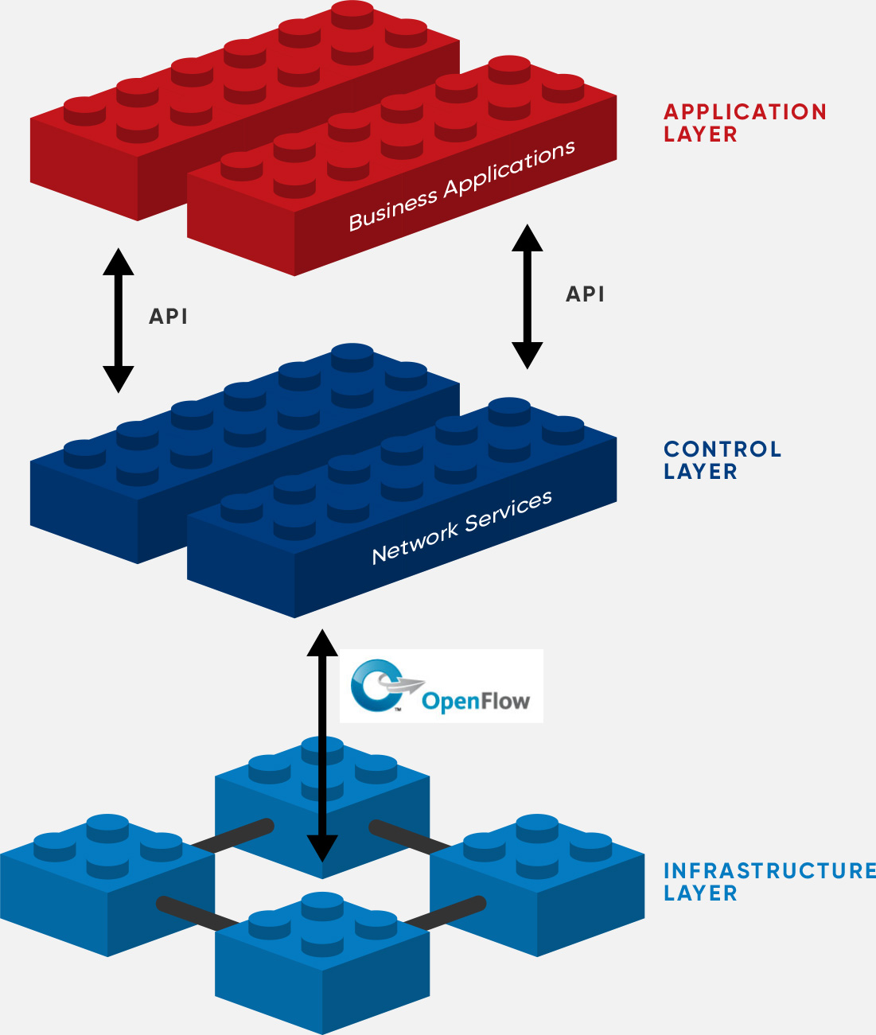
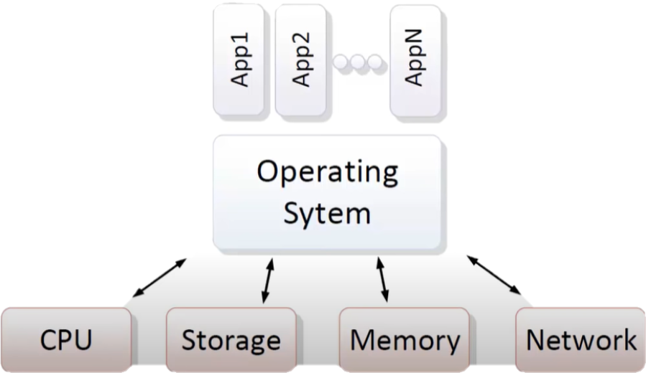
An Analogy
Notes:
From a high-level, conceptual view, there are many similarities between a traditional OS model and the SDN architecture. A traditional OS will both manage the underlying physical resources and create an abstraction to them so that applications can communicate with specific APIs exposed by the OS. Similarly, the set of switches/routers at the infrastructure layer implement a hardware abstraction layer and an OpenFlow interface to communicate with controllers at the control layer. Finally, apps will perform some operational tasks based on the flow messages received by the controller and communicate its desires back to the controller over the northbound API.

Slide 4
Key Contributions
architecting a basic software-defined network by leveraging GNS3 and VMWare Workstation, a separate host for our controller (HPE VAN version 2.8.8) with Network Protector App, and a Raspberry Pi 4 Model B (primarily used for executing the DoS attack) on a residential network
evaluating DNS latency and impact to page load times when browsing to each of the top 50 Alexa site by U.S. Region using Google Chrome before and during OpenFlow flooding attack
Notes:
GNS3 is a virtual network simulator that allows us to create full topologies that can be stored in a bundled Ubuntu server VM
production systems will have greater sophistication

Slide 5
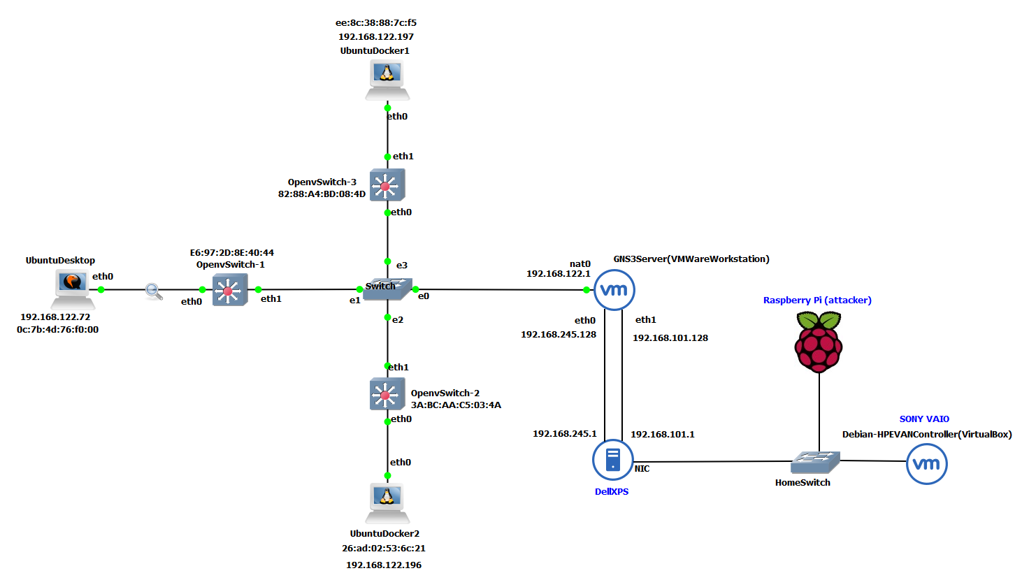
Testbed
Notes:
Let’s go over the testbed that is used in our experiment. To the left of the nat0 interface we have our software defined network comprised of three Ubuntu hosts and three OpenvSwitch appliances. However, only the Ubuntu Desktop and OpenvSwitch-1 will be actively involved in the experiment. The three OpenvSwitch devices are connected to a traditional switch, which is connected to a virtual network/port address translation service provided by our Ubuntu Server VM. In fact, the entire topology thus far resides on the server. Network traffic between the guest and host is communicated over virtual interface eth1. The eth0 interface is not involved in the SDN network and functions as a dedicated plane for connecting to the GNS3 web interface on port 80. Once traffic reaches the VMWare interface with IP 192.168.101.1, it is forwarded out of our physical NIC and to our SONY VAIO machine.

Slide 6
Hypothesis
DNS resolution will be unaffected unless the flooding throughput can meet— and exceed—all available bandwidth (as opposed to theoretical maximum)
Available bandwidth measured using iPerf

Slide 7
Studies on DDoS Mitigation
Proactive:
DELTA blackbox pen-testing framework using “fuzzing” technique to detect vulnerabilities in the SDN stack (Lee et al., 2017)
Reactive:
query flows and/or statistics from each switch across the network and conduct anomaly analysis (Wang, Jia, and Zhu (2015))
Module installed on top of controller where traffic samples is sent to a load-balanced, resource scaled pool of VMS and statistics are extrapolated (Miao, R., Yu, M., & Jain, N. (2014))

Slide 8
Study on feasibility of SDN in residential network (Taylor, Guo, Shue, and Najd (2017))
Sourced participants (U.S. based, on residential network) over Amazon Mechanical Turk to take a speed test, which connects to custom AWS, GCP, Azure, and Digital Ocean VMs
90% fell within 50ms RTT of two VMs
PLT measured for top 100 Alexa sites where each fetch for a remote resource must be approved by the controller
50 percentile: median page load time increases by ~2s
4s (plain routing/switching) → 6s (OpenFlow+50ms artificially induced latency to controller)
our study measures page load time, but within the context of a DoS attack and DNS filtering by an SDN application

Slide 9
Papers on Evaluating Controller Performance
Badotra and Panda (2019)
simulate a hierarchical network topology of 27 hosts and 13 OpenvSwitch switches using Mininet in one Ubuntu VM
Two other VMs used to host OpenDayLight and ONOS controllers
Zhu et al. (2019) – provide a list of benchmarking metrics & tools used to evaluate 9 controllers in different network scenarios
E.g. Throughput, latency, and flow installation rate

Slide 10
Results/Discussion
Notes:
In the scenario (red) where our Raspberry Pi was able to flood the VirtualBox VM at throughput speeds that were on average greater than 99% of the virtual adapter’s bandwidth, DNS security filtering was still being performed, but at about 0.02 seconds slower than our best performing case (purple). So in other words, 50% of the sites were able to resolve their domain name in ~0.03 seconds or faster. We also see that the caching scenario paradoxically has slower resolution times than the non-caching scenario, which we attribute to the behavior of the systemd resolver and anomalous fluctuations. Overall, we should perform multiple trials of each case to achieve greater accuracy of results.
------------- “After establishing the session, the controller and virtual switch exchange echo request and reply messages as a keepalive mechanism. The keepalive timer is reset if the virtual switch or controller receives either an echo reply or a packet. Echo requests are sent every 10 seconds during idle windows in the absence of other messages. If the switch receives no echo reply or other message from the controller for 120 seconds, the connection is considered lost, and the switch attempts to reestablish the connection for 10 seconds. If the connection cannot be established, the switch enters emergency mode as defined in the OpenFlow v1.3 specification. In emergency mode, the switch deletes normal flow entries, and after 30 seconds, purges flow entries that are installed in hardware.”
https://www.juniper.net/documentation/en_US/junos/topics/concept/junos-sdn-openflow-virtual-switch-connection-to-controller-overview.html

Slide 11
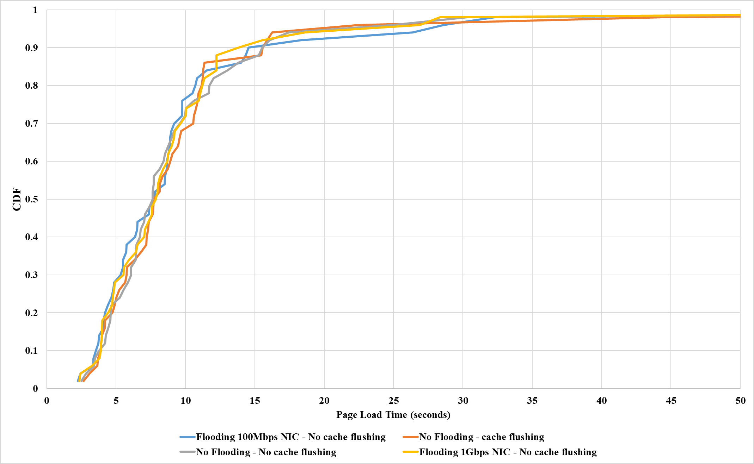
Results/Discussion
Notes:
However, a 0.02 second delay did not have any discernible impact to page load time. In the scenario (blue) where we had bound both the physical and virtual NICs to operate at Fast Ethernet speeds (100Mbps) before flooding the controller with PACKET_IN messages, the OpenFlow simply reverted to a traditional MAC learning switch (due to an empty flow table). This effectively provided a baseline for how quickly DNS queries could be resolved without filtering/mediation
Caveats
Controller becomes unavailable (from switches’ perspective)
Controller loses visibility of entire network (barring our bogus “switch”)

Slide 12
Conclusion / Future Work
Test more than once
Attempting a different form of DoS
More apps; programming flow paths
Controller failover: a practical deployment will have several distributed ones
Securing SBI with TLS and testing overhead
Virtualization/hardware limitations
Switching in software: (2 SW, 1 HW in line)
Type 2 Hypervisor (VirtualBox)
Available bandwidth disparity of 390 Mbps to 930 Mbps
Notes:
Controller failover and redundancy: A centralized controller does not necessarily imply one controller for all
As we mentioned earlier, the core strength of SDN is being able to program flow paths and send them to a switch without having to worry about underlying details as well as build policy that dynamically shifts the network according to certain conditions—we could implement multiple controllers in future work and perhaps look at DNS resolution time and page load time in failover scenarios

