Slide 1
Health Risk Prediction Based on Lifestyle and
Demographic Attributes
GROUP 9

Slide 2
Project Background & Motivation
This project explores the use of lifestyle and demographic data to predict chronic illness risk. With the rise of non-communicable diseases, proactive risk identification is crucial.

Slide 3
Objectives & Research Questions
- Identify significant health risk factors
- Predict chronic illness risk using classification models
- Cluster individuals based on risk profiles
- Visualize data to aid decision-making

Slide 4
Dataset Overview
Sample Size: 500 synthetic individuals
Features:
- Age, Gender
- Smoking, Alcohol, Exercise
- Height, Weight, BMI
- Family History
Target: Chronic Illness (binary)

Slide 5
Data Cleaning & BMI Calculation
BMI was calculated using height and weight.
Inconsistent or missing entries were handled during preprocessing.

Slide 6
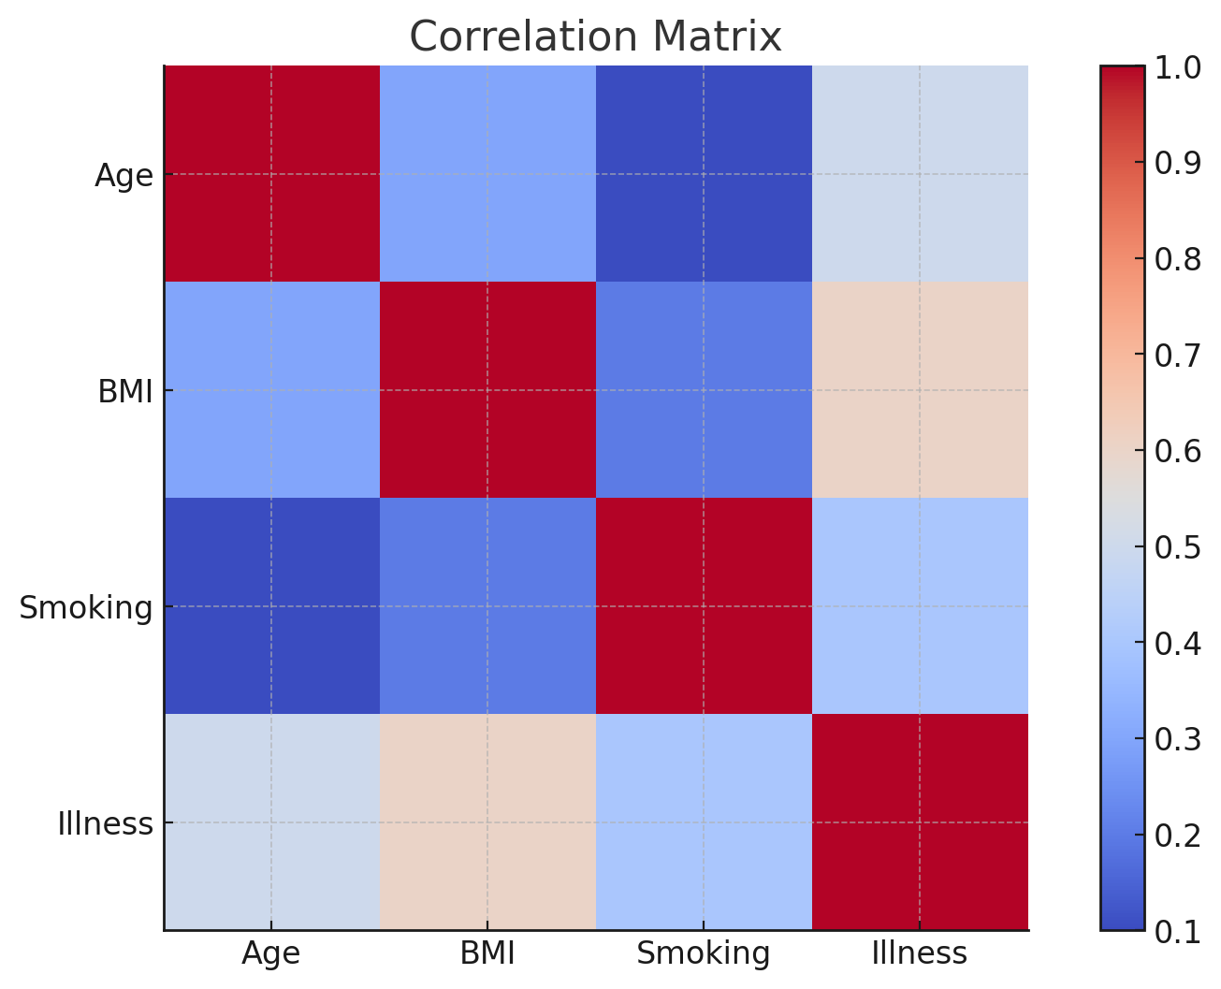
Exploratory Data Analysis
The analysis revealed strong relationships between BMI, smoking, and chronic illness risk. The chart below shows correlation patterns across variables.

Slide 7
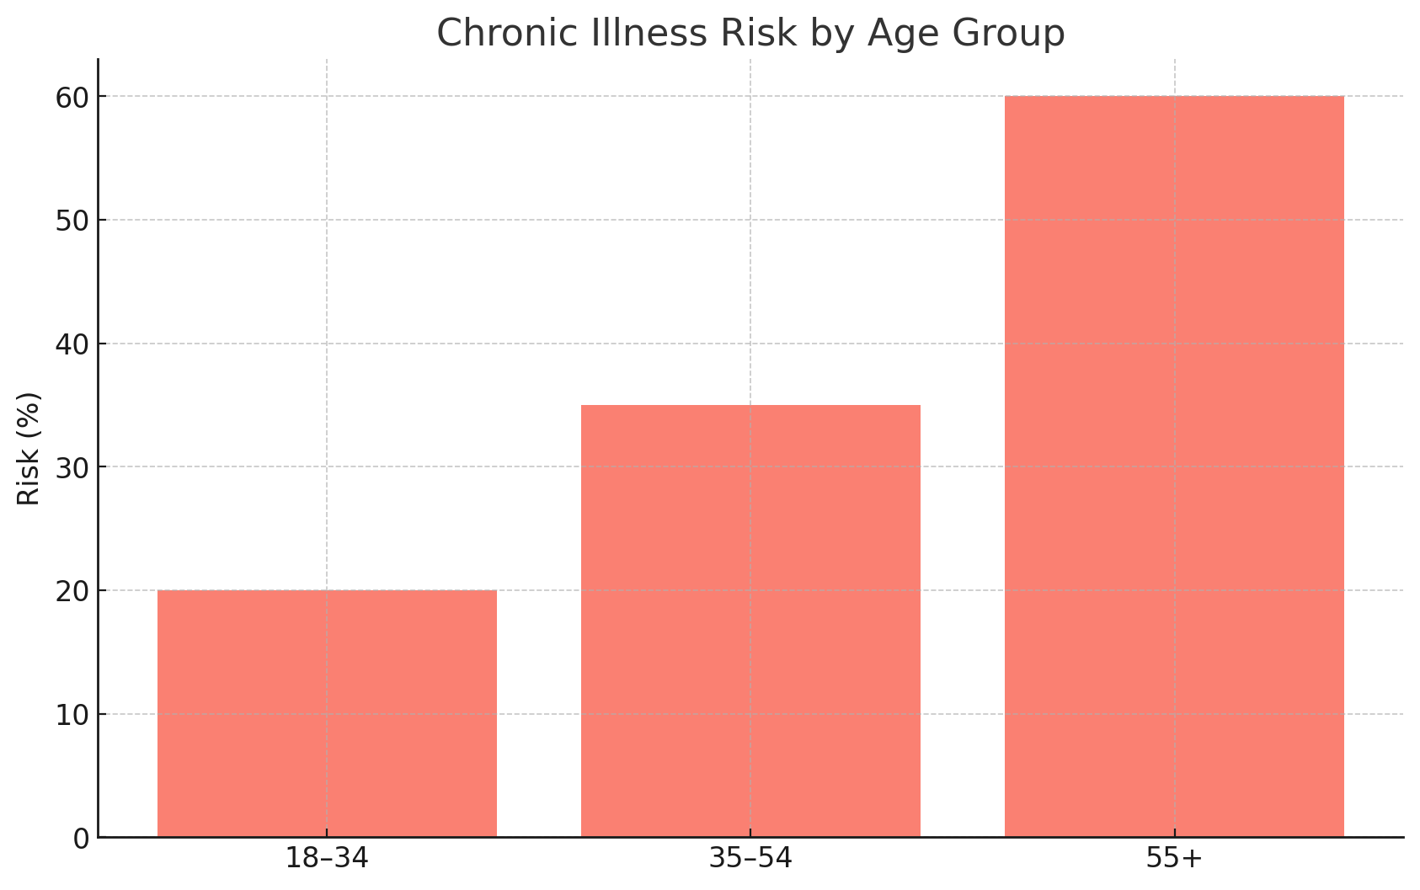
Key Findings from EDA
- Individuals with BMI > 30 showed >60% illness probability
- Older adults and smokers were more likely to be at risk
- Family history further increased risk among those 55+

Slide 8
Classification Models
- Logistic Regression and Decision Trees were used
- Both models confirmed BMI and smoking as key features
- Accuracy was sufficient for risk stratification

Slide 9
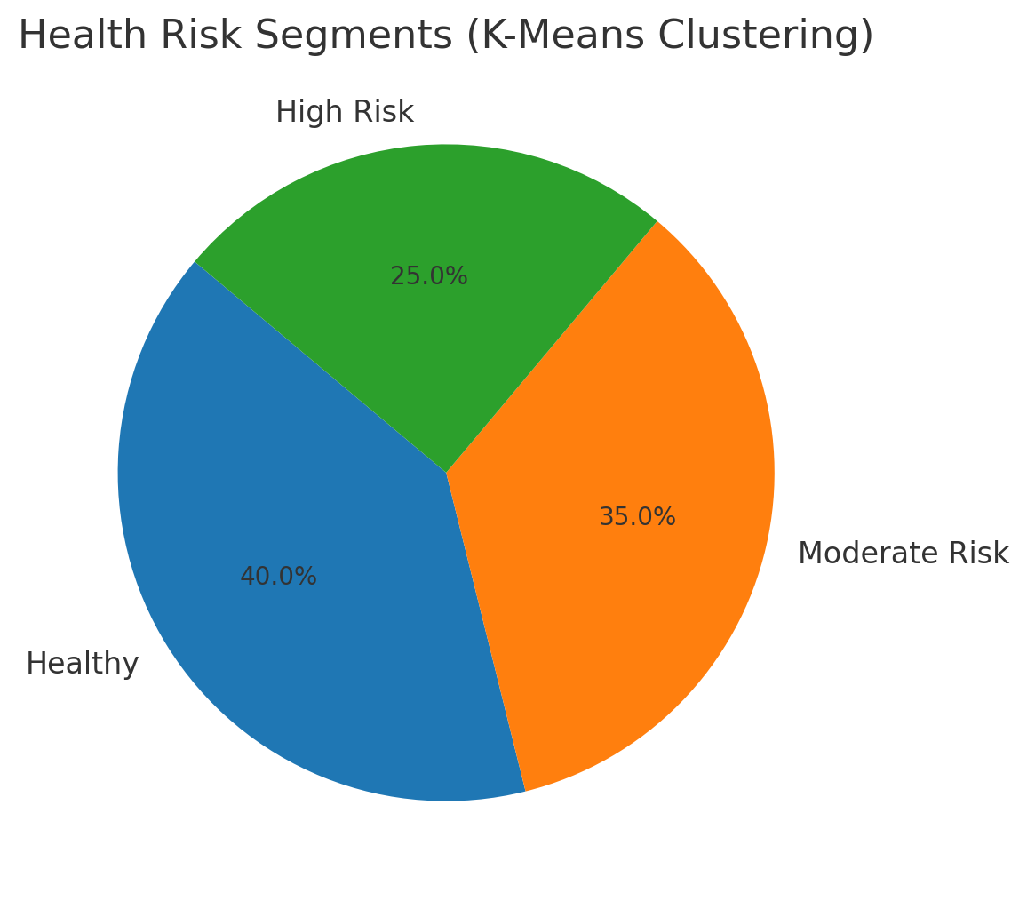
Clustering Results (K-Means)
K-Means clustering grouped individuals into:
- Healthy
- Moderate Risk
- High Risk
The pie chart illustrates the distribution.

Slide 10
Dashboard Walkthrough
Interactive dashboards were built using Plotly Dash to communicate health trends and predictions to stakeholders.

Slide 11
Key Insights & Recommendations
- Preventive strategies should focus on high BMI and low-exercise groups
- Predictive tools can support early intervention
- Ethical handling of health data is essential

Slide 12
Conclusion & Future Work
- Data mining offers valuable insights into health risk prediction
- Future work should incorporate real clinical data and additional variables
- Presenters: Kevin, Alfred, Satcha, Bricole, Geoffrey

