Slide 1
Visualizing Eye tracking data on the web
Kevin Krpicak
Undergraduate Capstone Presentation

Slide 2
Outline
Motivation
Background on Eye tracking
Approach
Problems Encountered
Lessons Learned
Future Work
Demo

Slide 3
Motivation
Need place to store video and XML data from eye-tracker session
Need for some sort of web visualization of eye-tracker data to be accessed remotely by anyone anywhere
Notes:
The project involves the ability to upload eye tracking data and corresponding video stimuli to the cloud. Here, we will use the Windows Azure cloud platform. The data should then be able to be visualized on different devices. The visualization will be displayed via a web page. The client should determine if the web page is displayed on a mobile device or not and set the display accordingly.
The eye tracker gives us an XML file and a video file. These need to be streamed to the client. We will use the Mirametrix S2 eye tracker for this project.

Slide 4
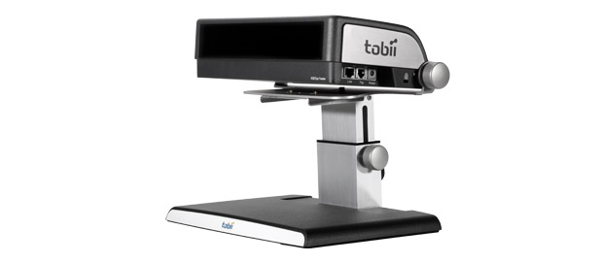
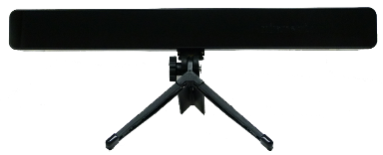
Background on Eye tracking
Provides a way to track what a user is looking at on a screen
Eye-tracker hardware
Mirametrix S2
Notes:
Put picture of ET
A piece of hardware equipment consisting of one or two cameras that track where the eyes are looking

Slide 5
Eye Tracking Terminology
Fixations: Points on the screen that the user is looking at
Saccades: Small movements between fixations
Scan Paths: the path that a bunch of fixations produce

Slide 6
Heatmaps
A visual representation using warmer colors to show which fixations occur more.

Slide 7
Approach
Server-side
Store files from eye-tracker application into database.
Client-side
Calculate fixations from eye gaze data.
Use current web technologies to display the data stored.

Slide 8
Input
AVI
Convert to the proper HTML5 video file type (webm, mp4, ogg)
XML
Convert to JSON for easier web use

Slide 9
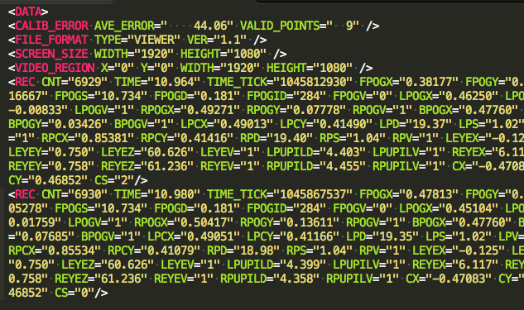
Sample Input XML

Slide 10
Calculating Fixations
Need to average fixations with same FPOGID
Bad fixations
Web visualization is based off the above fixations

Slide 11
Steps in Process
Convert XML to JSON
Filter out bad results (FPOGV = 0)
Group Fixations by ID (FPOGID)
Group X,Y values per Grouped Fixation (FPOGX, FPOGY)
Average X,Y values
Return Filtered Fixation List
Synchronizing Fixations with video
Get closest fixation based off time from current time in the video
Notes:
Maybe the high level pseudocode to do this.

Slide 12
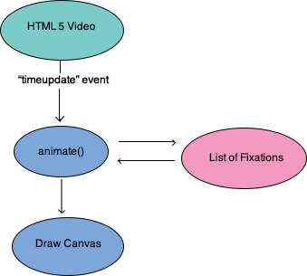
Synching Fixations with Video
Notes:
Maybe the high level pseudocode to do this.

Slide 13
Technology Used
Windows Azure
MySQL Database
Node.js
Express framework
Libraries: MySQL, Async, XML2js
Notes:
Explain what you learnt

Slide 14
Technology Used - Front End
Structure:
jQuery
Backbone.js
Underscore.js
Dom rendering:
Mustache templates
TwitterBootstrap
HTML5 Video
Canvas
Heatmapjs
Notes:
Backbone –gives js an mvc structure
Underscore – is required for backbone, but it does give some nice commonly used functions

Slide 15
Problems Encountered
Most of the problems came with using Windows Azure as a hosting platform.
Only supports MS SQL Server not MySQL
Had to build virtual machine to get MySQL running.
3 month trial download limits
Account temporarily disabled
VM deleted
SSH connection issues later on

Slide 16
Problems Encountered
JavaScript's asynchronous methods for uploading files
Used Node’s “async” library to handle this
Fixations syncing with Video
Delay between “timeupdate” event sent from HTML5 video API
Browser Interpretation

Slide 17
Lessons Learned
Choose the correct hosting for the type of project
Windows Azure should be used for windows based services.
Notes:
What did you learn from this process
I know one, documenting your steps always helps.

Slide 18
Future Work
Node library to convert AVI files to webm/ogg/mp4
Node library to grab frame (ex: ffmpeg)
Put on live server
Link directly with the eye tracker application

Slide 19
Github repository for project
Github repository link
https://github.com/kevinkrpicak/eye-tracker

Slide 20
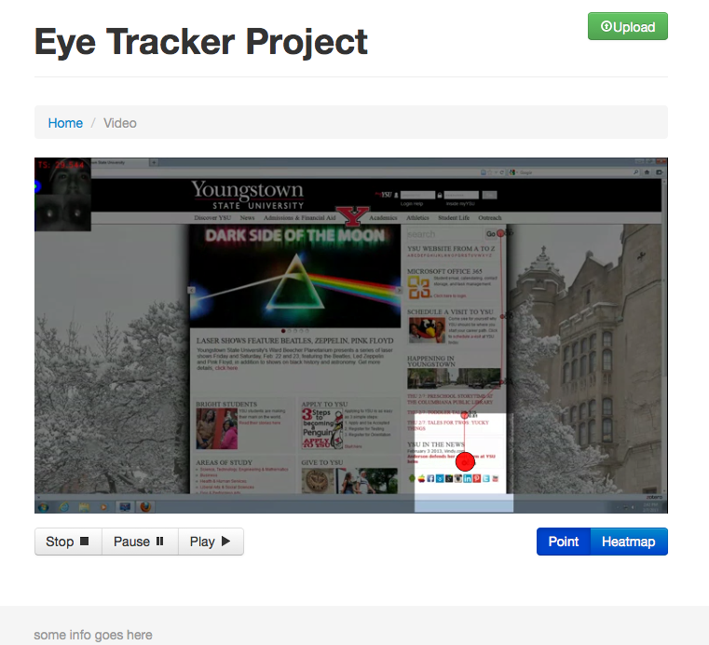
Demo

