Slide 1
♡
Healthcare Employee Attrition Analysis
Identifying the employee groups most at risk of leaving
♥
Kevin Serizawa・Data In Motion
WATSON HEALTHCARE

Slide 2
♡
Employee Attrition Is Concentrated Among a Small, High-Risk Workforce Segment
♥
11.87%
66.67%
Overlapping Factors
Overall Attrition Rate
High-Risk Segment Attrition
Age ≤25
199 employees
32 of 48 employees
≤1 year at company
left
left
Monthly income <$3,000
of 1,676 total employees
in this high-risk segment
Only 48 employees meet the 3 characteristics, but they account for 16.08% of all employee departures.
WATSON HEALTHCARE

Slide 3
♡
Retention Efforts Should Prioritize Early-Tenure, Younger, Lower-Paid Employees
♥
Strengthen
First-Year Retention
Review Entry-Level
Compensation
Improve Employee
Experience
31.95%
26.23%
26.67%
0–1 Year Attrition
<$3,000 Income Attrition
Work-Life Balance Level 1
30 / 60 / 90-day check-ins
Review lower-income roles
Track satisfaction & balance
Structured onboarding
& manager support
Benchmark pay &
advancement opportunities
Strengthen career development
& manager conversations
Early satisfaction pulse checks
Prioritize overlapping risks
Explore commute flexibility
WATSON HEALTHCARE

Slide 4
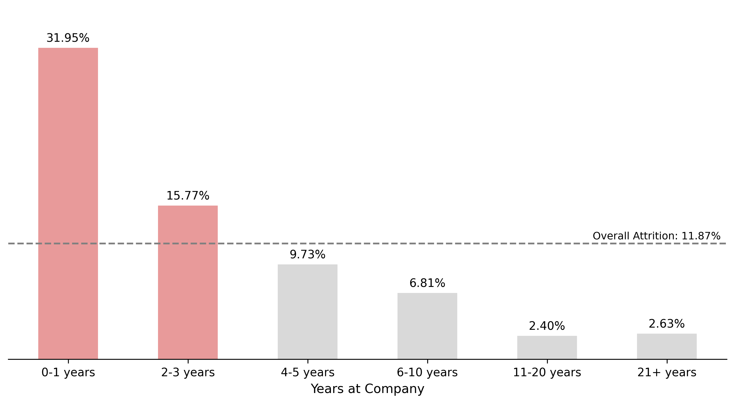
Attrition Falls Sharply as Employee Tenure Increases
♡
Retention risk is concentrated early: attrition drops below the 11.87% company average after employees reach 4-5 years.
WATSON HEALTHCARE

Slide 5
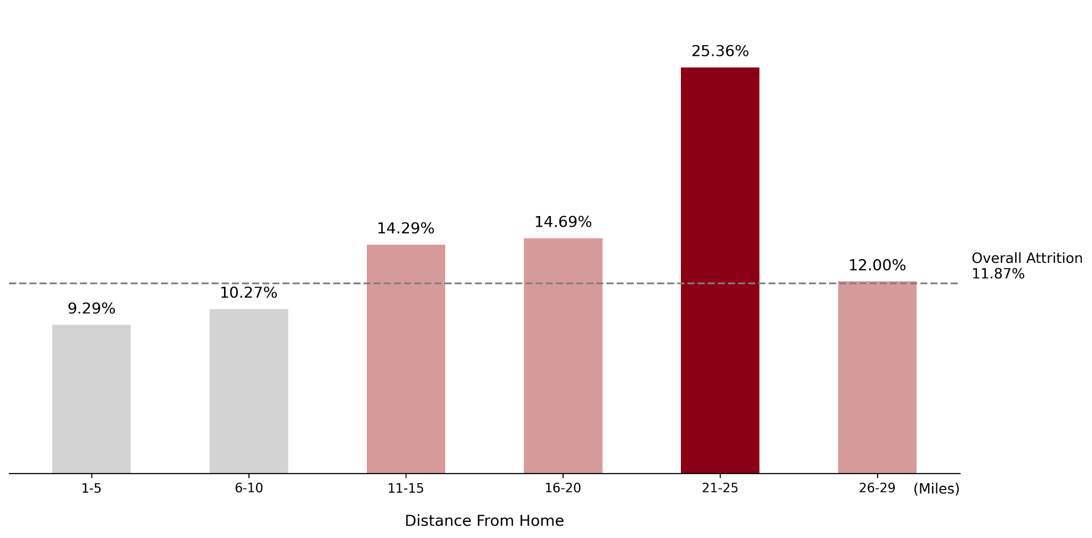
♡
Attrition Peaks Among Employees Living 21–25 Miles Away
♥
Employees living 21–25 miles from work have a 25.36% attrition rate—more than double the 11.87% company average.
WATSON HEALTHCARE

Slide 6
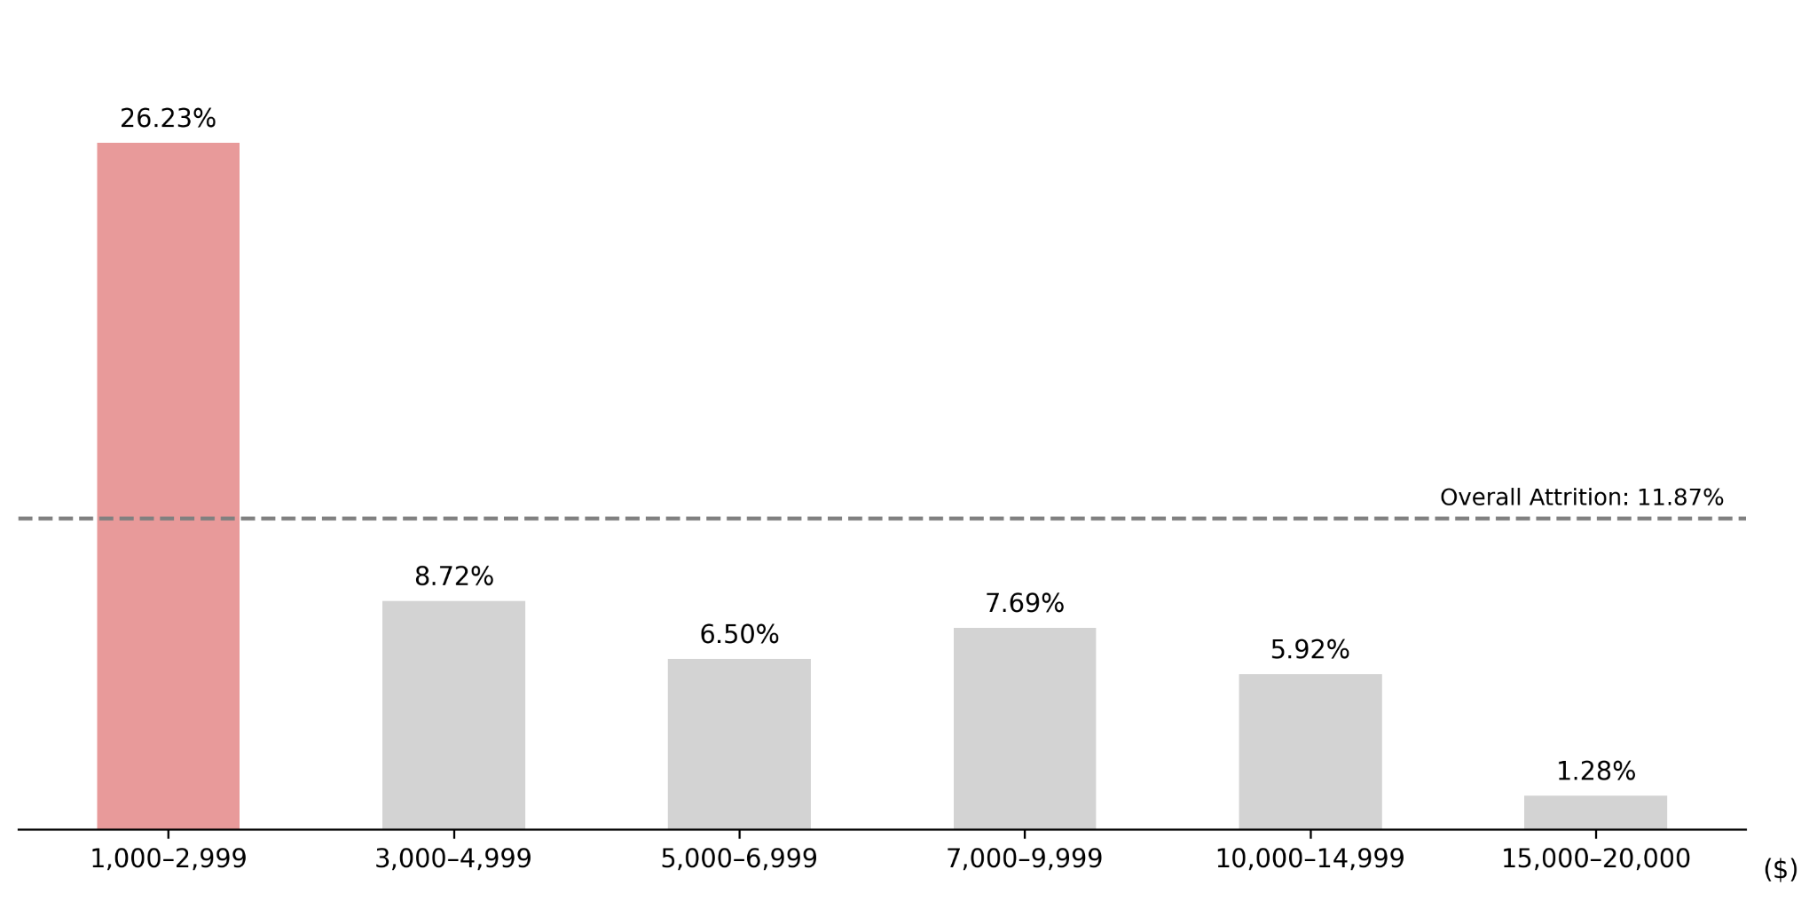
♡
Lower-Paid Employees Face Significantly Higher Attrition
♥
Employees earning under $3,000 per month have a 26.23% attrition rate — more than double the company average.
WATSON HEALTHCARE

Slide 7
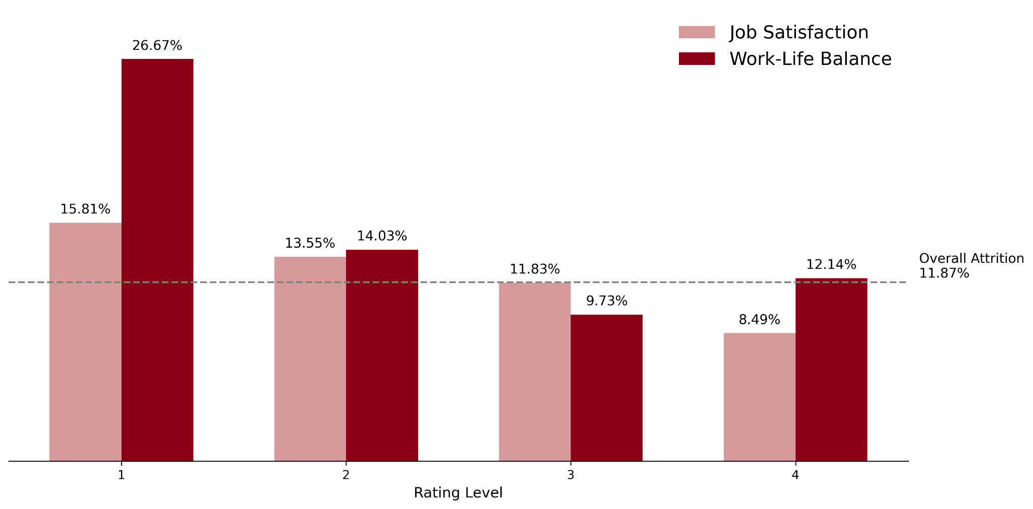
♡
Low Satisfaction and Work-Life Balance Signal Higher Attrition
♥
Work-Life Balance Level 1 reaches 26.67% attrition — more than twice the 11.87% company average.
WATSON HEALTHCARE

